Slide 1
Arvind Gavali College of Engineering, Satara
Department of E & TC Engineering
Third Year Feedback
Month-Dec 2021- Jan 2022
Total Responses- 19
Total Class Strength- 36
Feedback Percentage- 53%

Slide 2
Faculty-Subject Distribution
Sr.No | Subject | Abb. | Name of the Faculty | Abb.
1 | Electromagnetic Field Theory | EFT | Dr. Mirajkar Gayatri S | GMS
2 | Control System Engineering | CSE | Ms. Balgude Tejashree | BT
3 | Computer Architecture | CA | Mr. Jagtap Dayanand B. | JDB
4 | Digital Signal Processing | DSP | Ms. Sawashe Ketaki S. | SKS
5 | Microcontroller and its Applications | MIC | Mr. Chavan Santosh G | CSG
6 | Data Structure & Algorithms Using Java Programming | DS | Mr.Hingmire Vishal S | HVS

Slide 3
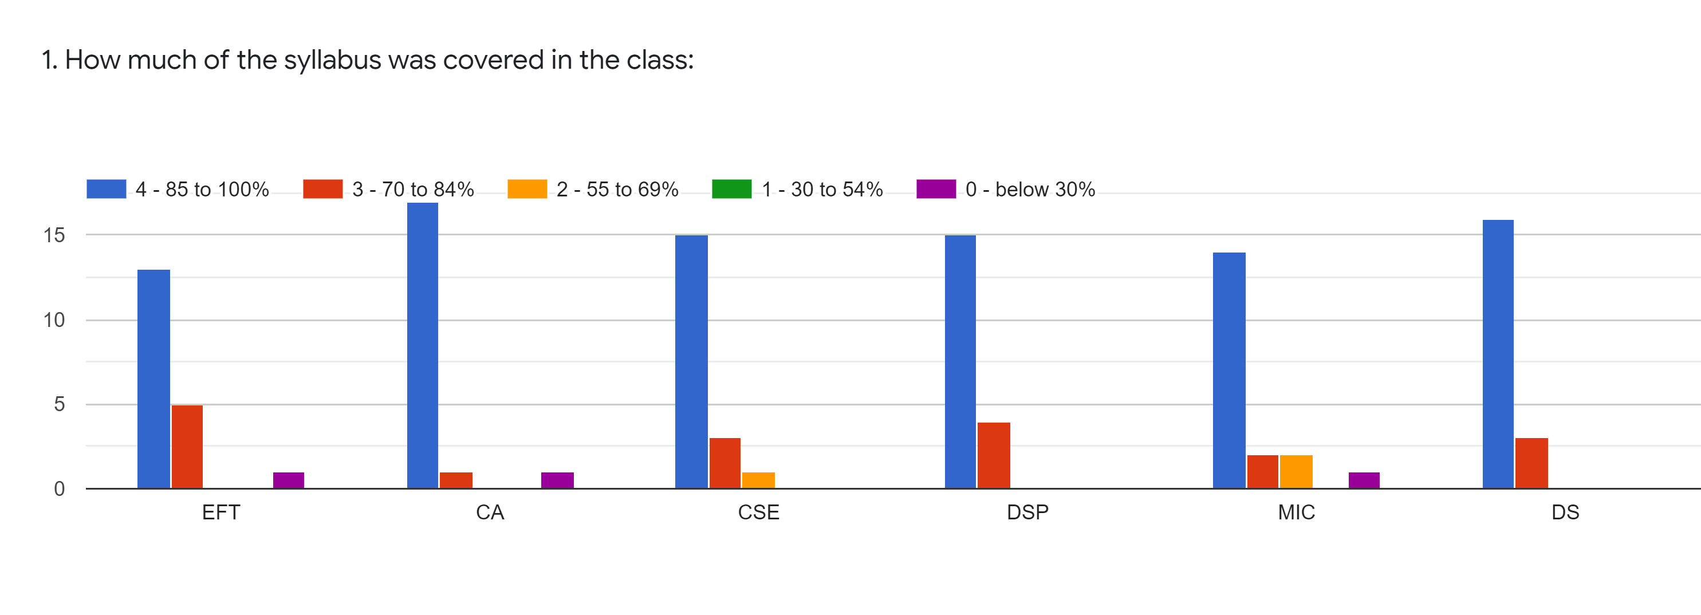
Subject | EFT | CA | CSE | DSP | MIC | DS
85 to 100% | 13 | 17 | 15 | 15 | 14 | 16
70 to 84% | 5 | 1 | 3 | 4 | 2 | 3
55 to 69% | 0 | 0 | 1 | 0 | 2 | 0
30 to 54% | 0 | 0 | 0 | 0 | 1 | 0
below 30% | 1 | 1 | 0 | 0 | 0 | 0
Total | 19 | 19 | 19 | 19 | 19 | 19

Slide 4
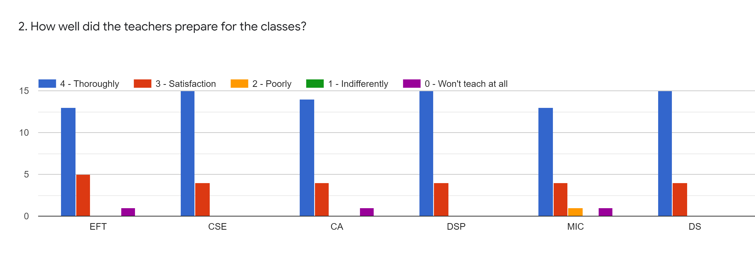
Subject | EFT | CA | CSE | DSP | MIC | DS
Thoroughly | 13 | 14 | 15 | 15 | 13 | 15
Satisfaction | 5 | 4 | 4 | 4 | 4 | 4
poorly | 1 | 0 | 0 | 0 | 1 | 0
Indifferently | 0 | 0 | 0 | 0 | 0 | 0
Wont Teach at all | 0 | 1 | 0 | 0 | 1 | 0
Total | 19 | 19 | 19 | 19 | 19 | 19

Slide 5
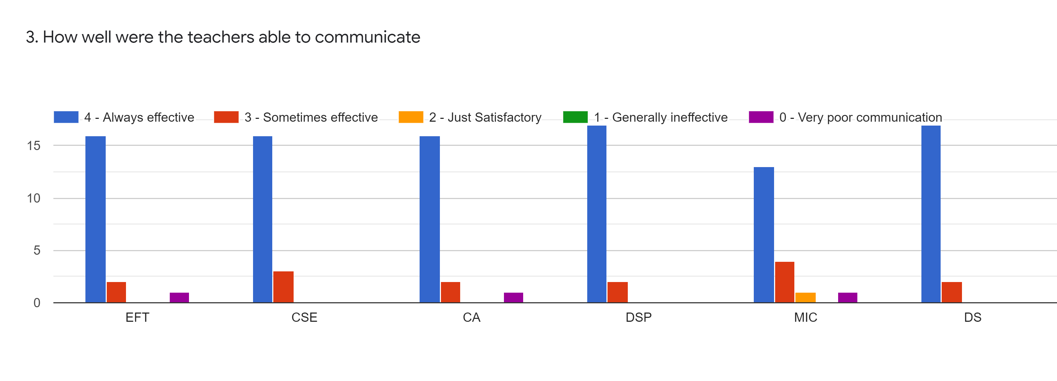
Subject | EFT | CA | CSE | DSP | MIC | DS
Always Effective | 16 | 16 | 16 | 17 | 13 | 17
Sometime effective | 2 | 2 | 3 | 2 | 4 | 2
Just Satisfactory | 1 | 1 | 0 | 0 | 1 | 0
Generally Ineffective | 0 | 0 | 0 | 0 | 0 | 0
Very Poor Communication | 0 | 0 | 0 | 0 | 1 | 0
Total | 19 | 19 | 19 | 19 | 19 | 19

Slide 6
Subject | EFT | CA | CSE | DSP | MIC | DS
Excellent | 15 | 16 | 16 | 16 | 11 | 17
Very Good | 2 | 0 | 1 | 1 | 3 | 1
Good | 1 | 2 | 2 | 2 | 3 | 1
Fair | 0 | 0 | 0 | 0 | 1 | 0
Poor | 1 | 1 | 0 | 0 | 1 | 0
Total | 19 | 19 | 19 | 19 | 19 | 19

Slide 7
Subject | EFT | CA | CSE | DSP | MIC | DS
Always fair | 15 | 16 | 16 | 15 | 13 | 16
Usually fair | 4 | 3 | 2 | 3 | 5 | 3
Sometimes unfair | 0 | 0 | 1 | 1 | 0 | 0
unfair | 0 | 0 | 0 | 0 | 1 | 0
Total | 19 | 19 | 19 | 19 | 19 | 19

Slide 8
Subject | EFT | CA | CSE | DSP | MIC | DS
Every time | 15 | 14 | 15 | 15 | 11 | 15
Usually | 4 | 5 | 3 | 3 | 7 | 3
Occasionally | 0 | 0 | 0 | 0 | 0 | 1
Rarely | 0 | 0 | 1 | 0 | 0 | 0
Never | 0 | 0 | 0 | 1 | 1 | 0
Total | 19 | 19 | 19 | 19 | 19 | 19

Slide 9
Subject | EFT | CA | CSE | DSP | MIC | DS
Regularly | 14 | 13 | 14 | 13 | 11 | 14
Often | 3 | 4 | 3 | 4 | 6 | 3
Sometimes | 0 | 0 | 0 | 0 | 0 | 0
Rarely | 0 | 0 | 0 | 0 | 0 | 0
Never | 2 | 2 | 2 | 2 | 2 | 2
Total | 19 | 19 | 19 | 19 | 19 | 19

Slide 10
Subject | EFT | CA | CSE | DSP | MIC | DS
Significantly | 15 | 15 | 15 | 14 | 13 | 15
Very Well | 3 | 2 | 2 | 3 | 4 | 2
Moderately | 0 | 1 | 1 | 1 | 1 | 1
Marginally | 0 | 0 | 0 | 0 | 0 | 0
Not at All | 1 | 1 | 1 | 1 | 1 | 1
Total | 19 | 19 | 19 | 19 | 19 | 19

Slide 11
Subject | EFT | CA | CSE | DSP | MIC | DS
Strongly Agree | 16 | 16 | 16 | 16 | 15 | 16
Agree | 3 | 3 | 3 | 3 | 4 | 3
Neutral | 0 | 0 | 0 | 0 | 0 | 0
Disagree | 0 | 0 | 0 | 0 | 0 | 0
Strongly Disagree | 0 | 0 | 0 | 0 | 0 | 0
Total | 19 | 19 | 19 | 19 | 19 | 19

Slide 12
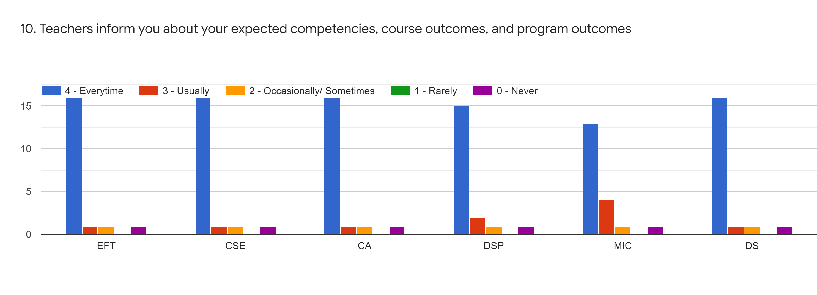
Subject | EFT | CA | CSE | DSP | MIC | DS
Every time | 16 | 16 | 16 | 15 | 13 | 16
Usually | 1 | 1 | 1 | 2 | 4 | 1
Occasionally | 1 | 1 | 1 | 1 | 1 | 1
Rarely | 0 | 0 | 0 | 0 | 0 | 0
Never | 1 | 1 | 1 | 1 | 1 | 1
Total | 19 | 19 | 19 | 19 | 19 | 19

Slide 13
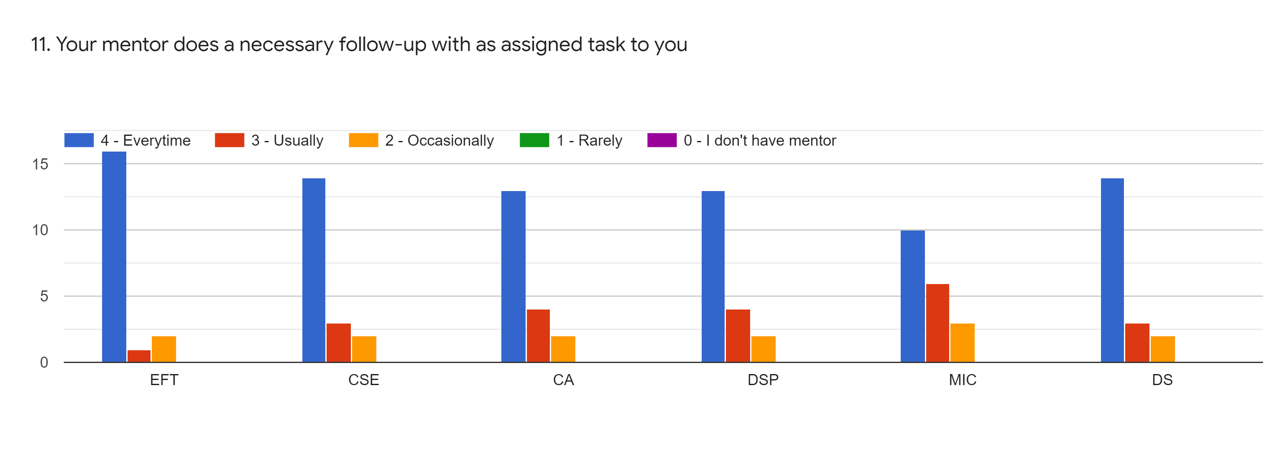
Subject | EFT | CA | CSE | DSP | MIC | DS
Every time | 16 | 13 | 14 | 13 | 10 | 14
Usually | 1 | 4 | 3 | 4 | 6 | 3
Occasionally | 2 | 2 | 2 | 2 | 3 | 2
Rarely | 0 | 0 | 0 | 0 | 0 | 0
I don’t have mentor | 0 | 0 | 0 | 0 | 0 | 0
Total | 19 | 19 | 19 | 19 | 19 | 19

Slide 14
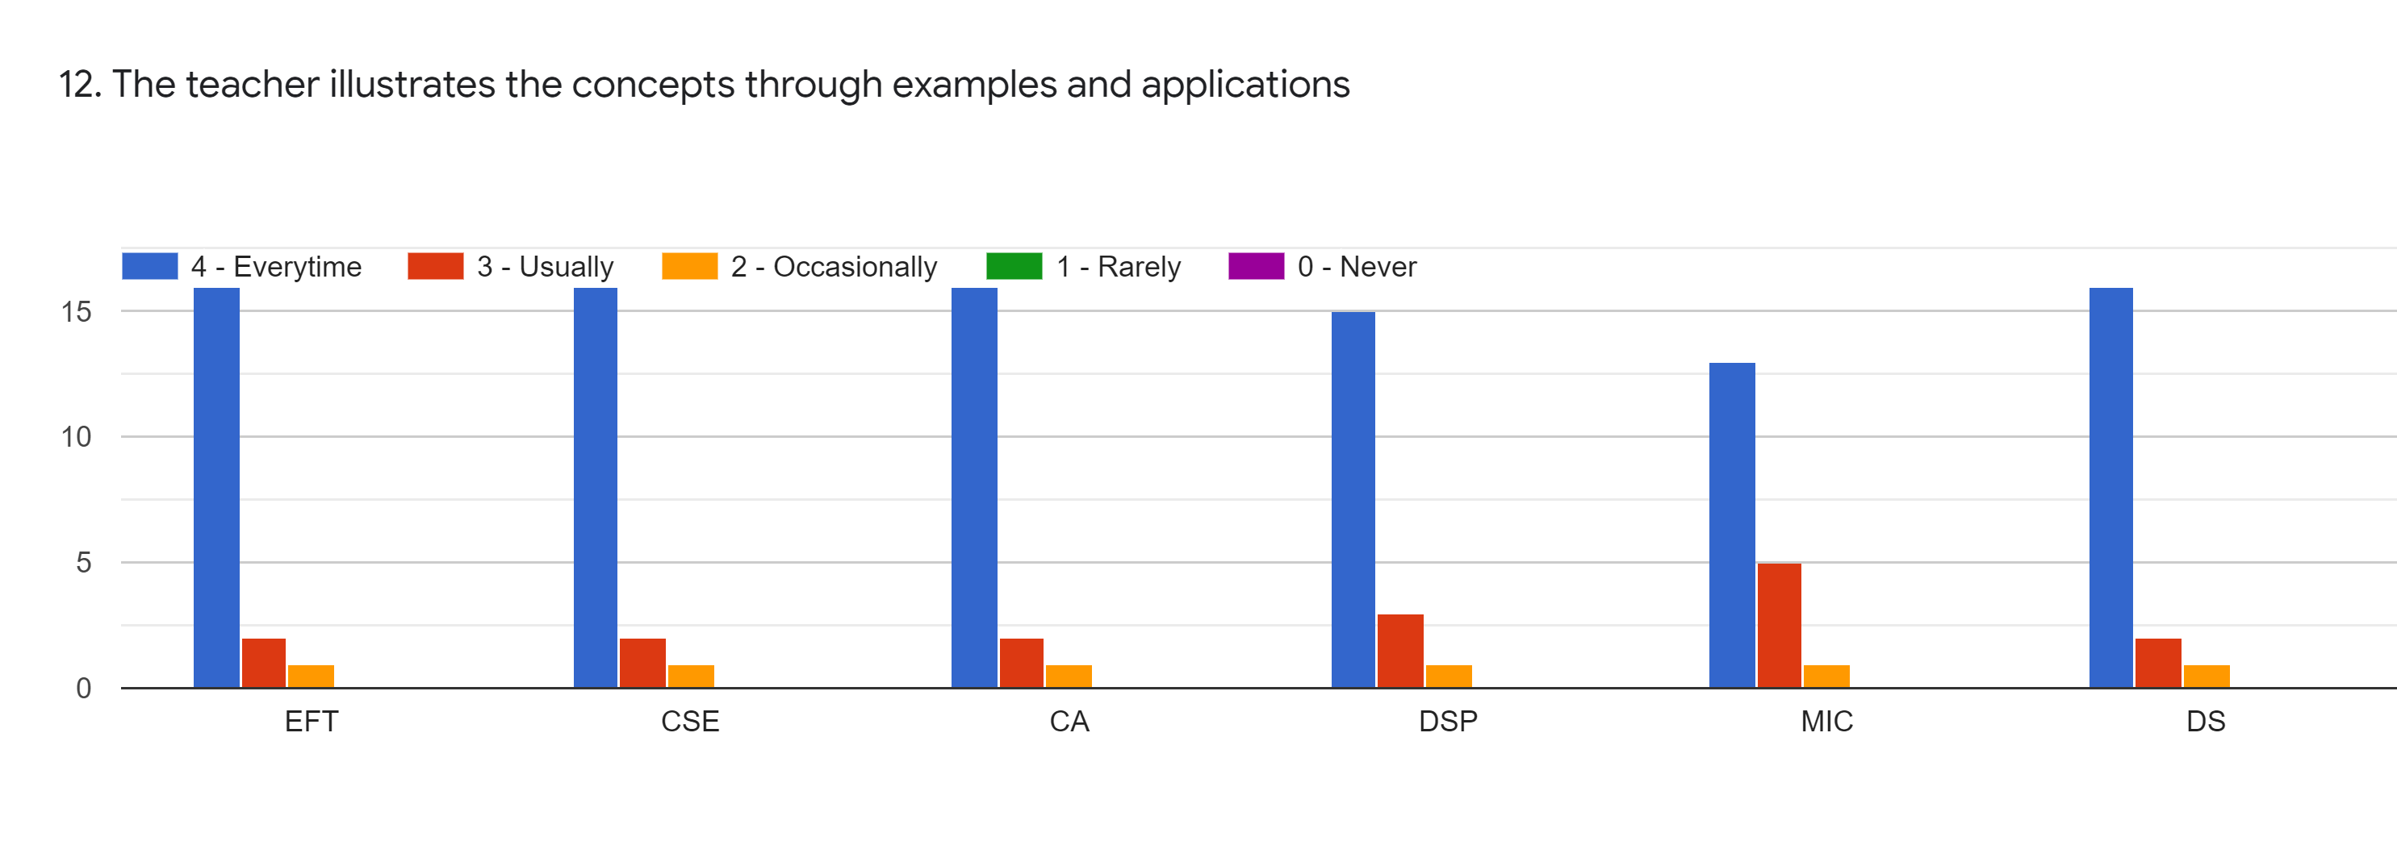
Subject | EFT | CA | CSE | DSP | MIC | DS
Every time | 16 | 16 | 16 | 15 | 13 | 16
Usually | 2 | 2 | 2 | 3 | 5 | 2
Occasionally | 1 | 1 | 1 | 1 | 1 | 1
Rarely | 0 | 0 | 0 | 0 | 0 | 0
Never | 0 | 0 | 0 | 0 | 0 | 0
Total | 19 | 19 | 19 | 19 | 19 | 19

Slide 15
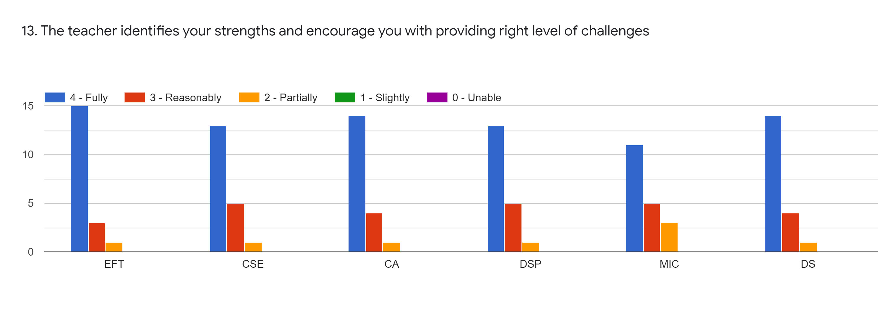
Subject | EFT | CA | CSE | DSP | MIC | DS
Fully | 15 | 14 | 13 | 13 | 11 | 14
Reasonably | 3 | 4 | 5 | 5 | 5 | 4
Partially | 1 | 1 | 1 | 1 | 3 | 1
Slightly | 0 | 0 | 0 | 0 | 0 | 0
Unable | 0 | 0 | 0 | 0 | 0 | 0
Total | 19 | 19 | 19 | 19 | 19 | 19

Slide 16
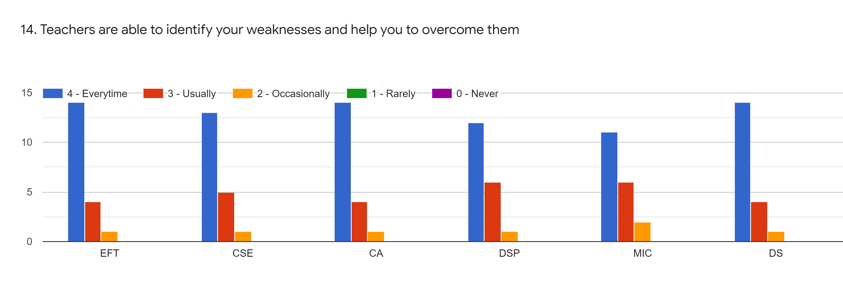
Subject | EFT | CA | CSE | DSP | MIC | DS
Every time | 14 | 14 | 13 | 12 | 11 | 14
Usually | 4 | 4 | 5 | 6 | 6 | 4
Occasionally | 1 | 1 | 1 | 1 | 2 | 1
Rarely | 0 | 0 | 0 | 0 | 0 | 0
Never | 0 | 0 | 0 | 0 | 0 | 0
Total | 19 | 19 | 19 | 19 | 19 | 19

Slide 17
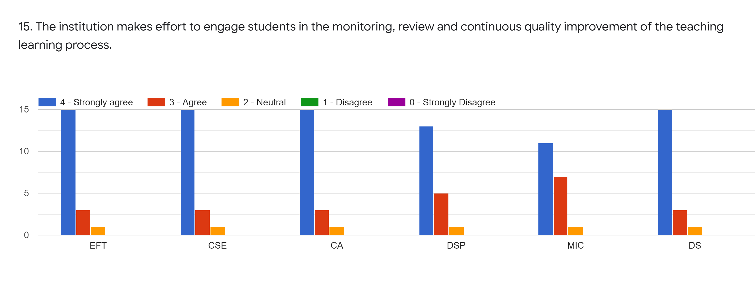
Subject | EFT | CA | CSE | DSP | MIC | DS
Strongly Agree | 15 | 15 | 15 | 13 | 11 | 15
Agree | 3 | 3 | 3 | 5 | 7 | 3
Neutral | 1 | 1 | 1 | 1 | 1 | 1
Disagree | 0 | 0 | 0 | 0 | 0 | 0
Strongly Disagree | 0 | 0 | 0 | 0 | 0 | 0
Total | 19 | 19 | 19 | 19 | 19 | 19

Slide 18
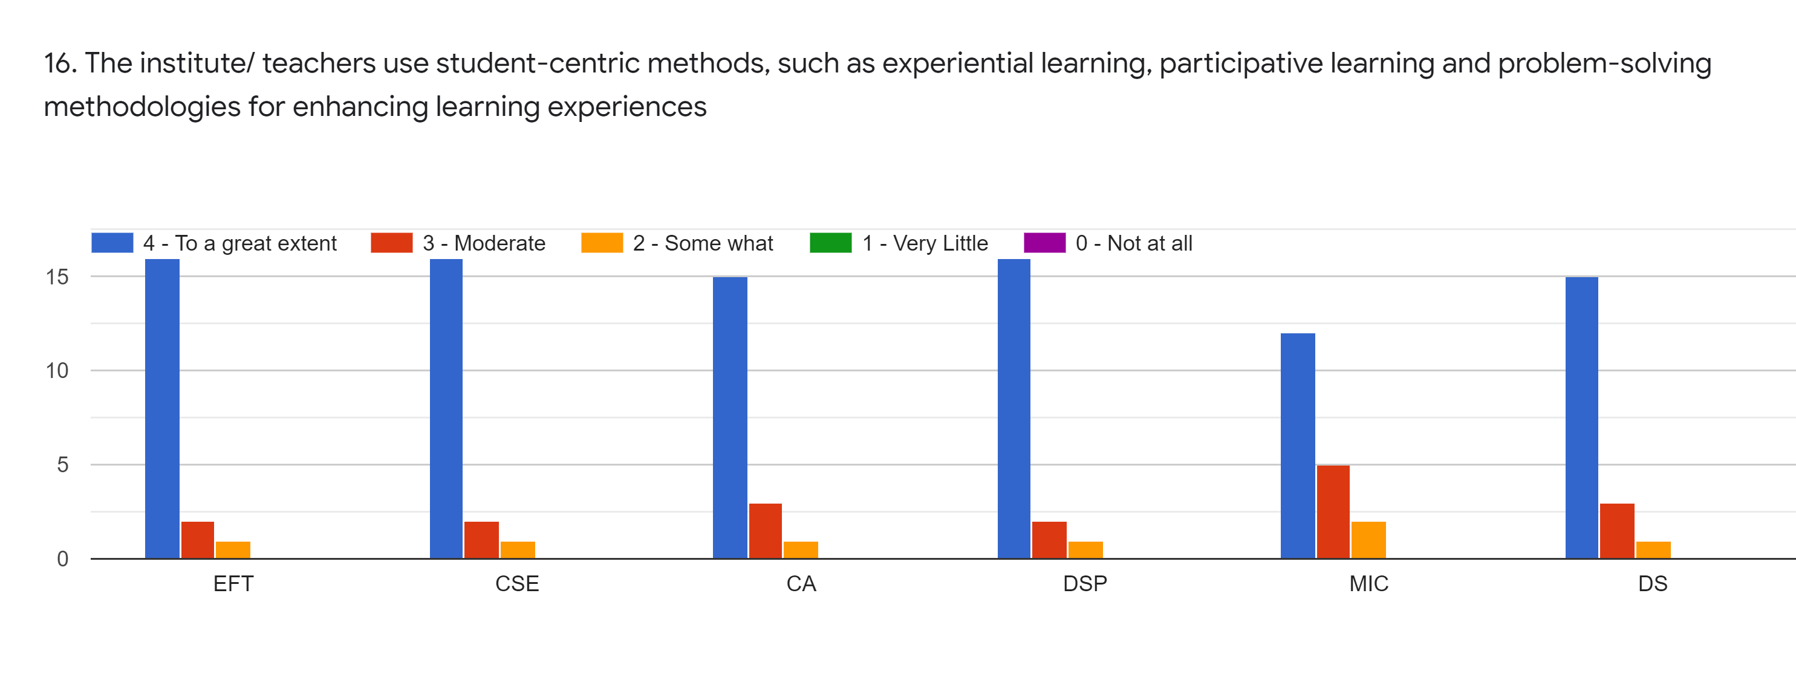
Subject | EFT | CA | CSE | DSP | MIC | DS
To a great extent | 16 | 15 | 16 | 16 | 12 | 15
Moderate | 2 | 3 | 2 | 2 | 5 | 3
Some What | 1 | 1 | 1 | 1 | 2 | 1
Very Little | 0 | 0 | 0 | 0 | 0 | 0
Not at all | 0 | 0 | 0 | 0 | 0 | 0
Total | 19 | 19 | 19 | 19 | 19 | 19

Slide 19
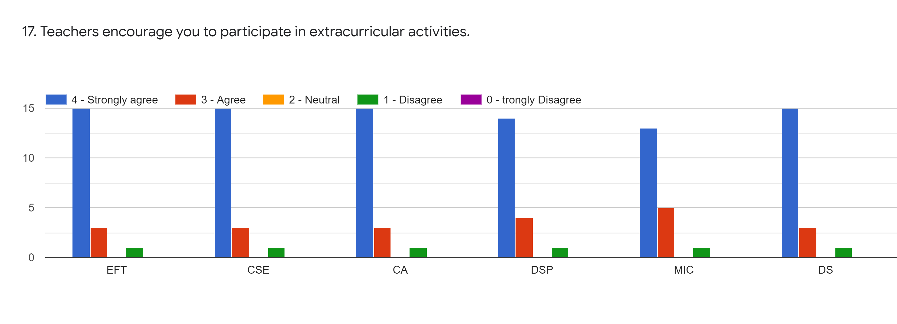
Subject | EFT | CA | CSE | DSP | MIC | DS
Strongly Agree | 15 | 15 | 15 | 14 | 13 | 15
Agree | 3 | 3 | 3 | 4 | 5 | 3
Neutral | 0 | 0 | 0 | 0 | 1 | 0
Disagree | 1 | 1 | 1 | 1 | 0 | 1
Strongly Disagree | 0 | 0 | 0 | 0 | 0 | 0
Total | 19 | 19 | 19 | 19 | 19 | 19

Slide 20
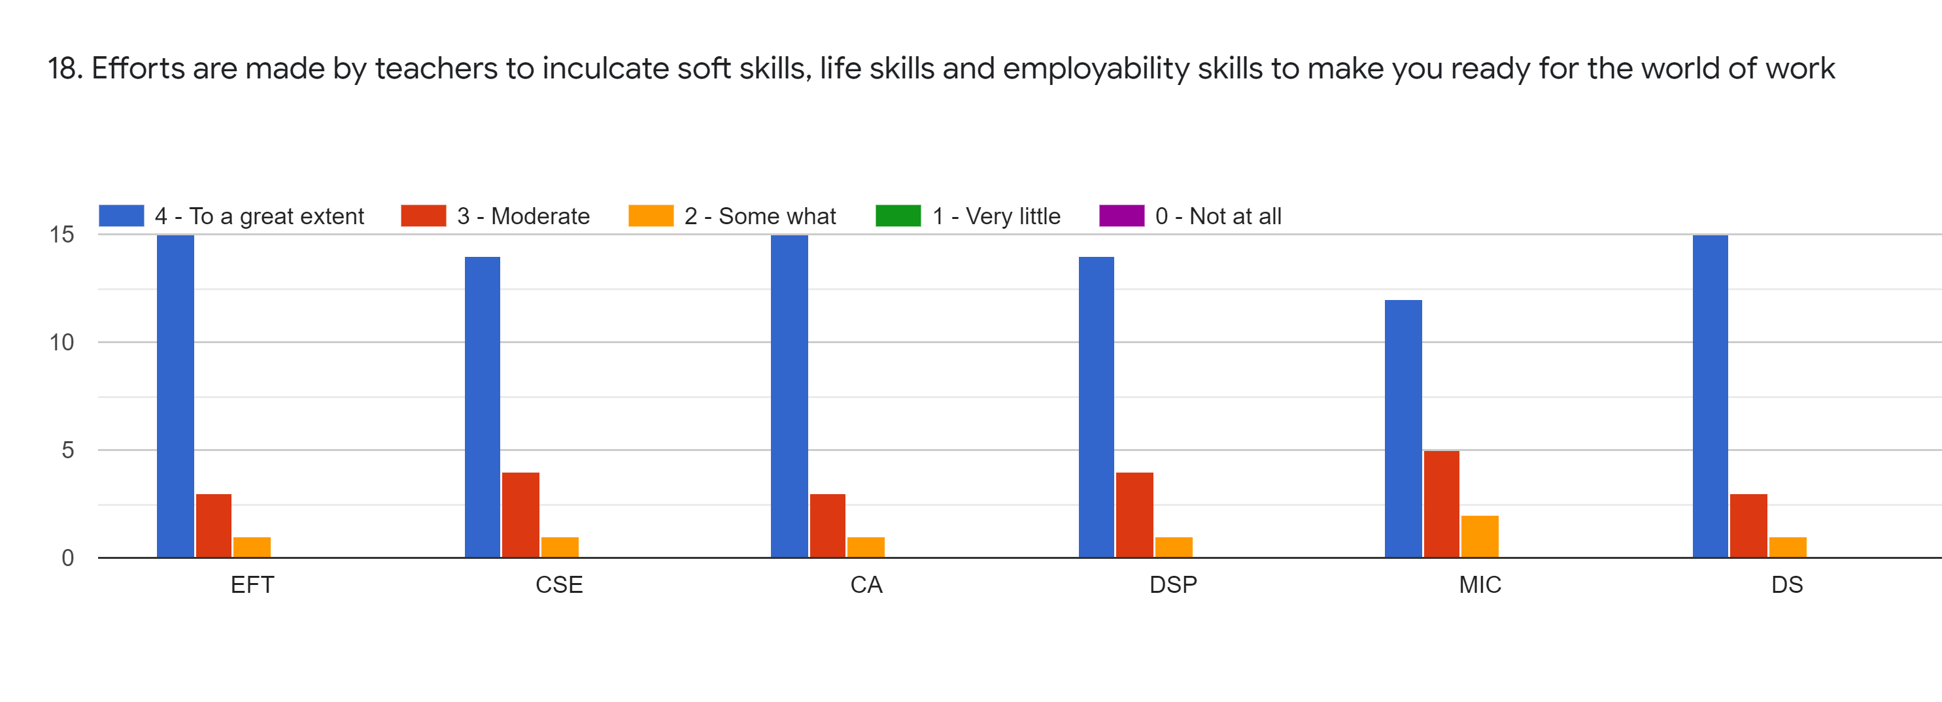
Subject | EFT | CA | CSE | DSP | MIC | DS
To a great extent | 15 | 15 | 14 | 14 | 12 | 15
Moderate | 3 | 3 | 4 | 4 | 5 | 3
Some What | 1 | 1 | 1 | 1 | 2 | 1
Very Little | 0 | 0 | 0 | 0 | 0 | 0
Not at all | 0 | 0 | 0 | 0 | 0 | 0
Total | 19 | 19 | 19 | 19 | 19 | 19

Slide 21
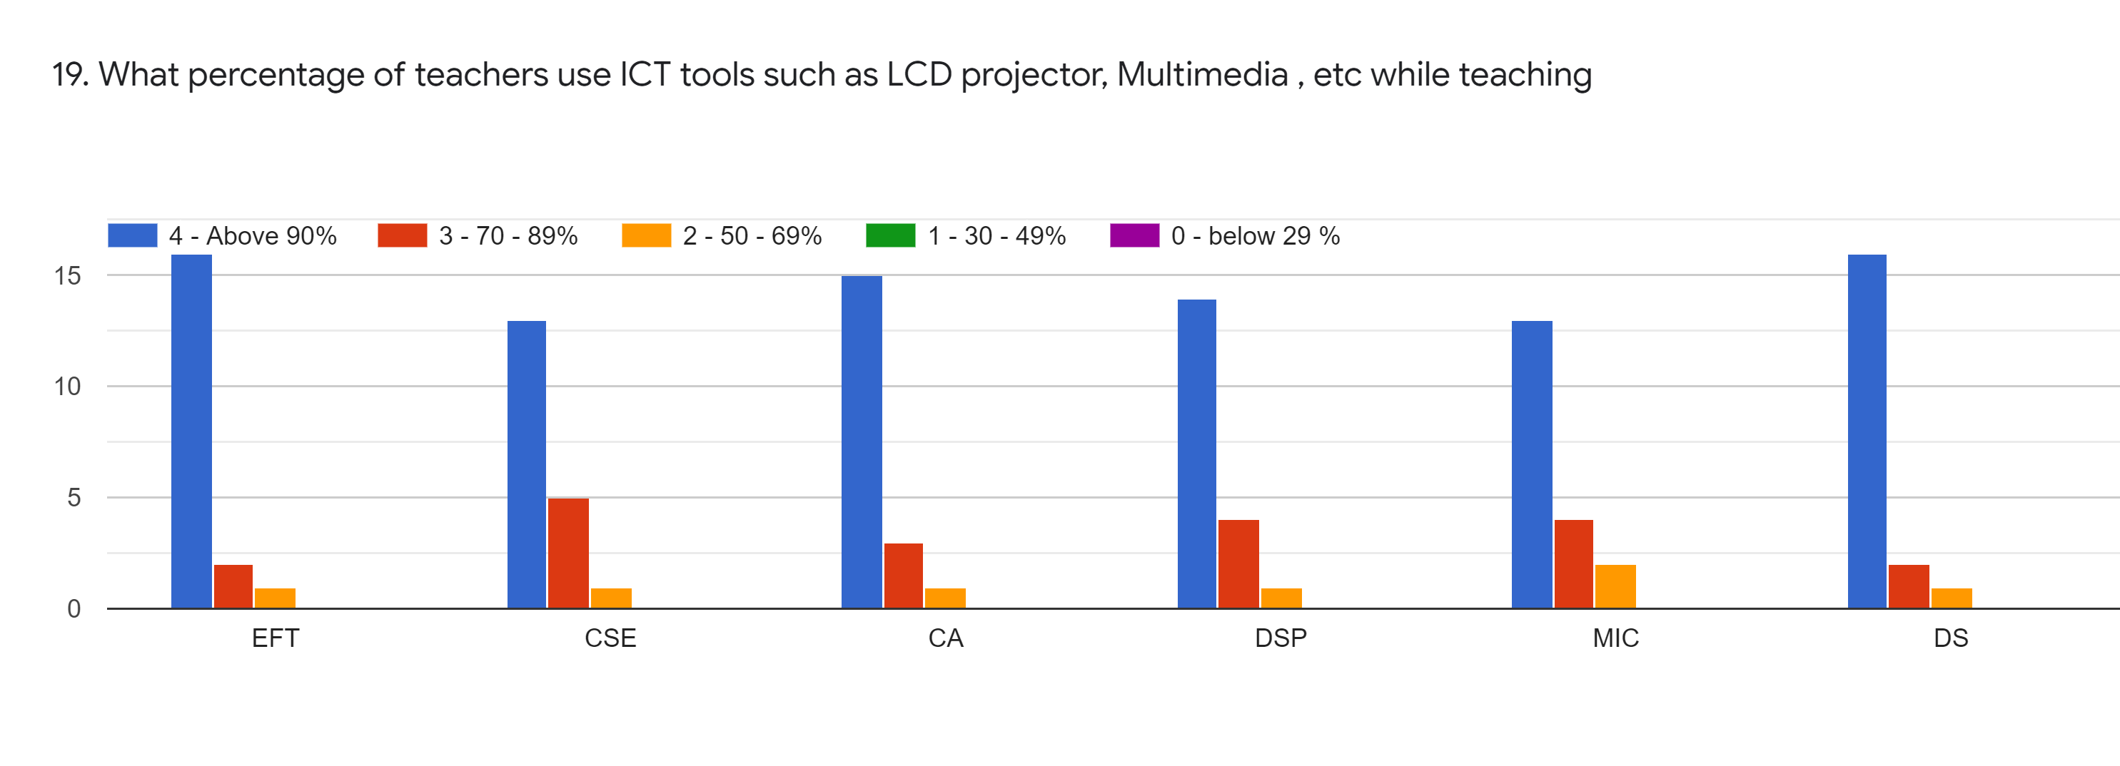
Subject | EFT | CA | CSE | DSP | MIC | DS
Above 90% | 16 | 15 | 13 | 14 | 13 | 16
70-89% | 3 | 3 | 5 | 4 | 5 | 3
50-69 % | 1 | 1 | 1 | 1 | 1 | 1
30-49 % | 0 | 0 | 0 | 0 | 0 | 0
0-below 29% | 0 | 0 | 0 | 0 | 0 | 0
Total | 19 | 19 | 19 | 19 | 19 | 19

Slide 22
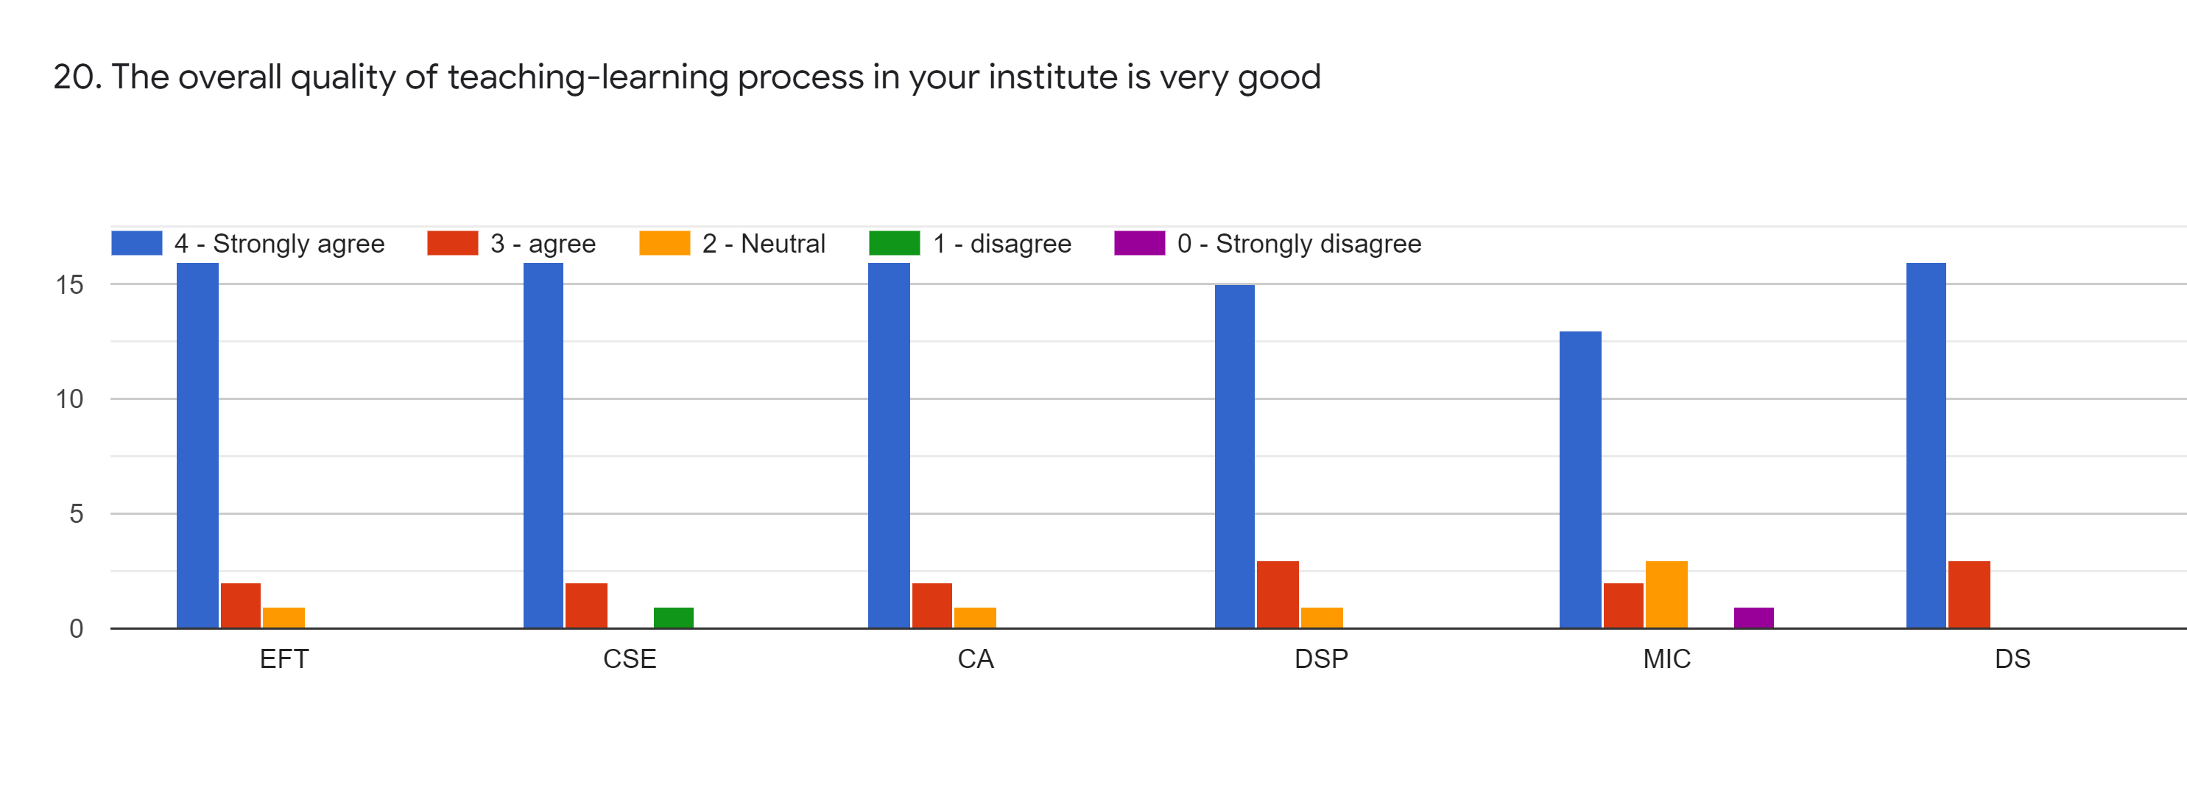
Subject | EFT | CA | CSE | DSP | MIC | DS
Strongly Agree | 16 | 16 | 16 | 15 | 13 | 16
Agree | 2 | 2 | 2 | 3 | 2 | 3
Neutral | 1 | 1 | 0 | 1 | 3 | 0
Disagree | 0 | 0 | 1 | 0 | 0 | 0
Strongly Disagree | 0 | 0 | 0 | 0 | 1 | 0
Total | 19 | 19 | 19 | 19 | 19 | 19

Slide 23
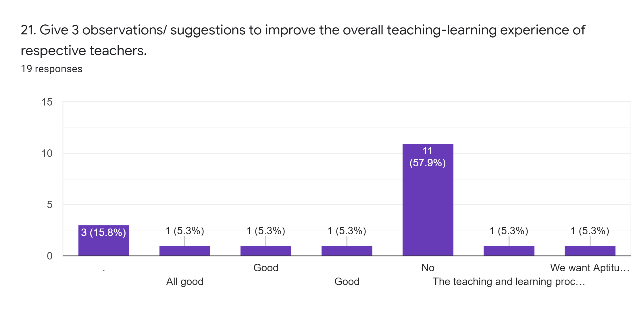

Slide 24
Give 3 observation/ Suggession to improve the overall teaching learning experience of respective teachers
Students-teacher communication is good. Teachers are helping students in their difficulties and doubts.
Teachers should explain the practical use of the subject using demonstrations, videos or live examples.
Teachers should give quiz, tests, problems for students’ practice.

Slide 25
Overall Analysis
Subject | Faculty | Appreciation | Suggestion for Improvement | Sign
EFT | GMS | Good efforts in encouraging students to participate in soft skill program, life skills | Syllabus coverage.
CSE | BT | Good follow up of assigned tasks. | Teacher should identify students’ strength & provide right level of challenge.
CA | JDB | Took efforts in monitoring teaching learning. | Take follow up of assigned tasks.
DSP | SKS | Good teaching approach. | Teacher should identify students’ weakness.
MIC | CSG | Good use of ICT tools. | Can improve the teaching approach.
DS | HVS | Efforts to encourage students to participate in extra curricular activities | Teacher should identify students’ strength & provide right level of challenge.
AMC Coordinator
HOD
Principal

