Slide 1
Arvind Gavali College of Engineering, Satara Department of Electronics & Telecommunication Engineering Second Year Feedback
Month : March 2022
Total Responses : 32
Total Class Strength : 58
Feedback Percentage : 54%

Slide 2
FACULTY – SUBJECT DISTRIBUTION
Sr. No | Subject | Abbrev. | Name of Faculty | Abbrev.
1. | Network Theory | NT | Mrs. Jadhav Snehal | JS
2. | Signals & Systems | SS | Mr. Chavan S. G. | CSG
3. | Basic Human Rights | BHR | Adv. Ghorpade Dhanashri | GD
4. | Probability Theory & Random Processes | PTRP | Dr. Mirajkar G. S. | MGS
5. | Python Programming | PP | Mr. Hingmire V. S. | HVS
6. | Network Theory lab | NT LAB | Ms. Sawashe K. S. | SKS
7. | Signals & Systems Lab | SS LAB | Mr. Chavan S. G. | CSG

Slide 3
Subject | NT | SS | BHR | PTRP | PP | NT LAB | SS LAB
Faculty | JS | CSG | GD | MGS | HVS | SKS | CSG
85 -100 % | 1 | 1 | 1 | 3 | 3 | 1 | 1
70 - 84 % | 9 | 7 | 8 | 11 | 10 | 9 | 6
55 – 69 % | 2 | 7 | 11 | 8 | 9 | 10 | 11
30 – 54 % | 11 | 10 | 10 | 7 | 9 | 7 | 9
0- Below 30 % | 9 | 7 | 2 | 3 | 1 | 5 | 5
TOTAL | 32 | 32 | 32 | 32 | 32 | 32 | 32

Slide 4
Subject | NT | SS | BHR | PTRP | PP | NT LAB | SS LAB
Faculty | JS | CSG | GD | MGS | HVS | SKS | CSG
Thoroughly | 6 | 6 | 10 | 15 | 13 | 9 | 5
Satisfaction | 13 | 11 | 17 | 14 | 15 | 14 | 16
poorly | 7 | 9 | 4 | 2 | 2 | 4 | 7
Indifferently | 3 | 3 | 1 | 1 | 1 | 4 | 3
Wont Teach at all | 3 | 3 | 0 | 0 | 1 | 1 | 1
TOTAL | 32 | 32 | 32 | 32 | 32 | 32 | 32

Slide 5
Subject | NT | SS | BHR | PTRP | PP | NT LAB | SS LAB
Faculty | JS | CSG | GD | MGS | HVS | SKS | CSG
Always Effective | 8 | 6 | 10 | 14 | 12 | 10 | 7
Sometime effective | 14 | 16 | 18 | 18 | 20 | 17 | 17
Just Satisfactory | 7 | 7 | 3 | 0 | 0 | 4 | 7
Generally Ineffective | 0 | 0 | 1 | 0 | 0 | 0 | 0
Very Poor Communication | 3 | 3 | 0 | 0 | 0 | 1 | 1
TOTAL | 32 | 32 | 32 | 32 | 32 | 32 | 32

Slide 6
Subject | NT | SS | BHR | PTRP | PP | NT LAB | SS LAB
Faculty | JS | CSG | GD | MGS | HVS | SKS | CSG
Excellent | 8 | 4 | 10 | 11 | 12 | 7 | 6
Very Good | 8 | 8 | 12 | 12 | 11 | 11 | 12
Good | 9 | 10 | 9 | 9 | 9 | 13 | 10
Fair | 5 | 7 | 0 | 0 | 0 | 0 | 2
Poor | 2 | 3 | 1 | 0 | 0 | 1 | 2
TOTAL | 32 | 32 | 32 | 32 | 32 | 32 | 32

Slide 7
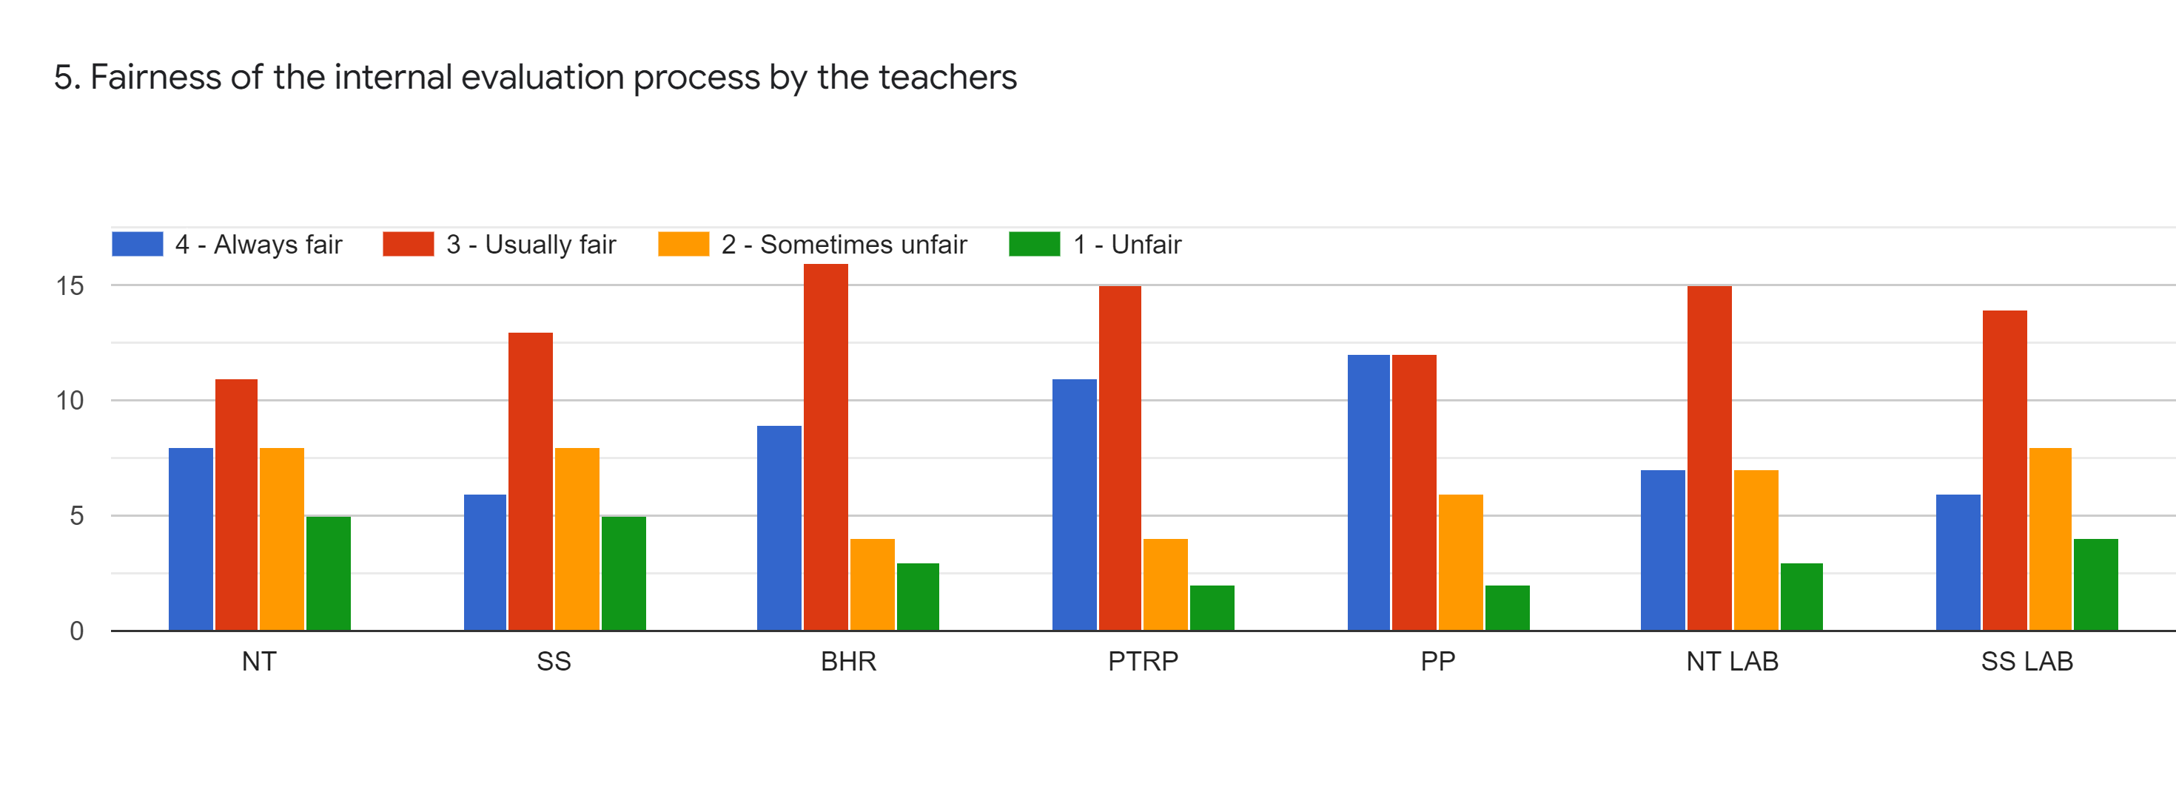
Subject | NT | SS | BHR | PTRP | PP | NT LAB | SS LAB
Faculty | JS | CSG | GD | MGS | HVS | SKS | CSG
Always fair | 8 | 6 | 9 | 11 | 12 | 7 | 6
Usually fair | 11 | 11 | 16 | 15 | 12 | 15 | 14
Sometimes fair | 8 | 8 | 4 | 4 | 6 | 7 | 8
Unfair | 5 | 5 | 3 | 2 | 2 | 3 | 4
TOTAL | 32 | 32 | 32 | 32 | 32 | 32 | 32

Slide 8
Subject | NT | SS | BHR | PTRP | PP | NT LAB | SS LAB
Faculty | JS | CSG | GD | MGS | HVS | SKS | CSG
Every time | 9 | 8 | 10 | 15 | 14 | 13 | 10
Usually | 11 | 10 | 12 | 10 | 10 | 10 | 11
Occasionally | 8 | 8 | 8 | 5 | 7 | 6 | 7
Rarely | 0 | 3 | 1 | 2 | 1 | 1 | 0
Never | 4 | 3 | 1 | 0 | 0 | 2 | 4
TOTAL | 32 | 32 | 32 | 32 | 32 | 32 | 32

Slide 9
Subject | NT | SS | BHR | PTRP | PP | NT LAB | SS LAB
Faculty | JS | CSG | GD | MGS | HVS | SKS | CSG
Regularly | 8 | 8 | 8 | 11 | 10 | 6 | 9
Often | 13 | 10 | 15 | 13 | 14 | 14 | 11
Sometimes | 6 | 10 | 4 | 6 | 5 | 9 | 9
Rarely | 1 | 1 | 2 | 0 | 0 | 0 | 0
Never | 4 | 3 | 3 | 2 | 3 | 3 | 3
TOTAL | 32 | 32 | 32 | 32 | 32 | 32 | 32

Slide 10
Subject | NT | SS | BHR | PTRP | PP | NT LAB | SS LAB
Faculty | JS | CSG | GD | MGS | HVS | SKS | CSG
Significantly | 10 | 6 | 12 | 11 | 14 | 10 | 10
Very Well | 8 | 11 | 13 | 14 | 10 | 11 | 9
Moderately | 9 | 11 | 6 | 6 | 7 | 8 | 8
Marginally | 2 | 3 | 1 | 1 | 1 | 2 | 3
Not at All | 3 | 1 | 0 | 0 | 0 | 1 | 2
TOTAL | 32 | 32 | 32 | 32 | 32 | 32 | 32

Slide 11
Subject | NT | SS | BHR | PTRP | PP | NT LAB | SS LAB
Faculty | JS | CSG | GD | MGS | HVS | SKS | CSG
Strongly Agree | 12 | 7 | 9 | 11 | 11 | 10 | 7
Agree | 9 | 12 | 11 | 13 | 14 | 11 | 10
Neutral | 5 | 8 | 9 | 6 | 5 | 8 | 11
Disagree | 4 | 4 | 3 | 2 | 2 | 2 | 3
Strongly Disagree | 2 | 1 | 0 | 0 | 0 | 1 | 1
TOTAL | 32 | 32 | 32 | 32 | 32 | 32 | 32

Slide 12
Subject | NT | SS | BHR | PTRP | PP | NT LAB | SS LAB
Faculty | JS | CSG | GD | MGS | HVS | SKS | CSG
Every time | 7 | 6 | 7 | 12 | 11 | 10 | 6
Usually | 14 | 15 | 19 | 16 | 17 | 16 | 19
Occasionally | 6 | 8 | 5 | 3 | 3 | 4 | 4
Rarely | 2 | 2 | 0 | 0 | 0 | 1 | 2
Never | 3 | 1 | 1 | 1 | 1 | 1 | 1
TOTAL | 32 | 32 | 32 | 32 | 32 | 32 | 32

Slide 13
Subject | NT | SS | BHR | PTRP | PP | NT LAB | SS LAB
Faculty | JS | CSG | GD | MGS | HVS | SKS | CSG
Every time | 10 | 10 | 11 | 15 | 12 | 15 | 9
Usually | 12 | 11 | 15 | 14 | 17 | 12 | 15
Occasionally | 6 | 8 | 5 | 2 | 2 | 3 | 6
Rarely | 1 | 2 | 0 | 0 | 0 | 0 | 0
I don’t have mentor | 3 | 1 | 1 | 1 | 1 | 2 | 2
TOTAL | 32 | 32 | 32 | 32 | 32 | 32 | 32

Slide 14
Subject | NT | SS | BHR | PTRP | PP | NT LAB | SS LAB
Faculty | JS | CSG | GD | MGS | HVS | SKS | CSG
Every time | 10 | 6 | 13 | 15 | 15 | 11 | 10
Usually | 10 | 14 | 11 | 13 | 13 | 13 | 14
Occasionally | 7 | 7 | 6 | 4 | 4 | 5 | 5
Rarely | 2 | 2 | 1 | 0 | 0 | 0 | 0
Never | 3 | 3 | 1 | 0 | 0 | 3 | 2
TOTAL | 32 | 32 | 32 | 32 | 32 | 32 | 32

Slide 15
Subject | NT | SS | BHR | PTRP | PP | NT LAB | SS LAB
Faculty | JS | CSG | GD | MGS | HVS | SKS | CSG
Fully | 15 | 13 | 18 | 19 | 18 | 15 | 13
Reasonably | 6 | 7 | 6 | 6 | 8 | 10 | 10
Partially | 7 | 9 | 7 | 6 | 6 | 5 | 6
Slightly | 1 | 2 | 1 | 1 | 0 | 0 | 0
Unable | 3 | 1 | 0 | 0 | 0 | 2 | 3
TOTAL | 32 | 32 | 32 | 32 | 32 | 32 | 32

Slide 16
Subject | NT | SS | BHR | PTRP | PP | NT LAB | SS LAB
Faculty | JS | CSG | GD | MGS | HVS | SKS | CSG
Every time | 7 | 3 | 11 | 11 | 10 | 7 | 8
Usually | 11 | 12 | 11 | 11 | 13 | 14 | 11
Occasionally | 9 | 12 | 8 | 9 | 8 | 7 | 8
Rarely | 2 | 2 | 1 | 1 | 1 | 2 | 2
Never | 3 | 3 | 1 | 0 | 0 | 2 | 3
TOTAL | 32 | 32 | 32 | 32 | 32 | 32 | 32

Slide 17
Subject | NT | SS | BHR | PTRP | PP | NT LAB | SS LAB
Faculty | JS | CSG | GD | MGS | HVS | SKS | CSG
Strongly Agree | 8 | 5 | 12 | 12 | 12 | 8 | 8
Agree | 11 | 12 | 14 | 13 | 14 | 13 | 12
Neutral | 5 | 9 | 4 | 6 | 4 | 8 | 8
Disagree | 5 | 4 | 2 | 1 | 1 | 1 | 2
Strongly Disagree | 3 | 2 | 0 | 0 | 0 | 2 | 2
TOTAL | 32 | 32 | 32 | 32 | 32 | 32 | 32

Slide 18
Subject | NT | SS | BHR | PTRP | PP | NT LAB | SS LAB
Faculty | JS | CSG | GD | MGS | HVS | SKS | CSG
To a great extent | 9 | 6 | 9 | 9 | 11 | 9 | 8
Moderate | 11 | 12 | 13 | 16 | 13 | 15 | 13
Some What | 4 | 6 | 6 | 5 | 6 | 3 | 5
Very Little | 4 | 6 | 2 | 1 | 1 | 3 | 4
Not at all | 4 | 2 | 1 | 1 | 1 | 2 | 2
TOTAL | 32 | 32 | 32 | 32 | 32 | 32 | 32

Slide 19
Subject | NT | SS | BHR | PTRP | PP | NT LAB | SS LAB
Faculty | JS | CSG | GD | MGS | HVS | SKS | CSG
Strongly Agree | 11 | 9 | 14 | 13 | 14 | 10 | 11
Agree | 10 | 13 | 10 | 12 | 12 | 14 | 12
Neutral | 4 | 4 | 5 | 4 | 4 | 3 | 4
Disagree | 4 | 5 | 2 | 3 | 2 | 3 | 3
Strongly Disagree | 3 | 1 | 1 | 0 | 0 | 2 | 2
TOTAL | 32 | 32 | 32 | 32 | 32 | 32 | 32

Slide 20
Subject | NT | SS | BHR | PTRP | PP | NT LAB | SS LAB
Faculty | JS | CSG | GD | MGS | HVS | SKS | CSG
To a great extent | 5 | 4 | 8 | 10 | 11 | 6 | 8
Moderate | 16 | 18 | 17 | 16 | 15 | 18 | 16
Some What | 5 | 5 | 6 | 4 | 5 | 6 | 5
Very Little | 3 | 4 | 1 | 2 | 1 | 1 | 1
Not at all | 3 | 1 | 0 | 0 | 0 | 1 | 2
TOTAL | 32 | 32 | 32 | 32 | 32 | 32 | 32

Slide 21
Subject | NT | SS | BHR | PTRP | PP | NT LAB | SS LAB
Faculty | JS | CSG | GD | MGS | HVS | SKS | CSG
Above 90% | 1 | 4 | 4 | 15 | 13 | 8 | 7
70-89% | 9 | 7 | 8 | 10 | 10 | 7 | 10
50-69 % | 7 | 6 | 9 | 5 | 6 | 7 | 7
30-49 % | 8 | 8 | 7 | 2 | 2 | 6 | 5
0-below 29% | 7 | 7 | 4 | 0 | 1 | 4 | 3
TOTAL | 32 | 32 | 32 | 32 | 32 | 32 | 32

Slide 22
Subject | NT | SS | BHR | PTRP | PP | NT LAB | SS LAB
Faculty | JS | CSG | GD | MGS | HVS | SKS | CSG
Strongly Agree | 7 | 3 | 12 | 14 | 15 | 8 | 8
Agree | 11 | 13 | 16 | 14 | 12 | 15 | 13
Neutral | 7 | 8 | 2 | 2 | 3 | 5 | 6
Disagree | 2 | 4 | 0 | 0 | 0 | 1 | 1
Strongly Disagree | 5 | 4 | 2 | 2 | 2 | 3 | 4
TOTAL | 32 | 32 | 32 | 32 | 32 | 32 | 32

Slide 23
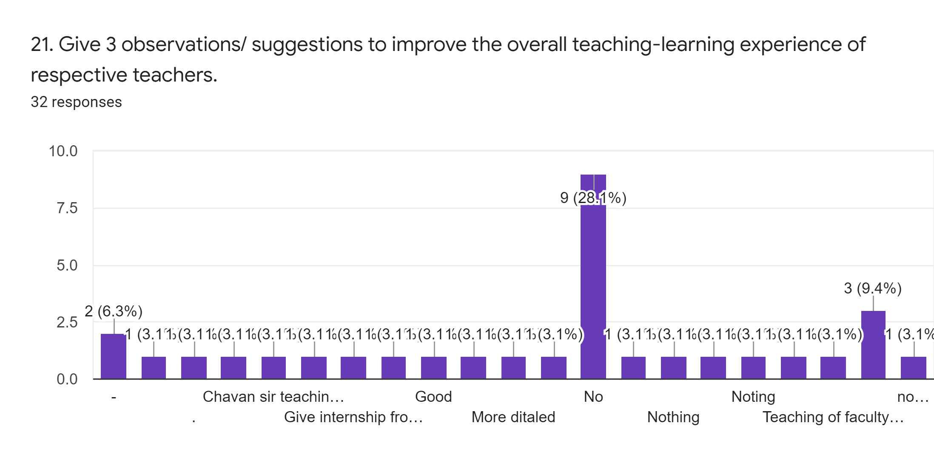

Slide 24
21. Give 3 observations/ suggestions to improve the overall teaching-learning experience of respective teachers
1. Provide study material i.e. ppt, videos, notes etc. for better understanding.
2. All teachers should keep good communication & interaction with students to understand their problems and weakness.
3. Please try to conduct numerical subject lectures in simple way and give more examples for practice.

Slide 25
OVERALL ANALYSIS
Sub | Faculty | Appreciation | Suggestions for improvement | Sign
NT | JS | Good teaching approach. | Improve the syllabus coverage.
SS | CSG | Takes follow up of assigned tasks. | Illustrate the concepts using more examples & applications.
PTRP | MGS | Effective use of ICT tools. | Identify students’ weakness & help them to overcome them.
BHR | GD | Identify students’ strengths & provide right level of challenge. | Take efforts in promoting internships, field visits etc.
PP | HVS | Good use of student centric methods.. | Identify students’ weakness & help them to overcome them.
NT LAB | SKS | Good efforts in taking follow up of assigned tasks & discussing performance with students. | Make efforts to inculcate soft skills, life skills in students.
SS LAB | CSG | Encourage students to participate in extra curricular activities. | Inform the students about CO, PO.
AMC Coordinator
HOD
Principal

