Slide 1
Arvind Gavali College of Engineering, Satara Department of Electronics & Telecommunication Engineering Second Year Feedback
Month :December 2021-January 2022
Total Responses : 25
Total Class Strength :
Feedback Percentage :

Slide 2
FACULTY – SUBJECT DISTRIBUTION
Sr. No | Subject | Abbrev. | Name of Faculty | Abbrev.
1. | Engineering Mathematics-III | M III | Mrs. Vidya Salunkhe | KAD
2. | Electronics Devices & Circuits | EDC | Mr. Jagtap D. B. | JDB
3. | Digital Electronics | DE | Mr. Hingmire V.S. | HVS
4. | Electrical Machines and Instruments | EMI | Mrs. Mahamuni P. N. | MPN
5. | Electronics Devices & Circuits lab | EDC LAB | Mr. Jagtap D. B. | JDB
6. | Digital Electronics lab | DE LAB | Mr. Hingmire V.S. | HVS

Slide 3
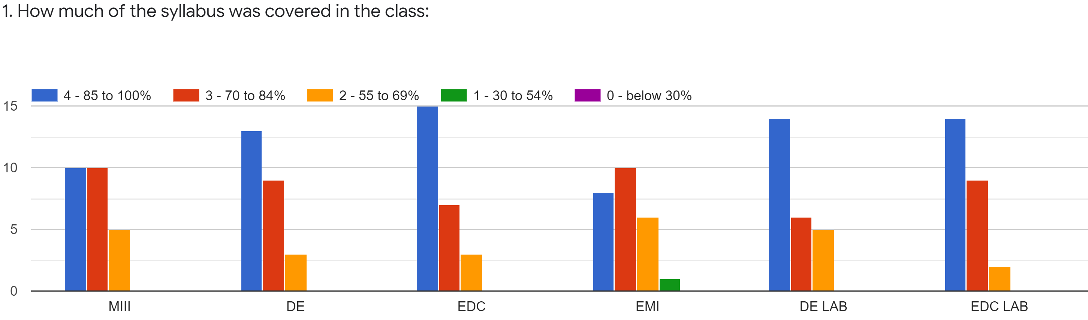
Faculty | SV | HVS | JDB | MPN | HVS | JDB
Subject | MIII | DE | EDC | EMI | DE LAB | EDC LAB
85 -100 % | 10 | 13 | 15 | 8 | 14 | 14
70 - 84 % | 10 | 9 | 7 | 10 | 6 | 9
55 – 69 % | 5 | 3 | 3 | 6 | 5 | 2
30 – 54 % | 0 | 0 | 0 | 1 | 0 | 0
0- Below 30 % | 0 | 0 | 0 | 0 | 0 | 0
TOTAL | 25 | 25 | 25 | 25 | 25 | 25

Slide 4
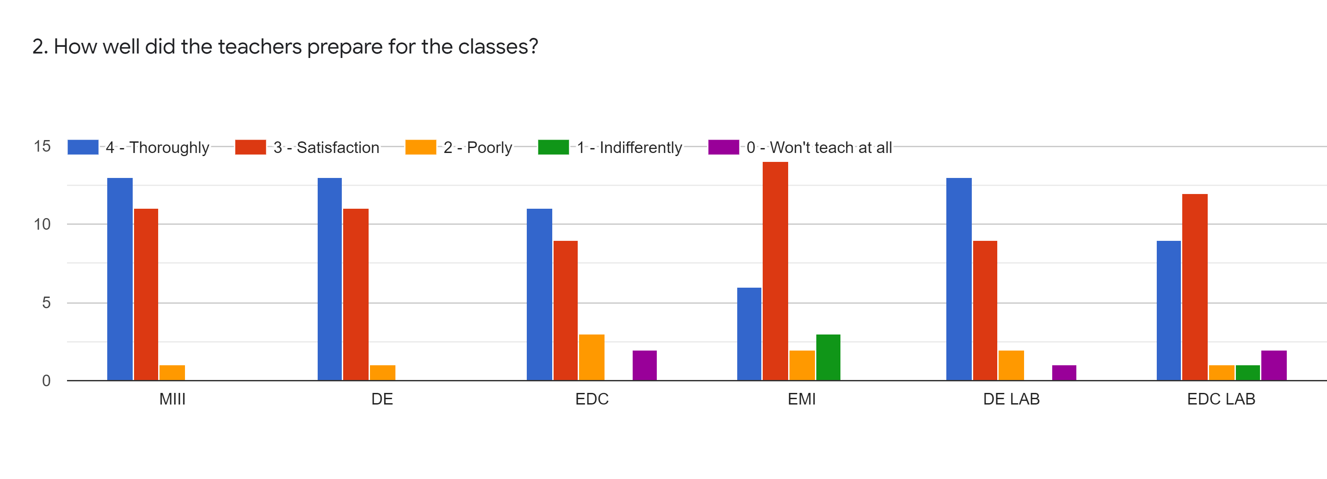
Faculty | SV | HVS | JDB | MPN | HVS | JDB
Subject | MIII | DE | EDC | EMI | DE LAB | EDC LAB
Thoroughly | 13 | 13 | 11 | 6 | 13 | 9
Satisfaction | 11 | 11 | 9 | 14 | 9 | 12
poorly | 1 | 1 | 3 | 2 | 2 | 1
Indifferently | 0 | 0 | 0 | 3 | 0 | 1
Wont Teach at all | 0 | 0 | 2 | 0 | 1 | 2
TOTAL | 25 | 25 | 25 | 25 | 25 | 25

Slide 5
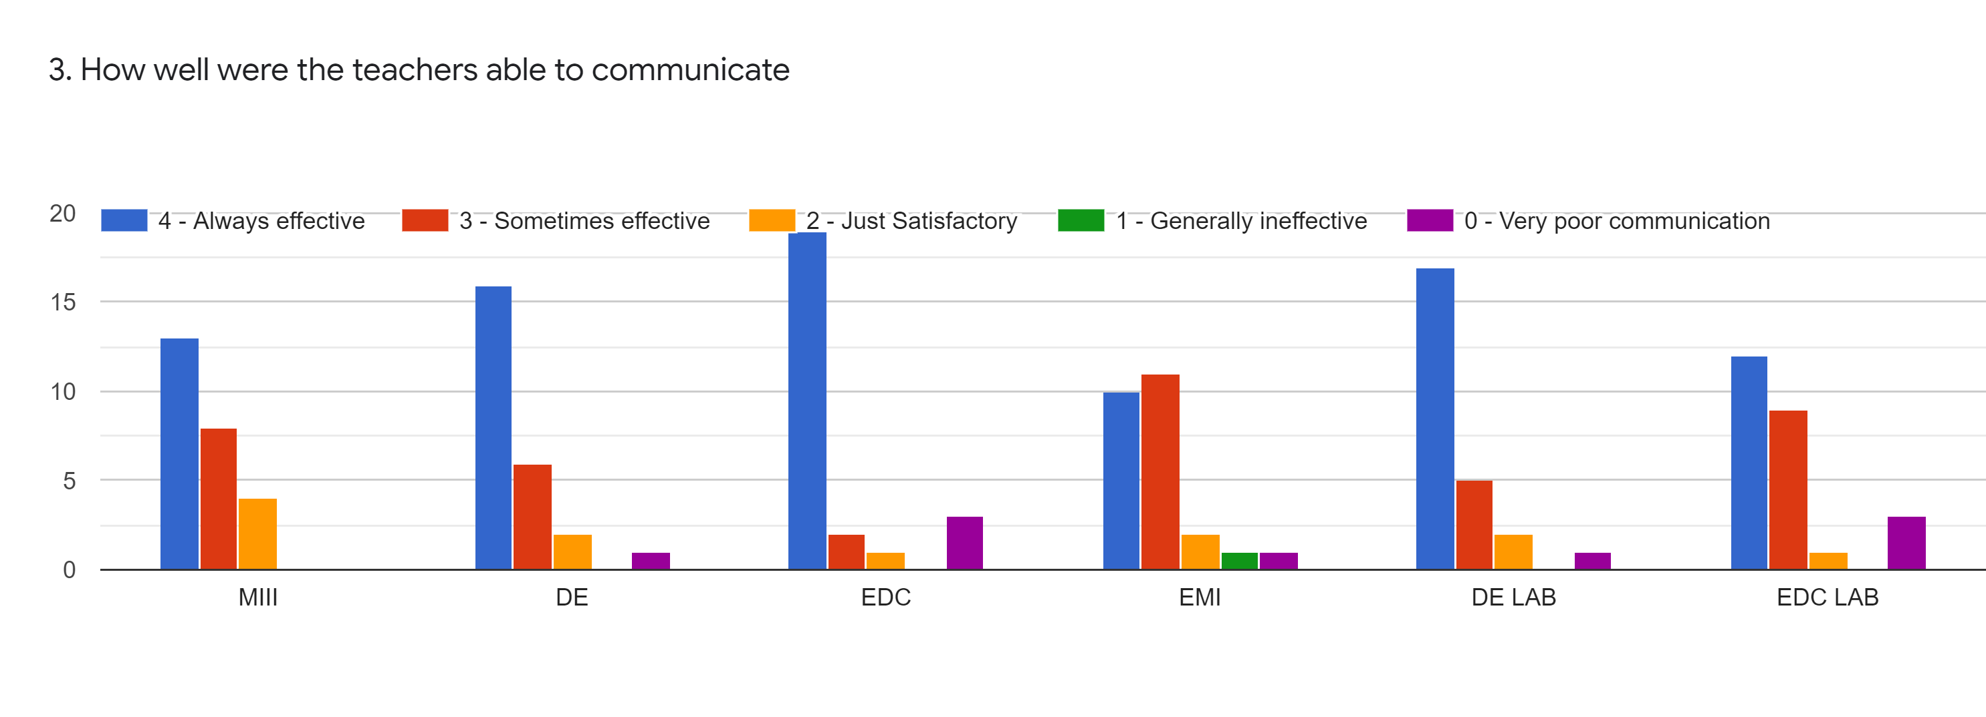
Faculty | SV | HVS | JDB | MPN | HVS | JDB
Subject | MIII | DE | EDC | EMI | DE LAB | EDC LAB
Always Effective | 13 | 16 | 19 | 10 | 17 | 12
Sometime effective | 8 | 6 | 2 | 11 | 5 | 9
Just Satisfactory | 4 | 2 | 1 | 2 | 2 | 1
Generally Ineffective | 0 | 0 | 0 | 1 | 0 | 0
Very Poor Communication | 0 | 1 | 3 | 1 | 1 | 3
TOTAL | 25 | 25 | 25 | 25 | 25 | 25

Slide 6
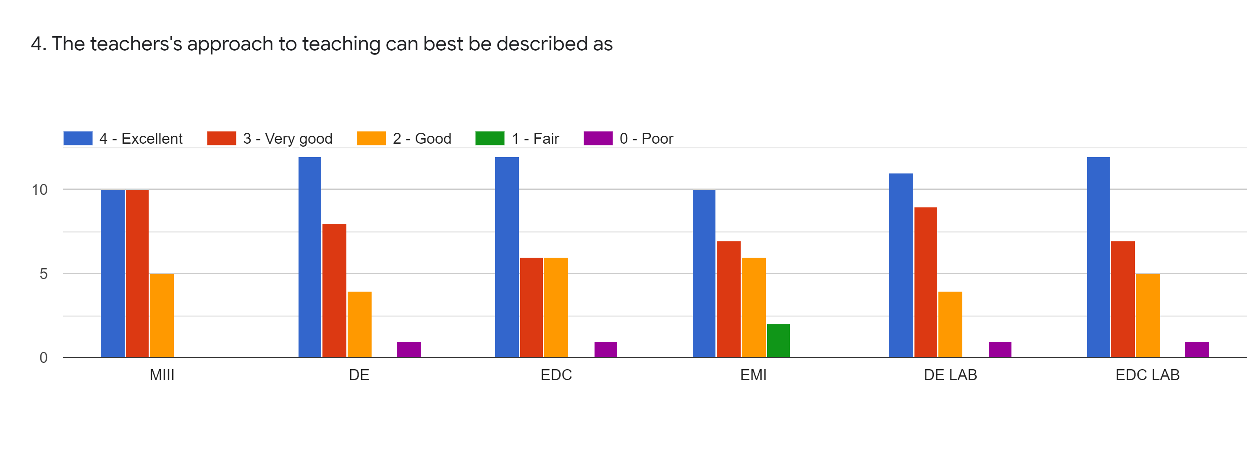
Faculty | SV | HVS | JDB | MPN | HVS | JDB
Subject | MIII | DE | EDC | EMI | DE LAB | EDC LAB
Excellent | 10 | 12 | 12 | 10 | 11 | 12
Very Good | 10 | 8 | 6 | 7 | 9 | 7
Good | 5 | 4 | 6 | 6 | 4 | 5
Fair | 0 | 0 | 0 | 2 | 0 | 0
Poor | 0 | 1 | 1 | 0 | 1 | 1
TOTAL | 25 | 25 | 25 | 25 | 25 | 25

Slide 7
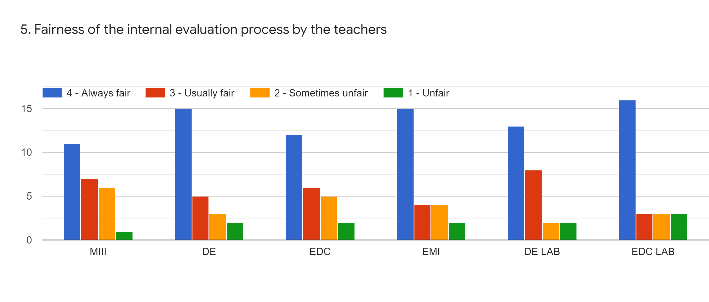
Faculty | SV | HVS | JDB | MPN | HVS | JDB
Subject | MIII | DE | EDC | EMI | DE LAB | EDC LAB
Always fair | 11 | 15 | 12 | 15 | 13 | 16
Usually fair | 7 | 5 | 6 | 4 | 8 | 3
Sometimes fair | 6 | 3 | 5 | 4 | 2 | 3
Unfair | 1 | 2 | 2 | 2 | 2 | 3
TOTAL | 25 | 25 | 25 | 25 | 25 | 25

Slide 8
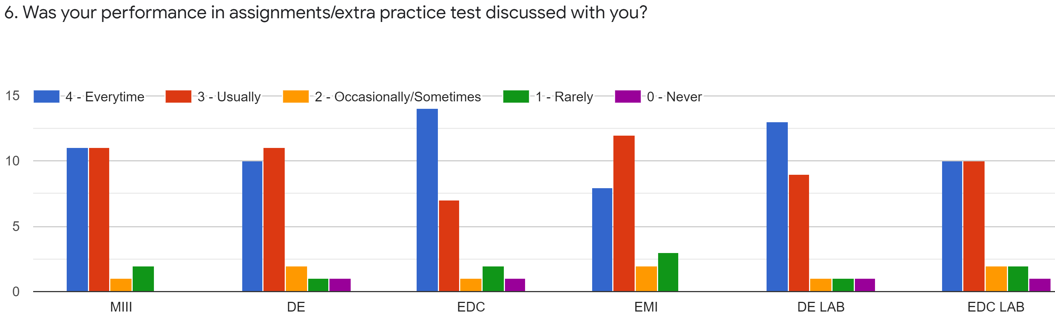
Faculty | SV | HVS | JDB | MPN | HVS | JDB
Subject | MIII | DE | EDC | EMI | DE LAB | EDC LAB
Every time | 11 | 10 | 14 | 8 | 13 | 10
Usually | 11 | 11 | 7 | 12 | 9 | 10
Occasionally | 1 | 2 | 1 | 2 | 1 | 2
Rarely | 2 | 1 | 2 | 3 | 1 | 2
Never | 0 | 1 | 1 | 0 | 1 | 1
TOTAL | 25 | 25 | 25 | 25 | 25 | 25

Slide 9
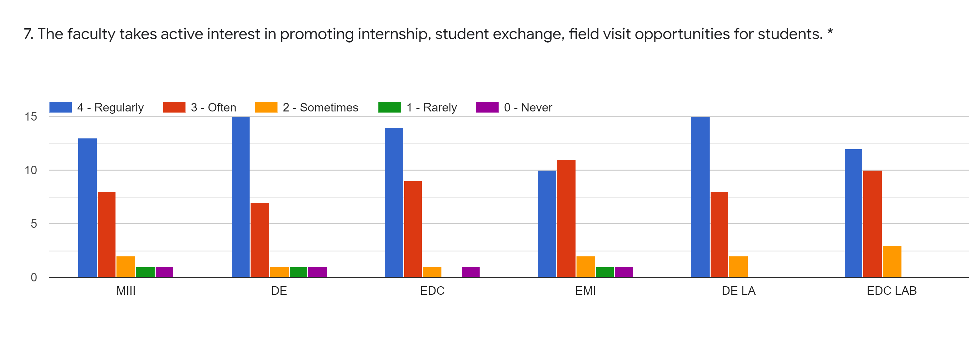
Faculty | SVD | HVS | JDB | MPN | HVS | JDB
Subject | MIII | DE | EDC | EMI | DE LAB | EDC LAB
Regularly | 13 | 15 | 14 | 10 | 15 | 12
Often | 8 | 7 | 9 | 11 | 8 | 10
Sometimes | 2 | 1 | 1 | 2 | 2 | 3
Rarely | 1 | 1 | 0 | 1 | 0 | 0
Never | 1 | 1 | 1 | 1 | 0 | 0
TOTAL | 25 | 25 | 25 | 25 | 25 | 25

Slide 10
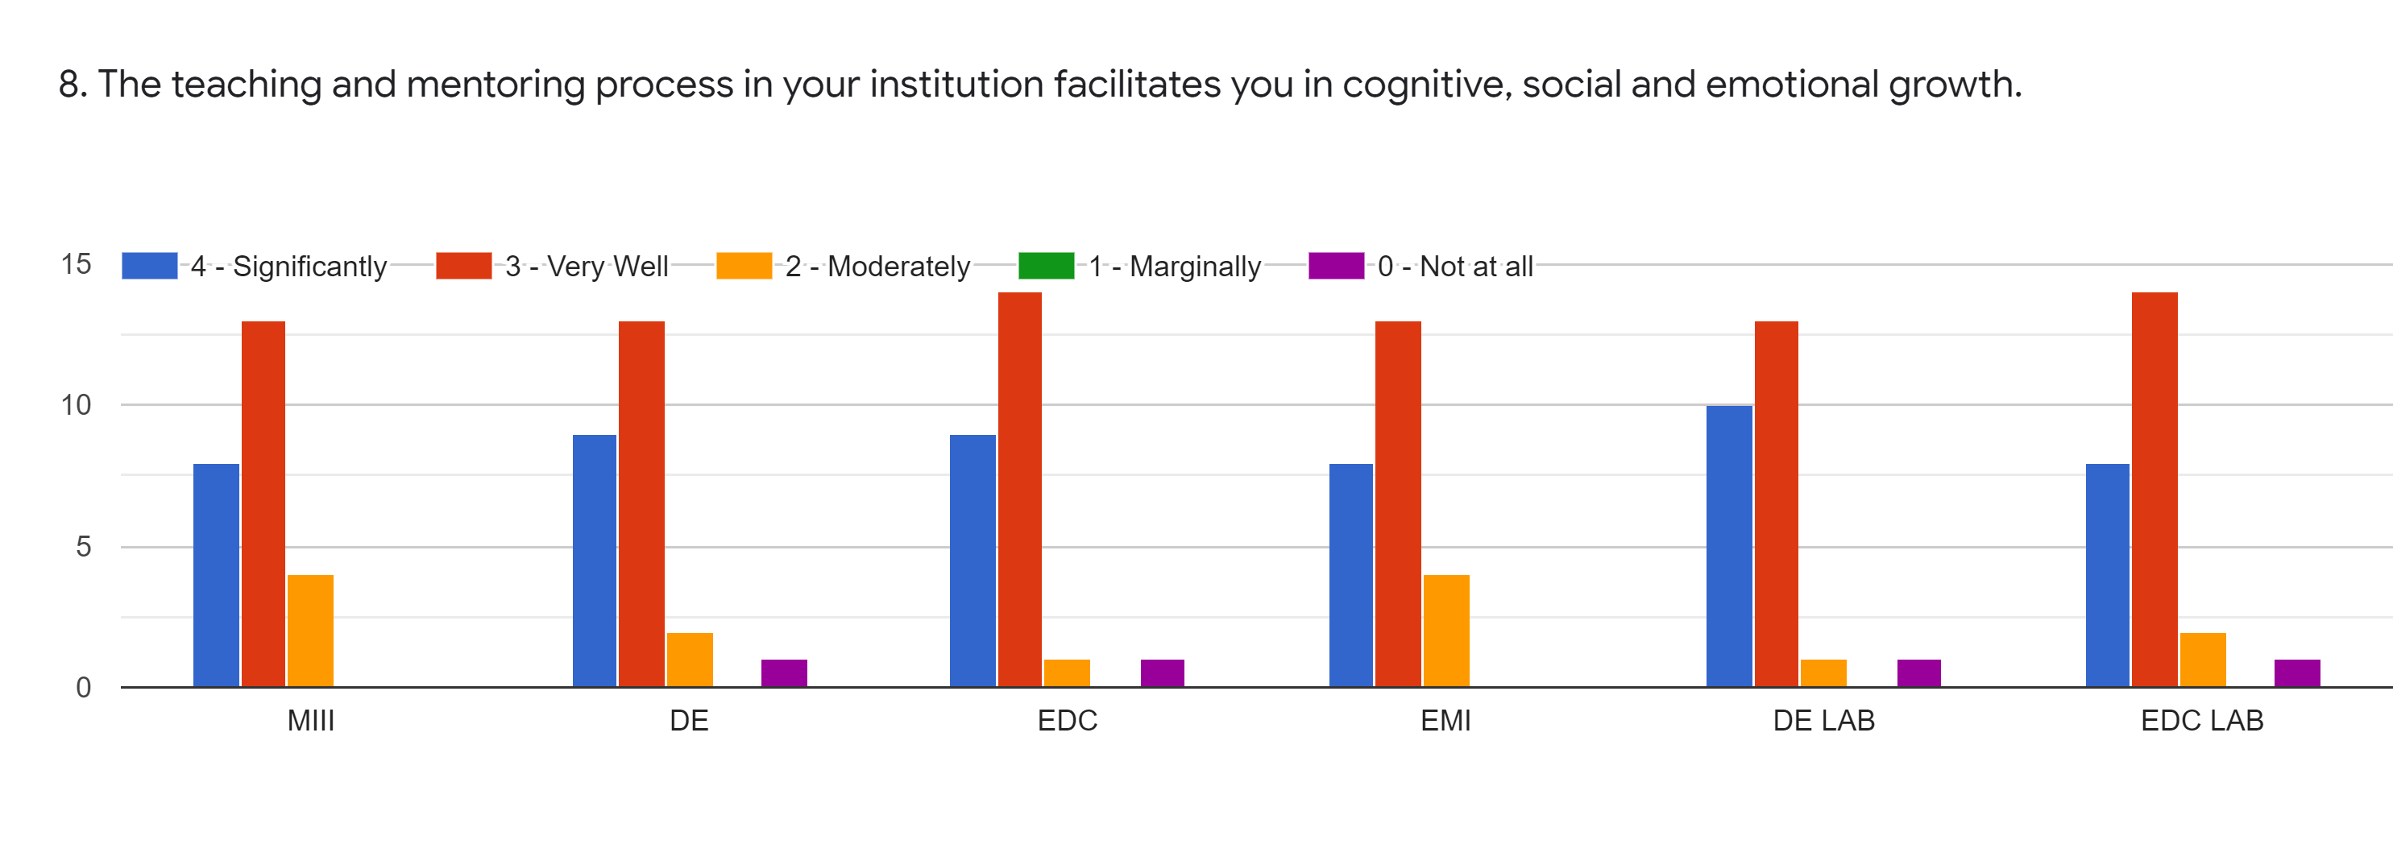
Faculty | SV | HVS | JDB | MPN | HVS | JDB
Subject | MIII | DE | EDC | EMI | DE LAB | EDC LAB
Significantly | 8 | 9 | 9 | 8 | 10 | 8
Very Well | 13 | 13 | 14 | 13 | 13 | 14
Moderately | 4 | 2 | 1 | 4 | 1 | 2
Marginally | 0 | 0 | 0 | 0 | 0 | 0
Not at All | 0 | 1 | 1 | 0 | 1 | 1
TOTAL | 25 | 25 | 25 | 25 | 25 | 25

Slide 11
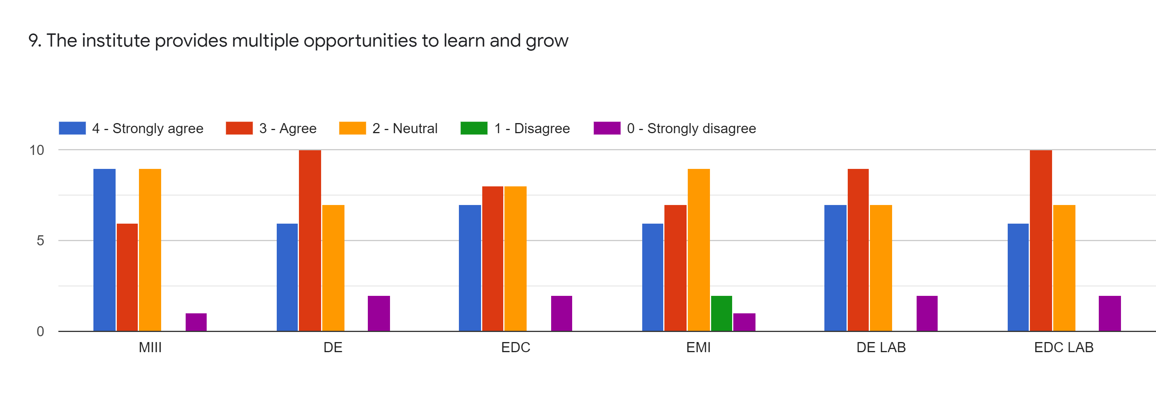
Faculty | SV | HVS | JDB | MPN | HVS | JDB
Subject | MIII | DE | EDC | EMI | DE LAB | EDC LAB
Strongly Agree | 9 | 6 | 7 | 6 | 7 | 6
Agree | 6 | 10 | 8 | 7 | 9 | 10
Neutral | 9 | 7 | 8 | 9 | 7 | 7
Disagree | 0 | 0 | 0 | 2 | 0 | 0
Strongly Disagree | 1 | 2 | 2 | 1 | 2 | 2
TOTAL | 25 | 25 | 25 | 25 | 25 | 25

Slide 12
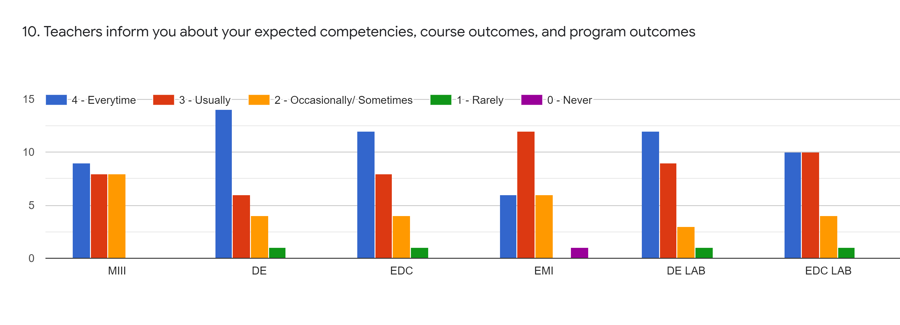
Faculty | SV | HVS | JDB | MPN | HVS | JDB
Subject | MIII | DE | EDC | EMI | DE LAB | EDC LAB
Every time | 9 | 14 | 12 | 6 | 12 | 10
Usually | 8 | 6 | 8 | 12 | 9 | 10
Occasionally | 8 | 4 | 4 | 6 | 3 | 4
Rarely | 0 | 1 | 1 | 0 | 1 | 1
Never | 0 | 0 | 0 | 1 | 0 | 0
TOTAL | 25 | 25 | 25 | 25 | 25 | 25

Slide 13
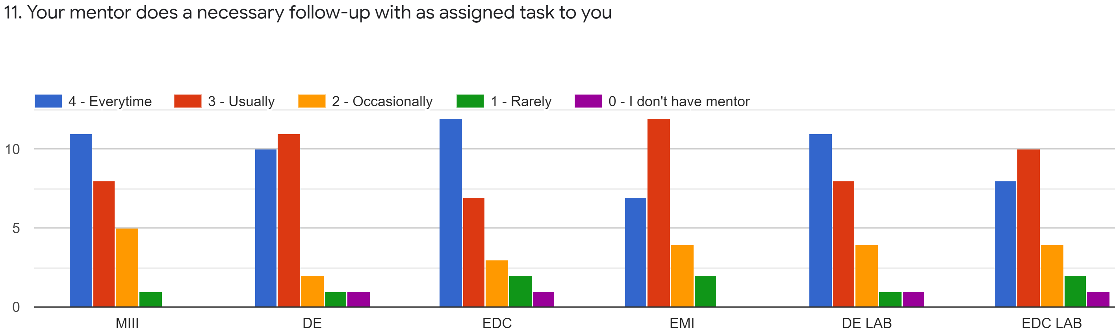
Faculty | SV | HVS | JDB | MPN | HVS | JDB
Subject | MIII | DE | EDC | EMI | DE LAB | EDC LAB
Every time | 11 | 10 | 12 | 7 | 11 | 8
Usually | 8 | 11 | 7 | 12 | 8 | 10
Occasionally | 5 | 2 | 3 | 4 | 4 | 4
Rarely | 1 | 1 | 2 | 2 | 1 | 2
I don’t have mentor | 0 | 1 | 1 | 0 | 1 | 1
TOTAL | 25 | 25 | 25 | 25 | 25 | 25

Slide 14
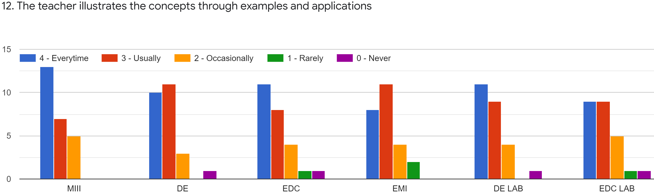
Faculty | SV | HVS | JDB | MPN | HVS | JDB
Subject | MIII | DE | EDC | EMI | DE LAB | EDC LAB
Every time | 13 | 10 | 10 | 8 | 11 | 9
Usually | 7 | 11 | 8 | 11 | 9 | 9
Occasionally | 5 | 3 | 4 | 4 | 4 | 5
Rarely | 0 | 0 | 1 | 2 | 0 | 1
Never | 0 | 1 | 1 | 0 | 1 | 1
TOTAL | 25 | 25 | 25 | 25 | 25 | 25

Slide 15
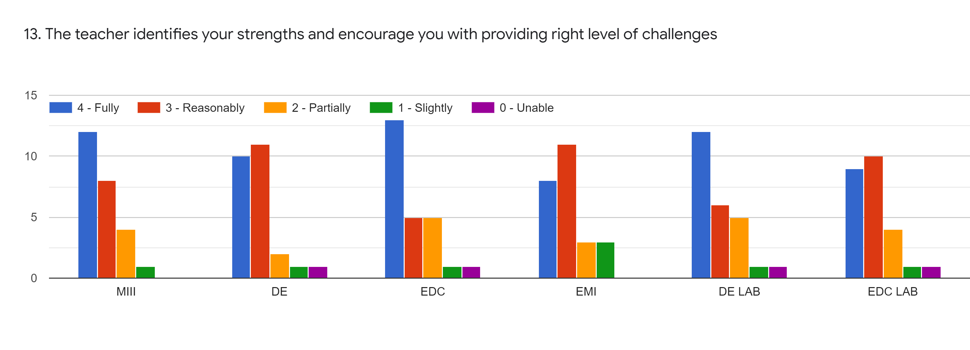
Faculty | SV | HVS | JDB | MPN | HVS | JDB
Subject | MIII | DE | EDC | EMI | DE LAB | EDC LAB
Fully | 12 | 10 | 13 | 8 | 12 | 9
Reasonably | 8 | 11 | 5 | 11 | 6 | 10
Partially | 4 | 2 | 5 | 3 | 5 | 4
Slightly | 1 | 1 | 1 | 3 | 1 | 1
Unable | 0 | 1 | 1 | 0 | 1 | 1
TOTAL | 25 | 25 | 25 | 25 | 25 | 25

Slide 16
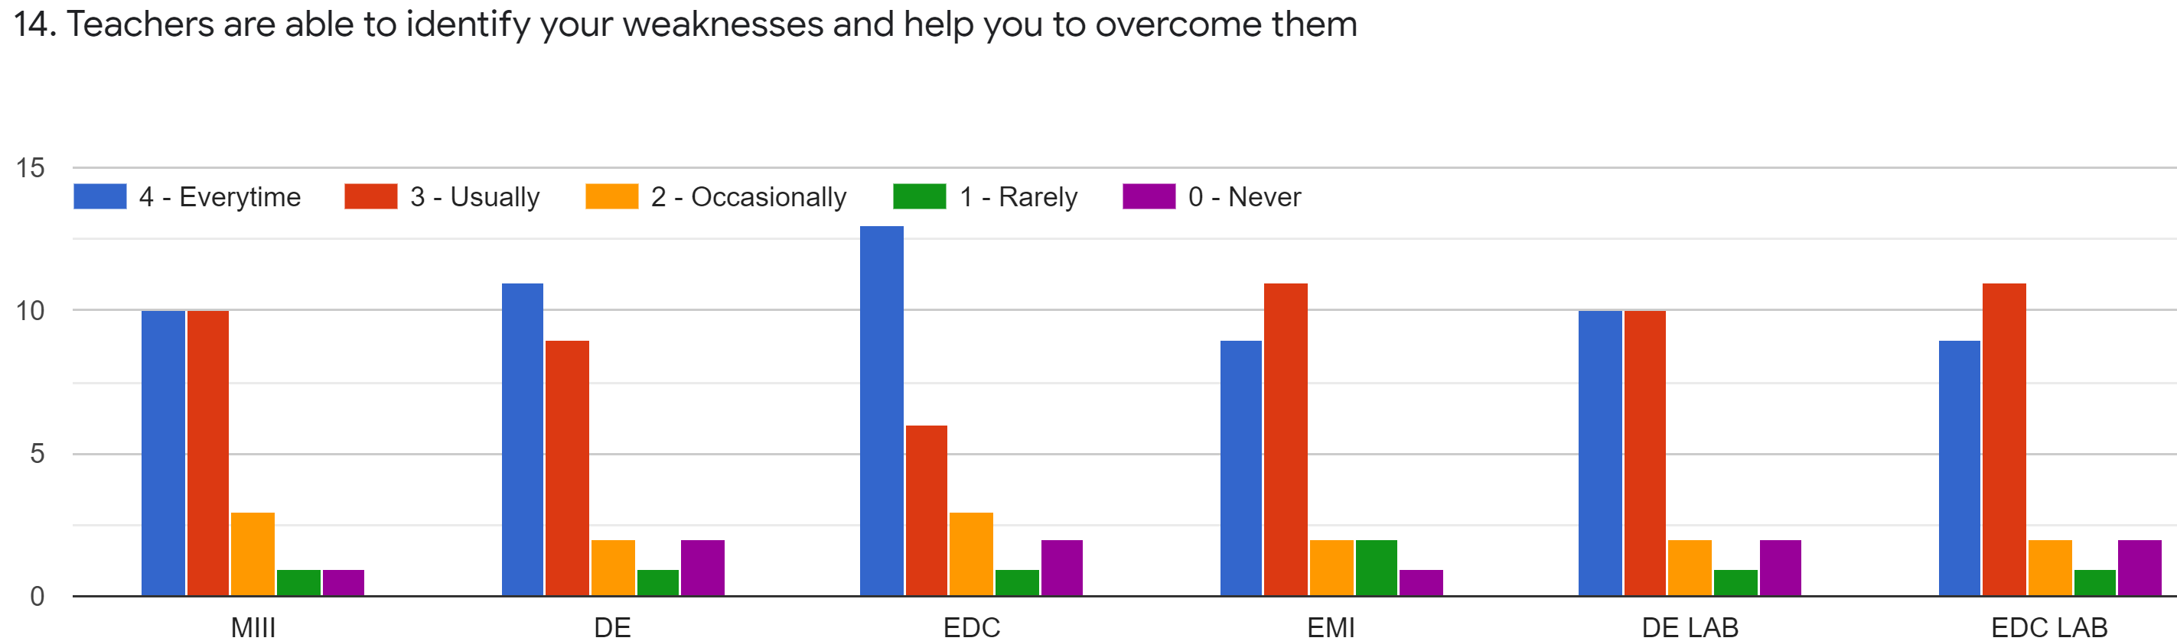
Faculty | SV | HVS | JDB | MPN | HVS | JDB
Subject | MIII | DE | EDC | EMI | DE LAB | EDC LAB
Every time | 10 | 11 | 13 | 9 | 10 | 9
Usually | 10 | 9 | 6 | 11 | 10 | 11
Occasionally | 3 | 2 | 3 | 2 | 2 | 2
Rarely | 1 | 1 | 1 | 2 | 1 | 1
Never | 1 | 2 | 2 | 1 | 2 | 2
TOTAL | 25 | 25 | 25 | 25 | 25 | 25

Slide 17
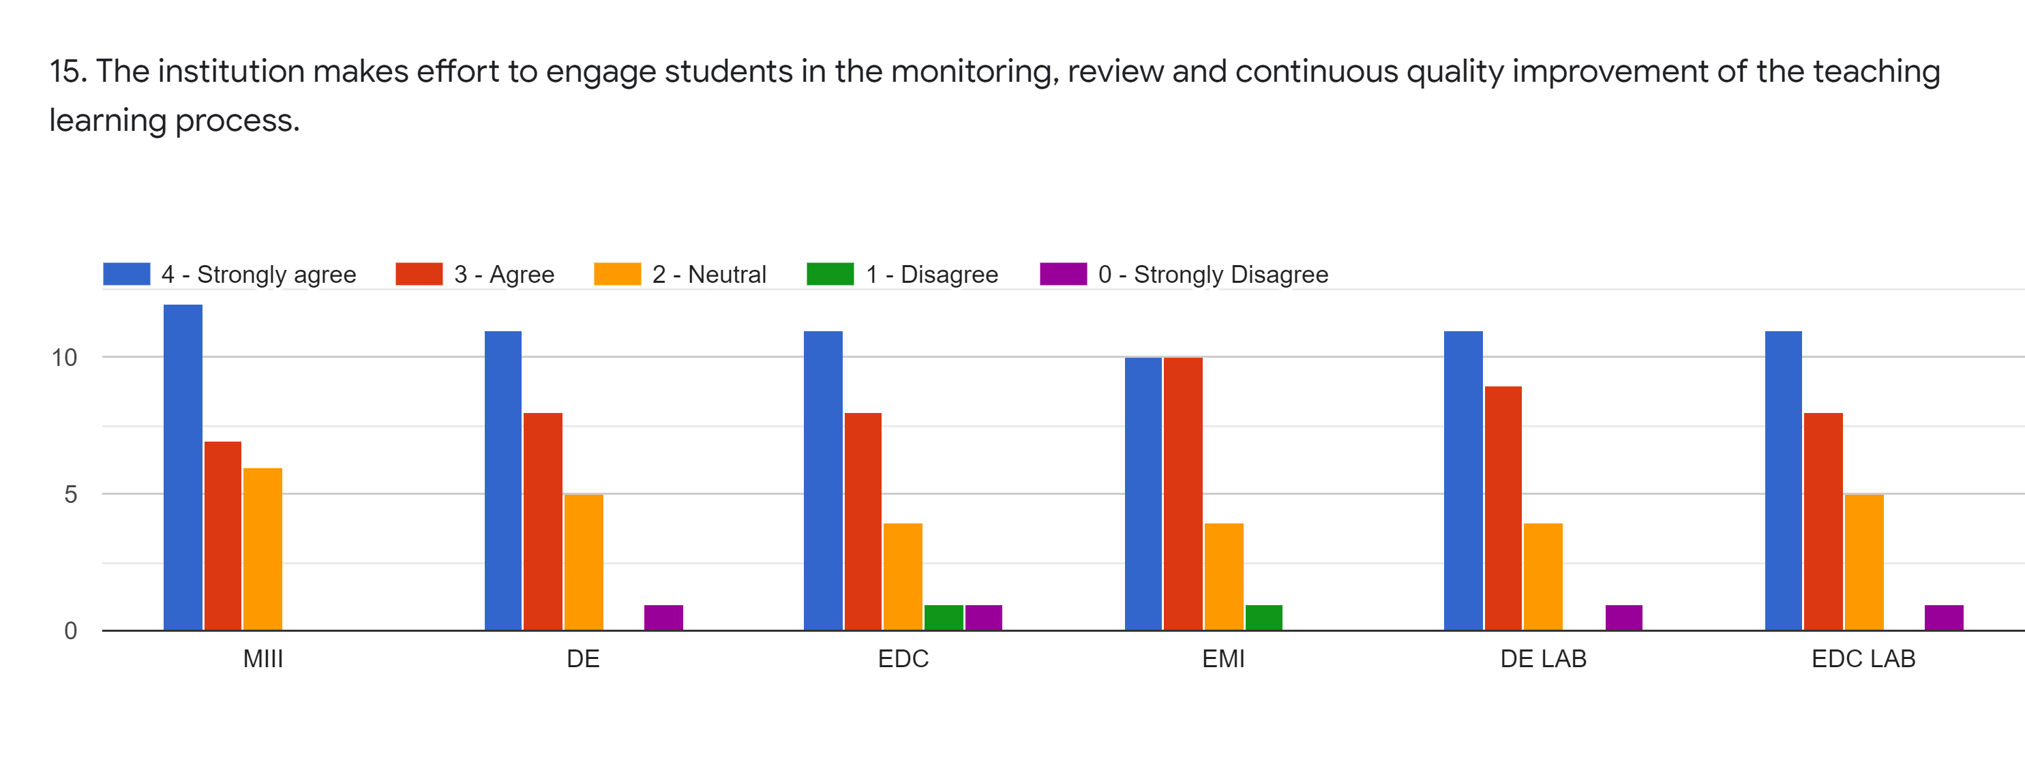
Faculty | SV | HVS | JDB | MPN | HVS | JDB
Subject | MIII | DE | EDC | EMI | DE LAB | EDC LAB
Strongly Agree | 12 | 11 | 11 | 10 | 11 | 11
Agree | 7 | 8 | 8 | 10 | 9 | 8
Neutral | 6 | 5 | 4 | 4 | 4 | 5
Disagree | 0 | 0 | 1 | 1 | 0 | 0
Strongly Disagree | 0 | 1 | 1 | 0 | 1 | 1
TOTAL | 25 | 25 | 25 | 25 | 25 | 25

Slide 18
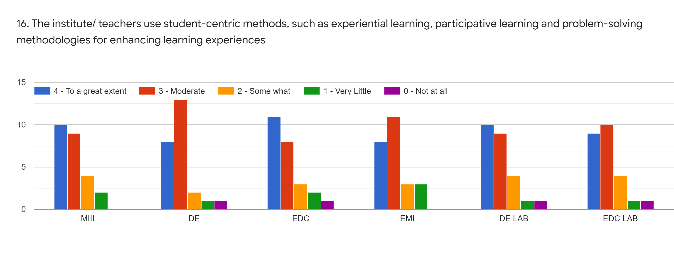
Faculty | SV | HVS | JDB | MPN | HVS | JDB
Subject | MIII | DE | EDC | EMI | DE LAB | EDC LAB
To a great extent | 10 | 8 | 11 | 8 | 10 | 10
Moderate | 9 | 13 | 8 | 11 | 9 | 9
Some What | 4 | 2 | 3 | 3 | 4 | 4
Very Little | 2 | 1 | 2 | 3 | 1 | 1
Not at all | 0 | 1 | 1 | 0 | 1 | 1
TOTAL | 25 | 25 | 25 | 25 | 25 | 25

Slide 19
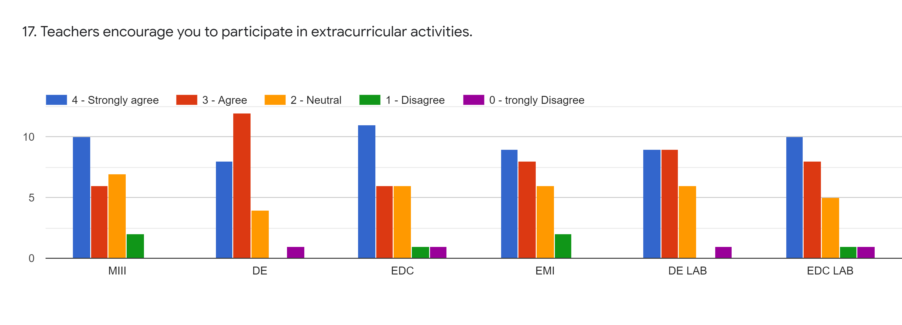
Faculty | SV | HVS | JDB | MPN | HVS | JDB
Subject | MIII | DE | EDC | EMI | DE LAB | EDC LAB
Strongly Agree | 10 | 8 | 11 | 9 | 9 | 10
Agree | 6 | 12 | 6 | 8 | 9 | 8
Neutral | 7 | 4 | 6 | 6 | 6 | 5
Disagree | 2 | 0 | 1 | 2 | 0 | 1
Strongly Disagree | 0 | 1 | 1 | 0 | 1 | 1
TOTAL | 25 | 25 | 25 | 25 | 25 | 25

Slide 20
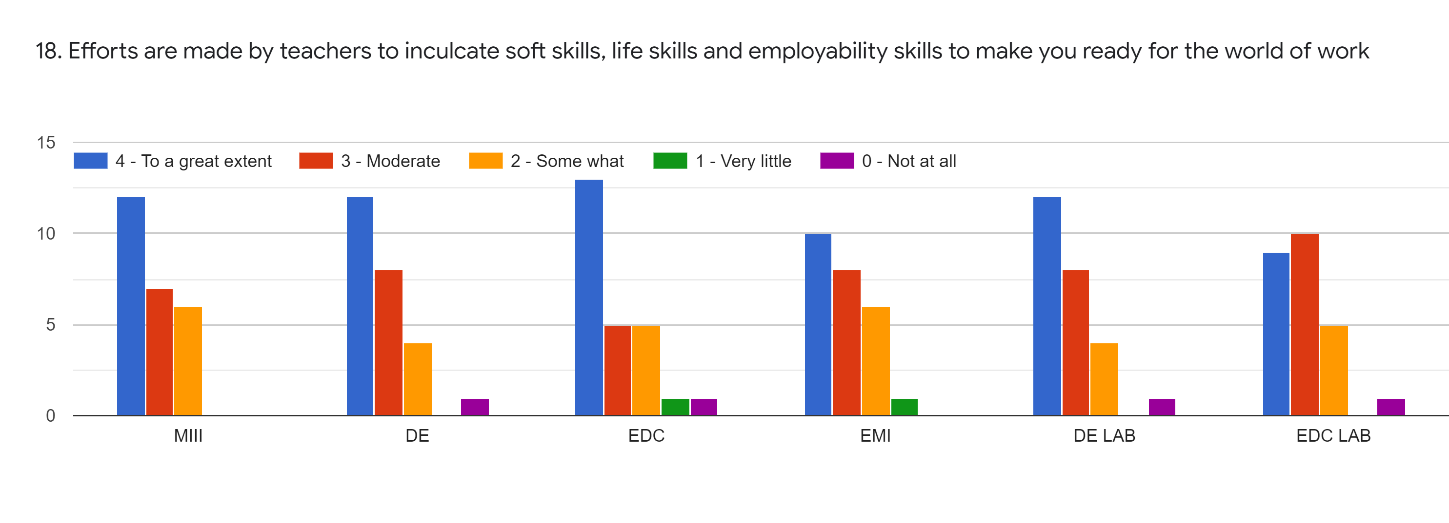
Faculty | SV | HVS | JDB | MPN | HVS | JDB
Subject | MIII | DE | EDC | EMI | DE LAB | EDC LAB
To a great extent | 12 | 12 | 13 | 10 | 12 | 9
Moderate | 7 | 8 | 5 | 8 | 8 | 10
Some What | 6 | 4 | 5 | 6 | 4 | 5
Very Little | 0 | 0 | 1 | 1 | 0 | 0
Not at all | 0 | 1 | 1 | 0 | 1 | 1
TOTAL | 25 | 25 | 25 | 25 | 25 | 25

Slide 21
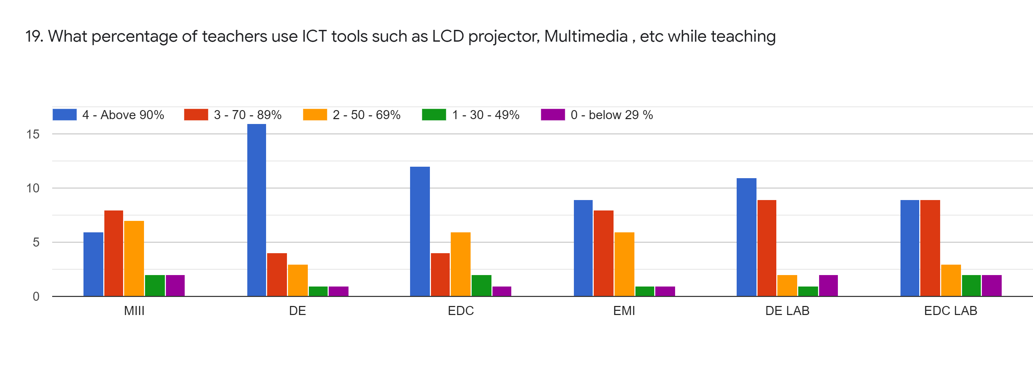
Faculty | SV | HVS | JDB | MPN | HVS | JDB
Subject | MIII | DE | EDC | EMI | DE LAB | EDC LAB
Above 90% | 6 | 16 | 12 | 9 | 11 | 9
70-89% | 8 | 4 | 4 | 8 | 9 | 9
50-69 % | 7 | 3 | 6 | 6 | 2 | 3
30-49 % | 2 | 1 | 2 | 1 | 1 | 2
0-below 29% | 2 | 1 | 1 | 1 | 2 | 2
TOTAL | 25 | 25 | 25 | 25 | 25 | 25

Slide 22
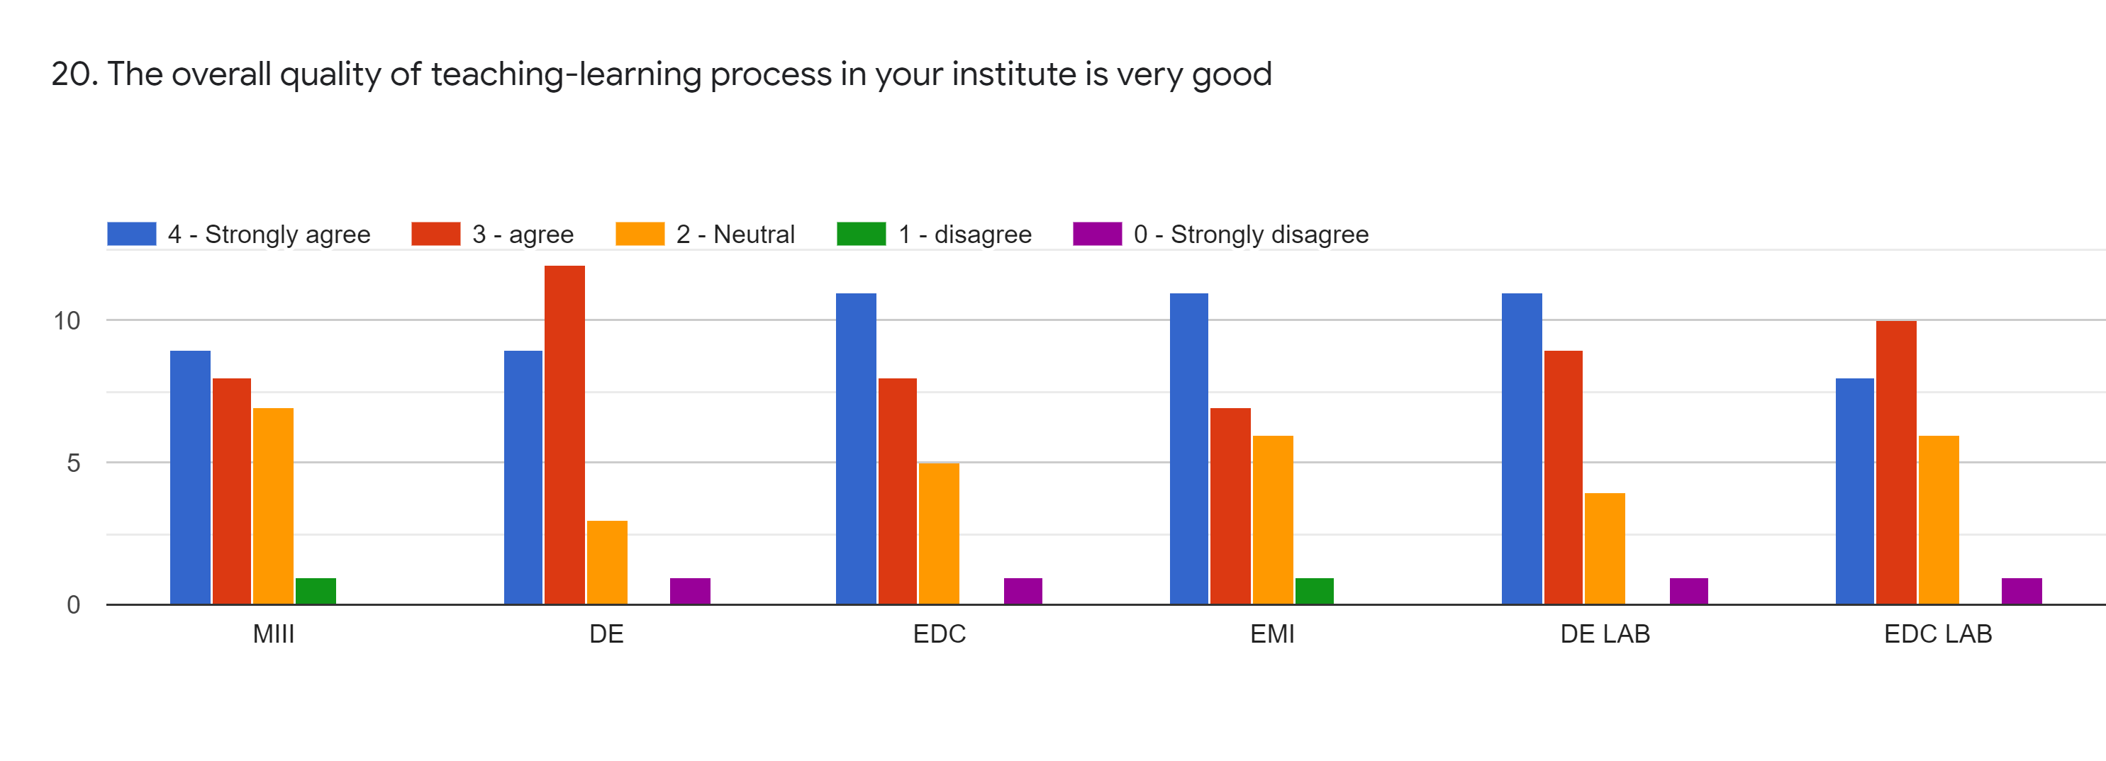
Faculty | SV | HVS | JDB | MPN | HVS | JDB
Subject | MIII | DE | EDC | EMI | DE LAB | EDC LAB
Strongly Agree | 9 | 9 | 11 | 11 | 11 | 8
Agree | 8 | 12 | 8 | 7 | 9 | 10
Neutral | 7 | 3 | 5 | 6 | 4 | 6
Disagree | 1 | 0 | 0 | 1 | 0 | 0
Strongly Disagree | 0 | 1 | 1 | 0 | 1 | 1
TOTAL | 25 | 25 | 25 | 25 | 25 | 25

Slide 23
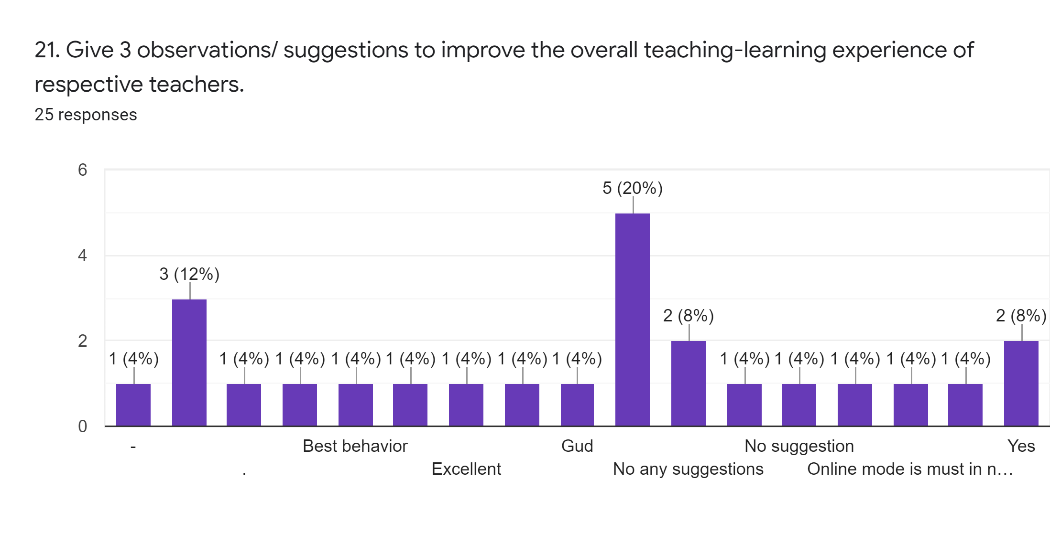

Slide 24
21. Give 3 observations/ suggestions to improve the overall teaching-learning experience of respective teachers
1. Provide study material i.e. ppt, videos, notes etc. for better understanding.
2. All teachers should keep good communication & interaction with students to understand their problems and weakness.
3.Most of teachers have made use of ICT, presentations and videos in teaching.

Slide 25
OVERALL ANALYSIS
Sub | Faculty | Appreciation | Suggestions for improvement | Sign
MIII | SV | Identify students’ strengths and encourage them & provide right level of challenge. | Inform students about CO and PO.
DE | HVS | Good efforts in discussing assignments with students. | Encourage students to participate in extra curricular activities.
EDC | JDB | Good efforts in taking follow up of assigned tasks. | Make efforts to inculcate soft skills, life skills in students.
EMI | MPN | Identify students’ strengths & provide right level of challenge. | Make use of student centric methods.
AMC Coordinator
HOD
Principal

