Slide 1
Arvind Gavali College of Engineering, Satara Department of Electrical Engineering Third Year Feedback
Month : September 2020 – 1st Week
Total Responses : 31
Total Class Strength : 61
Feedback Percentage :50.82%

Slide 2
FACULTY – SUBJECT DISTRIBUTION
Sr. No. | Subject | Abbrev. | Name of Faculty | Abbrev.
01 | Electrical Machines - II | EM - II | Mr. B. M. Nayak | BMN
02 | Power System - II | PS - II | Mrs. Eva Gupta | EG
03 | Microcontroller and Microprocessor | MM | Mr. B. M. Nayak | BMN
04 | Value Education, Human Rights and Legislative Procedures | Value added Course | Dr. Gayatri Mirajkar | GM
05 | Illumination Engineering | ILE | . Mr. Somesha Naik SR. | SRS
06 | Electrical Mobility | EM | Mr. B. G. Nelogal | BGN

Slide 3
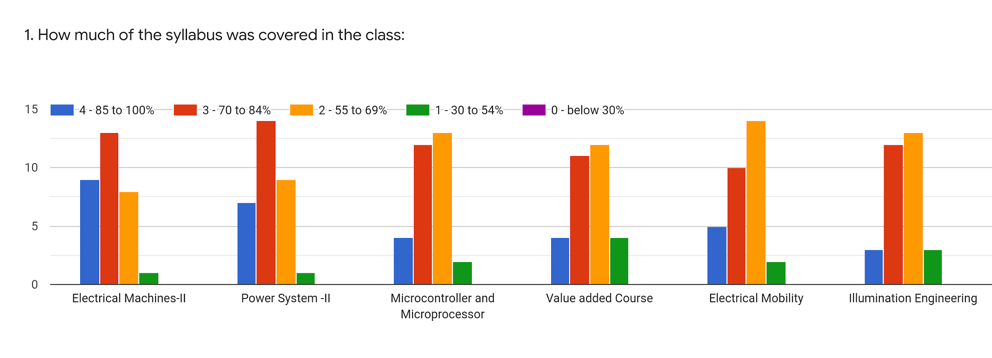
Faculty | BMN | EG | GM | SRS | BGN | SRS | %
Subject | EM - II | PS - II | MM | Value Added Education | EM | ILE
85 -100 % | 9 | 7 | 4 | 4 | 5 | 3 | 17.20
70 - 84 % | 13 | 14 | 12 | 11 | 10 | 12 | 38.71
55 – 69 % | 8 | 9 | 13 | 12 | 14 | 13 | 37.1
30 – 54 % | 1 | 1 | 2 | 4 | 2 | 3 | 6.99
0- Below 30 % | 0 | 0 | 0 | 0 | 0 | 0 | 0

Slide 4
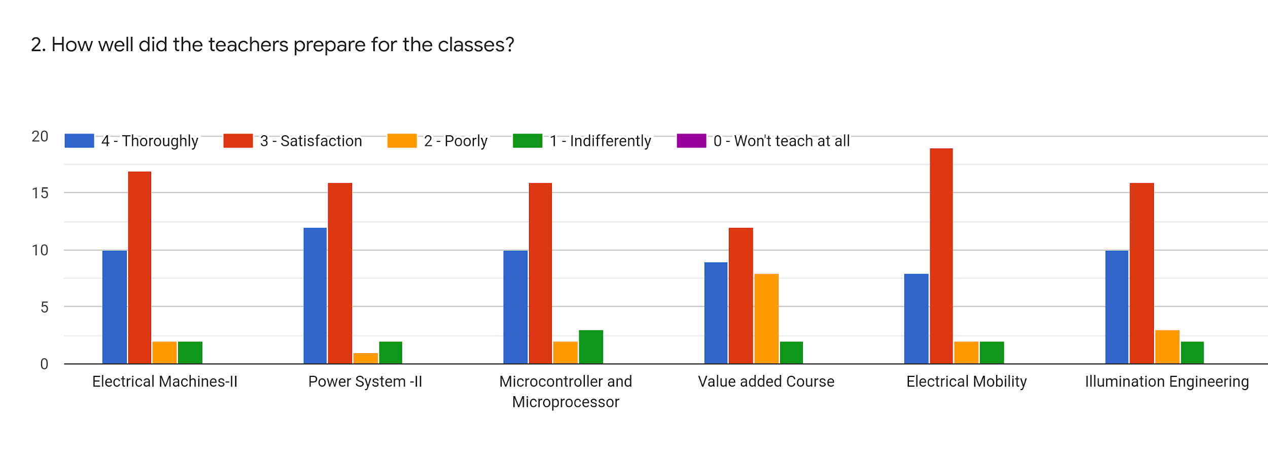
Faculty | BMN | EG | GM | SRS | BGN | SRS | %
Subject | EM - II | PS - II | MM | Value Added Education | EM | ILE
Thoroughly | 10 | 12 | 10 | 9 | 8 | 10 | 31.72
Satisfaction | 17 | 16 | 16 | 12 | 19 | 16 | 51.61
Poorly | 2 | 1 | 2 | 8 | 2 | 3 | 9.67
Indifferently | 2 | 2 | 3 | 2 | 2 | 2 | 6.99
Wont Teach at all | 0 | 0 | 0 | 0 | 0 | 0 | 0

Slide 5
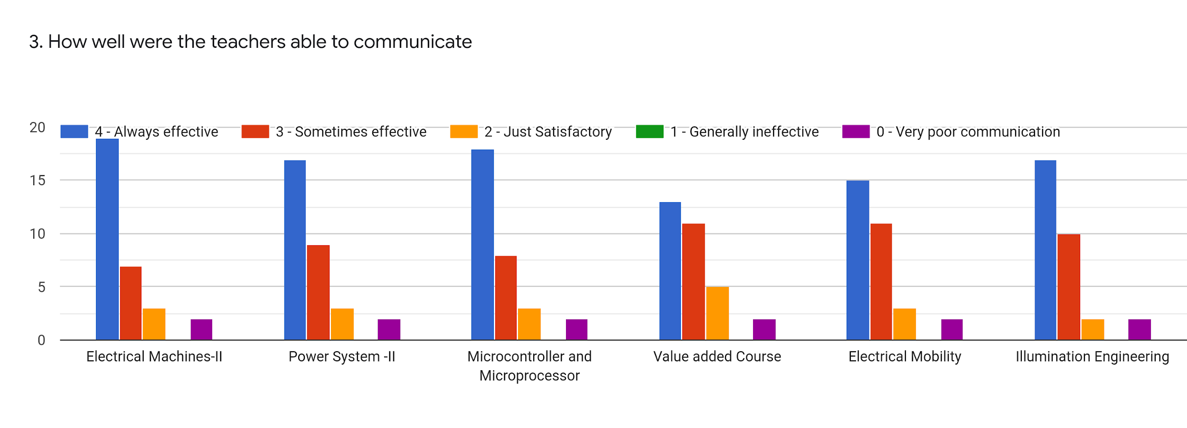
Faculty | BMN | EG | GM | SRS | BGN | SRS | %
Subject | EM - II | PS - II | MM | Value Added Education | EM | ILE
Always Effective | 19 | 17 | 18 | 13 | 15 | 17 | 53.22
Sometime effective | 7 | 9 | 8 | 11 | 11 | 10 | 30.10
Just Satisfactory | 3 | 3 | 3 | 5 | 3 | 2 | 10.21
Generally Ineffective | 0 | 0 | 0 | 0 | 0 | 0 | 0
Very Poor Communication | 2 | 2 | 2 | 2 | 2 | 2 | 6.45

Slide 6
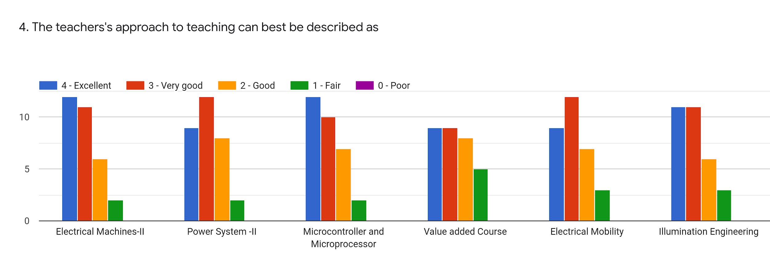
Faculty | BMN | EG | GM | SRS | BGN | SRS | %
Subject | EM - II | PS - II | MM | Value Added Education | EM | ILE
Excellent | 12 | 9 | 12 | 9 | 9 | 11 | 33.33
Very Good | 11 | 12 | 10 | 9 | 12 | 11 | 34.94
Good | 6 | 8 | 7 | 8 | 7 | 6 | 22.58
Fair | 2 | 2 | 2 | 5 | 3 | 3 | 9.14
Poor | 0 | 0 | 0 | 0 | 0 | 0 | 0

Slide 7
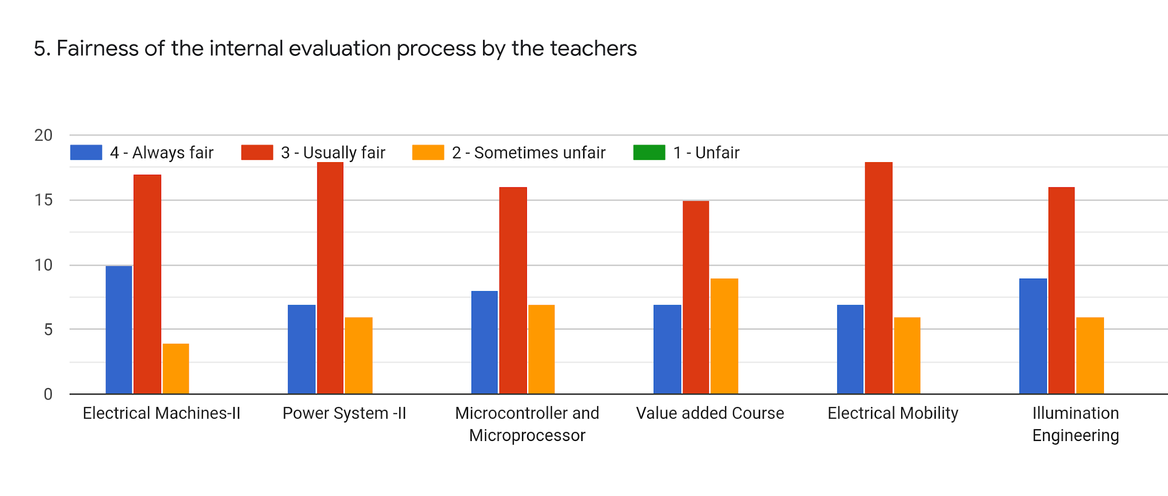
Faculty | BMN | EG | GM | SRS | BGN | SRS | %
Subject | EM - II | PS - II | MM | Value Added Education | EM | ILE
Regularly | 10 | 7 | 8 | 7 | 7 | 9 | 25.80
Often | 17 | 18 | 16 | 15 | 18 | 16 | 53.76
Sometimes | 4 | 6 | 7 | 9 | 6 | 6 | 20.43
Rarely | 0 | 0 | 0 | 0 | 0 | 0 | 0
Never | 0 | 0 | 0 | 0 | 0 | 0 | 0

Slide 8
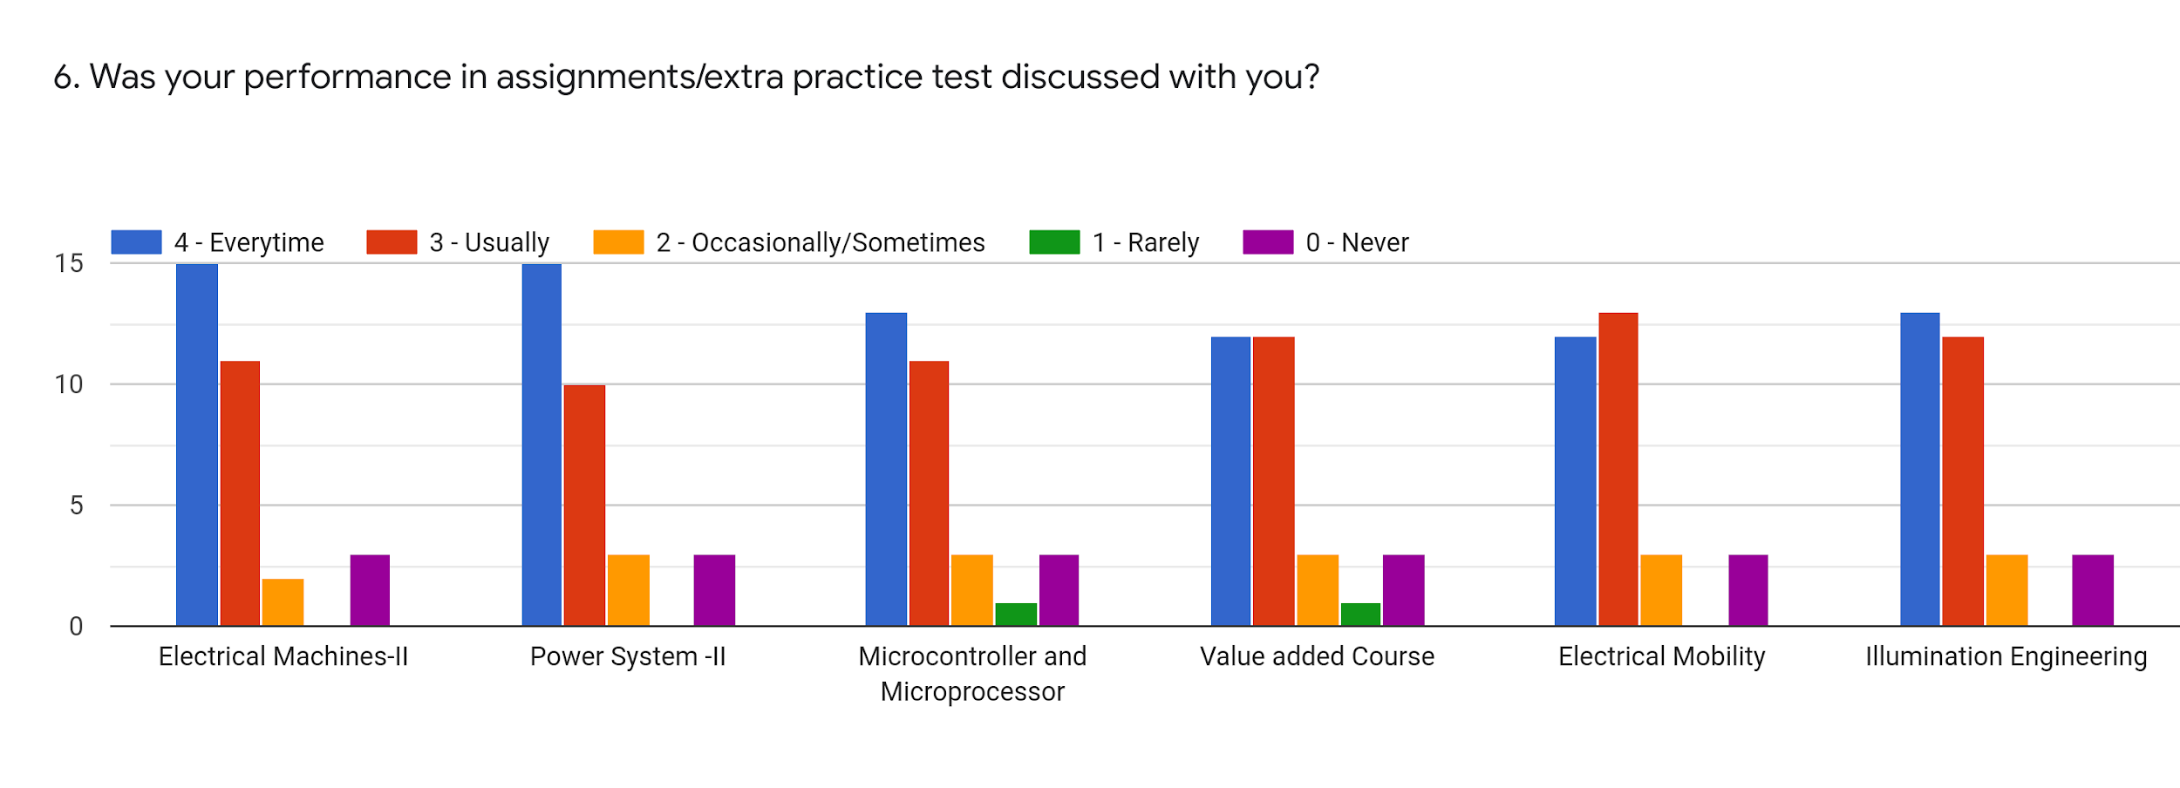
Faculty | BMN | EG | GM | SRS | BGN | SRS | %
Subject | EM - II | PS - II | MM | Value Added Education | EM | ILE
Every time | 15 | 15 | 13 | 12 | 12 | 13 | 43.01
Usually | 11 | 10 | 11 | 12 | 13 | 12 | 37.1
Occasionally/ Sometimes | 2 | 3 | 3 | 3 | 3 | 3 | 9.14
Rarely | 0 | 0 | 1 | 1 | 0 | 0 | 1.07
Never | 3 | 3 | 3 | 3 | 3 | 3 | 9.68

Slide 9
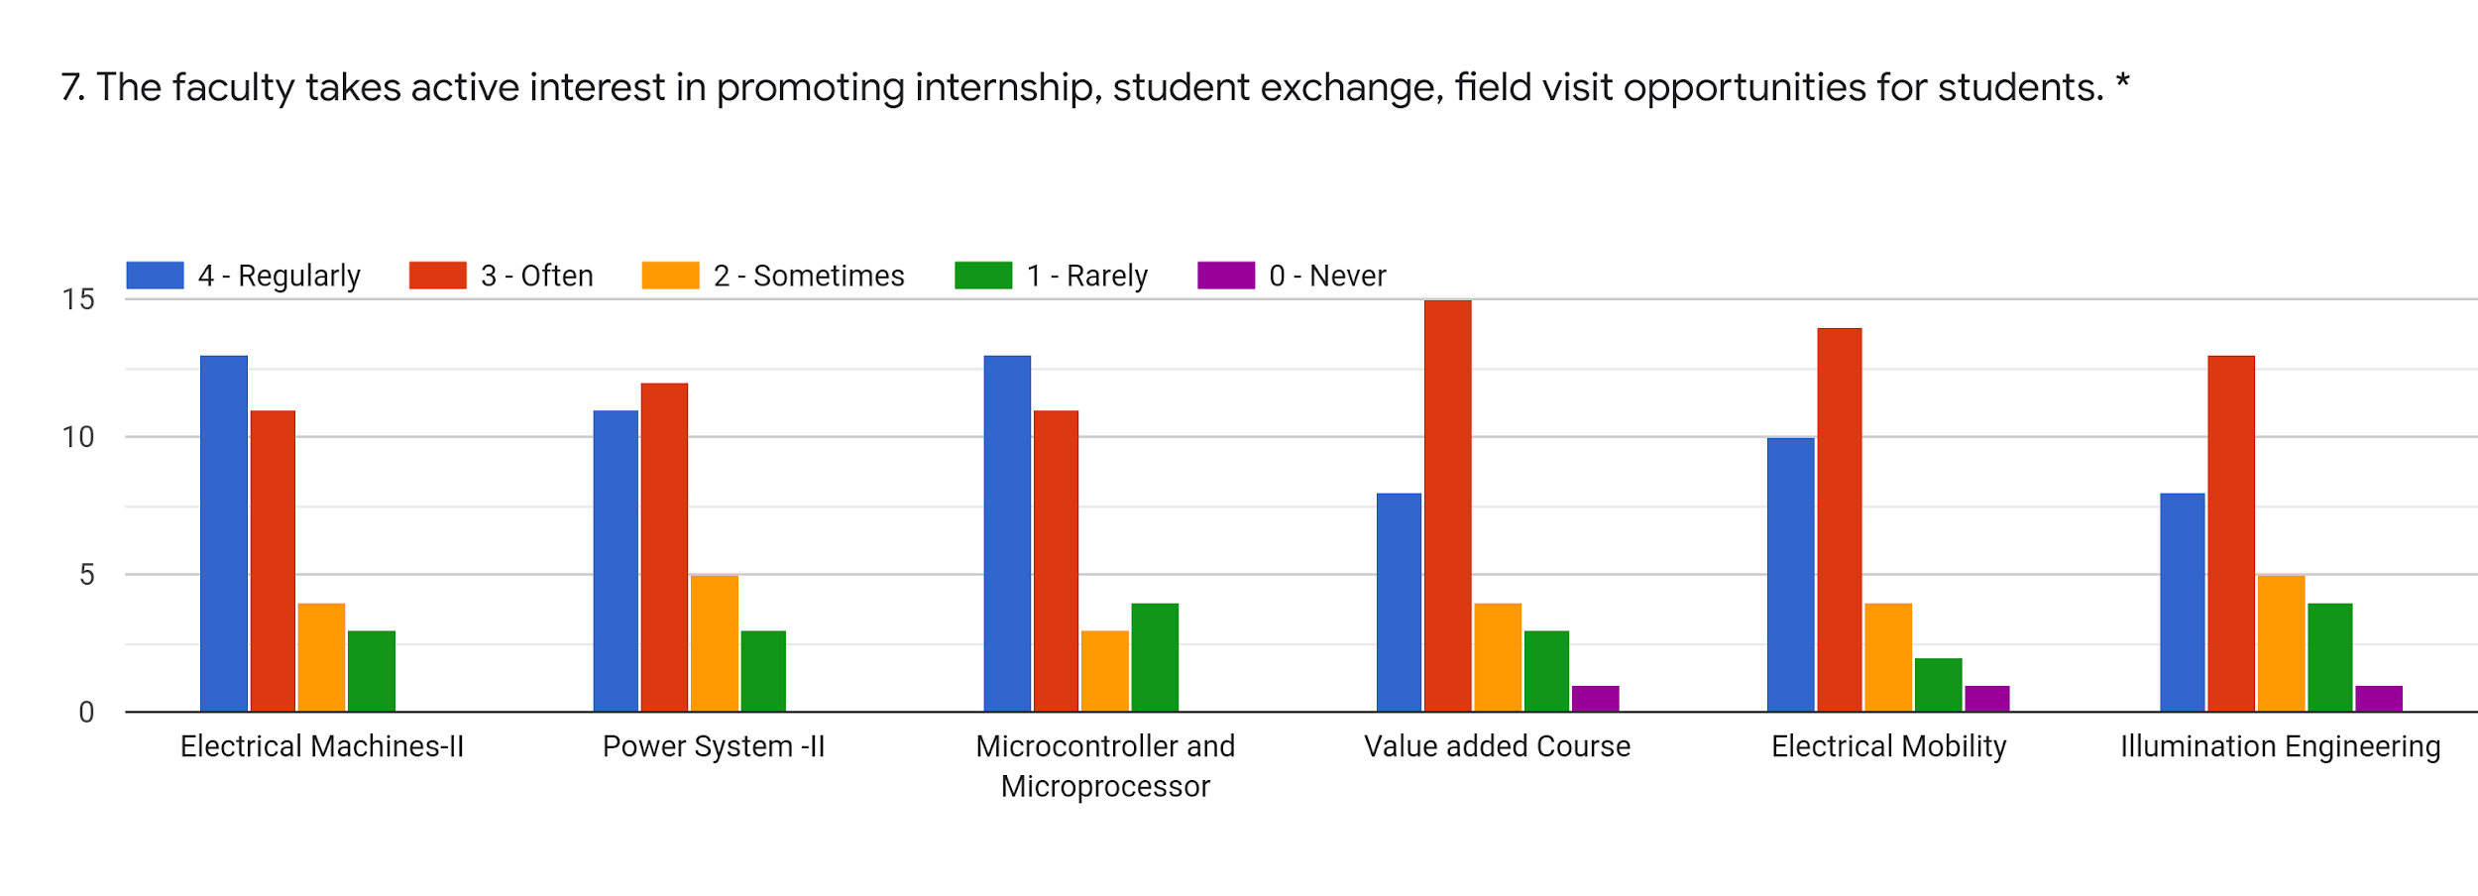
Faculty | BMN | EG | GM | SRS | BGN | SRS | %
Subject | EM - II | PS - II | MM | Value Added Education | EM | ILE
Regularly | 13 | 11 | 13 | 8 | 10 | 8 | 33.87
Often | 11 | 12 | 11 | 15 | 14 | 13 | 40.86
Sometimes | 4 | 5 | 3 | 4 | 4 | 5 | 13.44
Rarely | 3 | 3 | 4 | 3 | 3 | 4 | 10.75
Never | 0 | 0 | 0 | 1 | 1 | 1 | 1.61

Slide 10
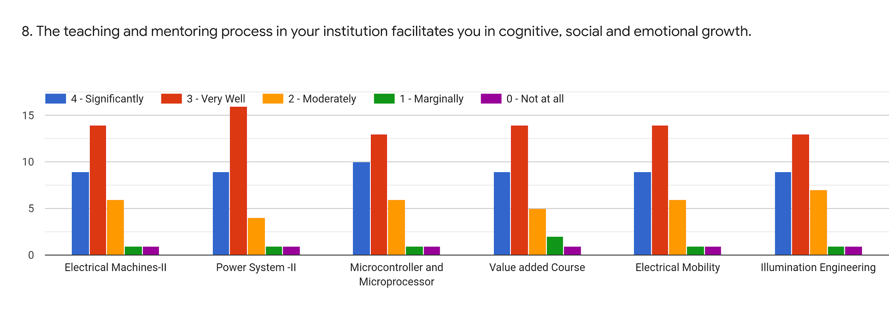
Faculty | BMN | EG | GM | SRS | BGN | SRS | %
Subject | EM - II | PS - II | MM | Value Added Education | EM | ILE
Significantly | 9 | 9 | 10 | 9 | 9 | 9 | 29.57
Very Well | 14 | 16 | 13 | 14 | 14 | 13 | 45.16
Moderately | 6 | 4 | 6 | 5 | 6 | 7 | 18.28
Marginally | 1 | 1 | 1 | 2 | 1 | 1 | 3.76
Not at All | 1 | 1 | 1 | 1 | 1 | 1 | 3.22

Slide 11
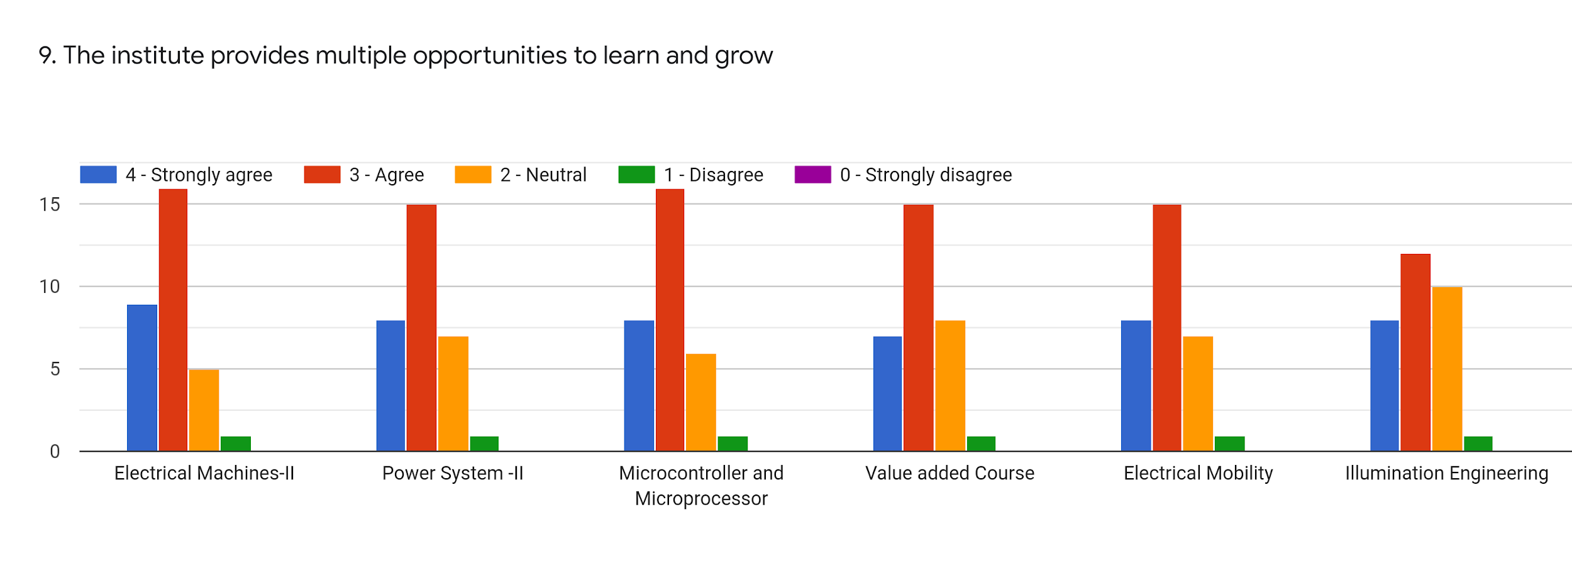
Faculty | BMN | EG | GM | SRS | BGN | SRS | %
Subject | EM - II | PS - II | MM | Value Added Education | EM | ILE
Strongly Agree | 9 | 8 | 8 | 7 | 8 | 8 | 25.80
Agree | 16 | 15 | 16 | 15 | 15 | 12 | 47.85
Neutral | 5 | 7 | 6 | 8 | 7 | 10 | 23.12
Disagree | 1 | 1 | 1 | 1 | 1 | 1 | 3.22
Strongly Disagree | 0 | 0 | 0 | 0 | 0 | 0 | 0

Slide 12
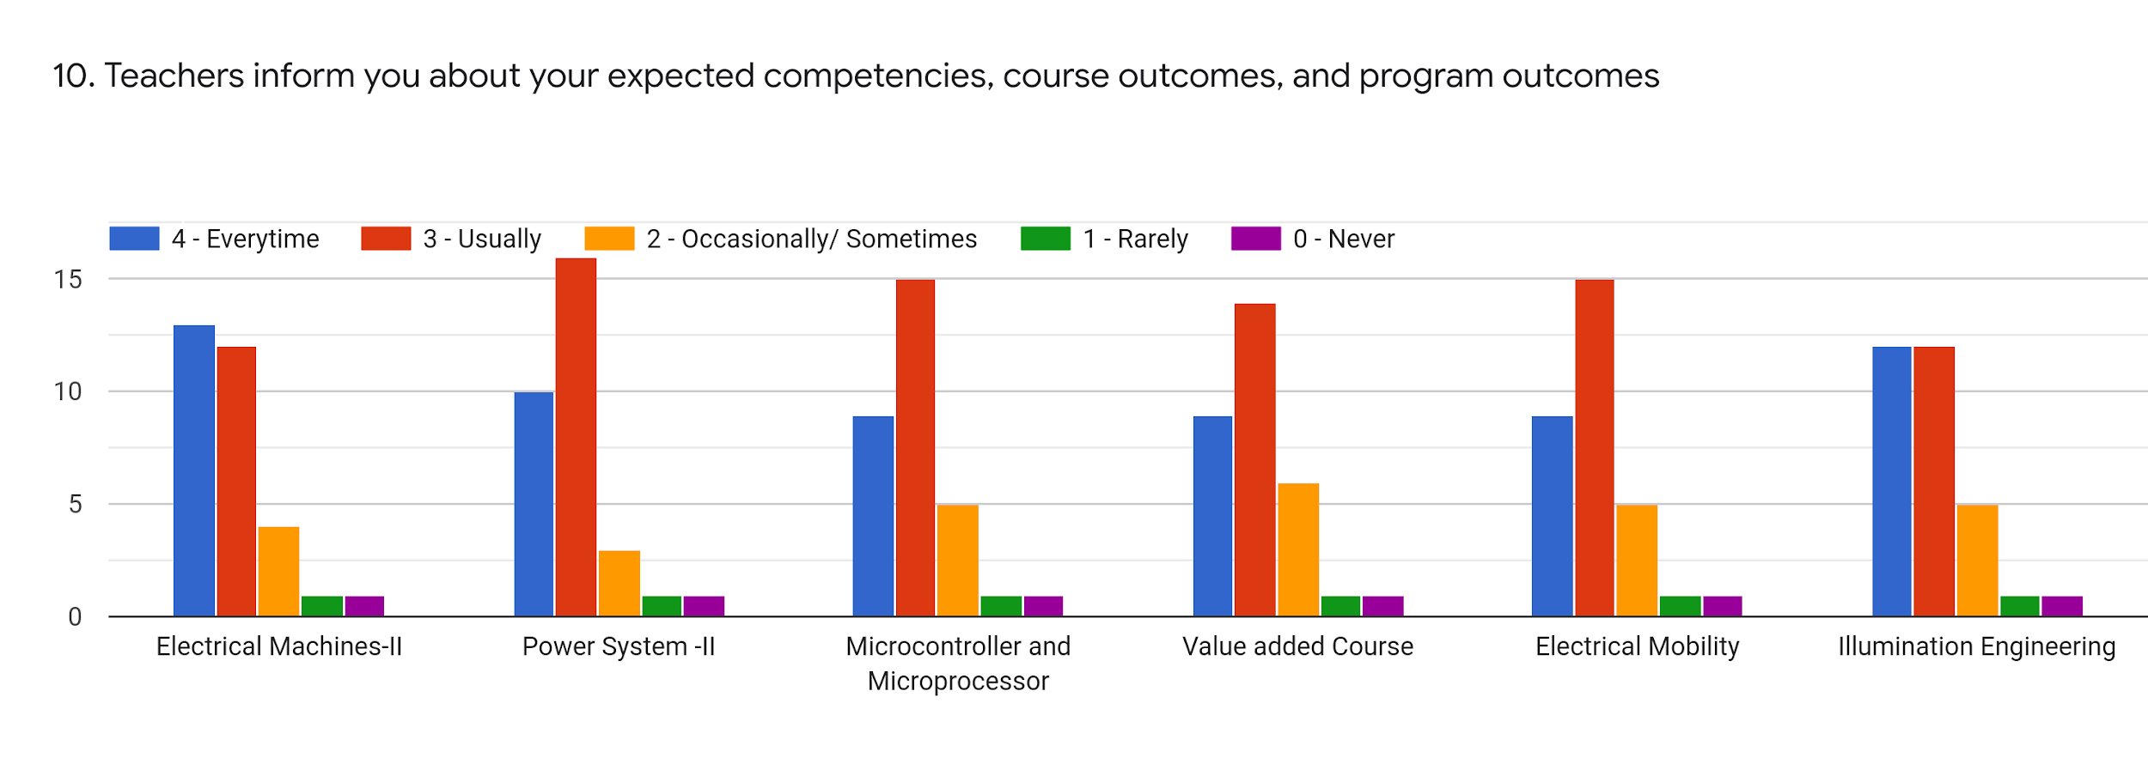
Faculty | BMN | EG | GM | SRS | BGN | SRS | %
Subject | EM - II | PS - II | MM | Value Added Education | EM | ILE
Every time | 13 | 10 | 9 | 9 | 9 | 12 | 33.33
Usually | 12 | 16 | 15 | 14 | 15 | 12 | 45.16
Occasionally | 4 | 3 | 5 | 6 | 5 | 5 | 15.05
Rarely | 1 | 1 | 1 | 1 | 1 | 1 | 3.23
Never | 1 | 1 | 1 | 1 | 1 | 1 | 3.23

Slide 13
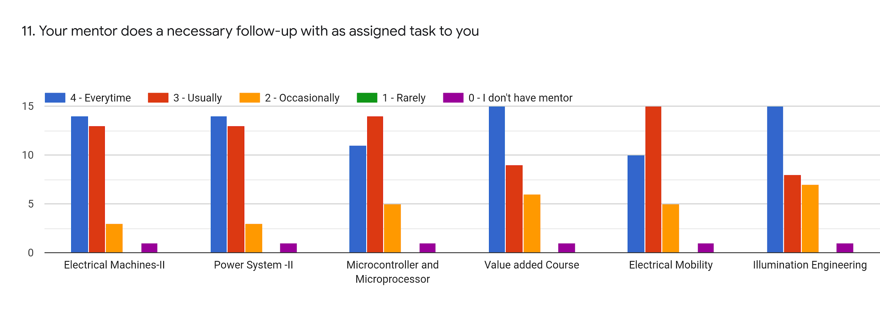
Faculty | BMN | EG | GM | SRS | BGN | SRS | %
Subject | EM - II | PS - II | MM | Value Added Education | EM | ILE
Every time | 14 | 14 | 11 | 15 | 10 | 15 | 42.47
Usually | 13 | 13 | 14 | 9 | 15 | 8 | 38.71
Occasionally | 3 | 3 | 5 | 6 | 5 | 7 | 15.6
Rarely | 0 | 0 | 0 | 0 | 0 | 0 | 0
Never | 1 | 1 | 1 | 1 | 1 | 1 | 3.22

Slide 14
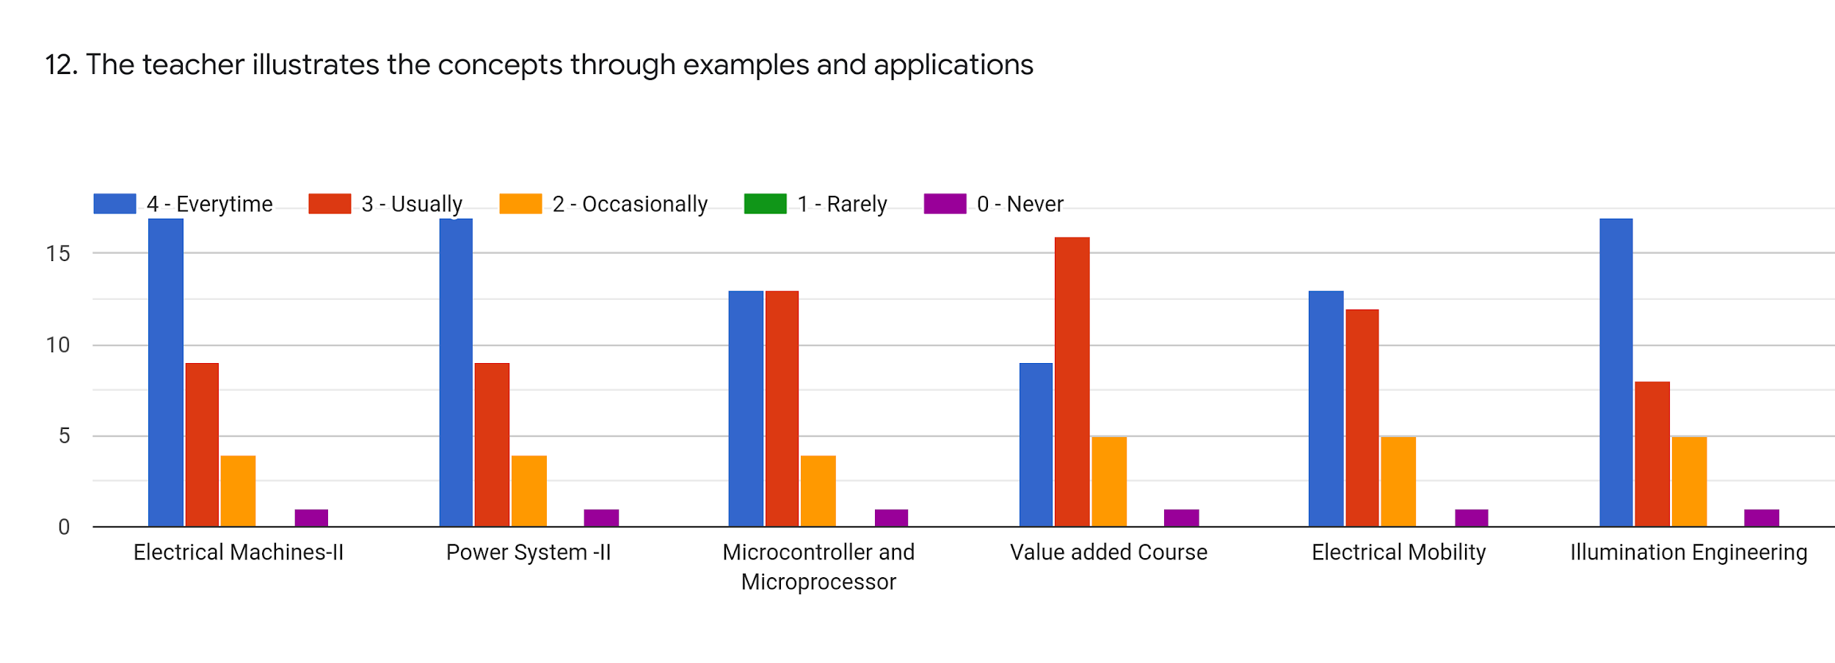
Faculty | BMN | EG | GM | SRS | BGN | SRS | %
Subject | EM - II | PS - II | MM | Value Added Education | EM | ILE
Every time | 17 | 17 | 13 | 9 | 13 | 17 | 46.23
Usually | 9 | 9 | 13 | 16 | 12 | 8 | 36.02
Occasionally | 4 | 4 | 4 | 5 | 5 | 5 | 14.51
Rarely | 0 | 0 | 0 | 0 | 0 | 0 | 0
Never | 1 | 1 | 1 | 1 | 1 | 1 | 3.22

Slide 15
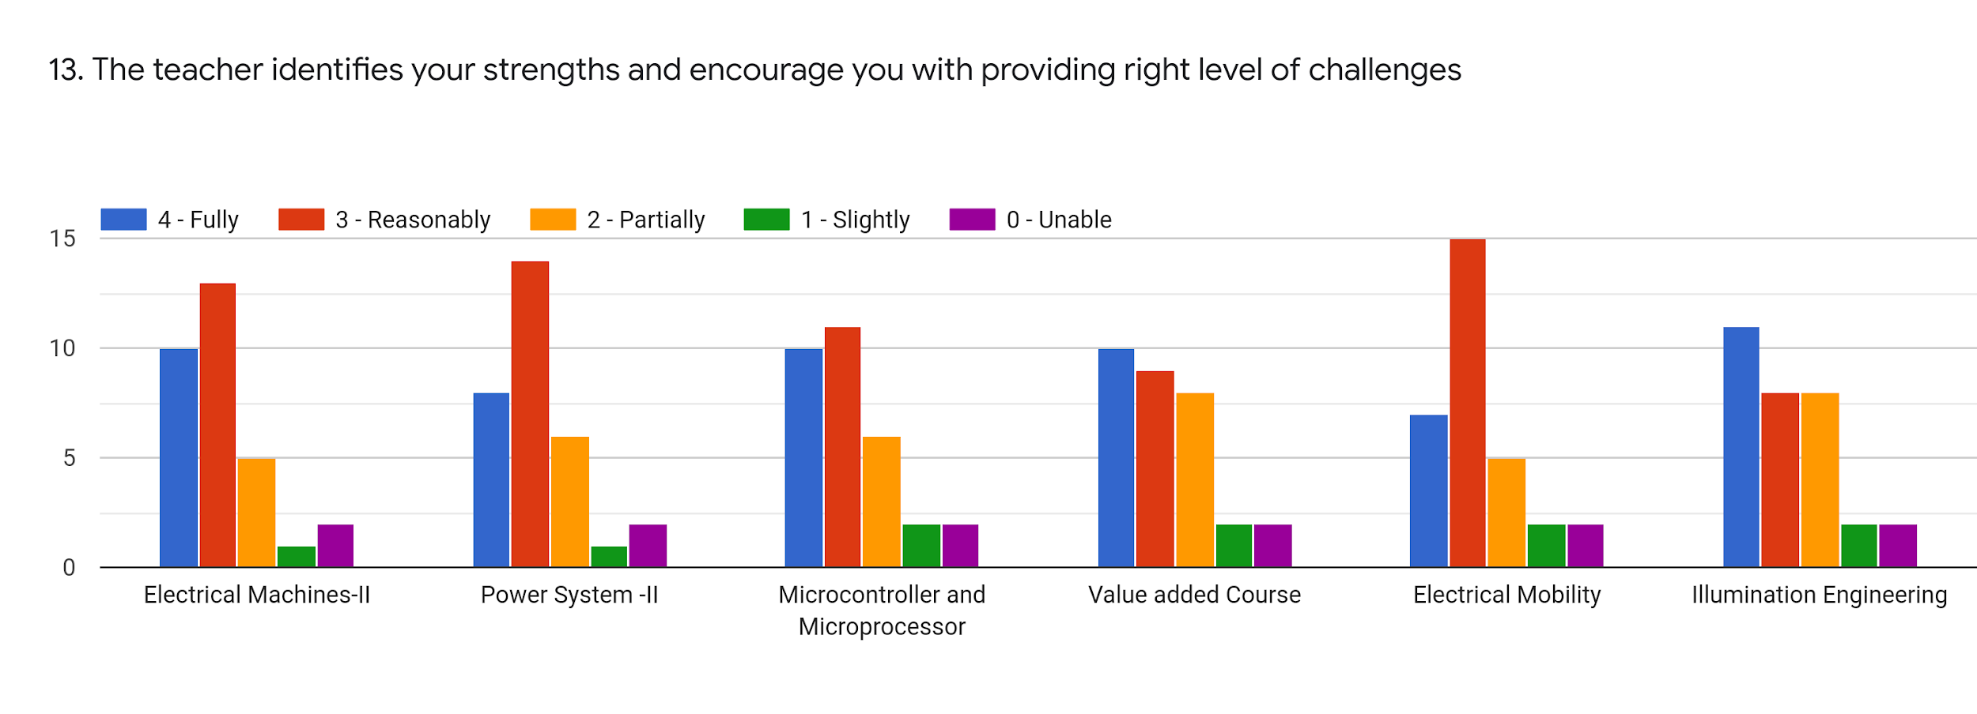
Faculty | BMN | EG | GM | SRS | BGN | SRS | %
Subject | EM - II | PS - II | MM | Value Added Education | EM | ILE
Fully | 10 | 8 | 10 | 10 | 7 | 8 | 28.50
Reasonably | 13 | 14 | 11 | 9 | 15 | 10 | 38.71
Partially | 5 | 6 | 6 | 8 | 5 | 4 | 18.28
Slightly | 1 | 1 | 2 | 2 | 2 | 2 | 5.38
Unable | 2 | 2 | 2 | 2 | 2 | 2 | 6.45

Slide 16
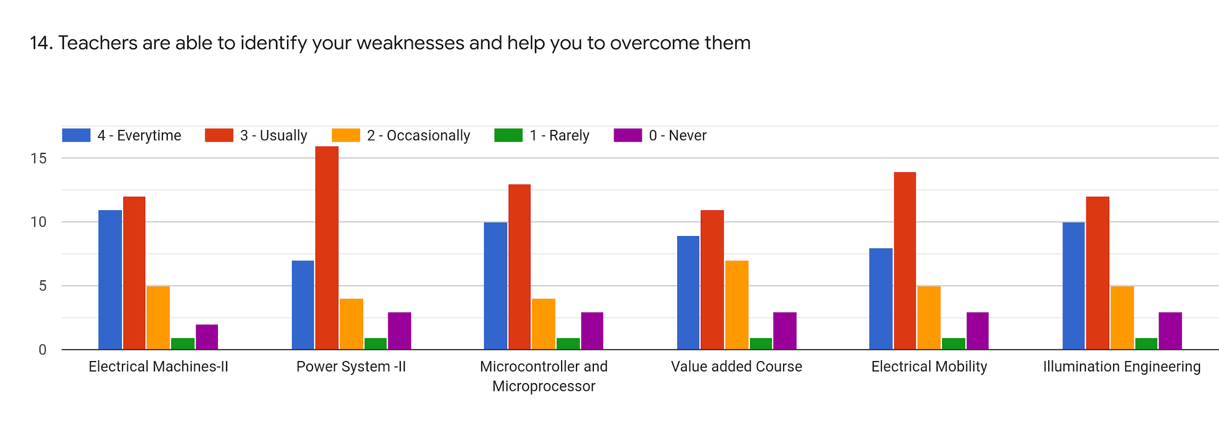
Faculty | BMN | EG | GM | SRS | BGN | SRS | %
Subject | EM - II | PS - II | MM | Value Added Education | EM | ILE
Every time | 11 | 7 | 9 | 9 | 8 | 10 | 29.03
Usually | 12 | 16 | 13 | 11 | 14 | 12 | 41.94
Occasionally | 5 | 4 | 4 | 7 | 5 | 5 | 16.13
Rarely | 1 | 1 | 1 | 1 | 1 | 1 | 3.22
Never | 2 | 3 | 3 | 3 | 3 | 3 | 9.14

Slide 17
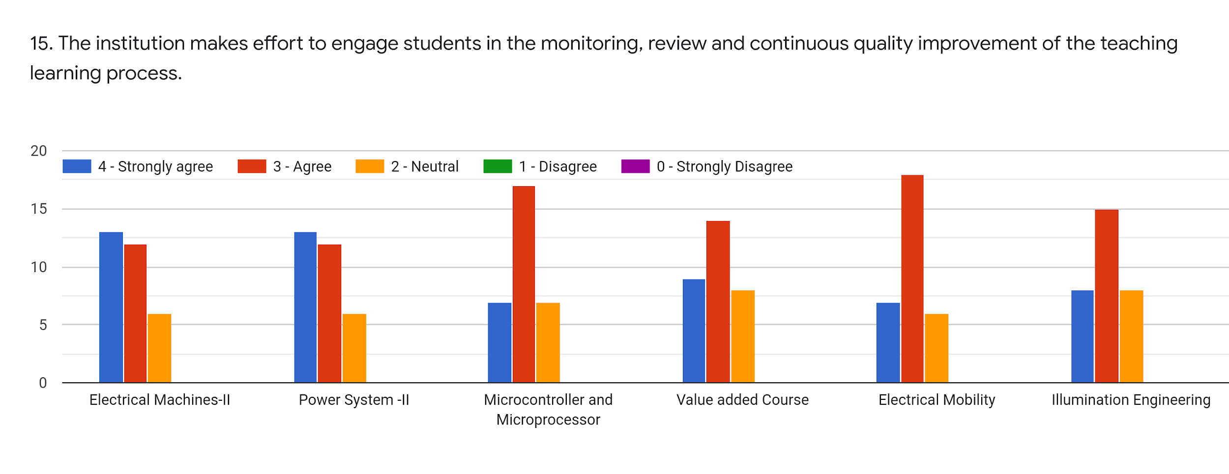
Faculty30 | BMN | EG | GM | SRS | BGN | SRS | %
Subject | EM - II | PS - II | MM | Value Added Education | EM | ILE
Strongly Agree | 13 | 13 | 7 | 9 | 7 | 8 | 30.65
Agree | 12 | 12 | 17 | 14 | 18 | 15 | 47.31
Neutral | 6 | 6 | 7 | 8 | 6 | 8 | 22.04
Disagree | 0 | 0 | 0 | 0 | 0 | 0 | 0
Strongly Disagree | 0 | 0 | 0 | 0 | 0 | 0 | 0

Slide 18
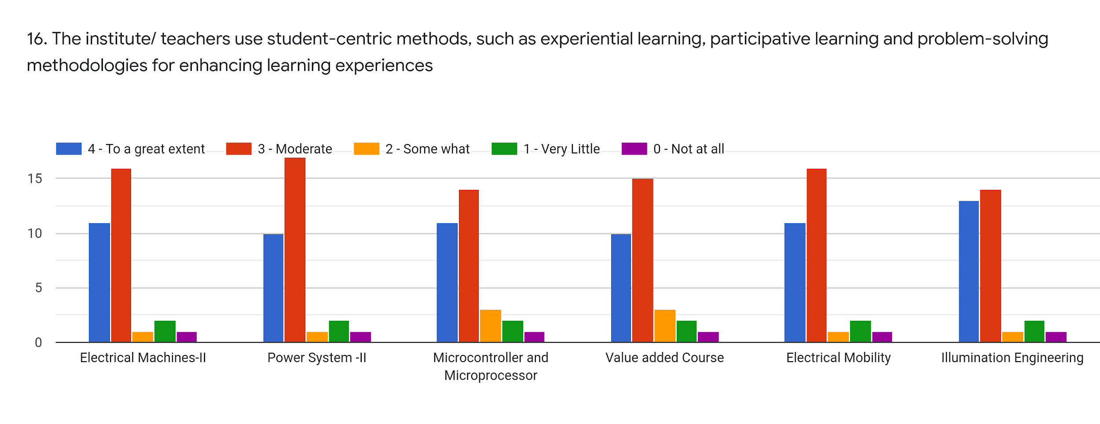
Faculty | BMN | EG | GM | SRS | BGN | SRS | %
Subject | EM - II | PS - II | MM | Value Added Education | EM | ILE
To a great extent | 11 | 10 | 11 | 15 | 11 | 13 | 38.17
Moderate | 16 | 17 | 14 | 10 | 16 | 14 | 46.77
Some What | 1 | 1 | 3 | 3 | 1 | 1 | 5.38
Very Little | 2 | 2 | 2 | 2 | 2 | 2 | 6.45
Not at all | 1 | 1 | 1 | 1 | 1 | 1 | 3.22

Slide 19
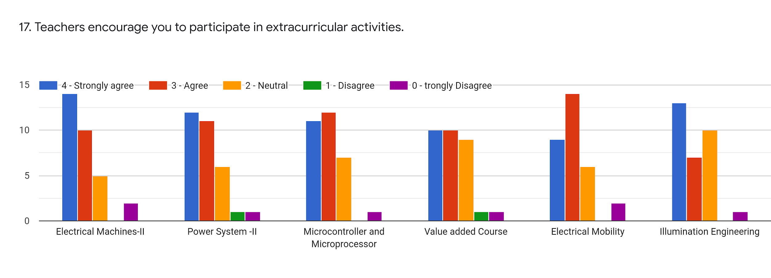
Faculty | BMN | EG | GM | SRS | BGN | SRS | %
Subject | EM - II | PS - II | MM | Value Added Education | EM | ILE
Strongly Agree | 15 | 12 | 11 | 10 | 9 | 13 | 37.63
Agree | 10 | 11 | 12 | 10 | 14 | 7 | 34.40
Neutral | 5 | 6 | 7 | 9 | 6 | 10 | 23.11
Disagree | 0 | 1 | 0 | 1 | 0 | 0 | 1.07
Strongly Disagree | 1 | 1 | 1 | 1 | 2 | 1 | 3.76

Slide 20
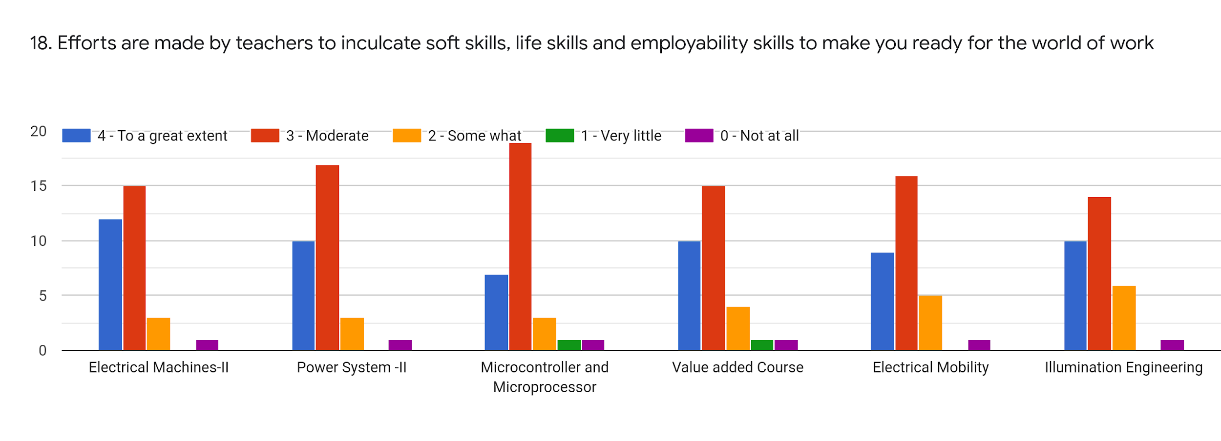
Faculty | BMN | EG | GM | SRS | BGN | SRS | %
Subject | EM - II | PS - II | MM | Value Added Education | EM | ILE
To a great extent | 12 | 10 | 7 | 10 | 9 | 10 | 31.19
Moderate | 15 | 17 | 19 | 15 | 16 | 14 | 51.62
Some What | 3 | 3 | 3 | 4 | 5 | 16 | 18.28
Very Little | 0 | 0 | 1 | 1 | 0 | 0 | 1.07
Not at all | 1 | 1 | 1 | 1 | 1 | 1 | 3.22

Slide 21
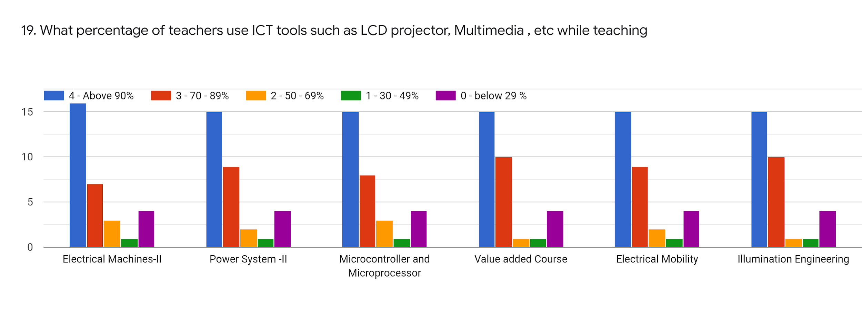
Faculty | BMN | EG | GM | SRS | BGN | SRS | %
Subject | EM - II | PS - II | MM | Value Added Education | EM | ILE
Above 90% | 16 | 15 | 15 | 15 | 15 | 15 | 48.92
70-89% | 7 | 9 | 8 | 10 | 9 | 10 | 28.49
50-69 % | 3 | 2 | 3 | 1 | 2 | 1 | 6.45
30-49 % | 1 | 1 | 1 | 1 | 1 | 1 | 3.23
0-below 29% | 4 | 4 | 4 | 4 | 4 | 4 | 12.90

Slide 22
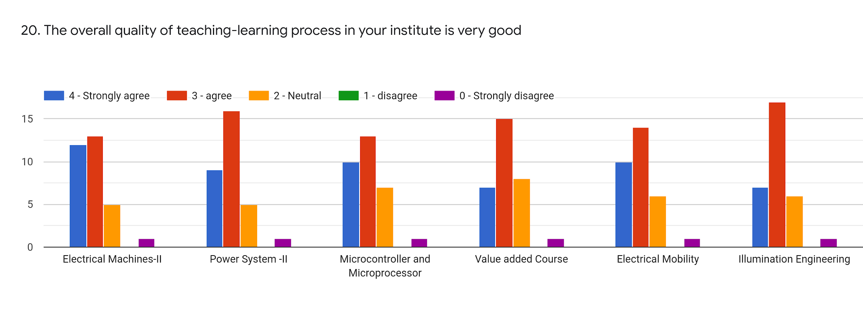
Faculty | BMN | EG | GM | SRS | BGN | SRS | %
Subject | EM - II | PS - II | MM | Value Added Education | EM | ILE
Strongly Agree | 12 | 9 | 10 | 7 | 10 | 7 | 29.57
Agree | 13 | 16 | 13 | 15 | 14 | 17 | 47.31
Neutral | 5 | 5 | 7 | 8 | 6 | 6 | 19.90
Disagree | 0 | 0 | 0 | 0 | 0 | 0 | 0
Strongly Disagree | 1 | 1 | 1 | 1 | 1 | 1 | 3.22

Slide 23
21. Give 3 observations/ suggestions to improve the overall teaching-learning experience of respective teachers.
Kindly conduct value education human rights classes.
Do moodle convenient
Please give exam notice 3-4 days before the exam
It is loosing interest on online classes and also less impact.
Due to network issue some students are not attending lectures if lecturers are conducted through youtube channel that will be more effective

Slide 24
OVERALL ANALYSIS
Sub | Faculty | Appreciation | Suggestions for improvement
EM - II | BMN | Syllabus Coverage, Approaching towards practically | Usage of ICT, Participation extra curricular activities
PS - II | EG | Syllabus Coverage, Communication, Internal Evaluation, Student centric, Quality teaching and learning, Use of ICT | Effectiveness in teaching, Student Centric,
MM | GM | Syllabus Coverage, Well Prepared, Communication, Promoting internship, Student Centric, Promoting Extra Curricular Activities | Usage of ICT, Course Outcomes and Program Outcomes
Value Added Education | SRS | Promoting students to Internship Timely providing Assignments, Usage of ICT, Internal Evaluation | Syllabus Coverage, Student Centric Process, Communication, Approach to teaching
EM | BGN | Syllabus coverage, | Student centric, Use of ICT, Preparation, Approach to teaching
ILE | SRS | CO-PO discussion, Multiple opportunities to grow, Timely Assignments providing, | Syllabus Coverage, Internal Evaluation

