Slide 1
Arvind Gavali College of Engineering, Satara
Department of civil Engineering
Third Year Feedback
Month-Sept.-Oct. 2020
Total Responses-:46
Total Class Strength-58
Feedback Percentage-:79.31%

Slide 2
Faculty-Subject Distribution
Sr.No | Subject | Abb. | Name of the Faculty | Abb.
1 | Design of Steel Structure | DSS | Mr. Salunkhe S.P. | SPS
2 | Structural Mechanics-II | SM-II | Dr. Thombare V.R. | VRT
3 | Soil Mechanics | Soil Mech | Mrs. Mohite J.R. | JRM
4 | Environmental Engineering | Env. Engg | Ms. Machhav Pallavi | PM
6 | Transportation Engineering | TRE Engg. | Ms. Jadhav D.S. | DSJ
7 | Material Testing & Evaluation | MTE | Mr. Sapkal R.N. | RNS

Slide 3
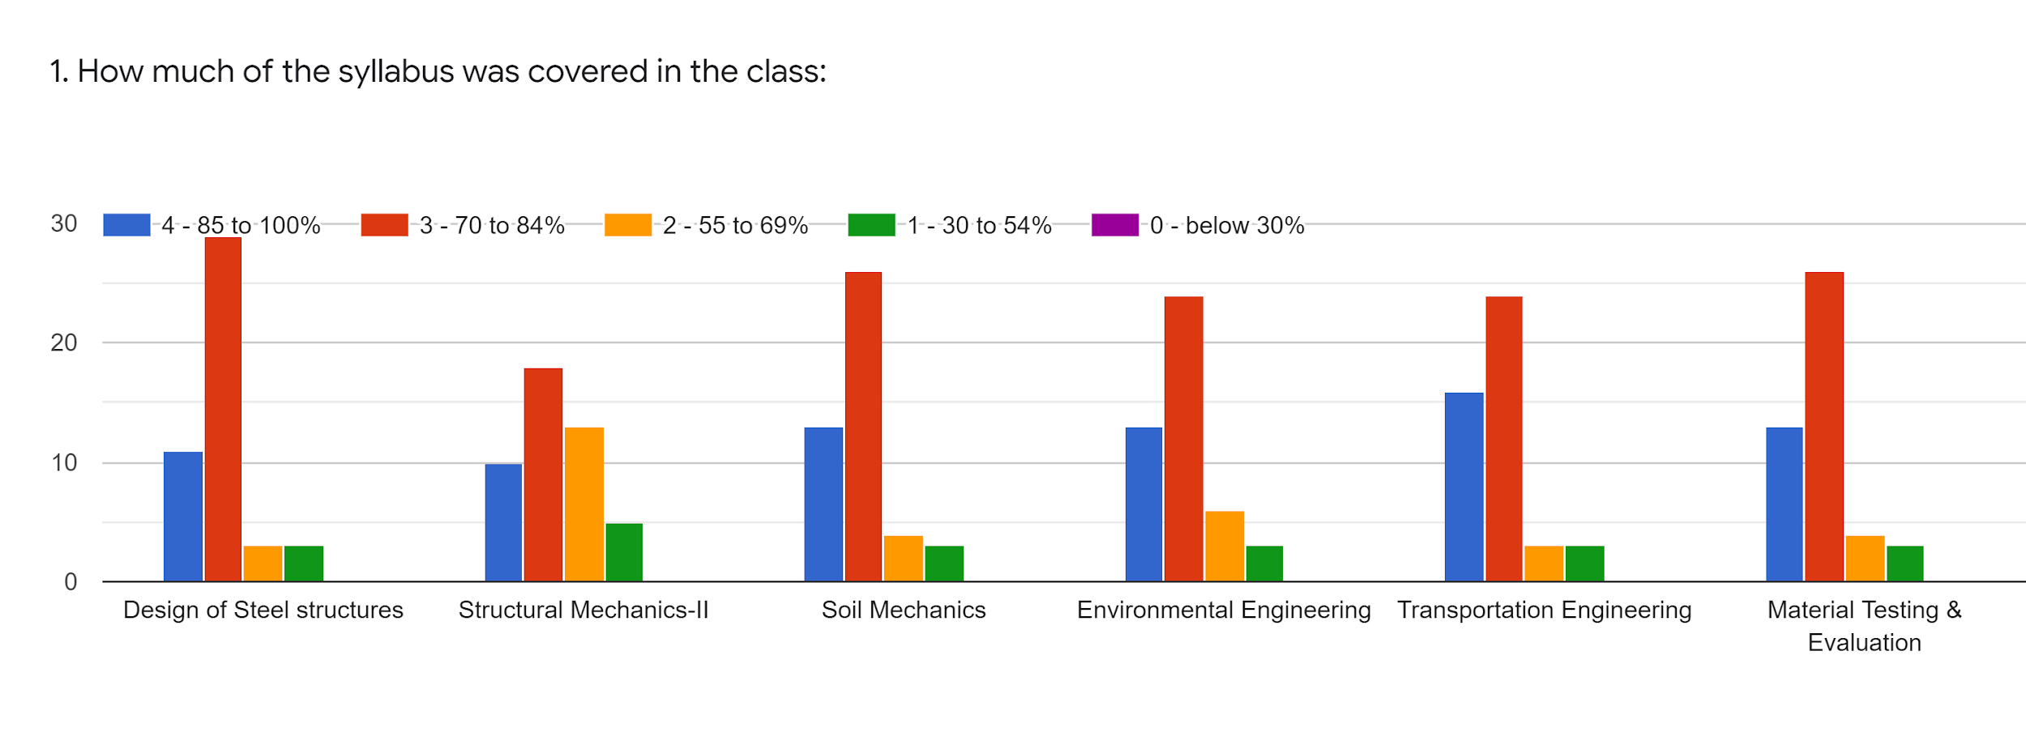
Faculty | SPS | VRT | JRM | PM | DSJ | RNS | %
Subject | DSS | SM-II | Soil Mech | Env.Engg | TRE Engg. | MTE
85-100% | 11 | 10 | 13 | 13 | 16 | 13 | 26.95
70-84% | 30 | 19 | 27 | 25 | 25 | 27 | 54.25
55-69% | 3 | 13 | 4 | 6 | 3 | 4 | 11.70
30-54% | 3 | 5 | 3 | 3 | 3 | 3 | 7.09
0-Below 30% | 0 | 0 | 0 | 0 | 0 | 0 | 0

Slide 4
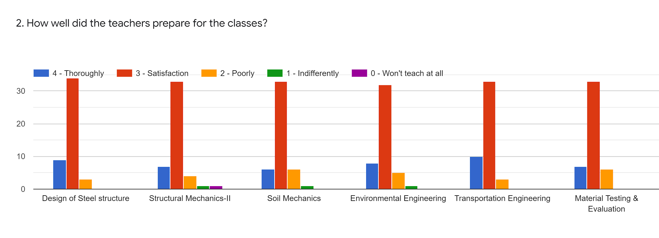
Faculty | SPS | VRT | JRM | PM | DSJ | RNS | %
Subject | DSS | SM-II | Soil Mech | Env.Engg | TRE Engg. | MTE
85-100% | 9 | 7 | 6 | 8 | 10 | 7 | 16.67
70-84% | 35 | 34 | 34 | 33 | 34 | 34 | 72.34
55-69% | 3 | 4 | 6 | 5 | 3 | 6 | 9.57
30-54% | 0 | 1 | 1 | 1 | 0 | 0 | 1.06
0-Below 30% | 0 | 1 | 0 | 0 | 0 | 0 | 0.35

Slide 5
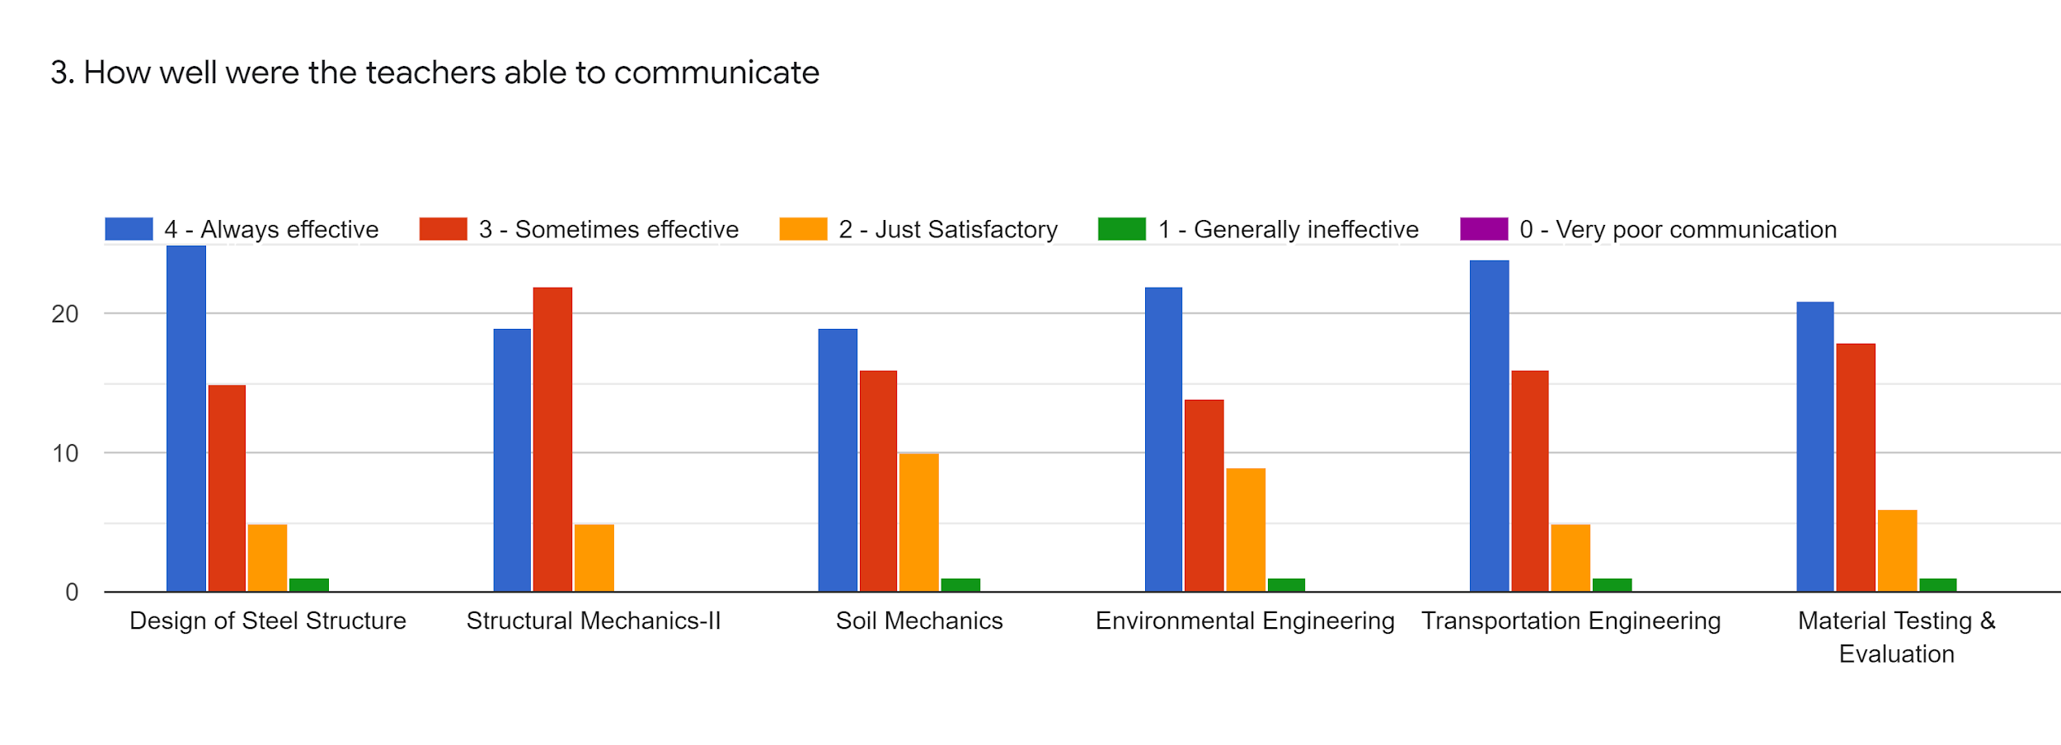
Faculty | SPS | VRT | JRM | PM | DSJ | RNS | %
Subject | DSS | SM-II | Soil Mech | Env.Engg | TRE Engg. | MTE
85-100% | 25 | 19 | 19 | 22 | 24 | 21 | 46.69
70-84% | 16 | 23 | 17 | 15 | 17 | 19 | 37.94
55-69% | 5 | 5 | 10 | 9 | 5 | 6 | 40.81
30-54% | 1 | 0 | 1 | 1 | 1 | 1 | 5.10
0-Below 30% | 0 | 0 | 0 | 0 | 0 | 0 | 0

Slide 6
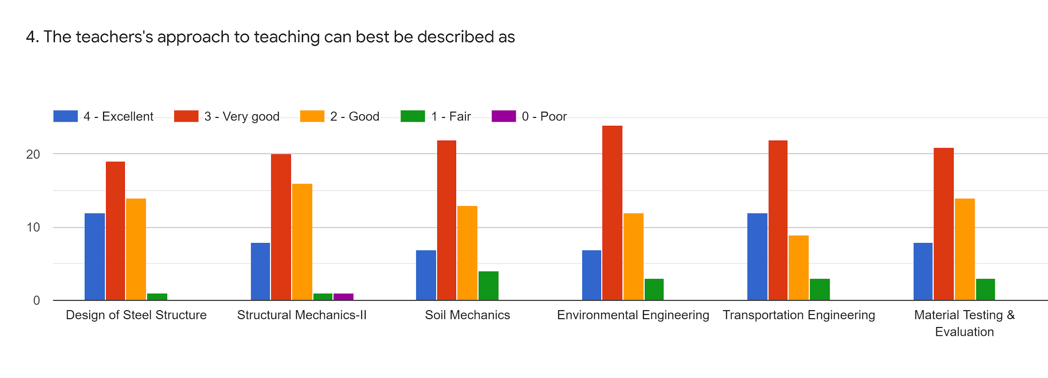
Faculty | SPS | VRT | JRM | PM | DSJ | RNS | %
Subject | DSS | SM-II | Soil Mech | Env.Engg | TRE Engg. | MTE
85-100% | 12 | 8 | 7 | 7 | 12 | 8 | 55.10
70-84% | 20 | 21 | 23 | 25 | 23 | 22 | 47.51
55-69% | 14 | 16 | 13 | 12 | 9 | 14 | 27.65
30-54% | 1 | 1 | 4 | 13 | 3 | 3 | 8.86
0-Below 30% | 0 | 1 | 0 | 0 | 0 | 0 | 0.35

Slide 7
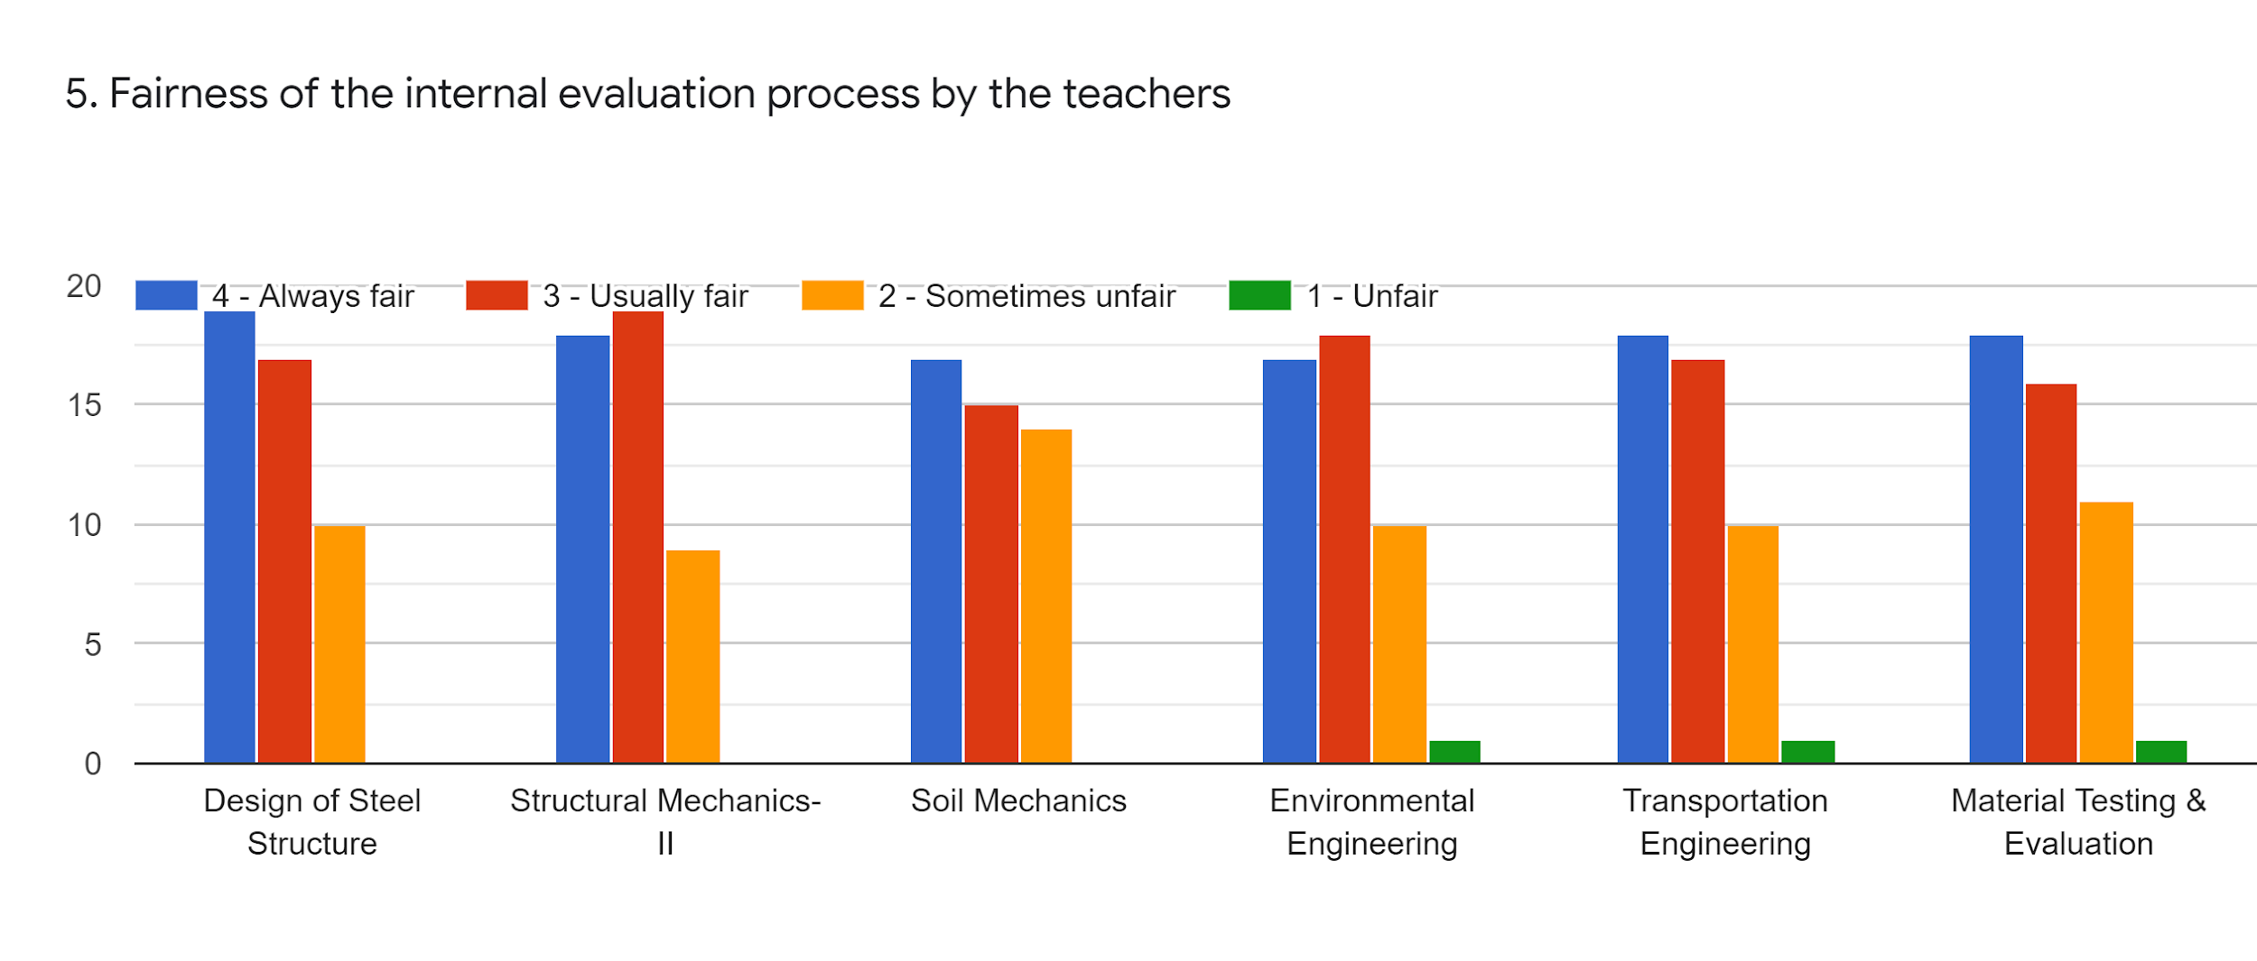
Faculty | SPS | VRT | JRM | PM | DSJ | RNS | %
Subject | DSS | SM-II | Soil Mech | Env.Engg | TRE Engg. | MTE
85-100% | 19 | 18 | 17 | 17 | 18 | 18 | 37.94
70-84% | 18 | 20 | 16 | 19 | 17 | 17 | 38.29
55-69% | 10 | 9 | 14 | 10 | 10 | 11 | 22.69
30-54% | 0 | 0 | 0 | 1 | 1 | 1 | 1.06
0-Below 30% | 0 | 0 | 0 | 0 | 0 | 0 | 0

Slide 8
Faculty | SPS | VRT | JRM | PM | DSJ | RNS | %
Subject | DSS | SM-II | Soil Mech | Env.Engg | TRE Engg. | MTE
85-100% | 19 | 16 | 16 | 16 | 18 | 15 | 35.46
70-84% | 21 | 24 | 23 | 22 | 21 | 22 | 47.16
55-69% | 6 | 6 | 7 | 8 | 7 | 8 | 14.89
30-54% | 0 | 0 | 0 | 0 | 0 | 1 | 3.54
0-Below 30% | 1 | 1 | 1 | 1 | 1 | 1 | 2.12

Slide 9
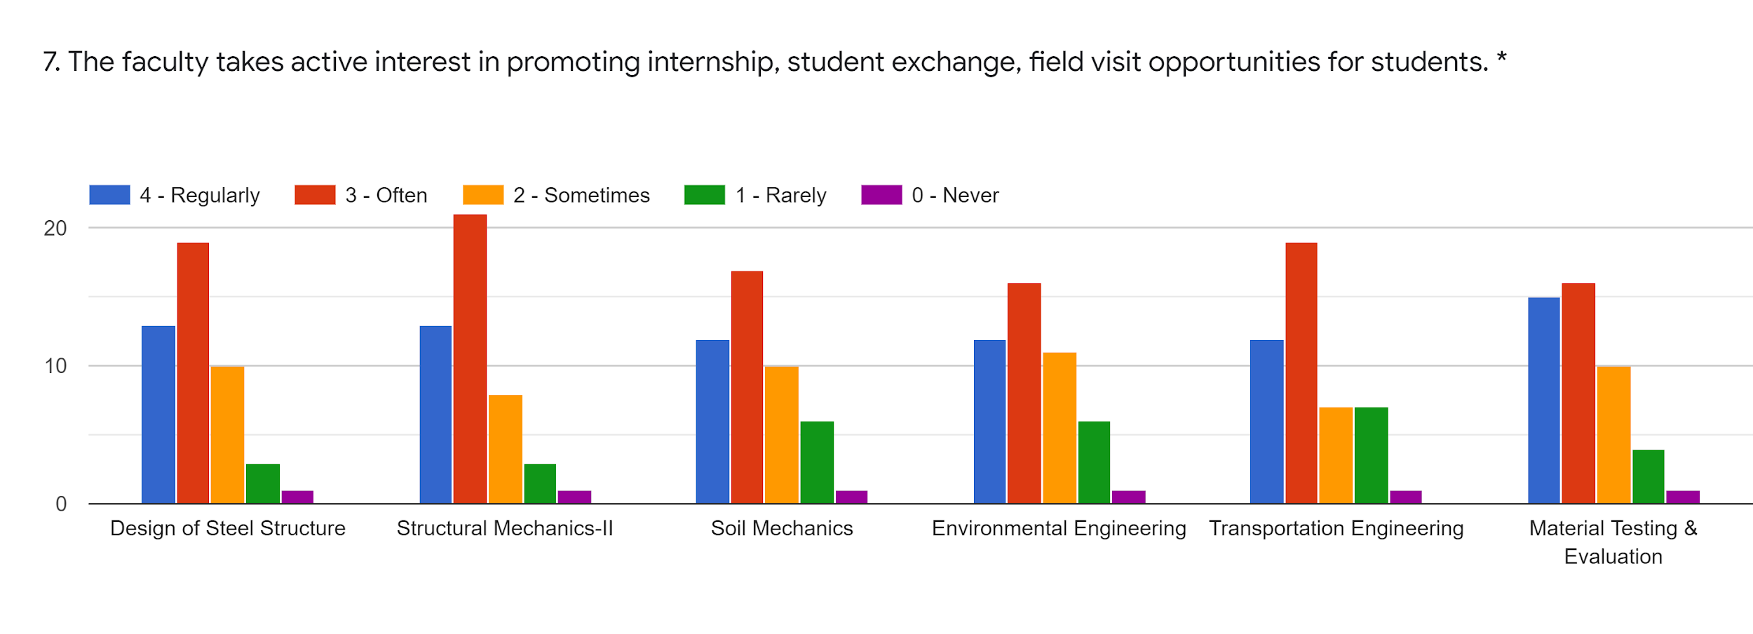
Faculty | SPS | VRT | JRM | PM | DSJ | RNS | %
Subject | DSS | SM-II | Soil Mech | Env.Engg | TRE Engg. | MTE
85-100% | 13 | 13 | 12 | 12 | 12 | 15 | 27.30
70-84% | 21 | 24 | 23 | 22 | 21 | 22 | 47.16
55-69% | 6 | 6 | 7 | 8 | 7 | 8 | 14.89
30-54% | 0 | 0 | 0 | 0 | 0 | 1 | 3.54
0-Below 30% | 1 | 1 | 1 | 1 | 1 | 1 | 2,12

Slide 10
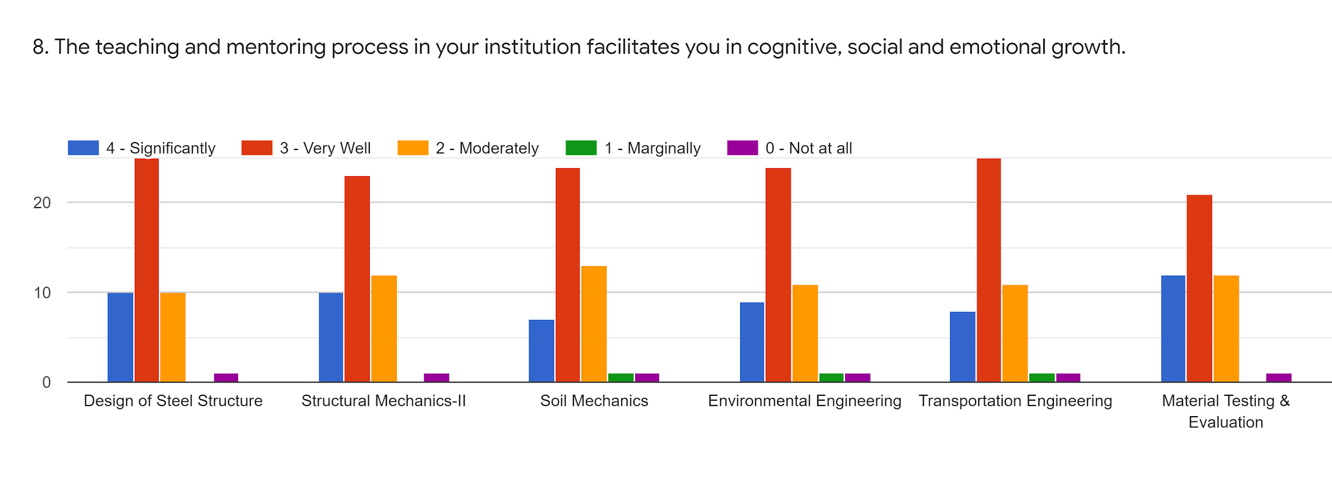
Faculty | SPS | VRT | JRM | PM | DSJ | RNS | %
Subject | DSS | SM-II | Soil Mech | Env.Engg | TRE Engg. | MTE
85-100% | 10 | 10 | 7 | 9 | 8 | 12 | 19.85
70-84% | 26 | 24 | 25 | 25 | 26 | 22 | 52.48
55-69% | 10 | 12 | 13 | 11 | 11 | 12 | 24.46
30-54% | 0 | 0 | 1 | 1 | 1 | 0 | 1.06
0-Below 30% | 1 | 1 | 1 | 1 | 1 | 1 | 2.12

Slide 11
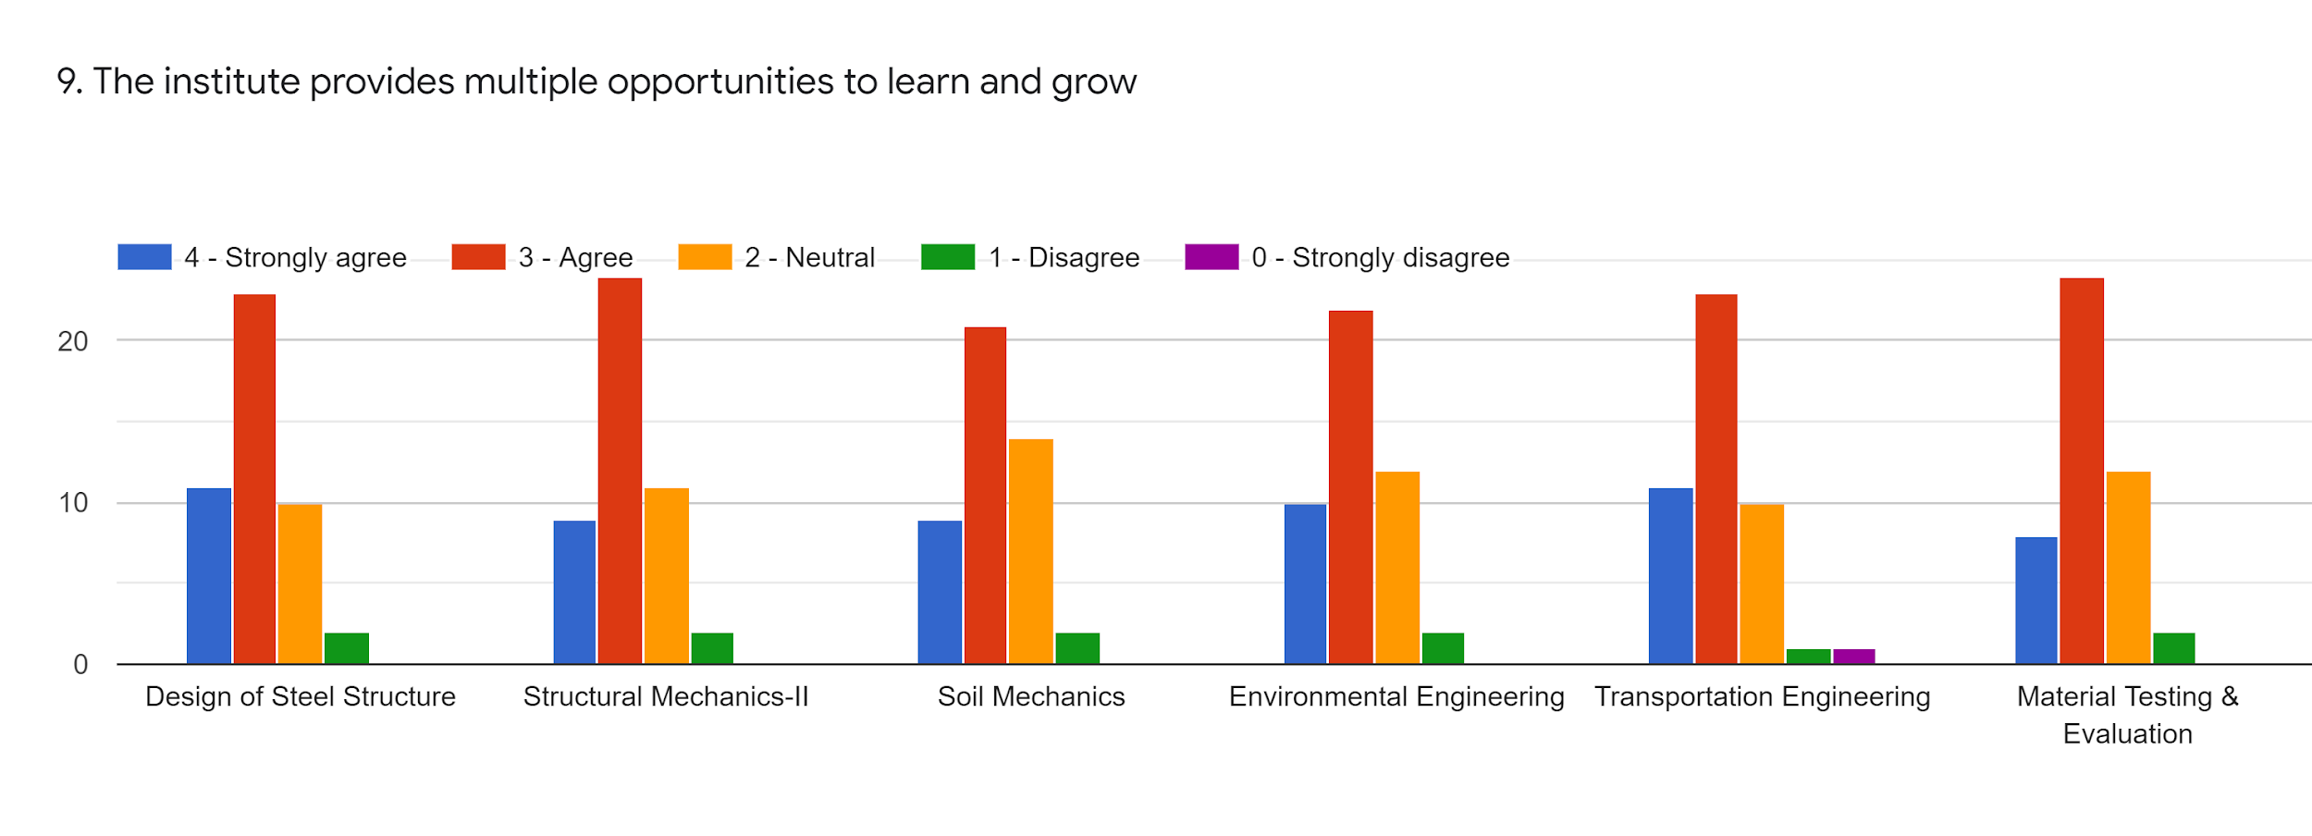
Faculty | SPS | VRT | JRM | PM | DSJ | RNS | %
Subject | DSS | SM-II | Soil Mech | Env.Engg | TRE Engg. | MTE
85-100% | 11 | 9 | 9 | 10 | 11 | 8 | 20.56
70-84% | 24 | 25 | 22 | 23 | 24 | 25 | 50.70
55-69% | 10 | 11 | 14 | 12 | 10 | 12 | 24.46
30-54% | 2 | 2 | 2 | 2 | 1 | 2 | 3.90
0-Below 30% | 0 | 0 | 0 | 0 | 1 | 0 | 0.35

Slide 12
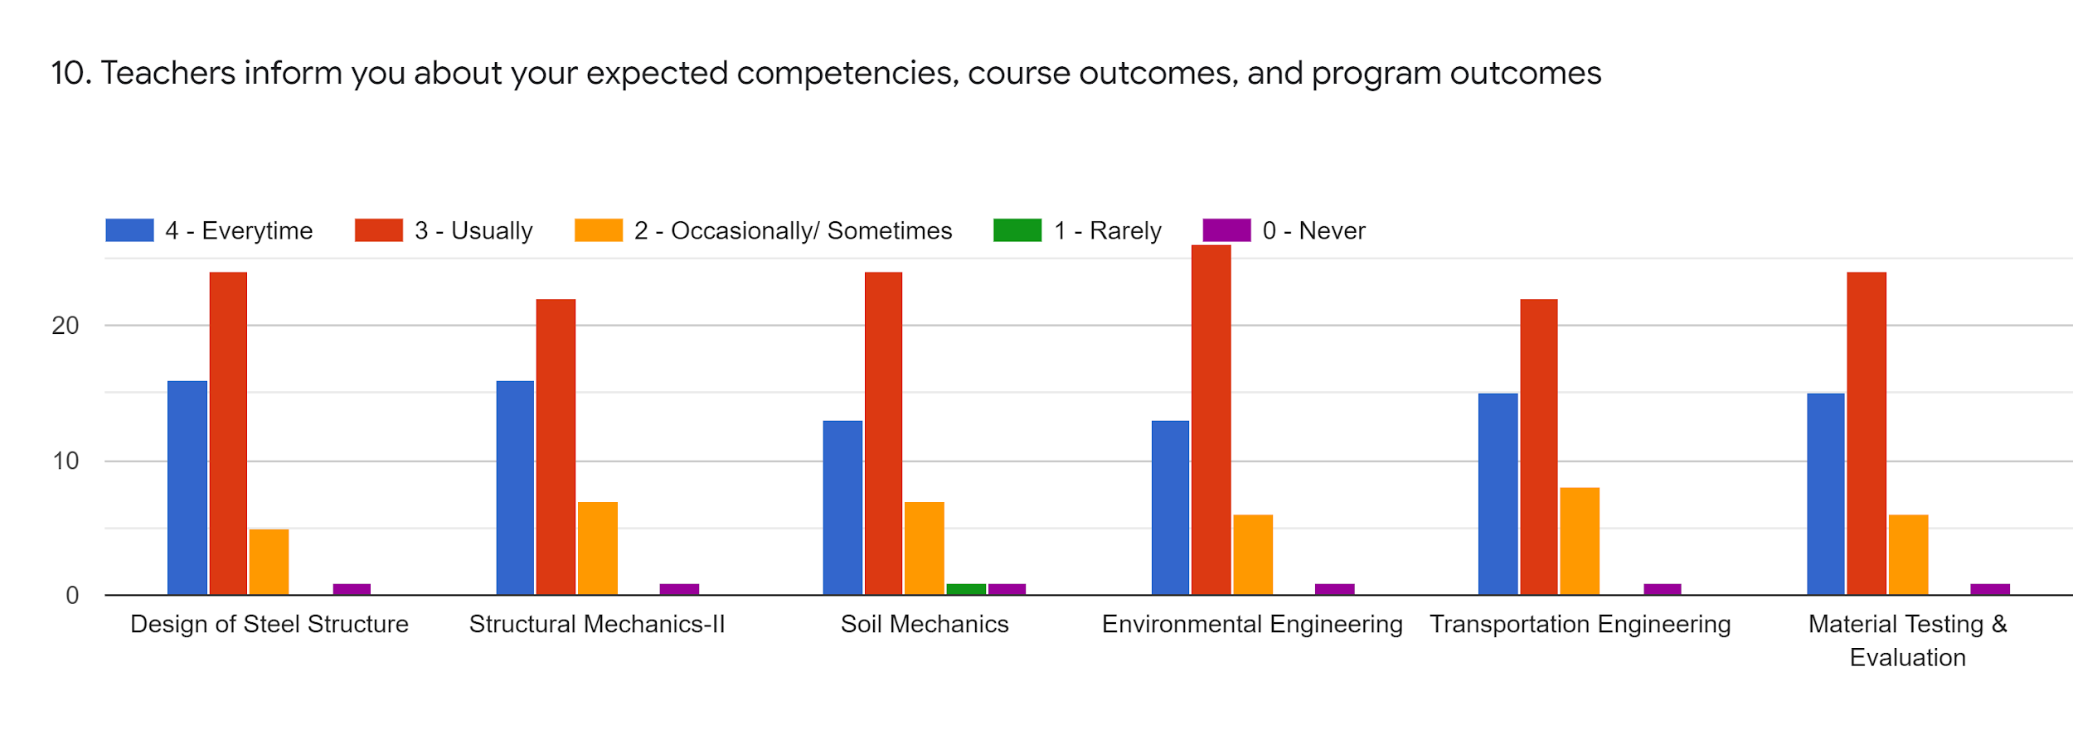
Faculty | SPS | VRT | JRM | PM | DSJ | RNS | %
Subject | DSS | SM-II | Soil Mech | Env.Engg | TRE Engg. | MTE
85-100% | 16 | 16 | 13 | 13 | 15 | 15 | 31.20
70-84% | 25 | 23 | 25 | 27 | 23 | 25 | 52.48
55-69% | 5 | 7 | 7 | 6 | 8 | 6 | 13.82
30-54% | 0 | 0 | 1 | 0 | 0 | 0 | 0.35
0-Below 30% | 1 | 1 | 1 | 1 | 1 | 1 | 2.12

Slide 13
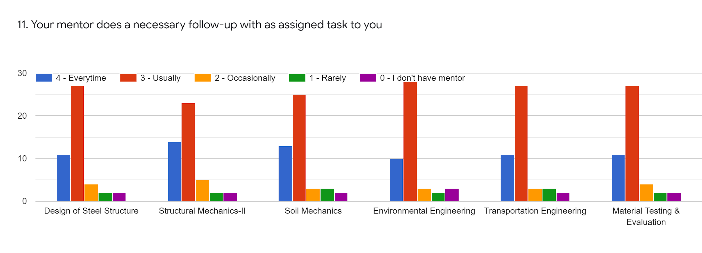
Faculty | SPS | VRT | JRM | PM | DSJ | RNS | %
Subject | DSS | SM-II | Soil Mech | Env.Engg | TRE Engg. | MTE
85-100% | 11 | 14 | 13 | 10 | 11 | 11 | 24.82
70-84% | 28 | 24 | 26 | 29 | 28 | 28 | 57.80
55-69% | 4 | 5 | 3 | 2 | 3 | 2 | 7.80
30-54% | 2 | 2 | 3 | 2 | 3 | 2 | 4.96
0-Below 30% | 2 | 2 | 2 | 3 | 2 | 2 | 4.60

Slide 14
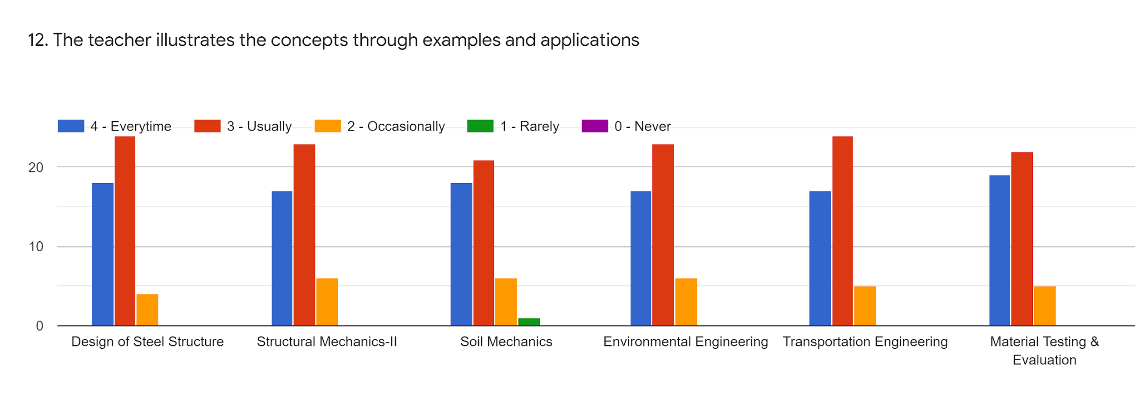
Faculty | SPS | VRT | JRM | PM | DSJ | RNS | %
Subject | DSS | SM-II | Soil Mech | Env.Engg | TRE Engg. | MTE
85-100% | 18 | 17 | 18 | 17 | 17 | 19 | 37.58
70-84% | 25 | 24 | 22 | 24 | 25 | 23 | 50.70
55-69% | 4 | 6 | 6 | 6 | 5 | 5 | 11.34
30-54% | 0 | 0 | 1 | 0 | 0 | 0 | 0.35
0-Below 30% | 0 | 0 | 0 | 0 | 0 | 0 | 0

Slide 15
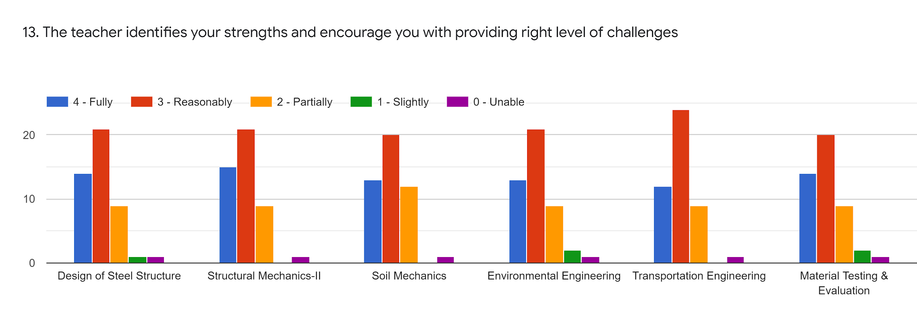
Faculty | SPS | VRT | JRM | PM | DSJ | RNS | %
Subject | DSS | SM-II | Soil Mech | Env.Engg | TRE Engg. | MTE
85-100% | 14 | 15 | 13 | 13 | 12 | 14 | 28.72
70-84% | 22 | 22 | 21 | 22 | 25 | 21 | 47.16
55-69% | 9 | 9 | 12 | 9 | 9 | 9 | 20.71
30-54% | 1 | 0 | 0 | 2 | 0 | 2 | 1.77
0-Below 30% | 1 | 1 | 1 | 1 | 1 | 1 | 2.12

Slide 16
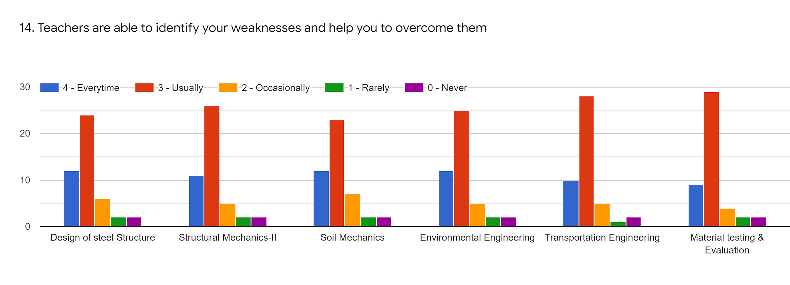
Faculty | SPS | VRT | JRM | PM | DSJ | RNS | %
Subject | DSS | SM-II | Soil Mech | Env.Engg | TRE Engg. | MTE
85-100% | 12 | 11 | 12 | 12 | 10 | 9 | 23.40
70-84% | 15 | 27 | 24 | 26 | 29 | 30 | 53.54
55-69% | 6 | 5 | 7 | 5 | 5 | 4 | 11.34
30-54% | 2 | 2 | 2 | 2 | 1 | 2 | 3.90
0-Below 30% | 2 | 2 | 2 | 2 | 2 | 2 | 4.25

Slide 17
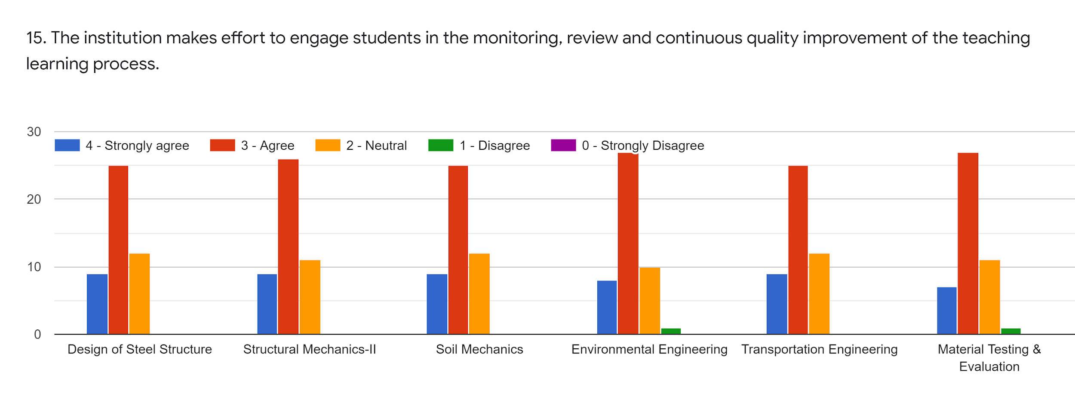
Faculty | SPS | VRT | JRM | PM | DSJ | RNS | %
Subject | DSS | SM-II | Soil Mech | Env.Engg | TRE Engg. | MTE
85-100% | 9 | 9 | 9 | 8 | 9 | 7 | 18.08
70-84% | 26 | 27 | 26 | 28 | 26 | 28 | 57.09
55-69% | 12 | 11 | 12 | 10 | 12 | 11 | 24.11
30-54% | 0 | 0 | 0 | 1 | 0 | 1 | 0.70
0-Below 30% | 0 | 0 | 0 | 0 | 0 | 0 | 0

Slide 18
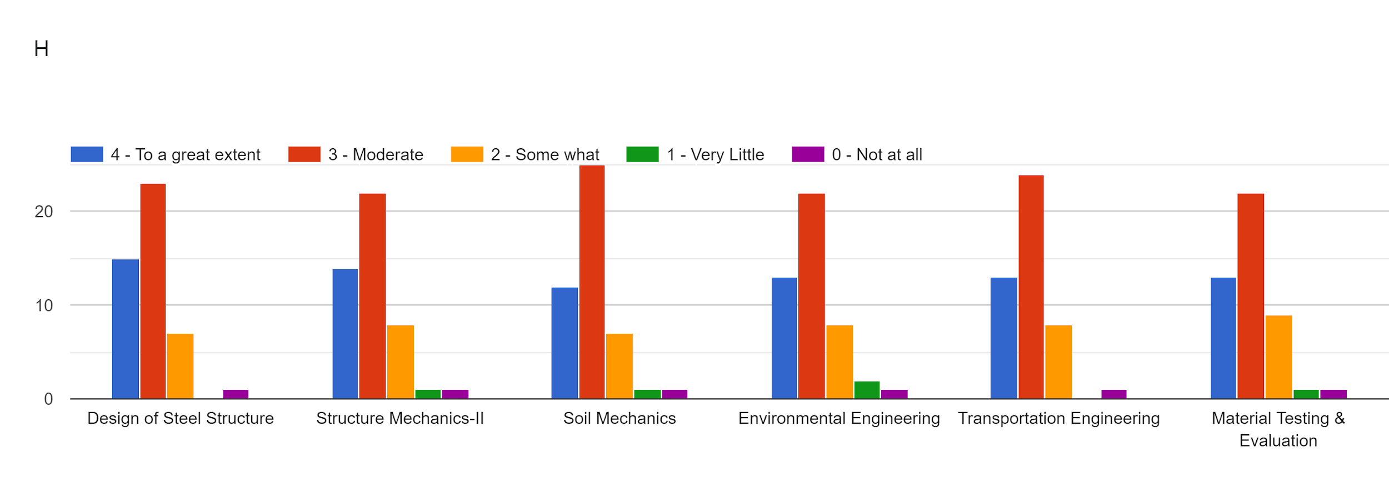
Faculty | SPS | VRT | JRM | PM | DSJ | RNS | %
Subject | DSS | SM-II | Soil Mech | Env.Engg | TRE Engg. | MTE
85-100% | 15 | 14 | 12 | 13 | 13 | 13 | 28.36
70-84% | 24 | 23 | 26 | 23 | 25 | 23 | 51.06
55-69% | 7 | 8 | 7 | 8 | 8 | 9 | 16.66
30-54% | 0 | 1 | 1 | 2 | 0 | 1 | 1.77
0-Below 30% | 1 | 1 | 1 | 1 | 1 | 1 | 2.12

Slide 19
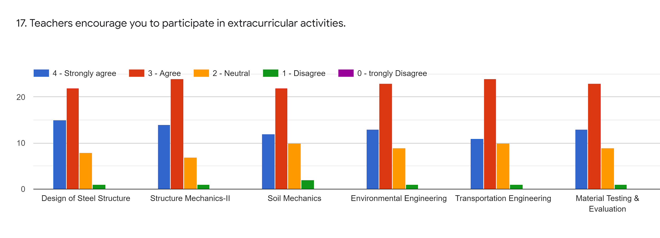
Faculty | SPS | VRT | JRM | PM | DSJ | RNS | %
Subject | DSS | SM-II | Soil Mech | Env.Engg | TRE Engg. | MTE
85-100% | 15 | 14 | 12 | 13 | 11 | 13 | 27.65
70-84% | 23 | 25 | 23 | 24 | 25 | 24 | 51.06
55-69% | 8 | 7 | 10 | 9 | 10 | 9 | 18.79
30-54% | 1 | 1 | 2 | 1 | 1 | 1 | 2.48
0-Below 30% | 0 | 0 | 0 | 0 | 0 | 0 | 0

Slide 20
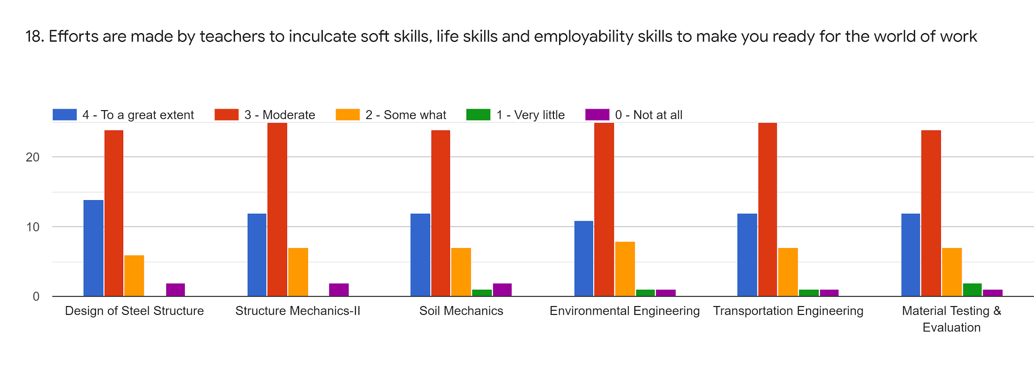
Faculty | SPS | VRT | JRM | PM | DSJ | RNS | %
Subject | DSS | SM-II | Soil Mech | Env.Engg | TRE Engg. | MTE
85-100% | 14 | 12 | 12 | 11 | 12 | 12 | 25.88
70-84% | 25 | 26 | 25 | 26 | 26 | 25 | 54.55
55-69% | 6 | 7 | 7 | 8 | 7 | 7 | 14.89
30-54% | 0 | 0 | 1 | 1 | 1 | 2 | 1.77
0-Below 30% | 2 | 2 | 2 | 1 | 1 | 1 | 3.19

Slide 21
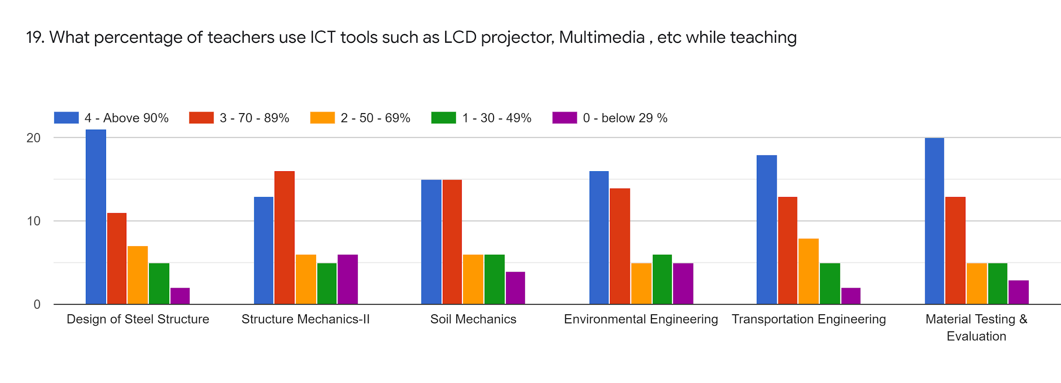
Faculty | SPS | VRT | JRM | PM | DSJ | RNS | %
Subject | DSS | SM-II | Soil Mech | Env.Engg | TRE Engg. | MTE
85-100% | 22 | 14 | 16 | 17 | 19 | 21 | 38.65
70-84% | 11 | 16 | 15 | 14 | 13 | 13 | 29.07
55-69% | 7 | 6 | 6 | 5 | 8 | 5 | 13.12
30-54% | 5 | 5 | 6 | 6 | 5 | 5 | 11.34
0-Below 30% | 2 | 6 | 4 | 5 | 2 | 3 | 7.80

Slide 22
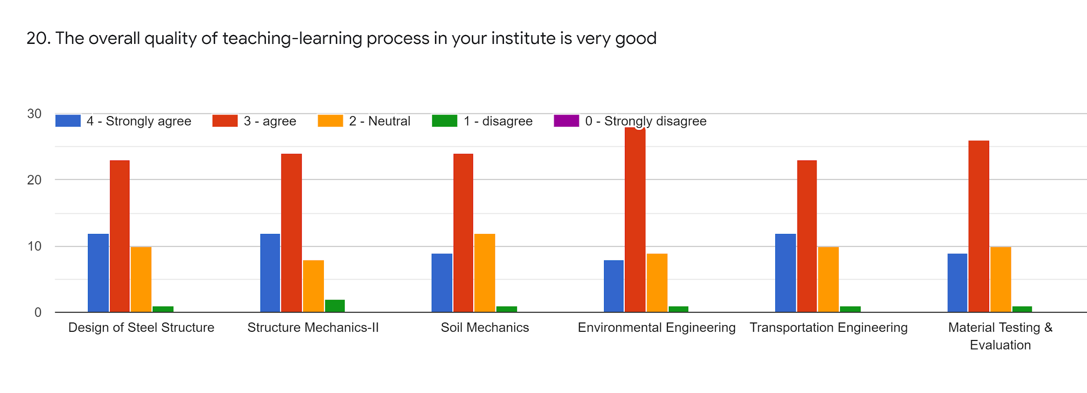
Faculty | SPS | VRT | JRM | PM | DSJ | RNS | %
Subject | DSS | SM-II | Soil Mech | Env.Engg | TRE Engg. | MTE
85-100% | 12 | 12 | 9 | 8 | 12 | 9 | 21.98
70-84% | 24 | 25 | 25 | 29 | 24 | 27 | 54.60
55-69% | 10 | 8 | 12 | 9 | 5 | 10 | 19.14
30-54% | 1 | 2 | 1 | 1 | 1 | 1 | 0.24
0-Below 30% | 0 | 0 | 0 | 0 | 0 | 0 | 0

Slide 23
Give 3 Observation/Suggestion to improve the overall teaching learning experience of respective teachers
Due to covid we are not able to take some collage material and that's going hard to complete assignment work and other written work, please give us study work in objective type its an request
Sound quality and screen presenting is slightly less
Improve the teaching process
Take More examples i.e Numericals
Share the screen in online lectures

Slide 24
Overall Analysis
Subject | Faculty | Appreciation | Suggestion for improvement
DSS | SPS | Syllabus Coverage, Talk to all Students | Give notes before lecture, Take more examples
SM-II | VRT | Give notes before lecture, Better Communication | Talk to all students, Share screen in online lecture
Soil Mech | JRM | Syllabus Coverage, Take more examples | Improve presentation skill, give notes before lecture
Env.Engg. | PM | Syllabus Coverage, Give assignment | Share screen in online lecture, Talk to all students
TRE Engg | DSJ | Better Communication, Syllabus Coverage | Give assignments, Record online lecture
MTE | RNS | Syllabus Coverage, Share screen in online lecture | Improve Presentation skill, Improve Teaching Process

