Slide 1
Arvind Gavali College of Engineering, Satara
Department of Computer Science & Engineering
TY Feedback
Month-Sept.-Oct. 2020
Total Responses-:67
Total Class Strength-67
Feedback Percentage-:100%

Slide 2
Faculty-Subject Distribution
Sr.No | Subject | Abb. | Name of the Faculty | Abb.
1 | Database System | DB | Dr.Varsha Bhosale | VB
2 | Theory of Computation | TOC | Mrs. Rajani Mandhare | RM
3 | Machine Learning | ML | Miss Samina Mulla | SM
4 | Introduction to Reacrch Methodology | ITR | Dr.Gayatri Mirajkar | GM
6 | Business Communication | BC | Mr.Pathak Pranav | PP

Slide 3
Subject Name | DB(BTCOC501) | TOC(BTCOC502) | ML(BTCOC503) | EL-III(BTCOC504) | EL-IV(BTCOC505) | %
Name of Faculty | Dr.V.K.Bhosale | Mrs Mandhare R.M | Ms Mulla S.Y | Mr Pathak P.A | Dr Mirajkar G.S
Excellent | 34 | 28 | 9 | 22 | 19 | 30%
Very Good | 24 | 25 | 30 | 27 | 32 | 43%
Good | 5 | 11 | 20 | 12 | 12 | 17%
Average | 4 | 3 | 07 | 5 | 4 | 7%
Poor | 0 | 0 | 01 | 1 | 0 | 1%

Slide 4
Subject Name | DB(BTCOC501) | TOC(BTCOC502) | ML(BTCOC503) | EL-III(BTCOC504) | EL-IV(BTCOC505) | %
Name of Faculty | Dr.V.K.Bhosale | Mrs Mandhare R.M | Ms Mulla S.Y | Dr Mirajkar G.S | Mr Pathak P.A
Excellent | 22 | 40 | 38 | 23 | 32 | 44%
Very Good | 41 | 27 | 28 | 41 | 33 | 50%
Good | 2 | 0 | 0 | 2 | 1 | 1%
Average | 2 | 0 | 0 | 1 | 1 | 1%
Poor | 0 | 0 | 01 | 0 | 0 | 1%

Slide 5
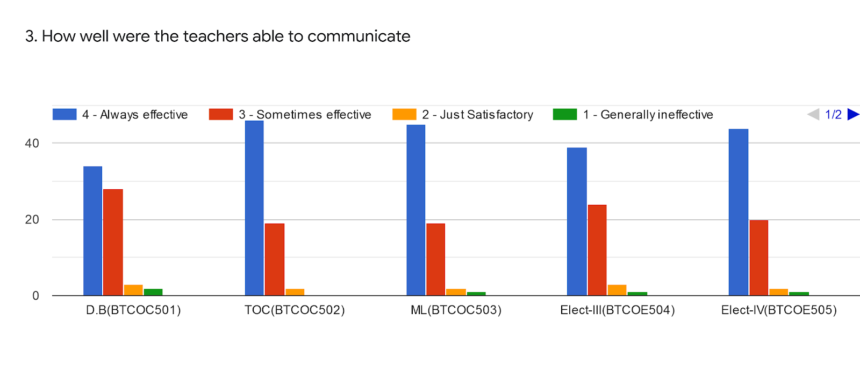
Subject Name | DB(BTCOC501) | TOC(BTCOC502) | ML(BTCOC503) | EL-III(BTCOC504) | EL-IV(BTCOC505)
Name of Faculty | Dr.V.K.Bhosale | Mrs Mandhare R.M | Ms Mulla S.Y | Dr Mirajkar G.S | Mr Pathak P.A
Always Effective | 35 | 46 | 45 | 39 | 43 | 51%
Sometimes effective | 28 | 19 | 19 | 24 | 20 | 27%
just satisfactory | 3 | 2 | 01 | 3 | 3 | 2%
Generally ineffective | 1 | 0 | 01 | 1 | 1 | 0%
Very poor communication | 0 | 0 | 0 | 0 | 0 | 0%

Slide 6
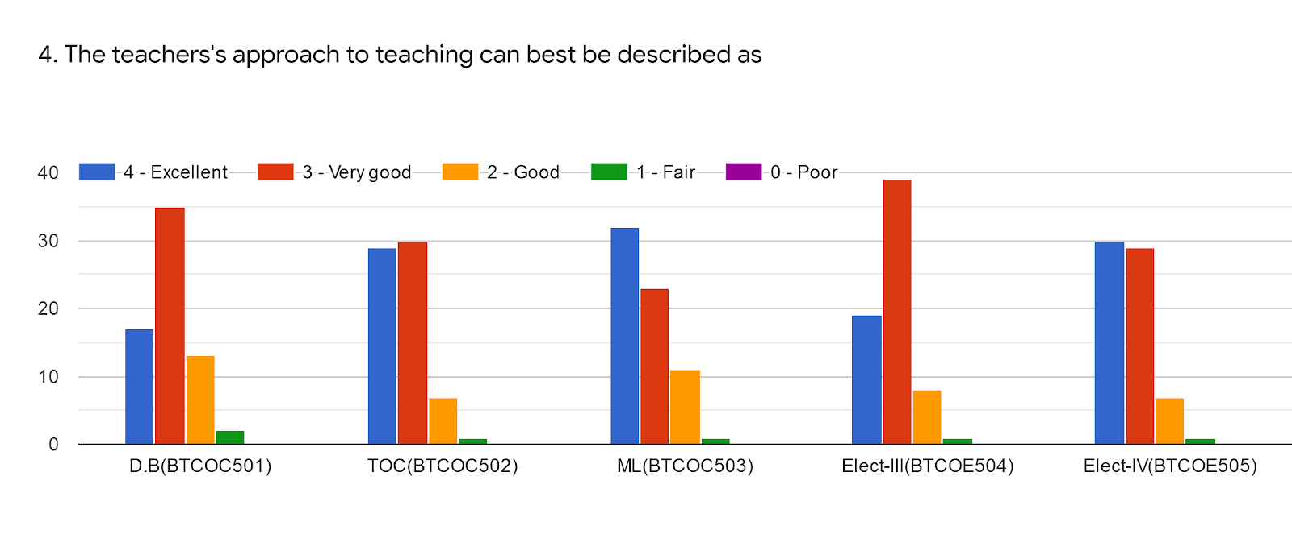
Subject Name | DB(BTCOC501) | TOC(BTCOC502) | ML(BTCOC503) | EL-III(BTCOC504) | EL-IV(BTCOC505)
Name of Faculty | Dr.V.K.Bhosale | Mrs Mandhare R.M | Ms Mulla S.Y | Dr Mirajkar G.S | Mr Pathak P.A
Excellent | 18 | 29 | 32 | 19 | 30 | 31%
Very Good | 35 | 30 | 24 | 39 | 29 | 39%
Good | 12 | 07 | 10 | 07 | 07 | 10%
Average | 2 | 01 | 01 | 02 | 01 | 1%
Poor | 00 | 00 | 00 | 00 | 00 | 0%

Slide 7
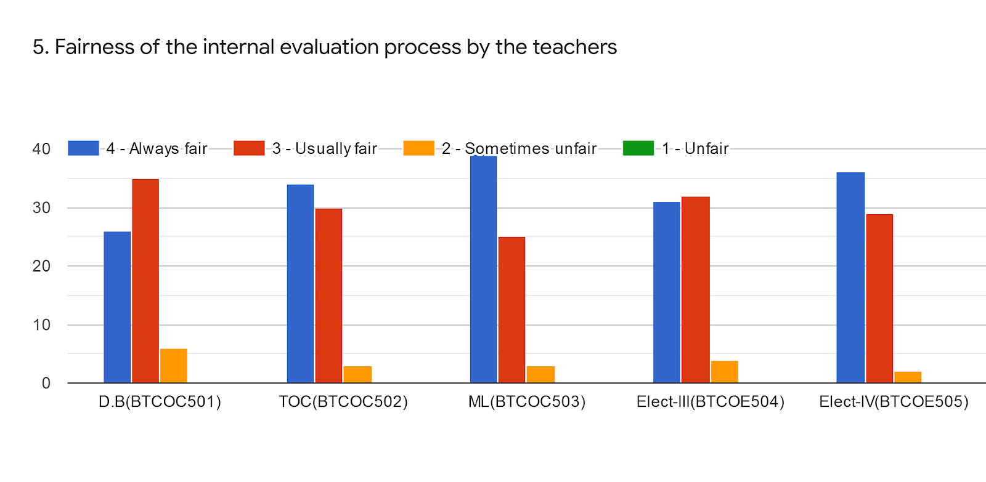
Subject Name | DB(BTCOC501) | TOC(BTCOC502) | ML(BTCOC503) | EL-III(BTCOC504) | EL-IV(BTCOC505) | %
Name of Faculty | Dr.V.K.Bhosale | Mrs Mandhare R.M | Ms Mulla S.Y | Dr Mirajkar G.S | Mr Pathak P.A
Always fair | 26 | 35 | 39 | 31 | 36 | 41%
Usually fair | 35 | 30 | 26 | 32 | 29 | 37%
Sometimes unfair | 6 | 2 | 02 | 4 | 2 | 3%
Unfair | 0 | 1 | 00 | 0 | 0 | 0%
Poor | 0 | 0 | 00 | 0 | 0 | 0%

Slide 8
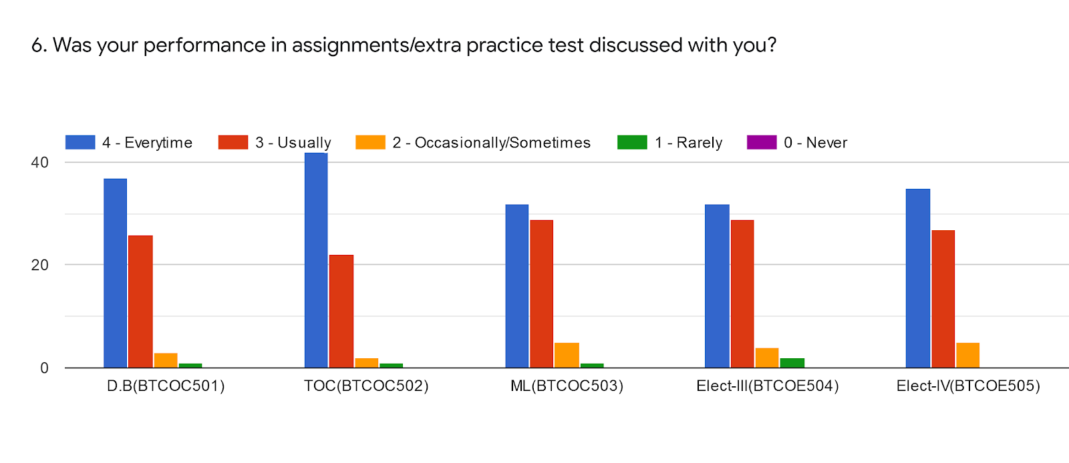
Subject Name | DB(BTCOC501) | TOC(BTCOC502) | ML(BTCOC503) | EL-III(BTCOC504) | EL-IV(BTCOC505) | %
Name of Faculty | Dr.V.K.Bhosale | Mrs Mandhare R.M | Ms Mulla S.Y | Dr Mirajkar G.S | Mr Pathak P.A
Everytime | 38 | 42 | 34 | 31 | 36 | 45%
Usually | 26 | 22 | 29 | 29 | 28 | 33%
Sometimes | 2 | 2 | 03 | 4 | 3 | 3%
Rarely | 1 | 1 | 01 | 3 | 0 | 1%
Never | 0 | 0 | 00 | 0 | 0 | 0%

Slide 9
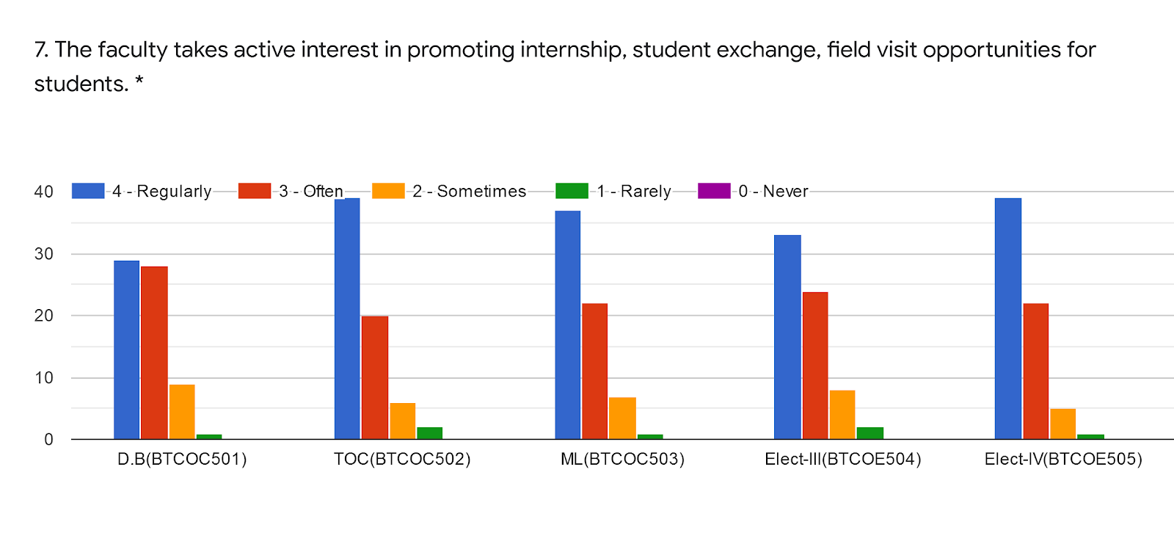
Subject Name | DB(BTCOC501) | TOC(BTCOC502) | ML(BTCOC503) | EL-III(BTCOC504) | EL-IV(BTCOC505) | %
Name of Faculty | Dr.V.K.Bhosale | Mrs Mandhare R.M | Ms Mulla S.Y | Mr Pathak P.A | Dr Mirajkar G.S
Regularly | 30 | 39 | 38 | 33 | 39 | 44%
Often | 28 | 20 | 22 | 24 | 22 | 28%
Sometimes | 8 | 6 | 6 | 8 | 5 | 8%
Rarely | 1 | 2 | 1 | 2 | 1 | 1%
Never | 0 | 0 | 0 | 0 | 0 | 0%

Slide 10
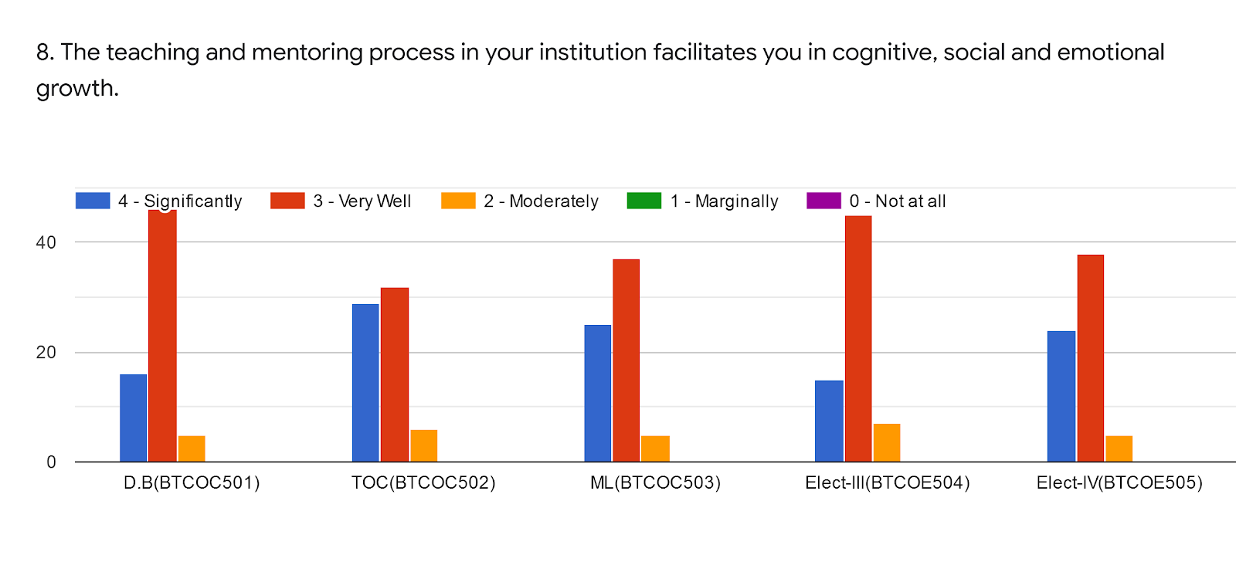
Subject Name | DB(BTCOC501) | TOC(BTCOC502) | ML(BTCOC503) | EL-III(BTCOC504) | EL-IV(BTCOC505) | %
Name of Faculty | Dr.V.K.Bhosale | Mrs Mandhare R.M | Ms Mulla S.Y | Dr Mirajkar G.S | Mr Pathak P.A
Significantly | 17 | 29 | 25 | 15 | 23 | 54%
Very Well | 45 | 32 | 38 | 46 | 39 | 49%
Moderately | 5 | 06 | 04 | 6 | 5 | 6%
Marginally | 00 | 00 | 00 | 0 | 0 | 0%
Not at all | 00 | 00 | 00 | 0 | 0 | 0%

Slide 11
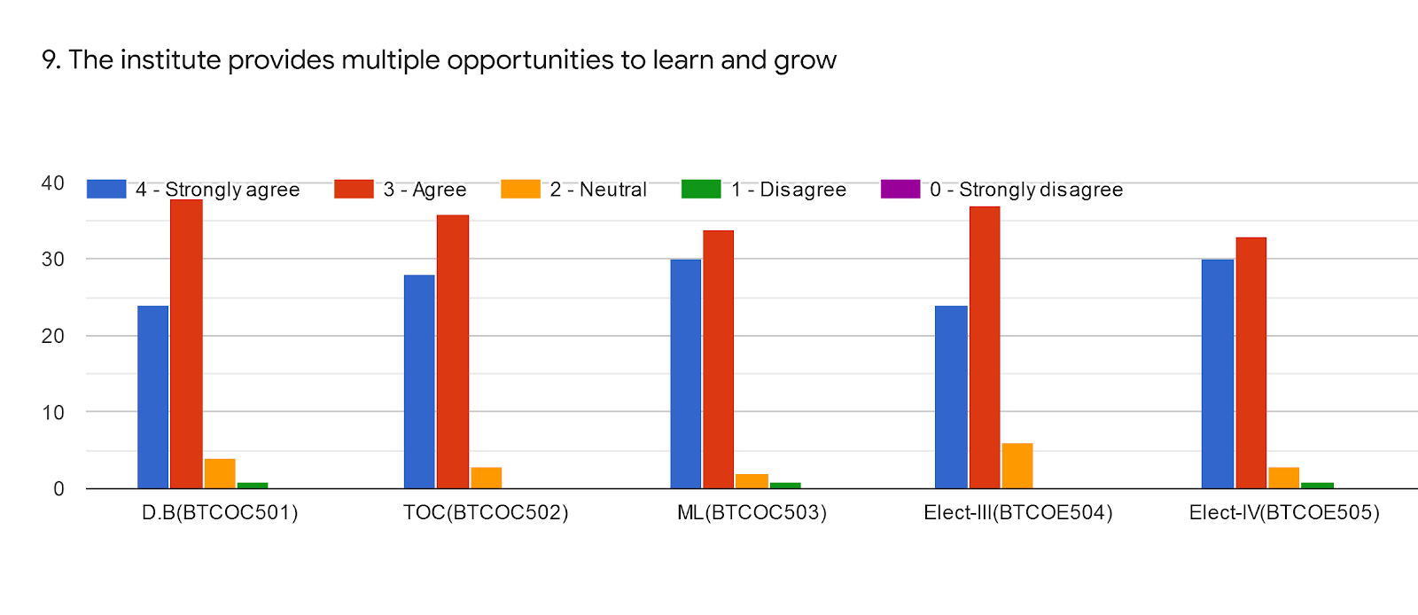
Subject Name | DB(BTCOC501) | TOC(BTCOC502) | ML(BTCOC503) | EL-III(BTCOC504) | EL-IV(BTCOC505) | %
Name of Faculty | Dr.V.K.Bhosale | Mrs Mandhare R.M | Ms Mulla S.Y | Mr Pathak P.A | Dr Mirajkar G.S
Significantly | 24 | 28 | 30 | 24 | 30 | 32%
Very well | 38 | 32 | 34 | 38 | 34 | 43%
Moderately | 4 | 7 | 02 | 5 | 2 | 4%
Marginally | 1 | 0 | 01 | 0 | 1 | 0%
Not at all | 00 | 0 | 00 | 0 | 0 | 0%

Slide 12
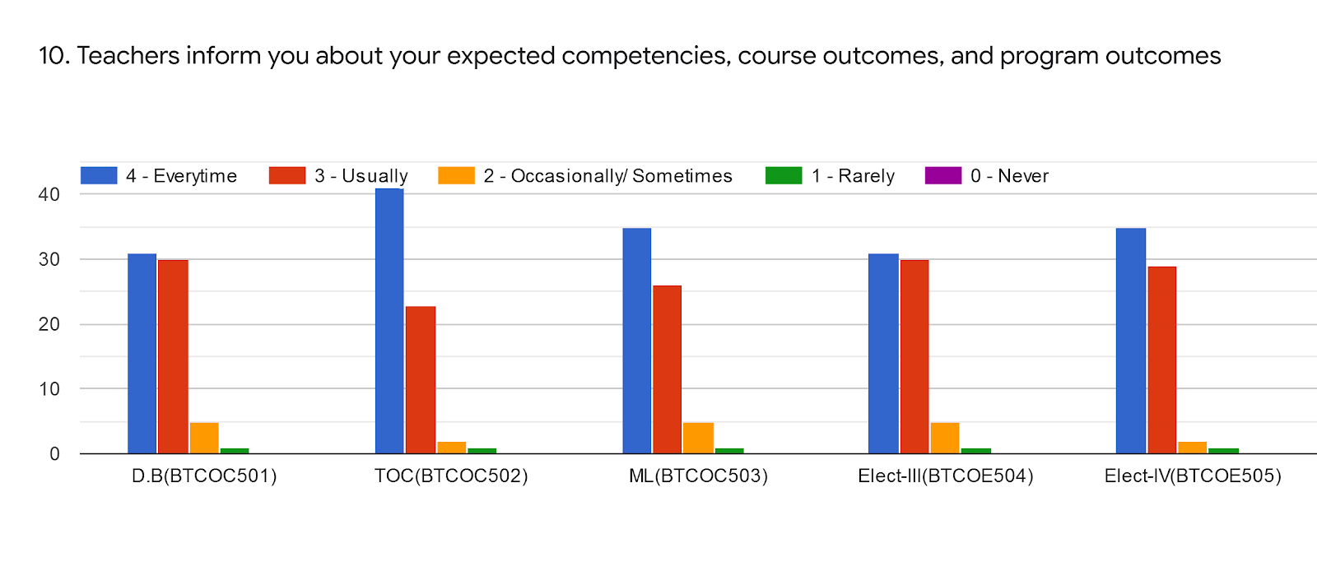
Subject Name | DB(BTCOC501) | TOC(BTCOC502) | ML(BTCOC503) | EL-III(BTCOC504) | EL-IV(BTCOC505) | %
Name of Faculty | Dr.V.K.Bhosale | Mrs Mandhare R.M | Ms Mulla S.Y | Dr Mirajkar G.S | Mr Pathak P.A
Everytime | 31 | 42 | 35 | 31 | 35 | 43%
Usually | 30 | 22 | 26 | 30 | 29 | 34%
Sometimes | 5 | 2 | 05 | 5 | 2 | 4%
Rarely | 1 | 1 | 01 | 1 | 2 | 1%
Never | 00 | 0 | 00 | 0 | 0 | 0%

Slide 13
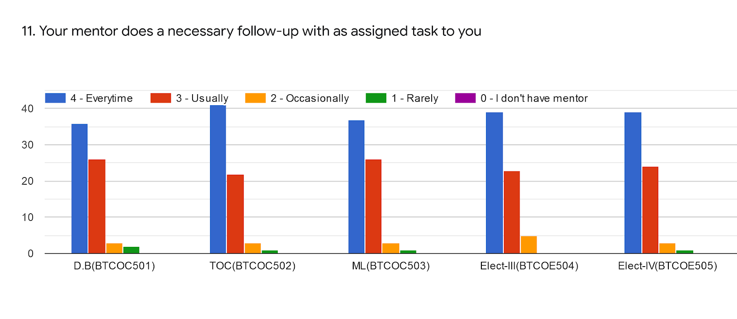
Subject Name | DB(BTCOC501) | TOC(BTCOC502) | ML(BTCOC503) | EL-III(BTCOC504) | EL-IV(BTCOC505) | %
Name of Faculty | Dr.V.K.Bhosale | Mrs Mandhare R.M | Ms Mulla S.Y | Dr Mirajkar G.S | Mr Pathak P.A
Everytime | 37 | 41 | 37 | 39 | 39 | 48%
Usually | 25 | 22 | 26 | 23 | 23 | 29%
Sometime | 3 | 3 | 03 | 5 | 4 | 4%
Rarely | 2 | 1 | 01 | 0 | 1 | 1%
I don't have mentor | 00 | 0 | 00 | 0 | 0 | 0%

Slide 14
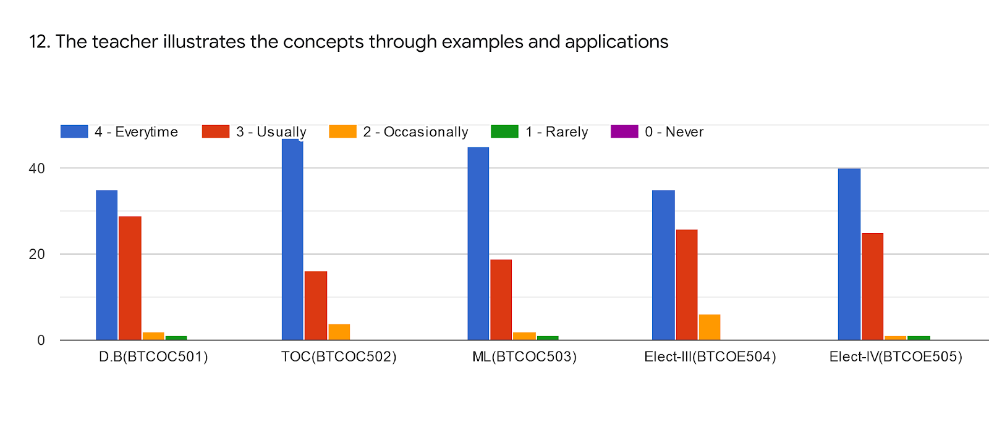
Subject Name | DB(BTCOC501) | TOC(BTCOC502) | ML(BTCOC503) | EL-III(BTCOC504) | EL-IV(BTCOC505) | %
Name of Faculty | Dr.V.K.Bhosale | Mrs Mandhare R.M | Ms Mulla S.Y | Dr Mirajkar G.S | Mr Pathak P.A
Everytime | 35 | 47 | 45 | 37 | 40 | 50%
Usually | 29 | 17 | 19 | 22 | 23 | 27%
Sometimes | 2 | 3 | 02 | 8 | 2 | 4%
Rarely | 1 | 0 | 01 | 0 | 2 | 0%
Never | 00 | 0 | 00 | 0 | 0 | 0%

Slide 15
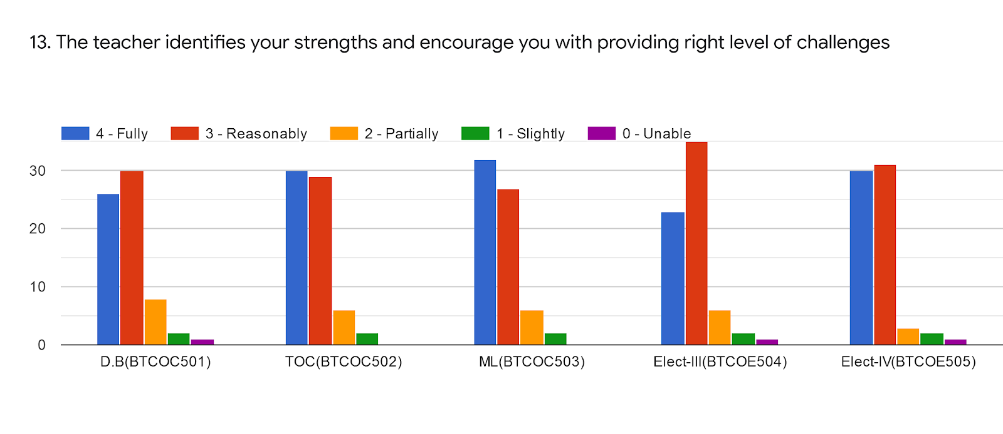
Subject Name | DB(BTCOC501) | TOC(BTCOC502) | ML(BTCOC503) | EL-III(BTCOC504) | EL-IV(BTCOC505) | %
Name of Faculty | Dr.V.K.Bhosale | Mrs Mandhare R.M | Ms Mulla S.Y | Dr Mirajkar G.S | Mr Pathak P.A
Fully | 26 | 30 | 32 | 22 | 30 | 34%
Reasonable | 30 | 29 | 27 | 35 | 31 | 37%
Partially | 7 | 6 | 06 | 6 | 3 | 6%
Slightly | 3 | 2 | 02 | 3 | 2 | 2%
Unable | 1 | 0 | 00 | 1 | 1 | 0%

Slide 16
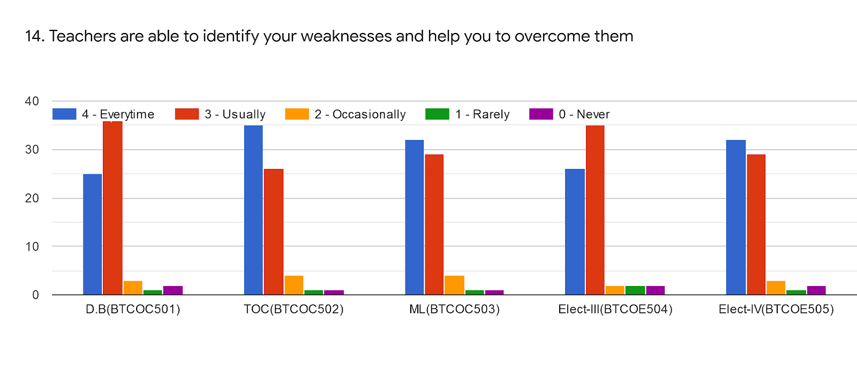
Subject Name | DB(BTCOC501) | TOC(BTCOC502) | ML(BTCOC503) | EL-III(BTCOC504) | EL-IV(BTCOC505) | %
Name of Faculty | Dr.V.K.Bhosale | Mrs Mandhare R.M | Ms Mulla S.Y | Dr Mirajkar G.S
Everytime | 25 | 35 | 32 | 26 | 32 | 29%
Usually | 36 | 26 | 29 | 35 | 29 | 38%
Sometimes | 3 | 4 | 04 | 2 | 3 | 3%
Rarely | 1 | 1 | 01 | 2 | 1 | 1%
Never | 2 | 1 | 01 | 2 | 2 | 1%

Slide 17
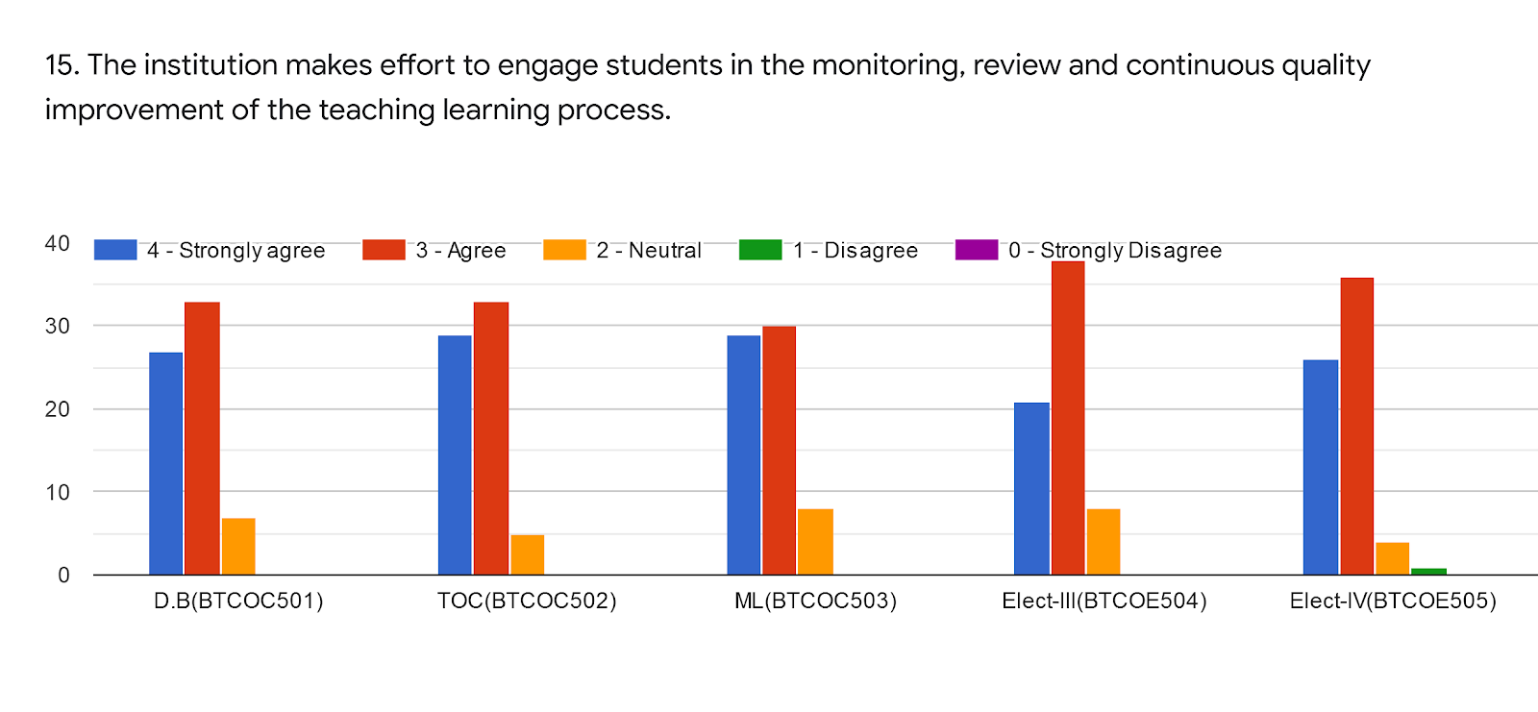
Subject Name | DB(BTCOC501) | TOC(BTCOC502) | ML(BTCOC503) | EL-III(BTCOC504) | EL-IV(BTCOC505) | %
Name of Faculty | Dr.V.K.Bhosale | Mrs Mandhare R.M | Ms Mulla S.Y | Dr Mirajkar G.S | Mr Pathak P.A
Strongly agree | 27 | 29 | 29 | 21 | 21 | 31%
Agree | 33 | 33 | 30 | 38 | 36 | 42%
Neutral | 7 | 5 | 08 | 8 | 8 | 8%
Disagree | 00 | 0 | 00 | 0 | 2 | 0%
Strongly disagree | 00 | 0 | 00 | 0 | 0 | 0

Slide 18
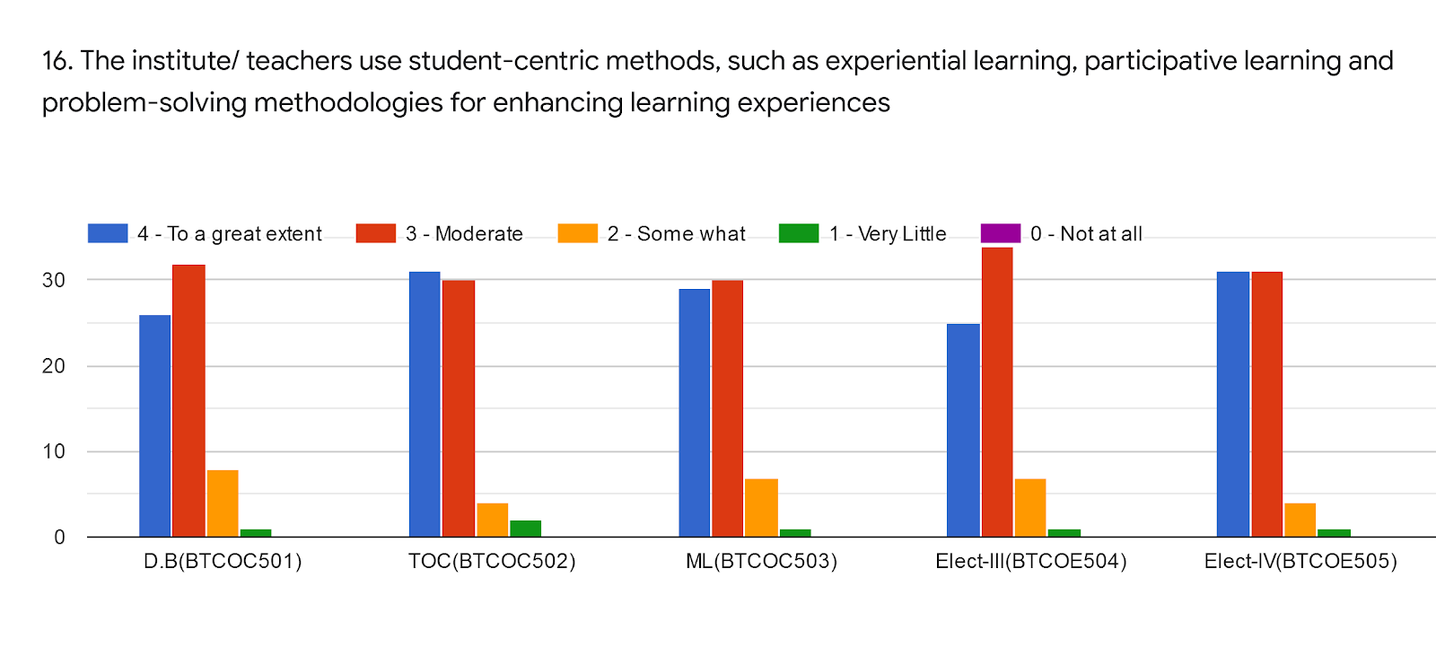
Subject Name | DB(BTCOC501) | TOC(BTCOC502) | ML(BTCOC503) | EL-III(BTCOC504) | EL-IV(BTCOC505) | %
Name of Faculty | Dr.V.K.Bhosale | Mrs Mandhare R.M | Ms Mulla S.Y | Dr Mirajkar G.S
To a extent | 26 | 31 | 29 | 25 | 31 | 35%
Moderate | 33 | 30 | 30 | 34 | 31 | 39%
Some what | 7 | 4 | 07 | 7 | 4 | 7%
Very little | 1 | 2 | 01 | 1 | 1 | 1%
Not at all | 00 | 0 | 00 | 0 | 0 | 0%

Slide 19
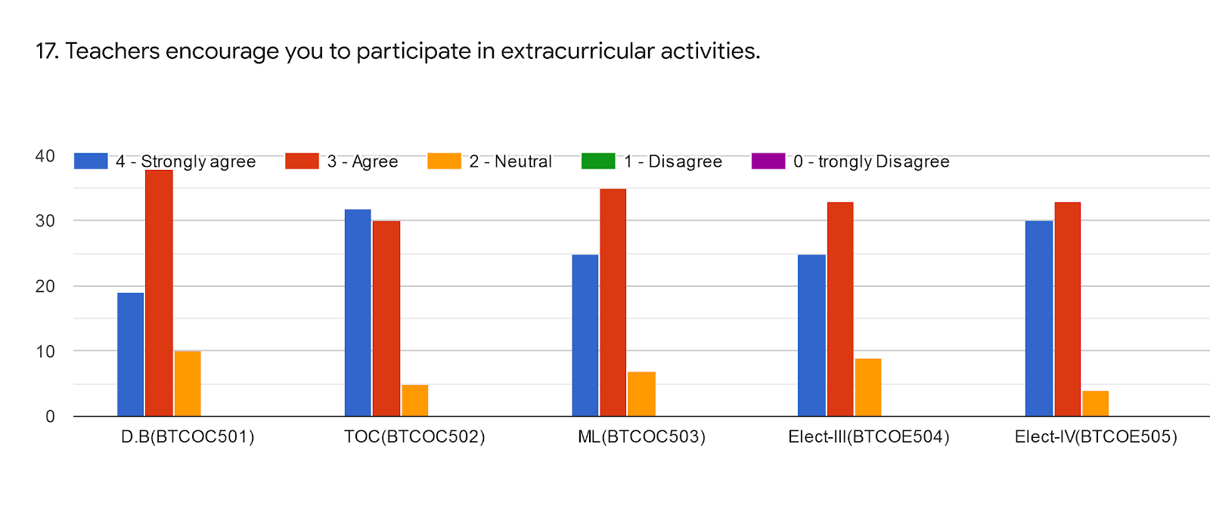
Subject Name | DB(BTCOC501) | TOC(BTCOC502) | ML(BTCOC503) | EL-III(BTCOC504) | EL-IV(BTCOC505) | %
Name of Faculty | Dr.V.K.Bhosale | Mrs Mandhare R.M | Ms Mulla S.Y | Dr Mirajkar G.S | Mr Pathak P.A
Strongly agree | 19 | 32 | 25 | 25 | 30 | 32%
Agree | 38 | 30 | 35 | 33 | 33 | 42%
Neutral | 10 | 5 | 07 | 9 | 4 | 8%
Disagree | 00 | 0 | 00 | 0 | 0 | 0%
Strongly disagree | 00 | 0 | 00 | 0 | 0 | 0%

Slide 20
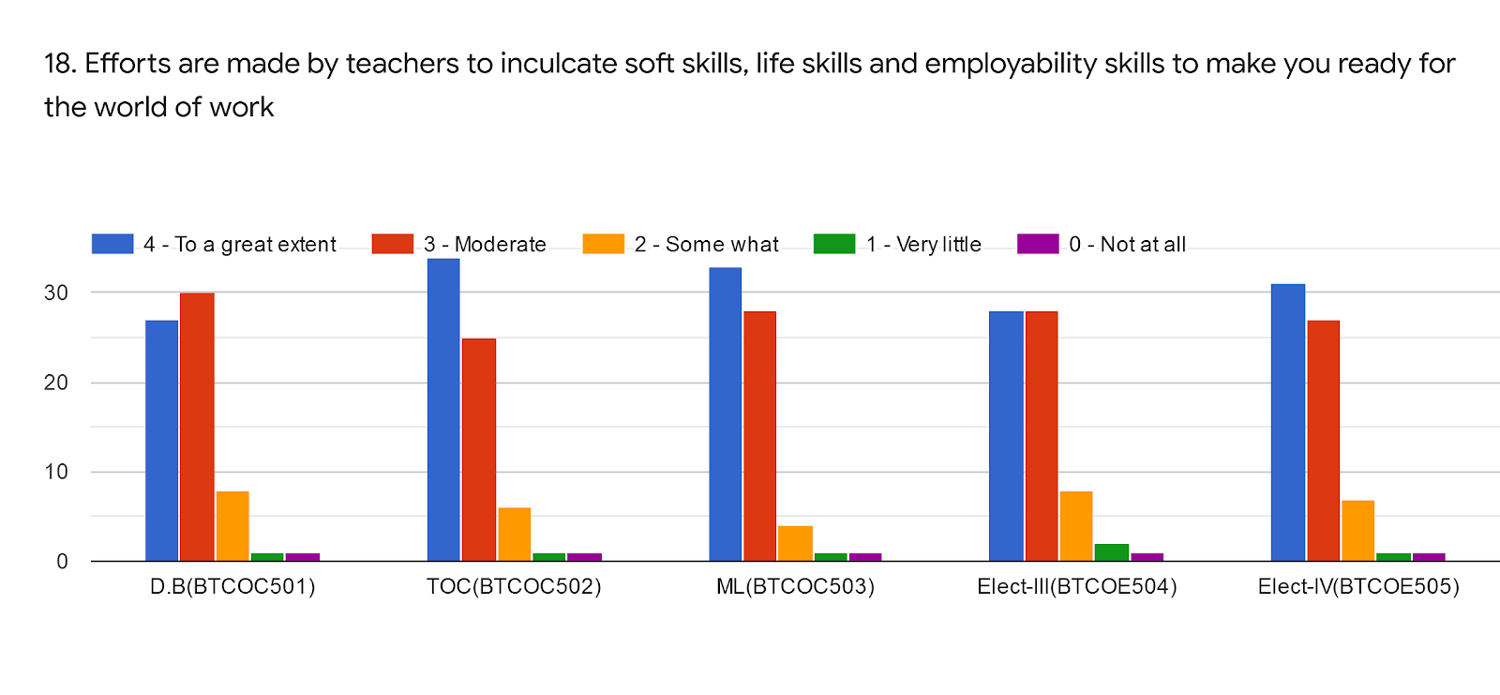
Subject Name | DB(BTCOC501) | TOC(BTCOC502) | ML(BTCOC503) | EL-III(BTCOC504) | EL-IV(BTCOC505) | %
Name of Faculty | Dr.V.K.Bhosale | Mrs Mandhare R.M | Ms Mulla S.Y | Dr Mirajkar G.S | Mr Pathak P.A
To a great extent | 27 | 34 | 33 | 28 | 32 | 38%
Moderate | 30 | 25 | 28 | 28 | 26 | 34%
Some what | 8 | 6 | 04 | 7 | 7 | 7%
Very little | 1 | 1 | 01 | 3 | 1 | 1%
Not at all | 1 | 1 | 01 | 1 | 1 | 1%

Slide 21
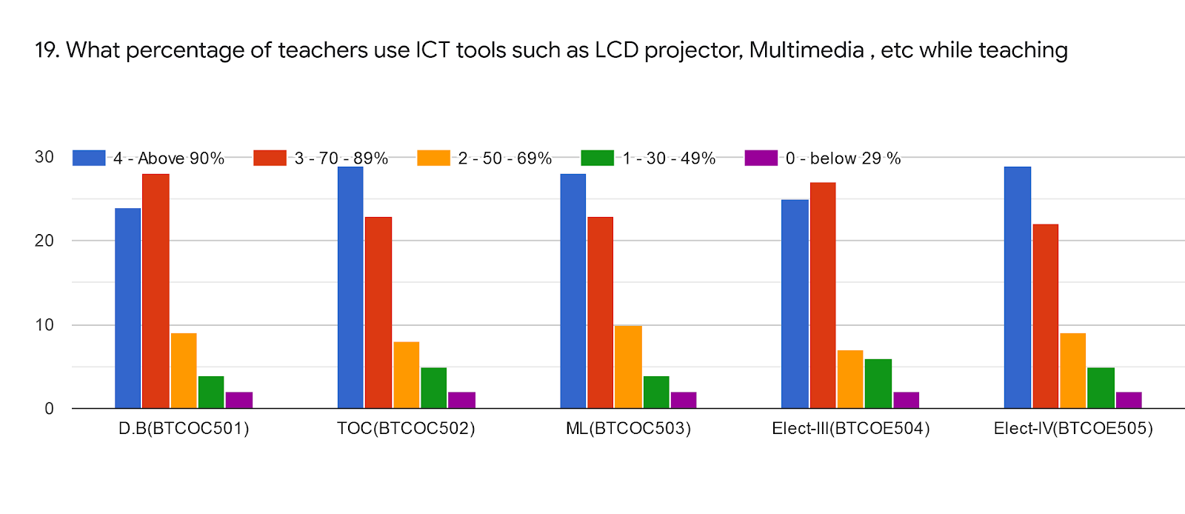
Subject Name | DB(BTCOC501) | TOC(BTCOC502) | ML(BTCOC503) | EL-III(BTCOC504) | EL-IV(BTCOC505) | %
Name of Faculty | Dr.V.K.Bhosale | Mrs Mandhare R.M | Ms Mulla S.Y | Dr Mirajkar G.S | Mr.Pathak P.A.
Above 90℅ | 24 | 28 | 27 | 25 | 28 | 32%
70 - 89% | 27 | 24 | 24 | 27 | 24 | 31%
50 - 69% | 9 | 8 | 10 | 6 | 9 | 10%
30 - 49% | 4 | 5 | 04 | 6 | 5 | 5%
29% | 3 | 2 | 02 | 3 | 1 | 2%

Slide 22
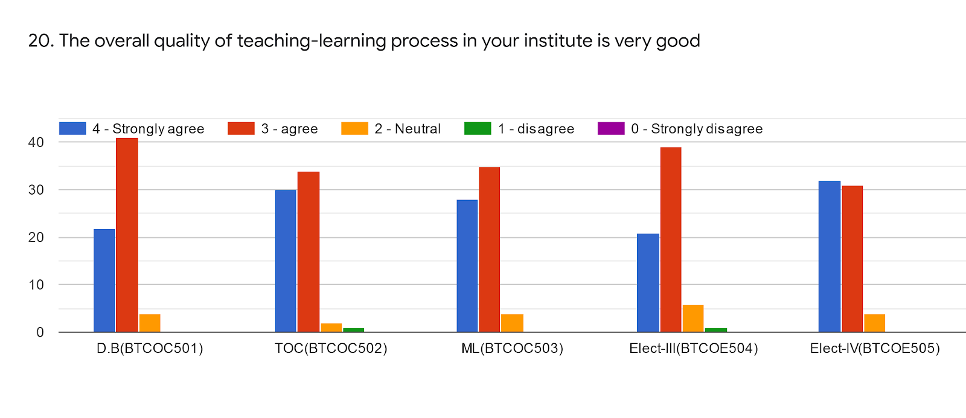
Subject Name | DB(BTCOC501) | TOC(BTCOC502) | ML(BTCOC503) | EL-III(BTCOC504) | EL-IV(BTCOC505) | %
Name of Faculty | Dr.V.K.Bhosale | Mrs Mandhare R.M | Ms Mulla S.Y | Dr Mirajkar G.S | Mr.Pathak P.A.
Strongly agree | 22 | 30 | 28 | 21 | 32 | 33%
Agree | 41 | 34 | 35 | 39 | 31 | 44%
Neutral | 4 | 2 | 4 | 6 | 4 | 4%
Disagree | 00 | 1 | 0 | 1 | 0 | 0%
Strongly disagree | 00 | 0 | 0 | 0 | 0 | 0%

Slide 23
Give 3 Observation/Suggestion to improve the overall teaching learning experience of respective teachers
Overall is very good , satisfied and nice
Practical based learning needed
No suggestions for the teaching staff They are really giving their best. I could not find any weak point as even due to this pandemic situation, they are trying really hard to teach us everything properly.
Cp lecture have to conduct practical oriented.
Students have not that kind of time from academic year for writing the assignment 3-3 times.
Online learning experience are wonderful for all subjects.
Increase soft skills program

Slide 24
Overall Analysis
Subject | Faculty | Appreciation | Suggestion for improvement
DB | VB | Syllabus Coverage, Overall teaching is good. ,Moderate use of ICT | Weak preparation for lecture. Need Improvement in follow up of assigned task. Weak encouragement of student to participate in extra curricular activities,
TOC | RM | Proper preparation of lecture, Use of ICT,Teacher takes effort for internship, softskill,employeability Teacher illustrate concept through example & application, | Need improvement in promoting internship, student exchange and field visit
ML | SM | Use of ICT , Teacher takes effort for internship, softskill,employeability Teacher identifies weakness & strength of student and helps to overcome it and provide proper level of challenge, Teacher illustrate concept through example & application, | Syllabus coverage is lagging, Needs to discuss course competencies, course outcome ,program outcome
ITR | GM | ,Teacher encourage student to participate in extra curricular activities | Weak use of ICT. Weak in follow-up of assigned task , Teacher is weak in identification of strength and weakness of student
BC | PP | Use of ICT , Teacher takes effort for internship, softskill,employeability , Teacher illustrate concept through example & application, | Needs to discuss course competencies, course outcome ,program outcome

