Slide 1
Arvind Gavali College of Engineering, Satara Department of Electrical Engineering Final Year Feedback
Month : September 2020 – 1st Week
Total Responses : 57
Total Class Strength : 78
Feedback Percentage :73.08%

Slide 2
FACULTY – SUBJECT DISTRIBUTION
Sr. No. | Subject | Abbrev. | Name of Faculty | Abbrev.
01 | Power System Operation and Control | PSOC | Ms. Shital S. Jadhav | SSJ
02 | High Voltage Engineering | HVE | Mrs. Eva Gupta | EG
03 | Electrical Drives | ED | Mr. B. M. Nayak | BMN
04 | Electrical Traction and Utilisation | ETU | Mr. Somesha Naik SR. | SRS
05 | HVDC Transmission and FACTS | HVDC and FACTS | .Mr. B. G. Nelogal | BGN

Slide 3
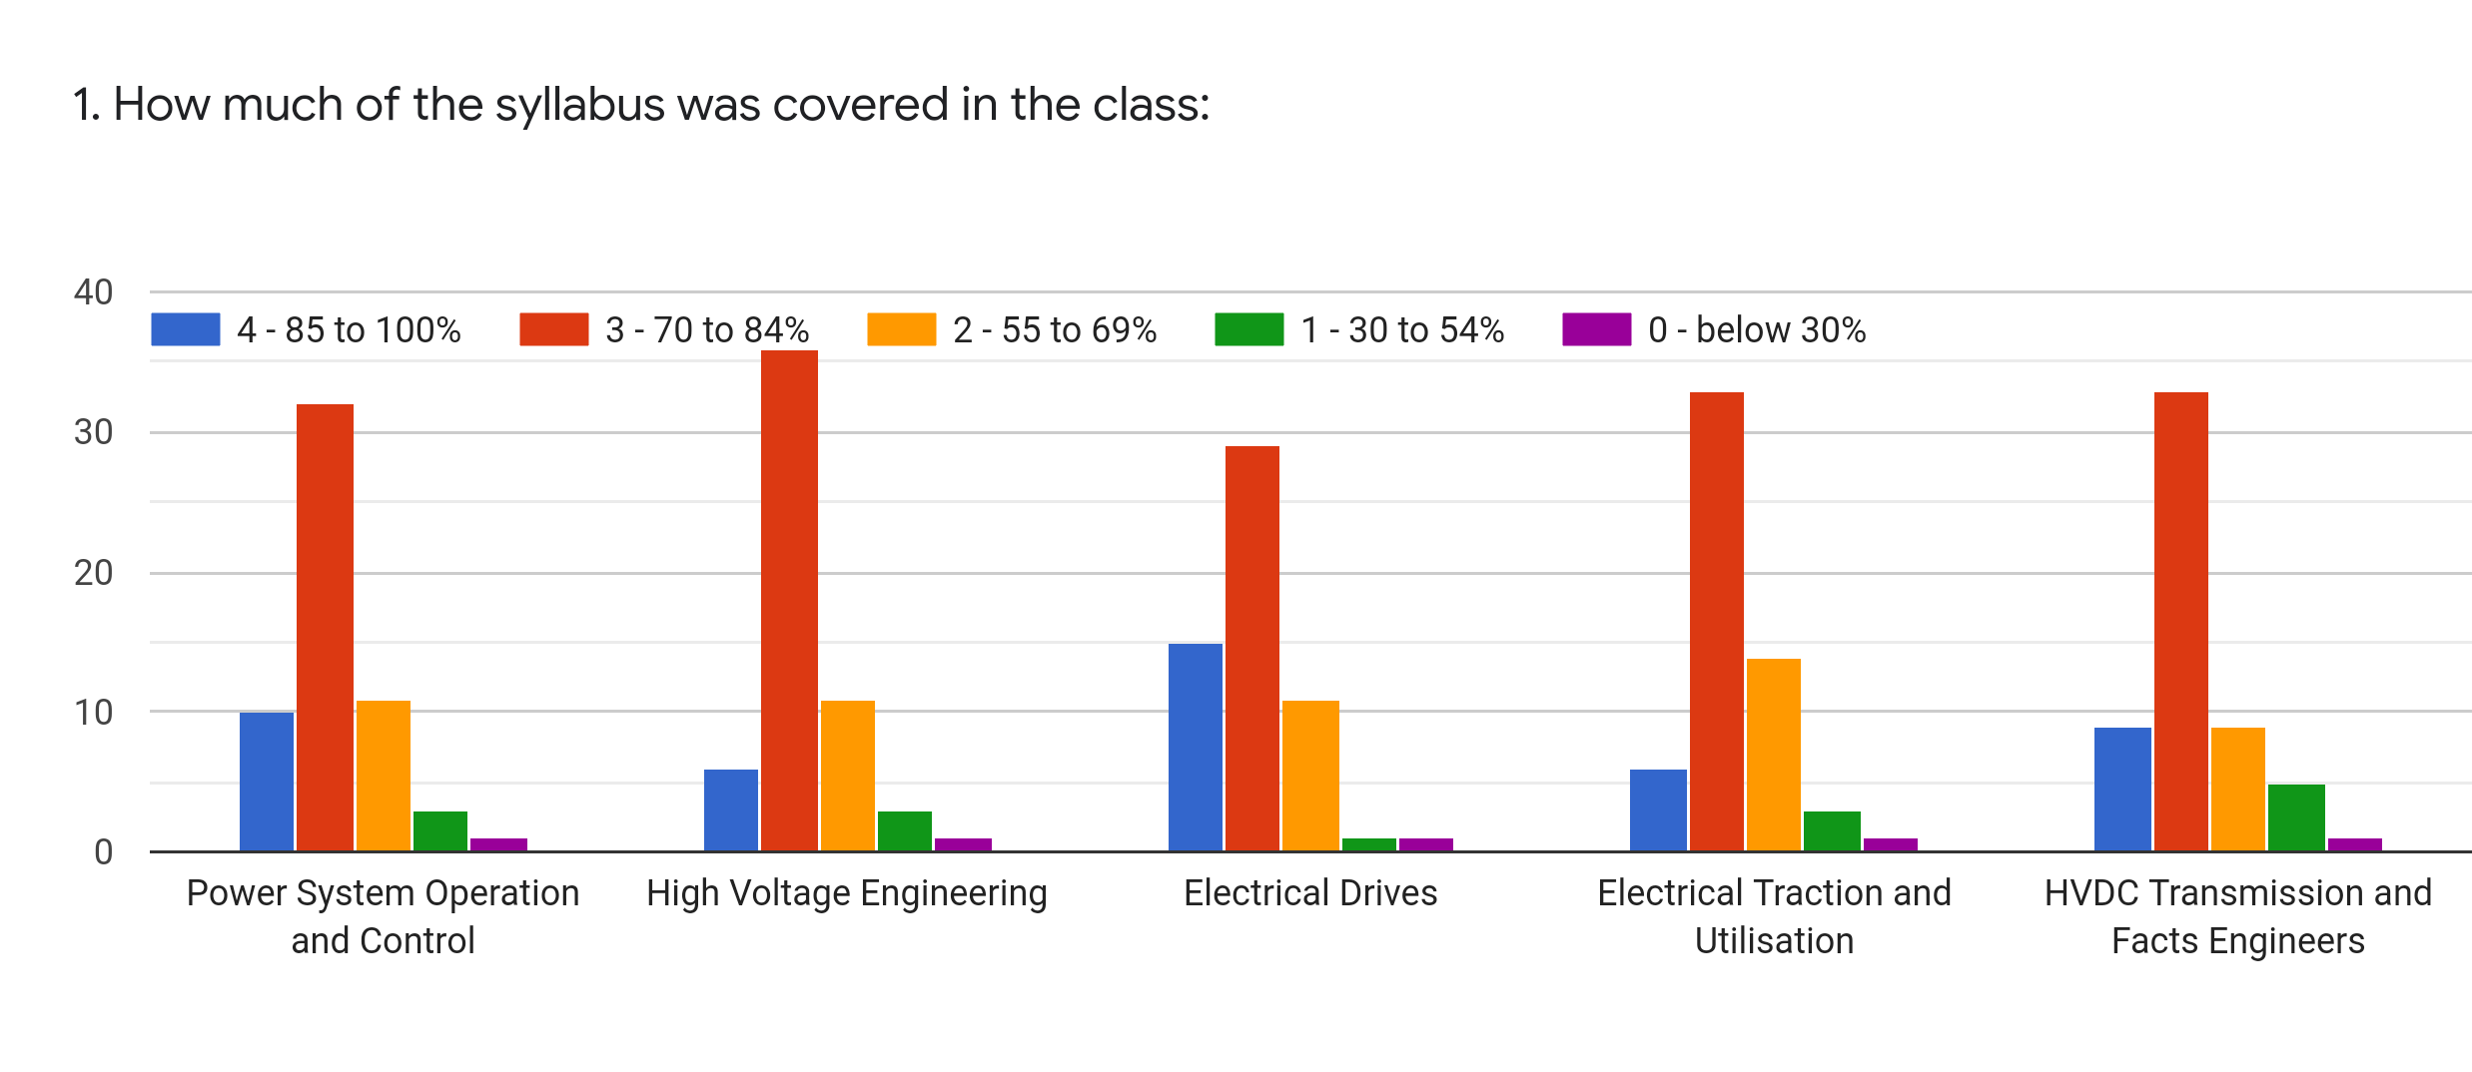
Faculty | SSJ | EG | BMN | SRS | BGN | %
Subject | PSOC | HVE | ED | ETU | HVDC and FACTS
85 -100 % | 10 | 6 | 15 | 6 | 9 | 16.14
70 - 84 % | 32 | 36 | 29 | 33 | 33 | 57.2
55 – 69 % | 11 | 11 | 11 | 14 | 9 | 19.65
30 – 54 % | 3 | 3 | 1 | 3 | 5 | 5.26
0- Below 30 % | 1 | 1 | 1 | 1 | 1 | 1.75

Slide 4
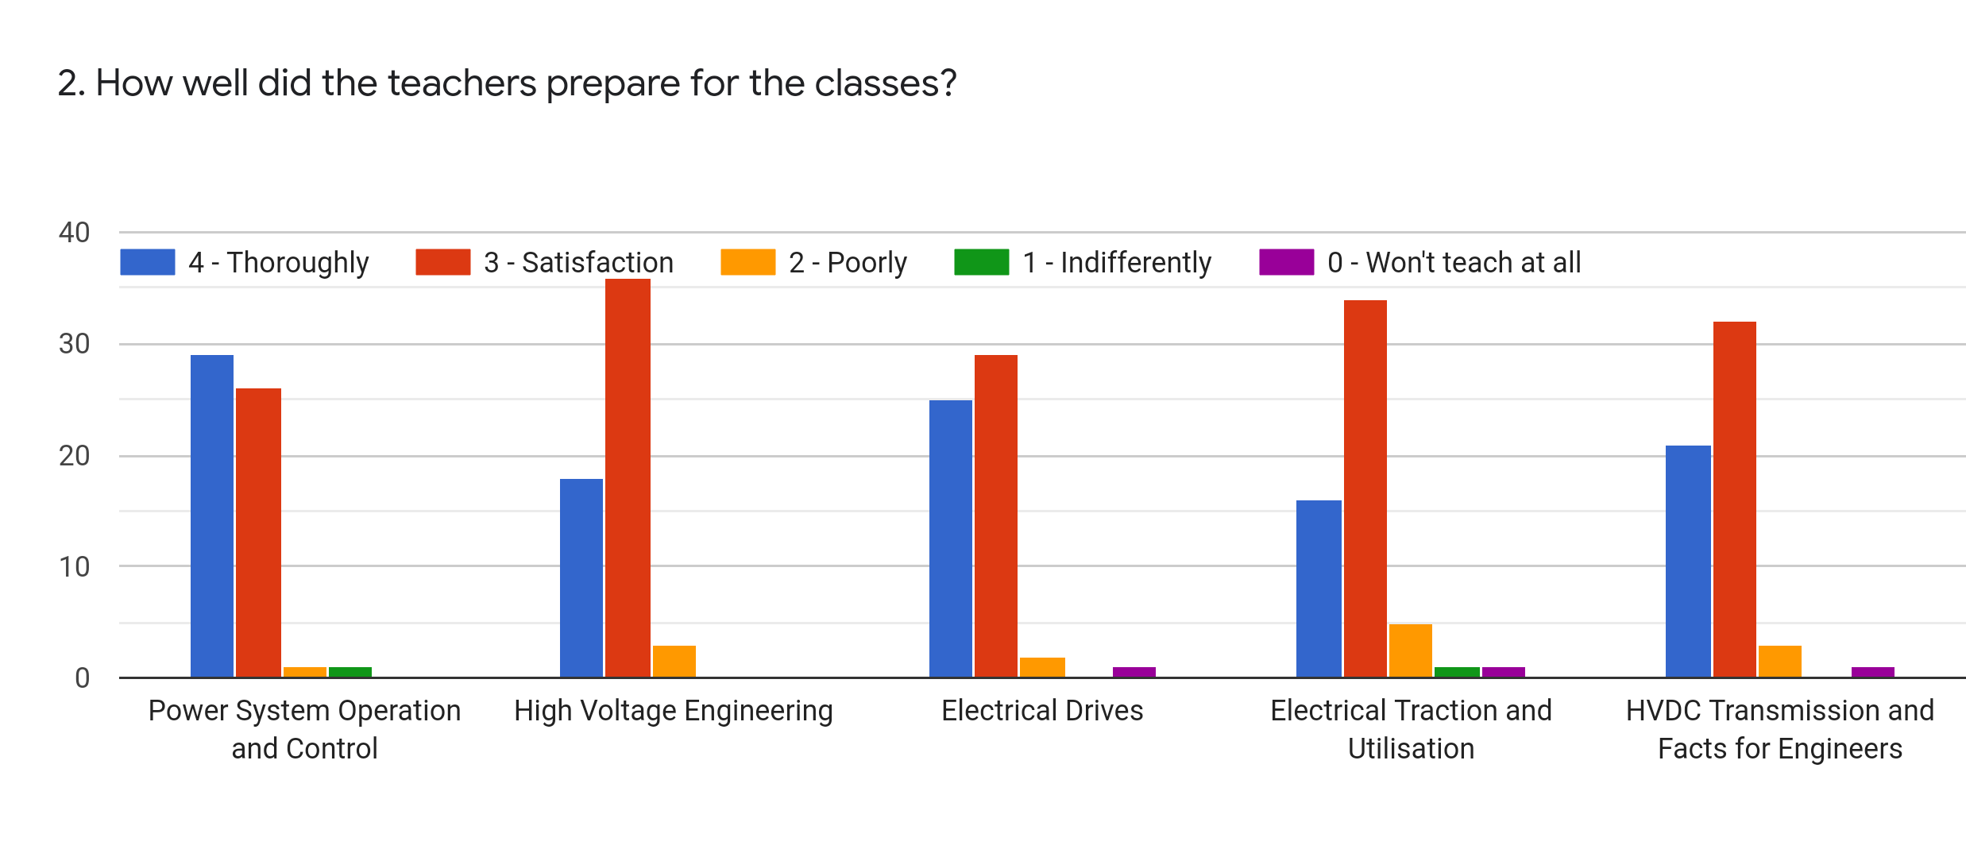
Faculty | SSJ | EG | BMN | SRS | BGN | %
Subject | PSOC | HVE | ED | ETU | HVDC and FACTS
Thoroughly | 29 | 18 | 25 | 16 | 21 | 38.25
Satisfaction | 26 | 36 | 29 | 34 | 32 | 55.09
Poorly | 1 | 3 | 2 | 5 | 3 | 4.91
Indifferently | 1 | 0 | 0 | 1 | 0 | 0.70
Wont Teach at all | 0 | 0 | 1 | 1 | 1 | 1.05

Slide 5
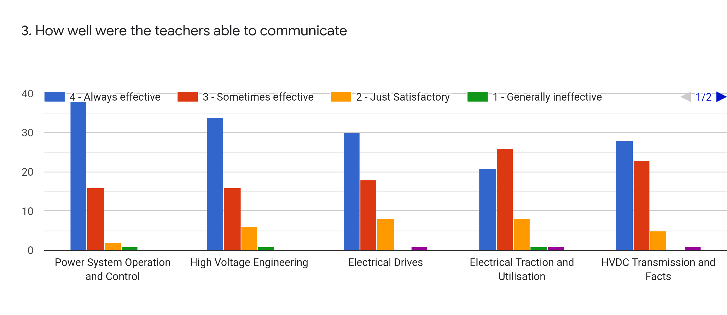
Faculty | SSJ | EG | BMN | SRS | BGN | %
Subject | PSOC | HVE | ED | ETU | HVDC and FACTS
Always Effective | 38 | 34 | 30 | 21 | 28 | 52.98
Sometime effective | 16 | 16 | 18 | 26 | 23 | 34.73
Just Satisfactory | 2 | 6 | 8 | 8 | 5 | 10.18
Generally Ineffective | 1 | 1 | 0 | 1 | 0 | 1.05
Very Poor Communication | 0 | 0 | 1 | 1 | 1 | 1.05

Slide 6
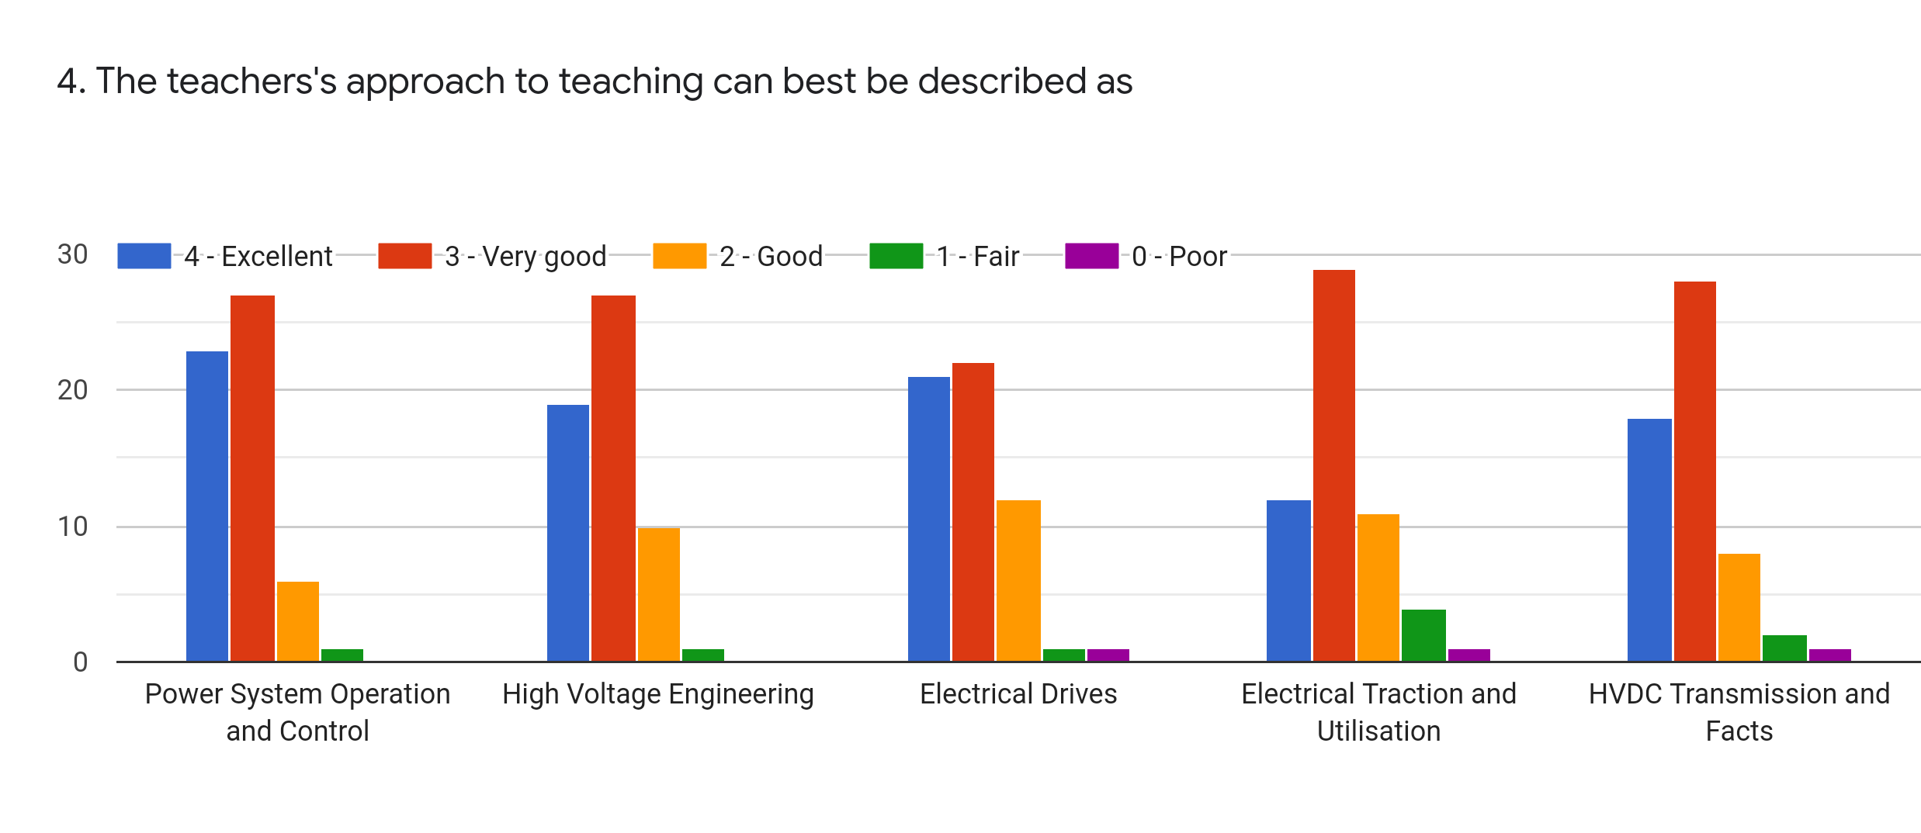
Faculty | SSJ | EG | BMN | SRS | BGN | %
Subject | PSOC | HVE | ED | ETU | HVDC and FACTS
Excellent | 23 | 19 | 21 | 12 | 18 | 32.63
Very Good | 27 | 27 | 22 | 29 | 28 | 46.67
Good | 6 | 10 | 12 | 11 | 8 | 16.49
Fair | 1 | 1 | 1 | 4 | 2 | 3.16
Poor | 0 | 0 | 1 | 1 | 1 | 1.05

Slide 7
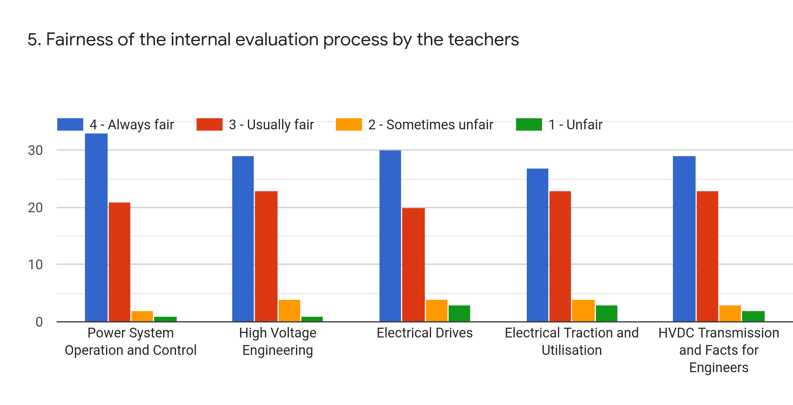
Faculty | SSJ | EG | BMN | SRS | BGN | %
Subject | PSOC | HVE | ED | ETU | HVDC and FACTS
Regularly | 33 | 29 | 30 | 27 | 29 | 51.93
Often | 21 | 23 | 20 | 23 | 23 | 38.60
Sometimes | 2 | 4 | 4 | 4 | 3 | 5.96
Rarely | 1 | 1 | 3 | 3 | 2 | 3.51
Never | 0 | 0 | 0 | 0 | 0 | 0

Slide 8
Faculty | SSJ | EG | BMN | SRS | BGN | %
Subject | PSOC | HVE | ED | ETU | HVDC and FACTS
Every time | 33 | 30 | 30 | 27 | 24 | 50.52
Usually | 19 | 22 | 23 | 22 | 26 | 39.30
Occasionally/ Sometimes | 5 | 5 | 3 | 7 | 6 | 9.12
Rarely | 0 | 0 | 0 | 0 | 0 | 0
Never | 0 | 0 | 1 | 1 | 1 | 1.05

Slide 9
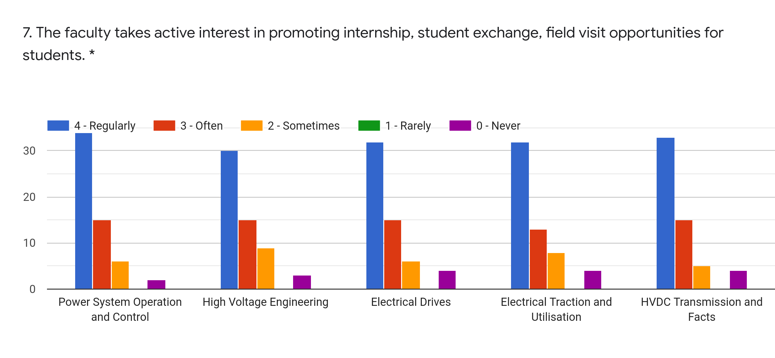
Faculty | SSJ | EG | BMN | SRS | BGN | %
Subject | PSOC | HVE | ED | ETU | HVDC and FACTS
Regularly | 34 | 30 | 32 | 32 | 33 | 56.49
Often | 15 | 15 | 15 | 13 | 15 | 25.61
Sometimes | 6 | 9 | 6 | 8 | 5 | 11.93
Rarely | 0 | 0 | 0 | 0 | 0 | 0
Never | 2 | 3 | 4 | 4 | 4 | 5.96

Slide 10
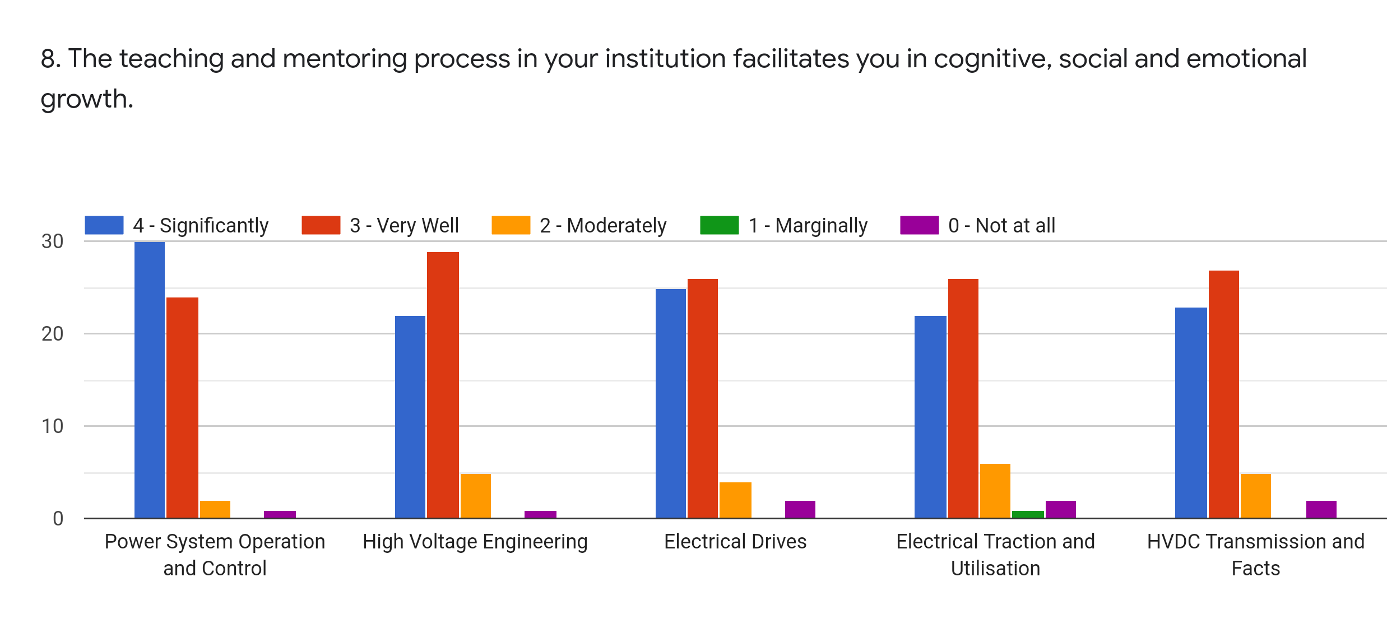
Faculty | SSJ | EG | BMN | SRS | BGN | %
Subject | PSOC | HVE | ED | ETU | HVDC and FACTS
Significantly | 30 | 22 | 25 | 22 | 23 | 42.81
Very Well | 24 | 29 | 26 | 26 | 27 | 46.31
Moderately | 2 | 5 | 4 | 6 | 5 | 7.72
Marginally | 0 | 0 | 0 | 1 | 0 | 0.35
Not at All | 1 | 1 | 2 | 2 | 2 | 2.81

Slide 11
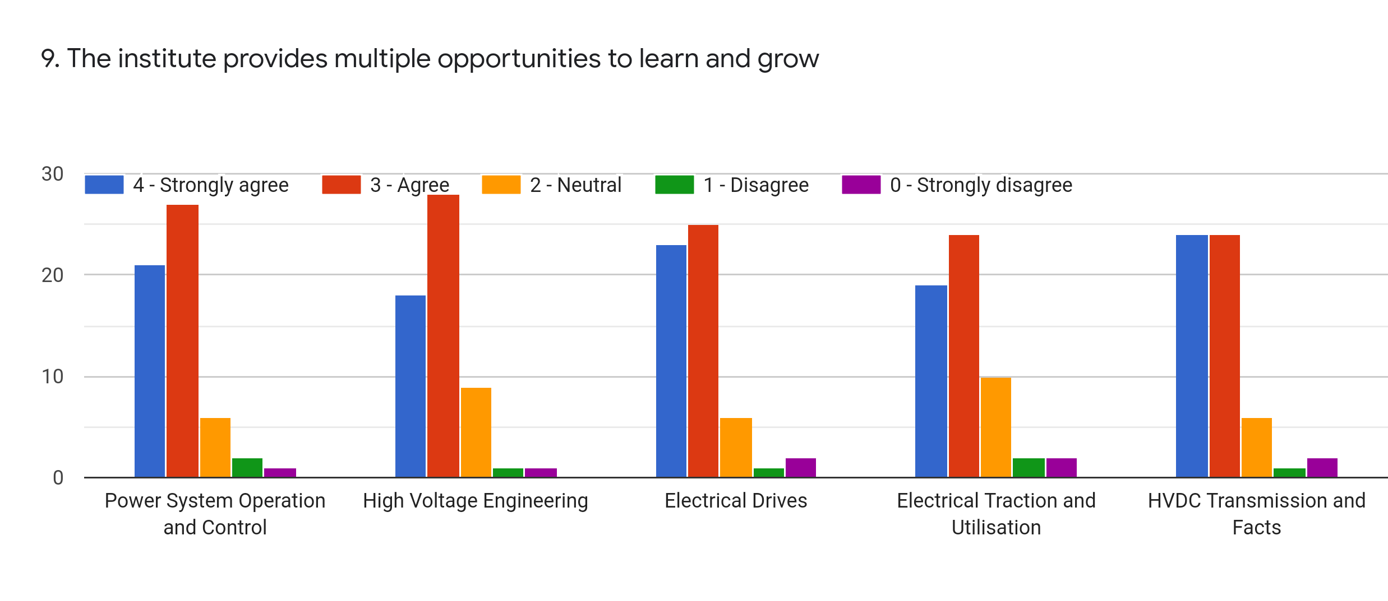
Faculty | SSJ | EG | BMN | SRS | BGN | %
Subject | PSOC | HVE | ED | ETU | HVDC and FACTS
Strongly Agree | 21 | 18 | 23 | 19 | 24 | 36.84
Agree | 27 | 28 | 25 | 24 | 24 | 44.91
Neutral | 6 | 9 | 6 | 10 | 6 | 12.98
Disagree | 2 | 1 | 1 | 2 | 1 | 2.46
Strongly Disagree | 1 | 1 | 2 | 2 | 2 | 2.80

Slide 12
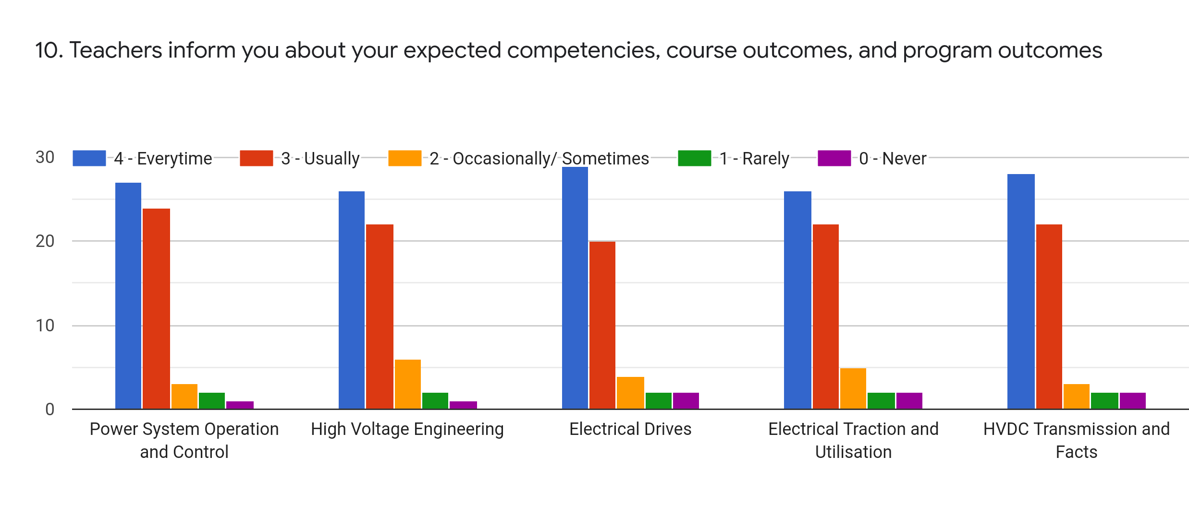
Faculty | SSJ | EG | BMN | SRS | BGN | %
Subject | PSOC | HVE | ED | ETU | HVDC and FACTS
Every time | 27 | 26 | 29 | 26 | 28 | 47.72
Usually | 24 | 22 | 20 | 22 | 22 | 38.60
Occasionally | 3 | 6 | 4 | 5 | 3 | 7.37
Rarely | 2 | 2 | 2 | 2 | 2 | 3.51
Never | 1 | 1 | 2 | 2 | 2 | 2.81

Slide 13
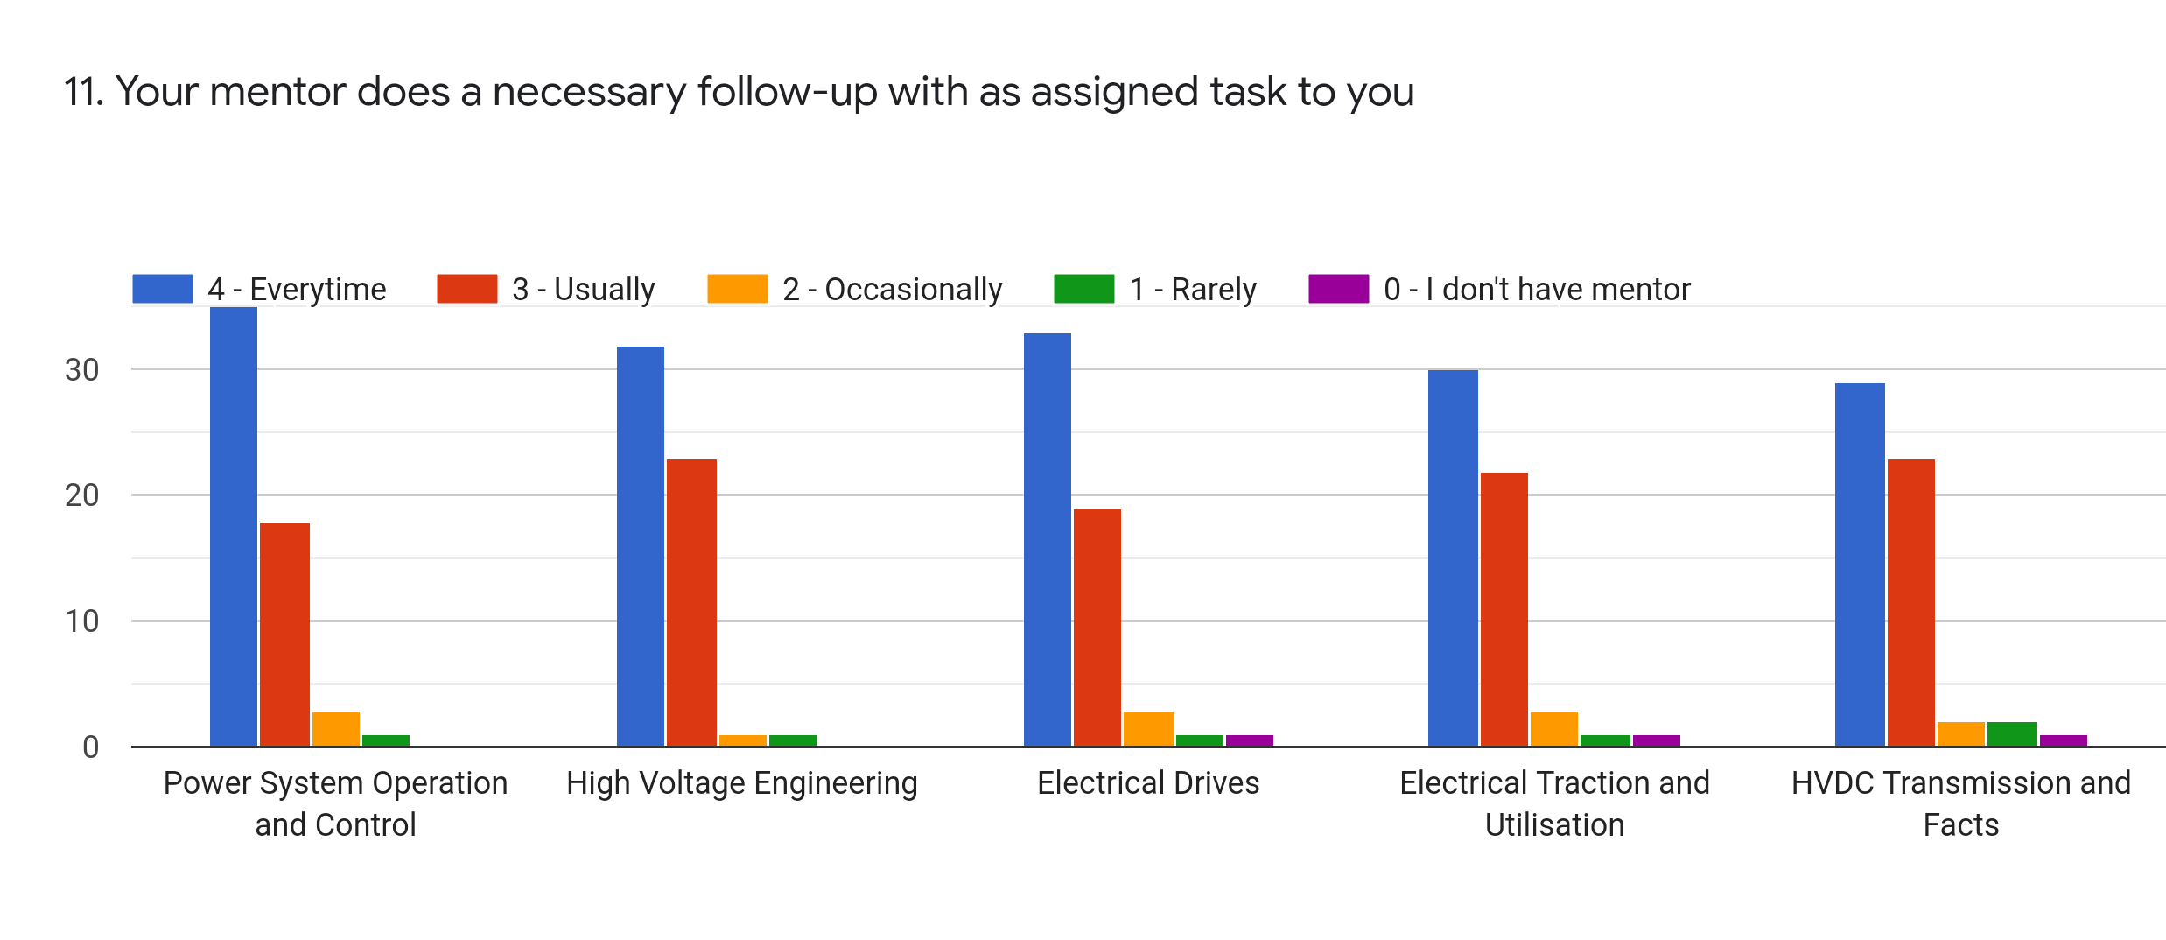
Faculty | SSJ | EG | BMN | SRS | BGN | %
Subject | PSOC | HVE | ED | ETU | HVDC and FACTS
Every time | 35 | 32 | 33 | 30 | 29 | 55.79
Usually | 19 | 23 | 19 | 22 | 23 | 37.19
Occasionally | 2 | 1 | 3 | 3 | 2 | 3.86
Rarely | 1 | 1 | 1 | 1 | 2 | 1.75
Never | 0 | 0 | 1 | 1 | 1 | 1.05

Slide 14
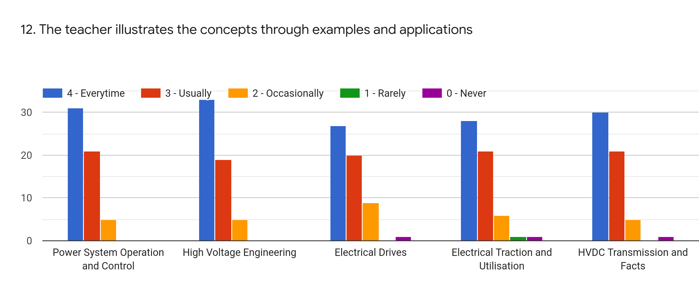
Faculty | SSJ | EG | BMN | SRS | BGN | %
Subject | PSOC | HVE | ED | ETU | HVDC and FACTS
Every time | 31 | 33 | 27 | 28 | 30 | 52.28
Usually | 21 | 19 | 20 | 21 | 21 | 35.79
Occasionally | 5 | 5 | 9 | 6 | 5 | 10.53
Rarely | 0 | 0 | 0 | 1 | 0 | 0.35
Never | 0 | 0 | 1 | 1 | 1 | 1.05

Slide 15
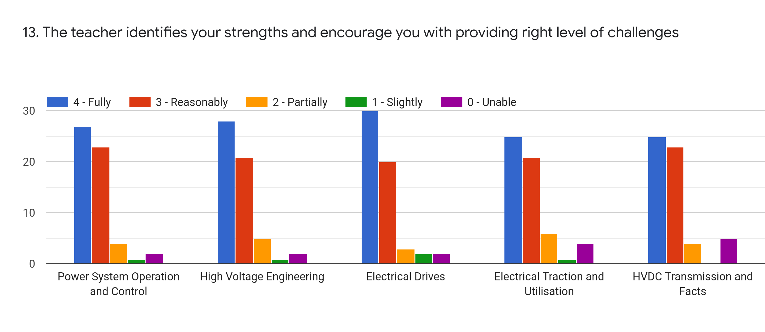
Faculty | SSJ | EG | BMN | SRS | BGN | %
Subject | PSOC | HVE | ED | ETU | HVDC and FACTS
Fully | 27 | 28 | 30 | 25 | 25 | 47.37
Reasonably | 23 | 21 | 20 | 21 | 23 | 37.90
Partially | 4 | 5 | 3 | 6 | 4 | 7.72
Slightly | 1 | 1 | 2 | 1 | 0 | 1.75
Unable | 2 | 2 | 2 | 4 | 5 | 5.26

Slide 16
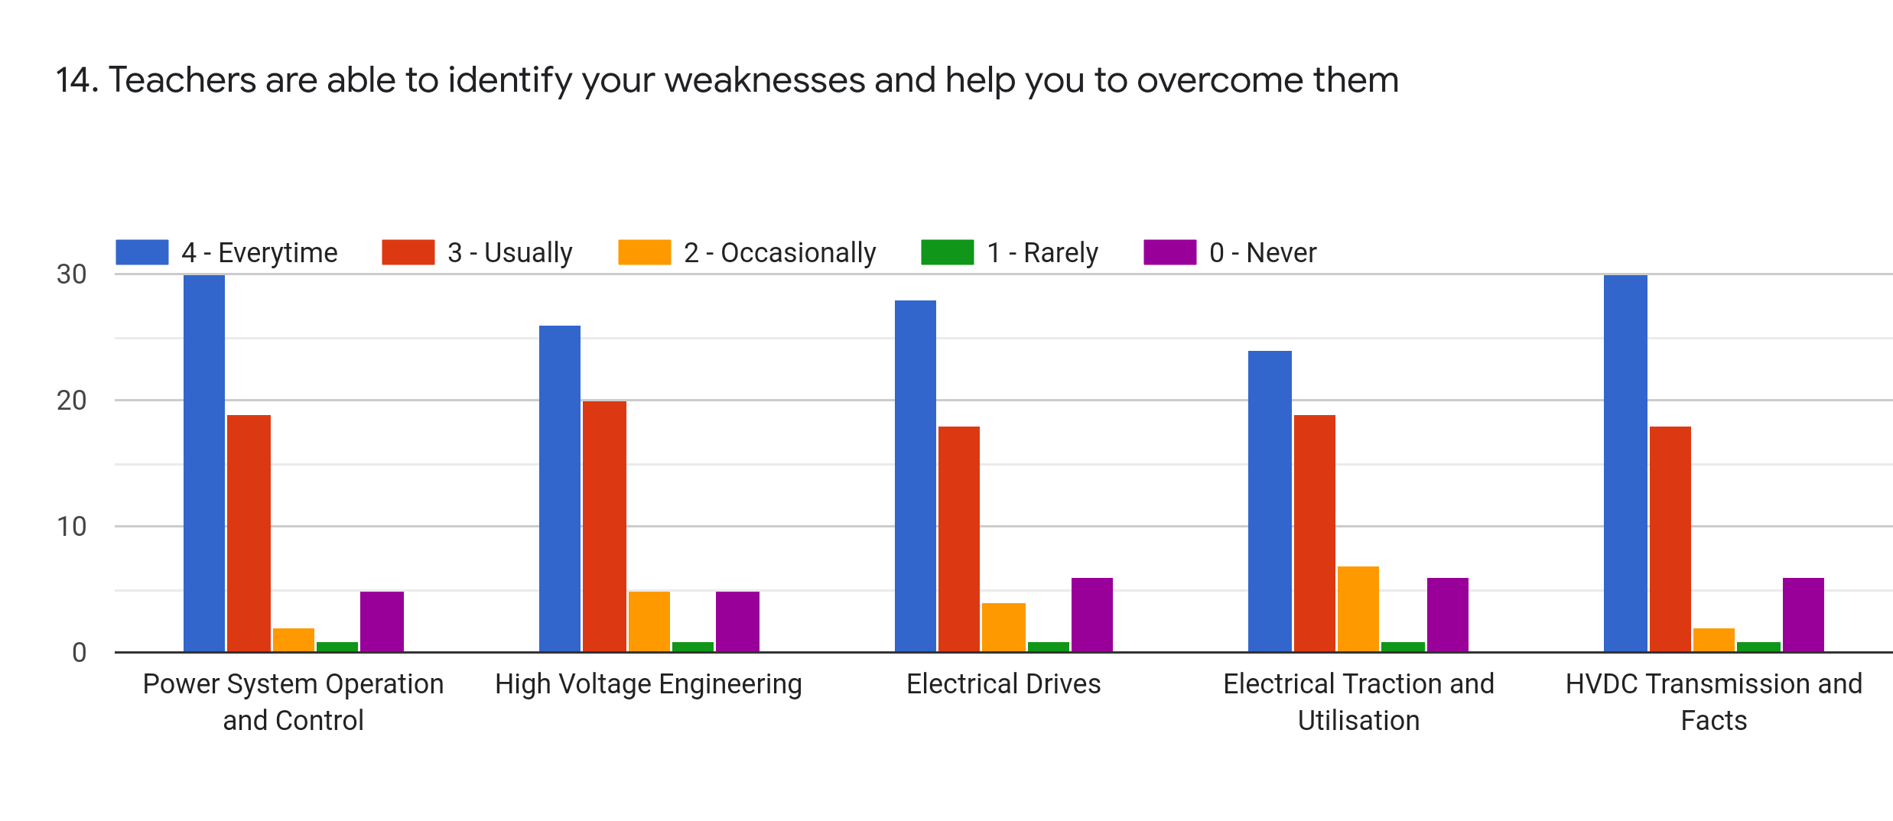
Faculty | SSJ | EG | BMN | SRS | BGN | %
Subject | PSOC | HVE | ED | ETU | HVDC and FACTS
Every time | 30 | 26 | 28 | 24 | 30 | 48.42
Usually | 19 | 20 | 18 | 19 | 18 | 32.98
Occasionally | 2 | 5 | 4 | 7 | 2 | 7.01
Rarely | 1 | 1 | 1 | 1 | 1 | 1.75
Never | 5 | 5 | 6 | 6 | 6 | 9.82

Slide 17
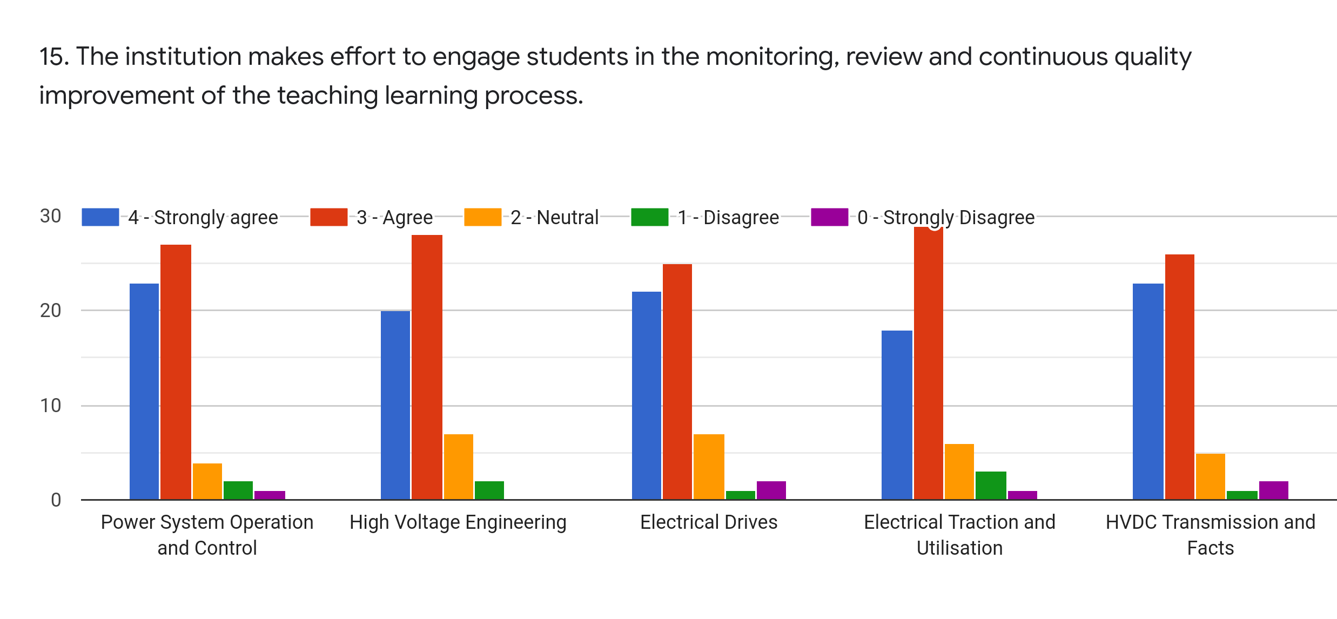
Faculty | SSJ | EG | BMN | SRS | BGN | %
Subject | PSOC | HVE | ED | ETU | HVDC and FACTS
Strongly Agree | 23 | 20 | 22 | 18 | 23 | 37.20
Agree | 27 | 28 | 25 | 29 | 26 | 47.37
Neutral | 4 | 7 | 7 | 6 | 5 | 10.17
Disagree | 2 | 2 | 1 | 3 | 1 | 3.16
Strongly Disagree | 1 | 0 | 2 | 1 | 2 | 2.10

Slide 18
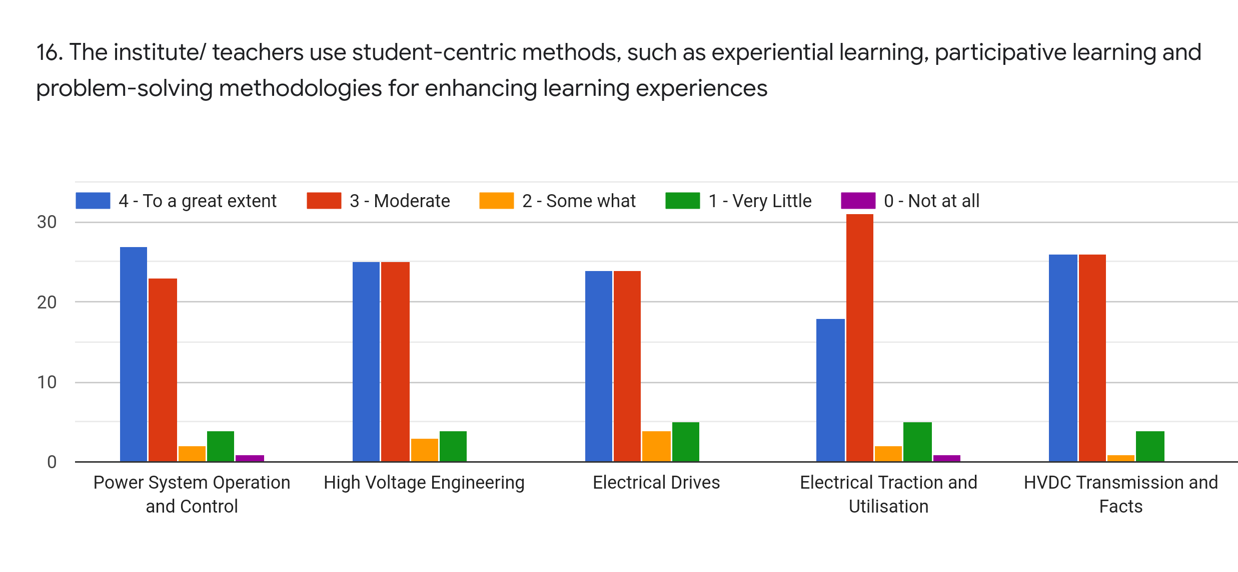
Faculty | SSJ | EG | BMN | SRS | BGN | %
Subject | PSOC | HVE | ED | ETU | HVDC and FACTS
To a great extent | 27 | 25 | 24 | 18 | 26 | 42.10
Moderate | 23 | 25 | 24 | 31 | 26 | 45.26
Some What | 2 | 3 | 4 | 2 | 1 | 4.21
Very Little | 4 | 4 | 5 | 5 | 4 | 7.72
Not at all | 1 | 0 | 0 | 1 | 0 | 0.70

Slide 19
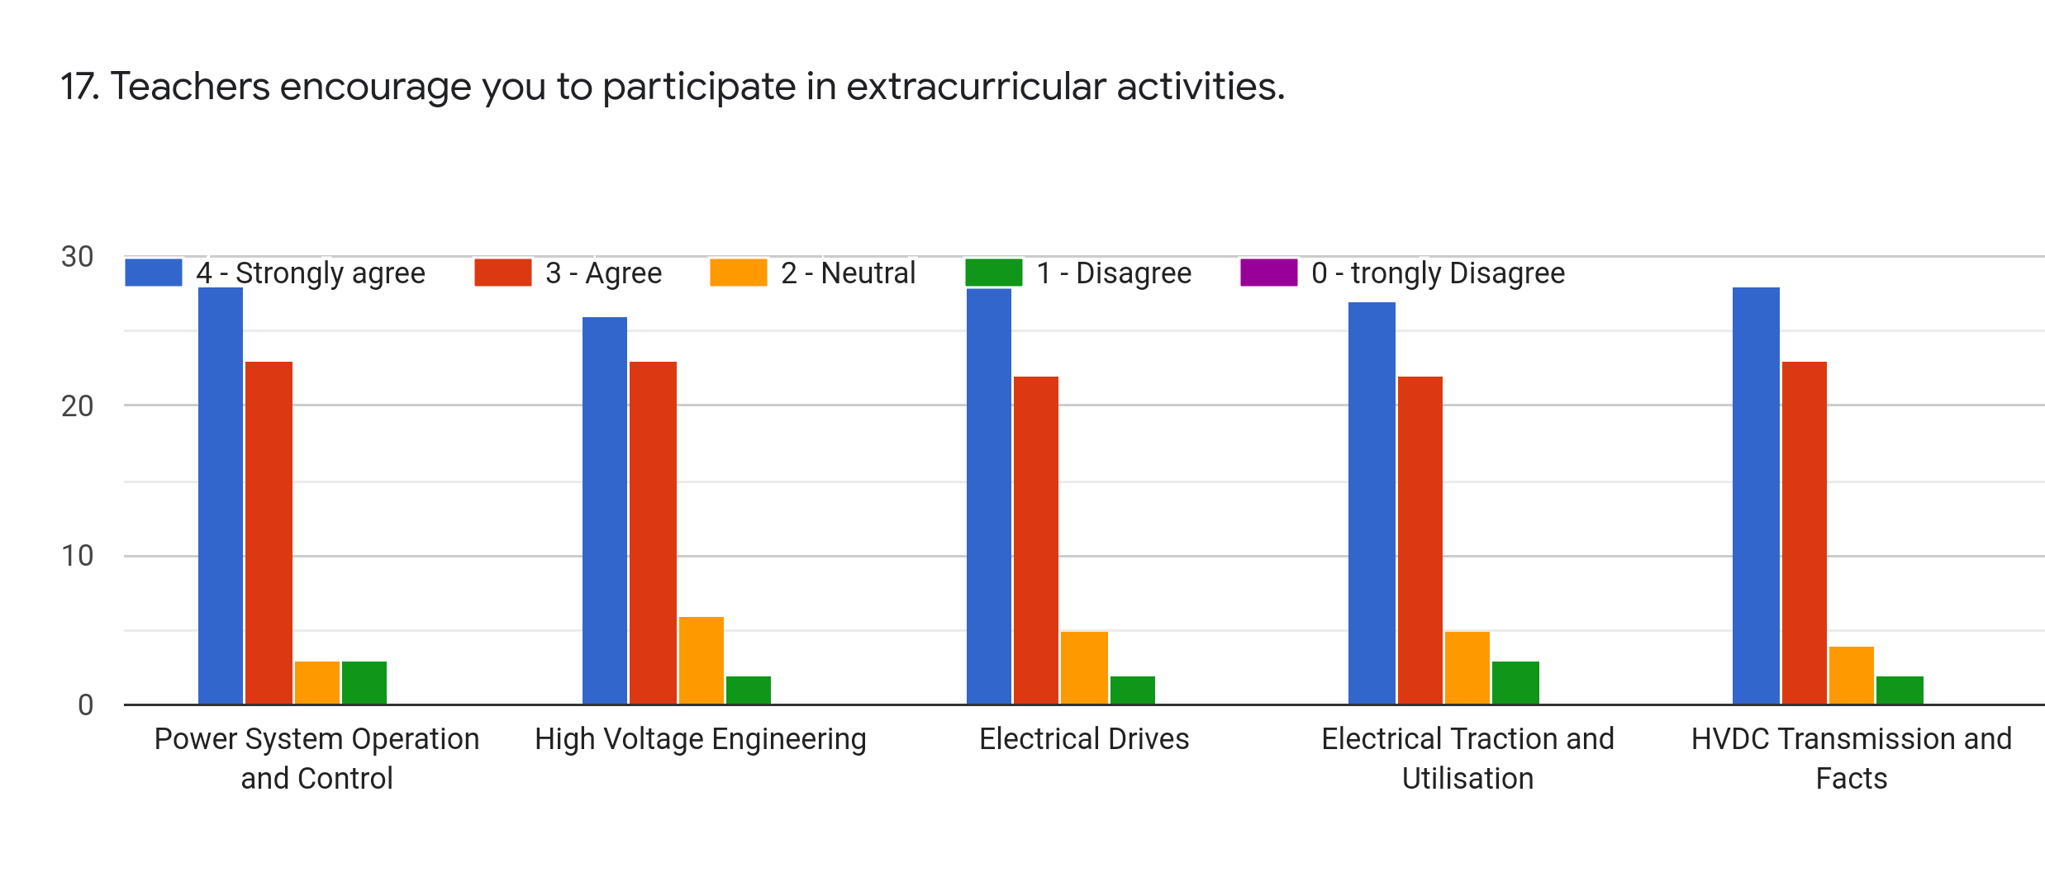
Faculty | SSJ | EG | BMN | SRS | BGN | %
Subject | PSOC | HVE | ED | ETU | HVDC and FACTS
Strongly Agree | 28 | 26 | 28 | 27 | 28 | 48.07
Agree | 23 | 23 | 22 | 22 | 23 | 39.65
Neutral | 3 | 6 | 5 | 5 | 4 | 8.07
Disagree | 3 | 2 | 2 | 3 | 2 | 4.21
Strongly Disagree | 0 | 0 | 0 | 0 | 0 | 0

Slide 20
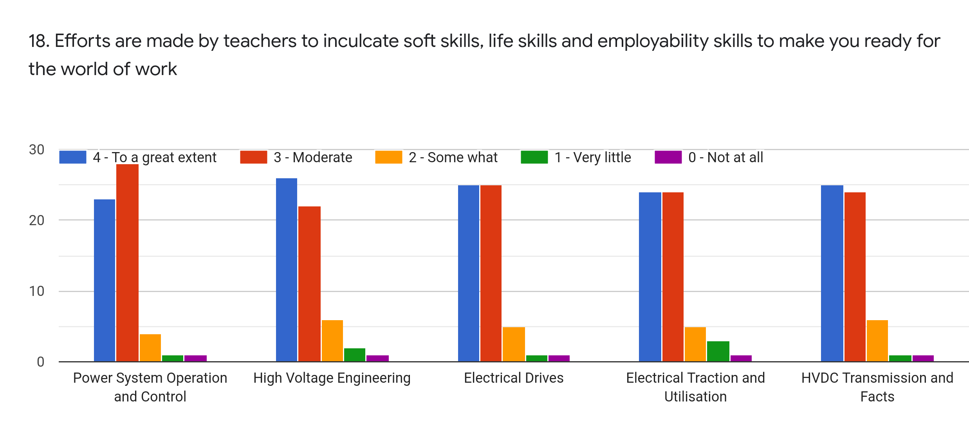
Faculty | SSJ | EG | BMN | SRS | BGN | %
Subject | PSOC | HVE | ED | ETU | HVDC and FACTS
To a great extent | 23 | 26 | 25 | 24 | 25 | 43.16
Moderate | 28 | 22 | 25 | 24 | 24 | 43.16
Some What | 4 | 6 | 5 | 5 | 6 | 9.12
Very Little | 1 | 2 | 1 | 3 | 1 | 2.80
Not at all | 1 | 1 | 1 | 1 | 1 | 1.75

Slide 21
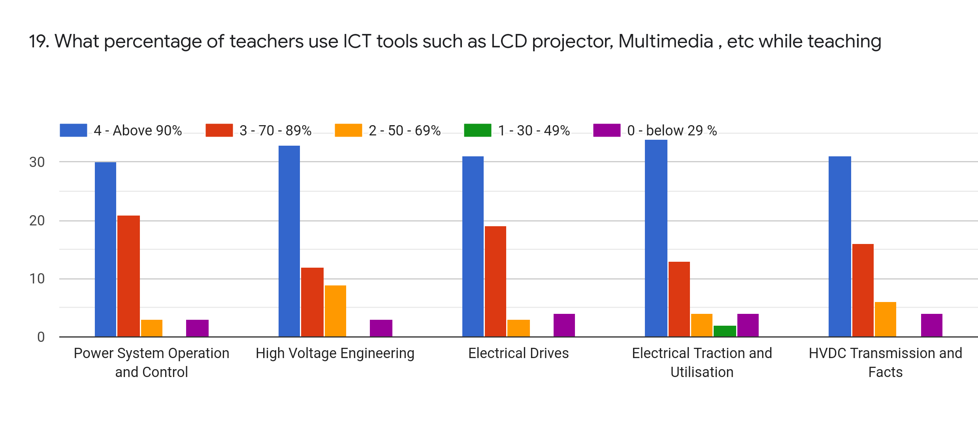
Faculty | SSJ | EG | BMN | SRS | BGN | %
Subject | PSOC | HVE | ED | ETU | HVDC and FACTS
Above 90% | 30 | 33 | 31 | 34 | 31 | 55.79
70-89% | 21 | 12 | 19 | 13 | 16 | 28.42
50-69 % | 3 | 9 | 3 | 4 | 6 | 8.77
30-49 % | 0 | 0 | 0 | 2 | 0 | 0.70
0-below 29% | 3 | 3 | 4 | 4 | 4 | 6.31

Slide 22
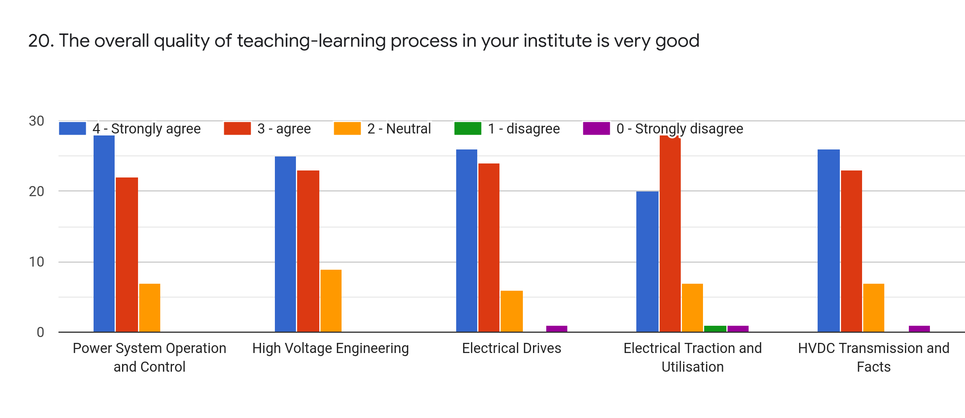
Faculty | SSJ | EG | BMN | SRS | BGN | %
Subject | PSOC | HVE | ED | ETU | HVDC and FACTS
Strongly Agree | 28 | 25 | 26 | 20 | 26 | 43.86
Agree | 22 | 23 | 24 | 28 | 23 | 42.10
Neutral | 7 | 9 | 6 | 7 | 7 | 12.63
Disagree | 0 | 0 | 0 | 1 | 0 | 0.35
Strongly Disagree | 0 | 0 | 1 | 1 | 1 | 1.05

Slide 23
21. Give 3 observations/ suggestions to improve the overall teaching-learning experience of respective teachers.
We expect the notices of the exam 4 or 5 days earlier
Please provide proper notes of all subject
Please focus on placements
Good overall observation but try to something new to improve students interest in online class

Slide 24
OVERALL ANALYSIS
Sub | Faculty | Appreciation | Suggestions for improvement
PSOC | SSJ | Preparation of classes, Internal Evaluation, Communication | Syllabus Coverage, Soft Skills,
HVE | EG | Communication, Internal Evaluation, Student centric, Quality teaching and learning | Syllabus Coverage, Assigning right level Challenges, Monitoring
ED | BMN | Timely providing assignments, Internal Evaluation | Identifying weakness, Involvement with the students
ETU | SRS | Assigning challengeable work, Communication, Promoting for internships, Use of ICT | Need to Explain Program Outcomes, Identifying weakness
HVDC and FACTS | BGN | Quality of teaching, Inculcate soft skills | Student centric,, Syllabus Coverage

