Slide 1
Arvind Gavali College of Engineering, Satara Department of Electronics & Telecommunication Engineering Final Year Feedback
Month : Sept-Oct 2020 –21
Total Responses : 47
Total Class Strength : 72
Feedback Percentage : 65%

Slide 2
FACULTY – SUBJECT DISTRIBUTION
Sr. No. | Subject | Abbrev. | Name of Faculty | Abbrev.
01 | Digital communication | DCOM | Mr. Jagtap D.B. | JDB
02 | Satellite communication | SCOM | Mr. Barkade V.T. | BVT
03 | Embedded System Design | ESD | Mr. Hingmire V.S. | HVS
04 | Mechatronics | MTX | Ms.Kambale A. | KA
05 | Finance Management | FM | Ms.Kambale A. | KA

Slide 3
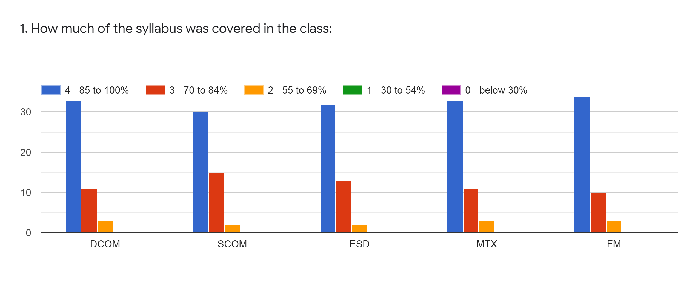
Faculty | JDB | BVT | HVS | KA | KA | %
Subject | DCOM | SCOM | ESD | MTX | FM
85 -100 % | 33 | 30 | 32 | 33 | 34 | 66%
70 - 84 % | 11 | 15 | 13 | 11 | 10 | 24%
55 – 69 % | 3 | 2 | 2 | 3 | 3 | 5%
30 – 54 % | 0 | 0 | 0 | 0 | 0 | 0%
0- Below 30 % | 0 | 0 | 0 | 0 | 0 | 0%

Slide 4
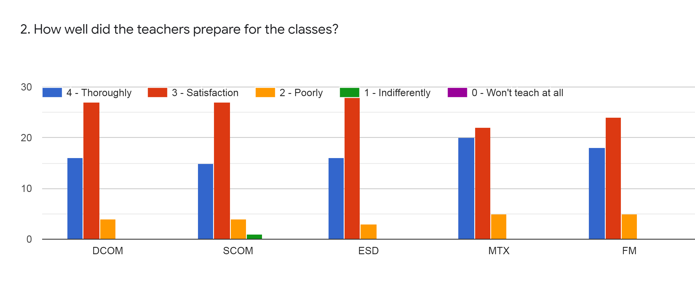
Faculty | JDB | BVT | HVS | KA | KA | %
Subject | DCOM | SCOM | ESD | MTX | FM
Thoroughly | 16 | 15 | 16 | 20 | 18 | 35%
Satisfaction | 27 | 27 | 28 | 22 | 24 | 52%
Poorly | 4 | 4 | 3 | 5 | 5 | 9%
Indifferently | 0 | 1 | 0 | 0 | 0 | 0%
Wont Teach at all | 0 | 0 | 0 | 0 | 0 | 0%

Slide 5
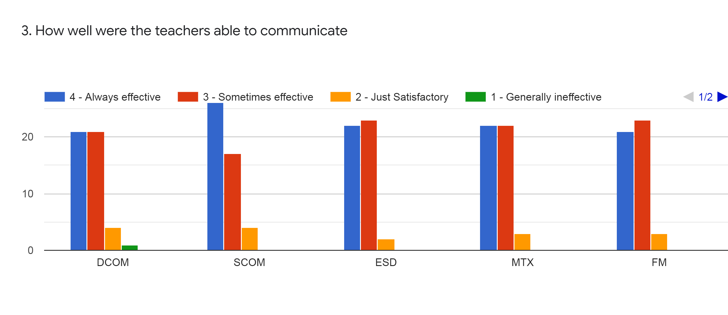
Faculty | JDB | BVT | HVS | KA | KA | %
Subject | DCOM | SCOM | ESD | MTX | FM
Always Effective | 21 | 26 | 22 | 22 | 21 | 46%
Sometime effective | 21 | 17 | 23 | 22 | 23 | 43%
Just Satisfactory | 4 | 4 | 2 | 3 | 3 | 7%
Generally Ineffective | 1 | 0 | 0 | 0 | 0 | 0%
Very Poor Communication | 0 | 0 | 0 | 0 | 0 | 0%

Slide 6
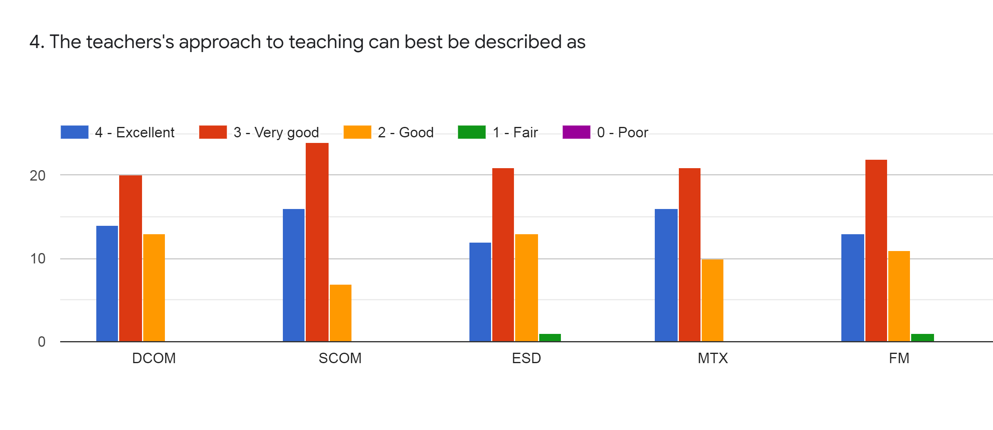
Faculty | JDB | BVT | HVS | KA | KA | %
Subject | DCOM | SCOM | ESD | MTX | FM
Excellent | 14 | 16 | 12 | 16 | 13 | 29%
Very Good | 20 | 24 | 21 | 21 | 22 | 44%
Good | 13 | 7 | 13 | 10 | 11 | 22%
Fair | 0 | 0 | 1 | 0 | 1 | 1%
Poor | 0 | 0 | 0 | 0 | 0 | 0%

Slide 7
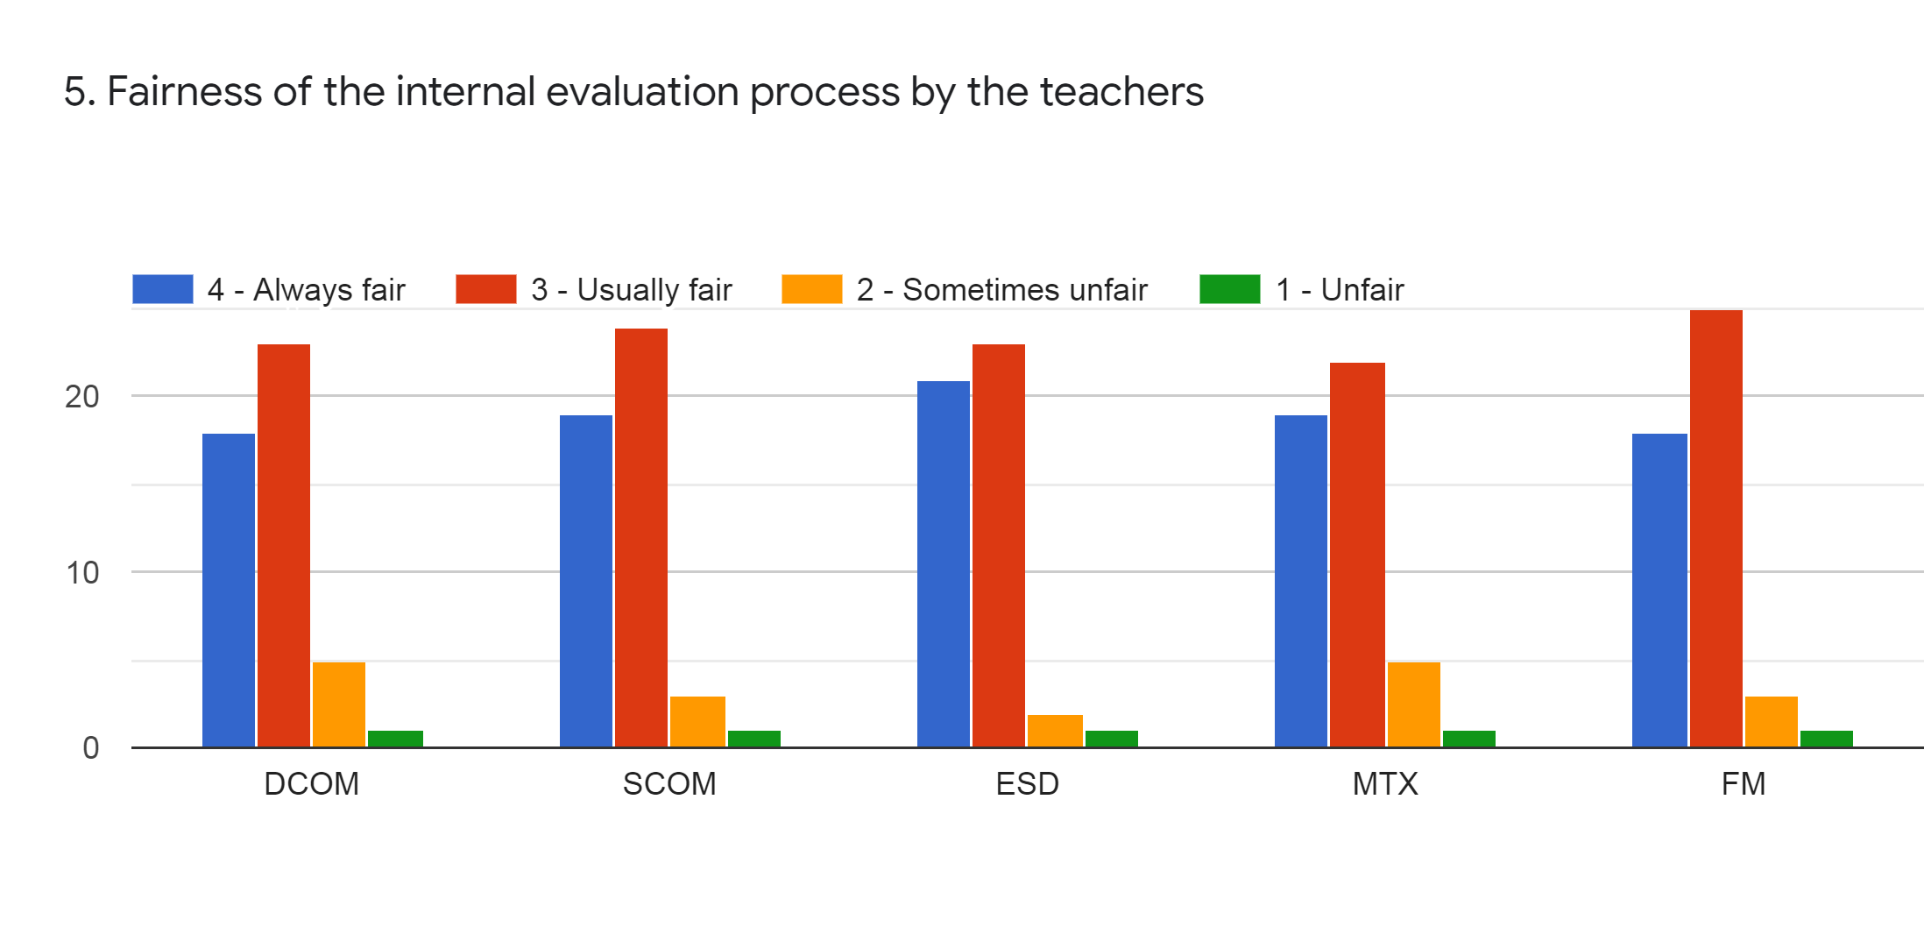
Faculty | JDB | BVT | HVS | KA | KA | %
Subject | DCOM | SCOM | ESD | MTX | FM
Regularly | 18 | 19 | 21 | 19 | 18 | 39%
Often | 23 | 24 | 23 | 22 | 25 | 48%
Sometimes | 5 | 3 | 2 | 5 | 3 | 7%
Rarely | 1 | 1 | 1 | 1 | 1 | 2%
Never | 0 | 0 | 0 | 0 | 0 | 0%

Slide 8
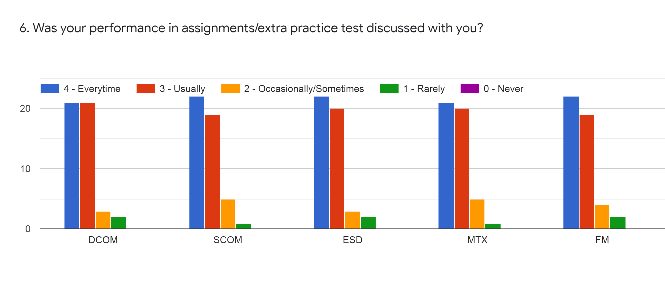
Faculty | JDB | BVT | HVS | KA | KA | %
Subject | DCOM | SCOM | ESD | MTX | FM
Every time | 21 | 22 | 22 | 21 | 22 | 44%
Usually | 21 | 19 | 20 | 20 | 19 | 40%
Occasionally | 3 | 5 | 3 | 5 | 4 | 8%
Rarely | 2 | 1 | 2 | 3 | 2 | 4%
Never | 0 | 0 | 0 | 0 | 0 | 0%

Slide 9
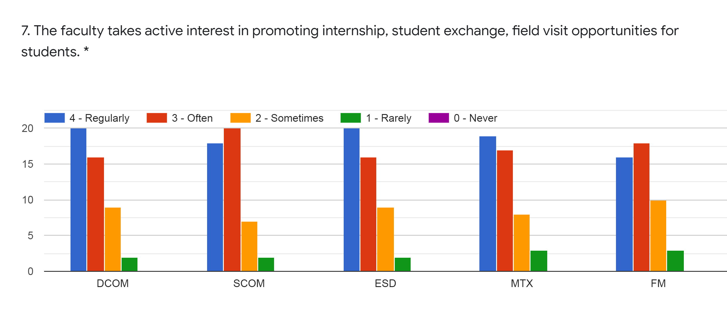
Faculty | JDB | BVT | HVS | KA | KA | %
Subject | DCOM | SCOM | ESD | MTX | FM
Regularly | 20 | 18 | 20 | 19 | 16 | 38%
Often | 16 | 20 | 16 | 17 | 18 | 36%
Sometimes | 9 | 7 | 9 | 8 | 10 | 18%
Rarely | 2 | 2 | 2 | 3 | 3 | 5%
Never | 0 | 0 | 0 | 0 | 0 | 0%

Slide 10
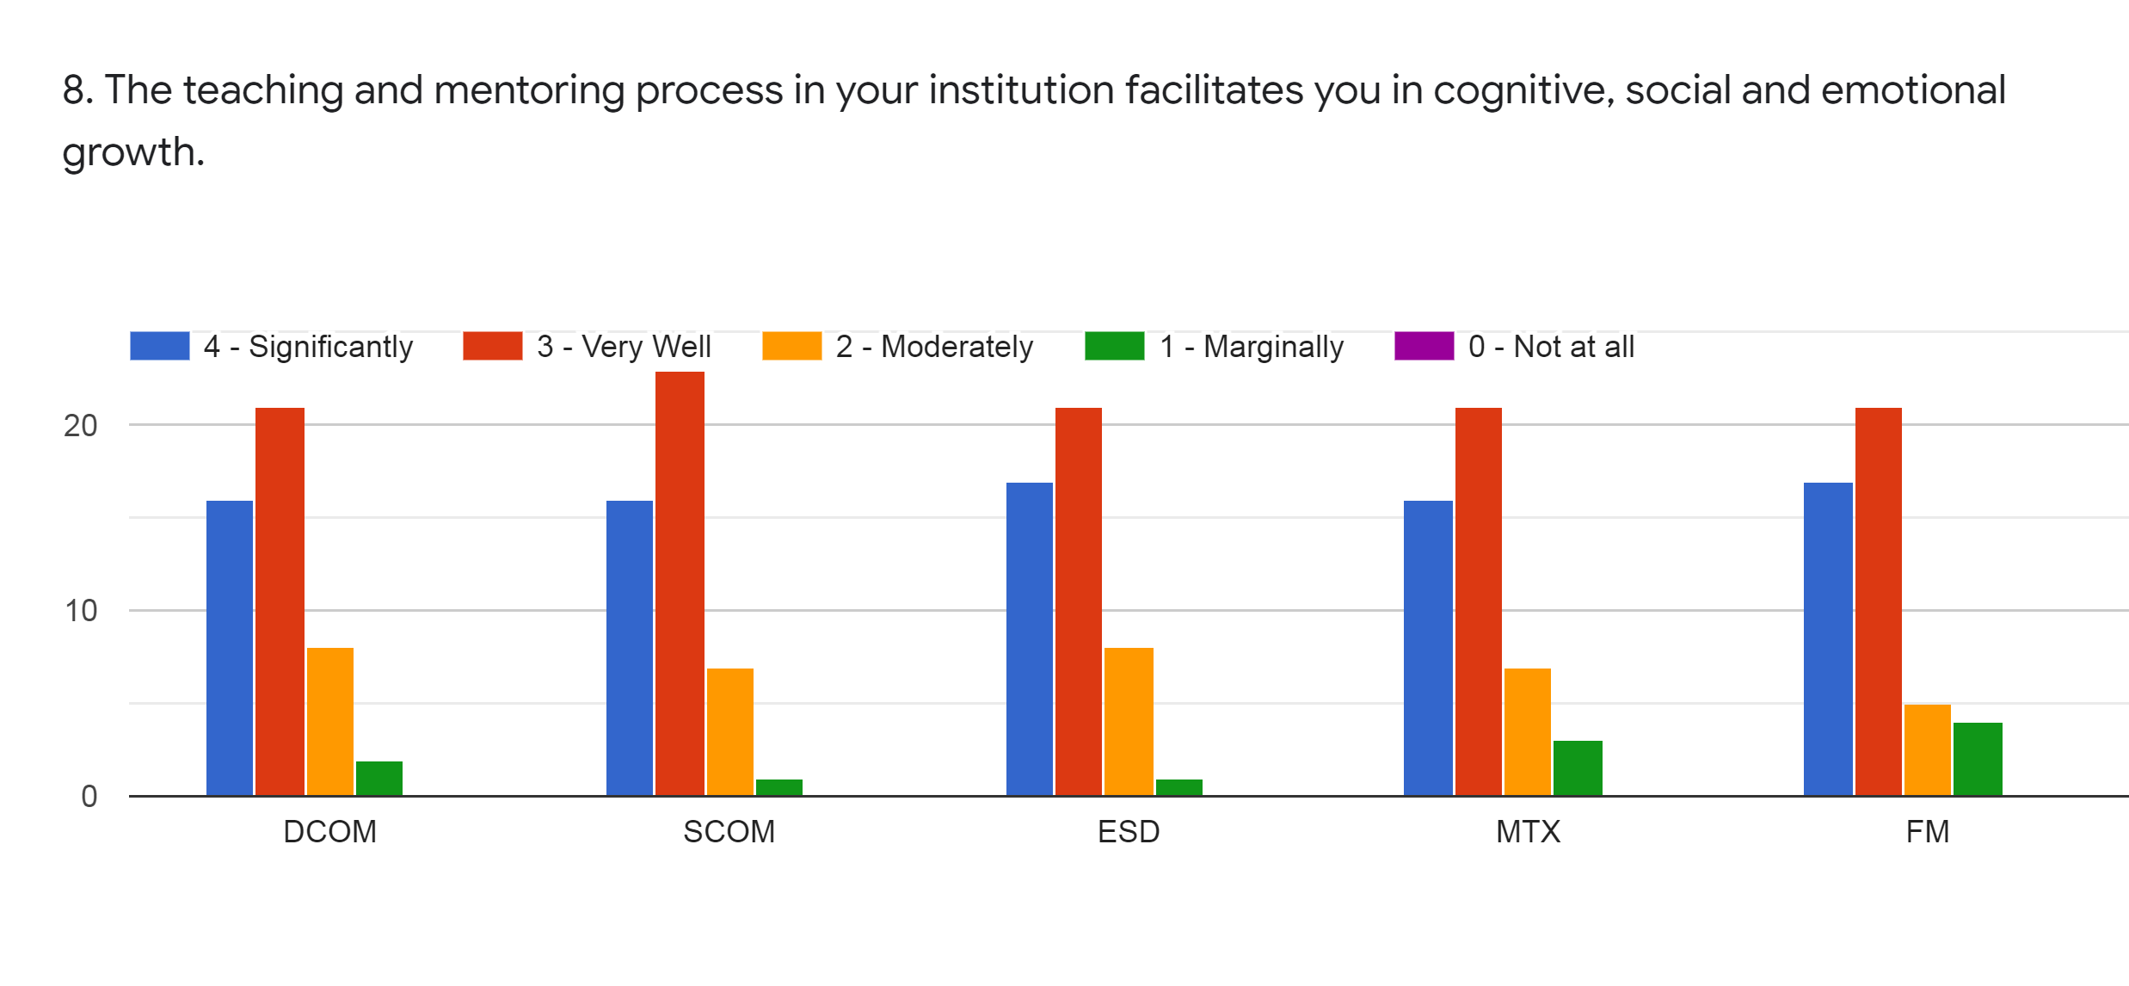
Faculty | JDB | BVT | HVS | KA | KA | %
Subject | DCOM | SCOM | ESD | MTX | FM
Significantly | 16 | 16 | 17 | 16 | 17 | 33%
Very Well | 21 | 23 | 21 | 21 | 21 | 44%
Moderately | 8 | 7 | 8 | 7 | 5 | 14%
Marginally | 2 | 1 | 1 | 3 | 4 | 4%
Not at All | 0 | 0 | 0 | 0 | 0 | 0%

Slide 11
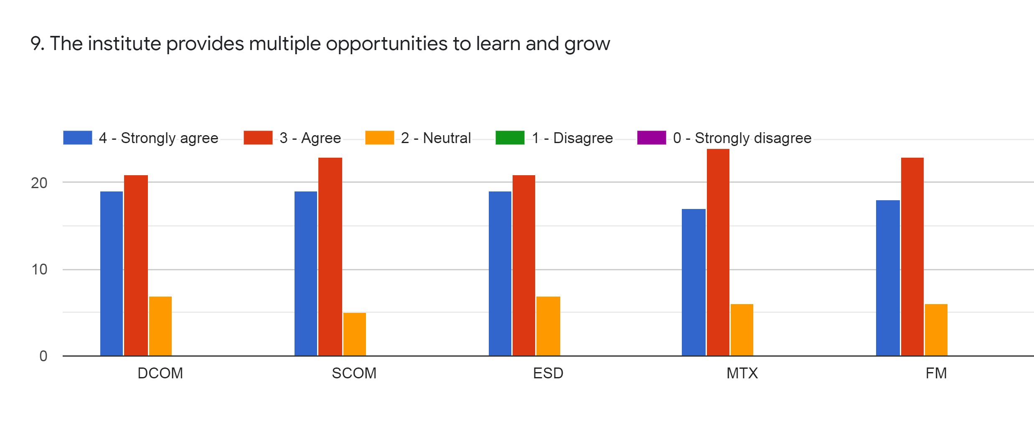
Faculty | JDB | BVT | HVS | KA | KA | %
Subject | DCOM | SCOM | ESD | MTX | FM
Strongly Agree | 19 | 19 | 19 | 17 | 18 | 38%
Agree | 21 | 23 | 21 | 24 | 23 | 46%
Neutral | 7 | 5 | 7 | 6 | 6 | 13%
Disagree | 0 | 0 | 0 | 0 | 0 | 0%
Strongly Disagree | 0 | 0 | 0 | 0 | 0 | 0%

Slide 12
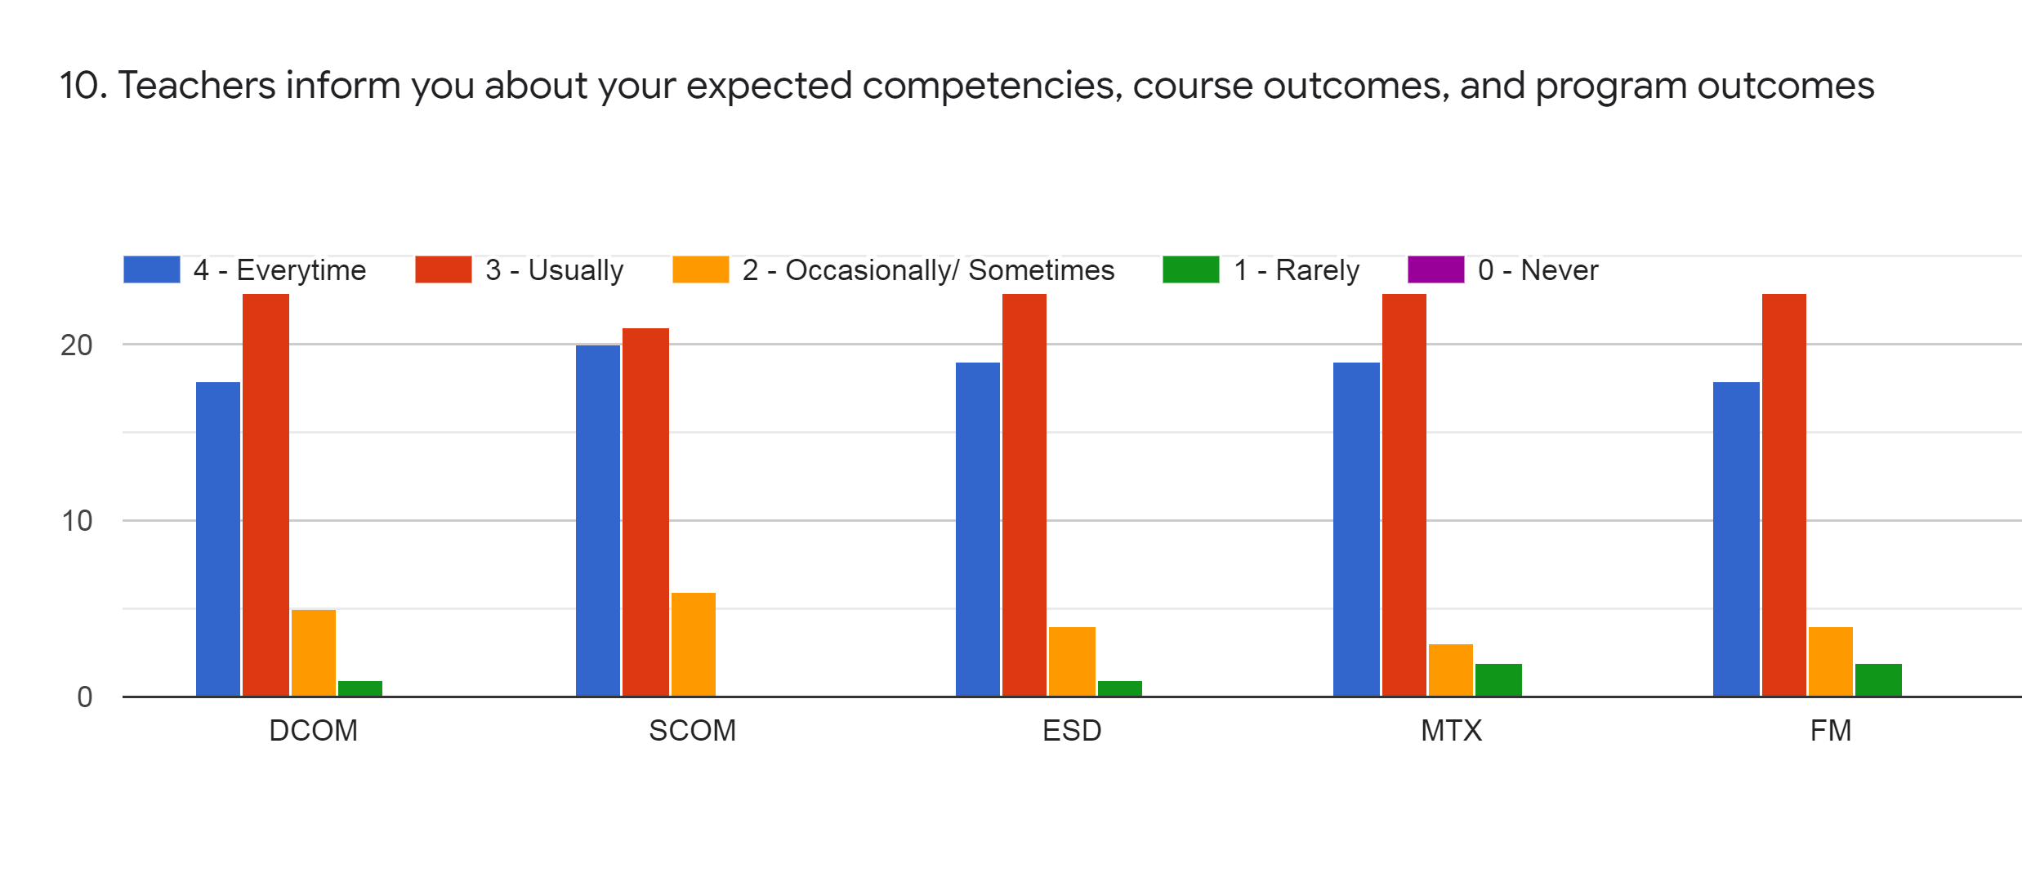
Faculty | JDB | BVT | HVS | KA | KA | %
Subject | DCOM | SCOM | ESD | MTX | FM
Every time | 18 | 19 | 19 | 17 | 18 | 37%
Usually | 23 | 23 | 21 | 24 | 23 | 47%
Occasionally | 7 | 5 | 7 | 6 | 6 | 13%
Rarely | 0 | 0 | 0 | 0 | 0 | 0%
Never | 0 | 0 | 0 | 0 | 0 | 0%

Slide 13
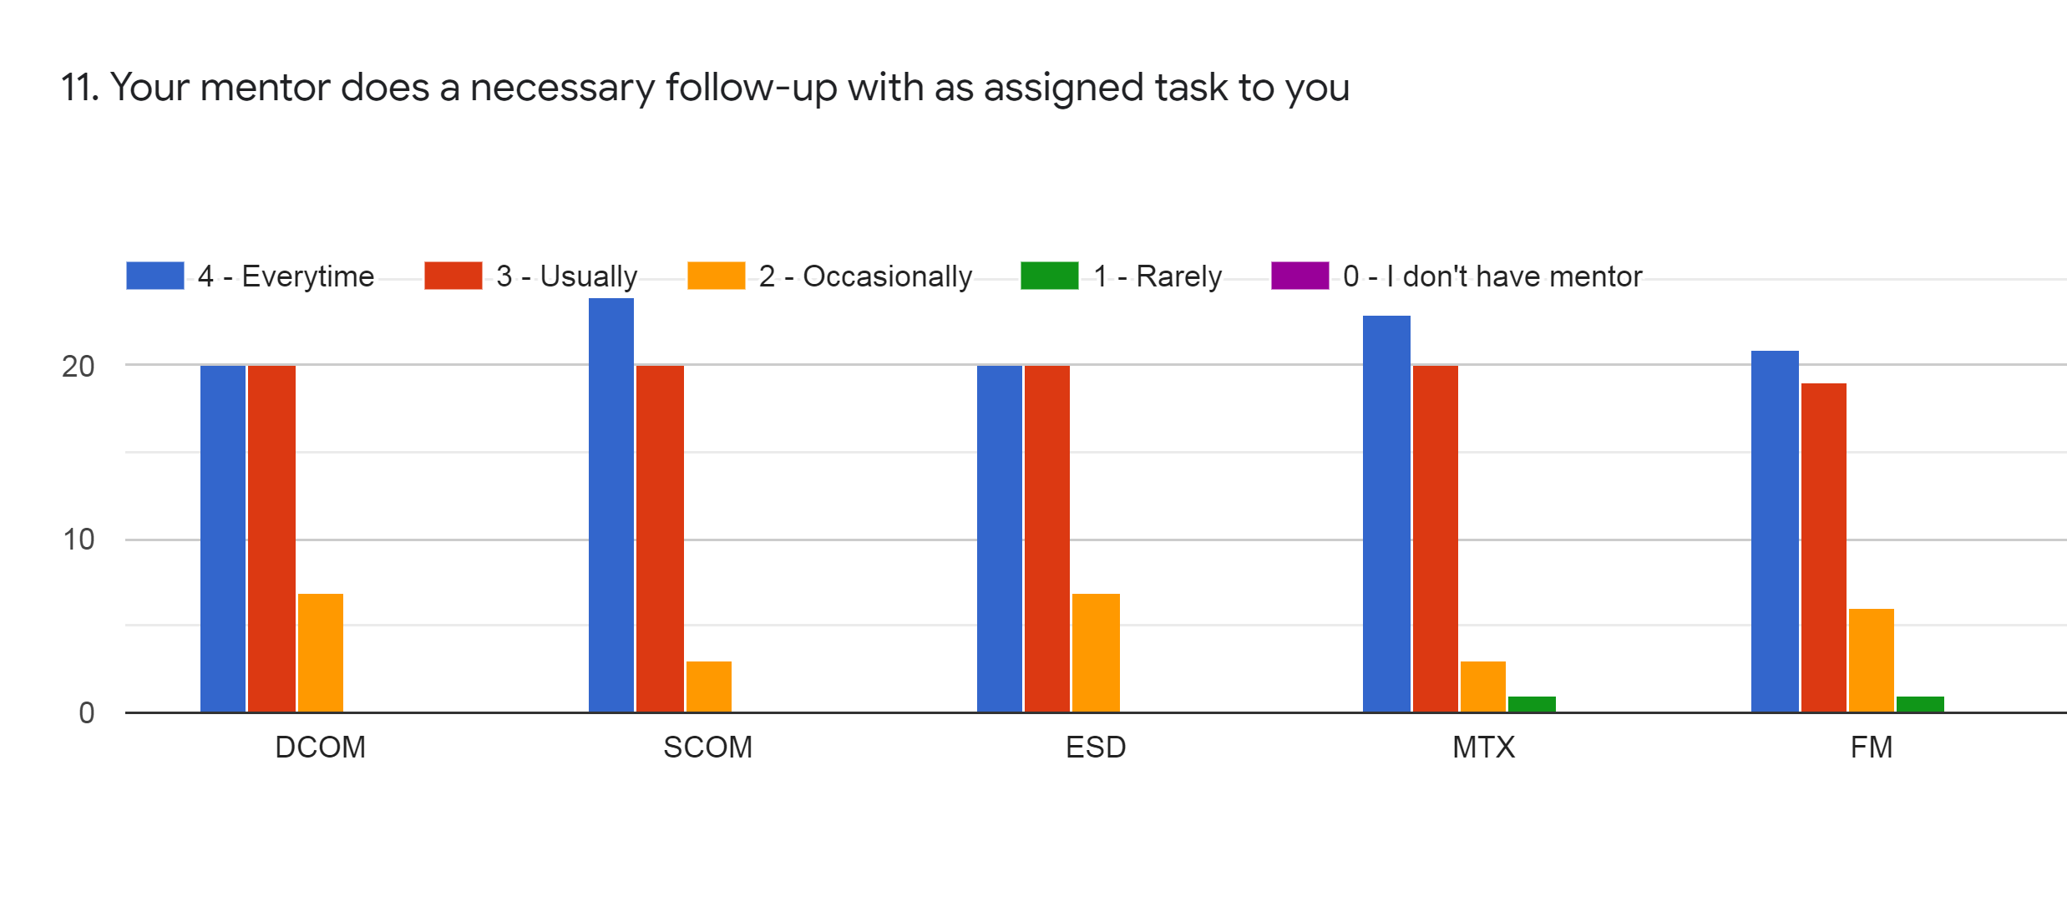
Faculty | JDB | BVT | HVS | KA | KA | %
Subject | DCOM | SCOM | ESD | MTX | FM
Every time | 20 | 24 | 20 | 23 | 21 | 44%
Usually | 20 | 20 | 20 | 20 | 19 | 40%
Occasionally | 7 | 3 | 7 | 3 | 6 | 11%
Rarely | 0 | 0 | 0 | 1 | 1 | 1%
I don’t have mentor | 0 | 0 | 0 | 0 | 0 | 0%

Slide 14
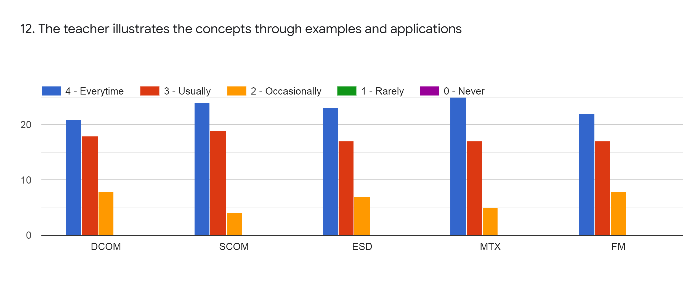
Faculty | JDB | BVT | HVS | KA | KA | %
Subject | DCOM | SCOM | ESD | MTX | FM
Every time | 21 | 24 | 23 | 25 | 22 | 47%
Usually | 18 | 19 | 17 | 17 | 17 | 36%
Occasionally | 8 | 4 | 7 | 5 | 8 | 13%
Rarely | 0 | 0 | 0 | 0 | 0 | 0%
Never | 0 | 0 | 0 | 0 | 0 | 0%

Slide 15
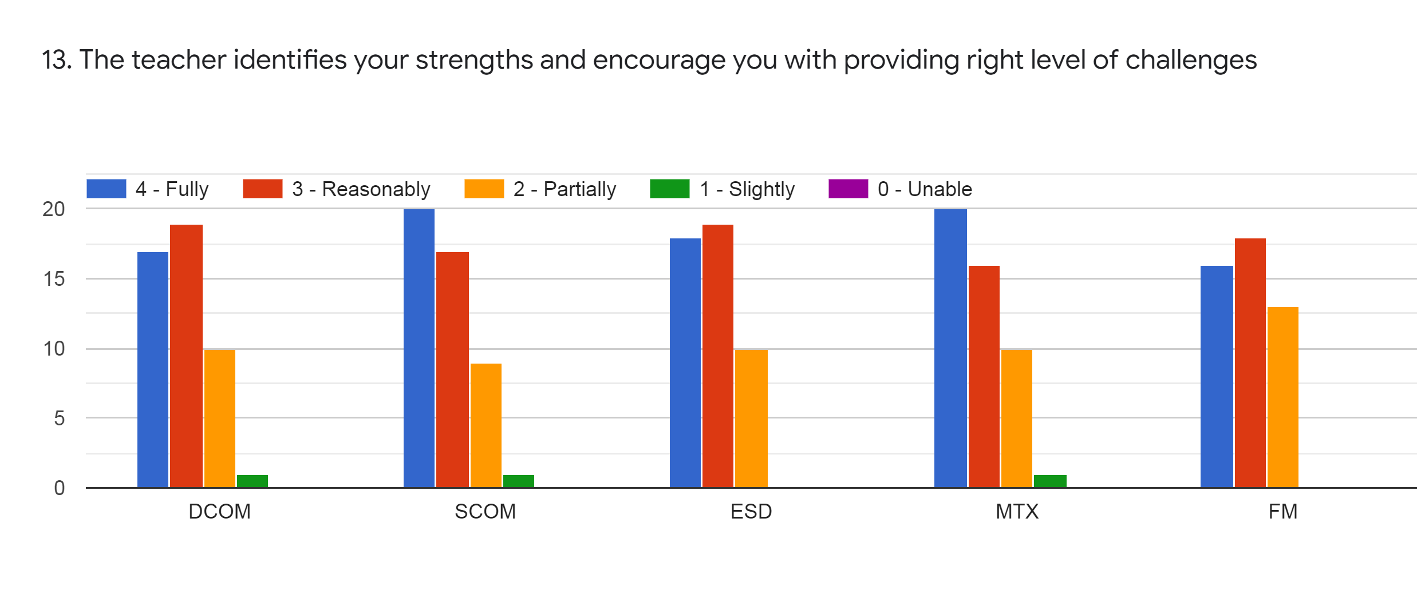
Faculty | JDB | BVT | HVS | KA | KA | %
Subject | DCOM | SCOM | ESD | MTX | FM
Fully | 17 | 20 | 18 | 20 | 16 | 37%
Reasonably | 19 | 17 | 19 | 16 | 18 | 36%
Partially | 10 | 9 | 10 | 10 | 13 | 21%
Slightly | 1 | 1 | 0 | 1 | 0 | 1%
Unable | 0 | 0 | 0 | 0 | 0 | 0%

Slide 16
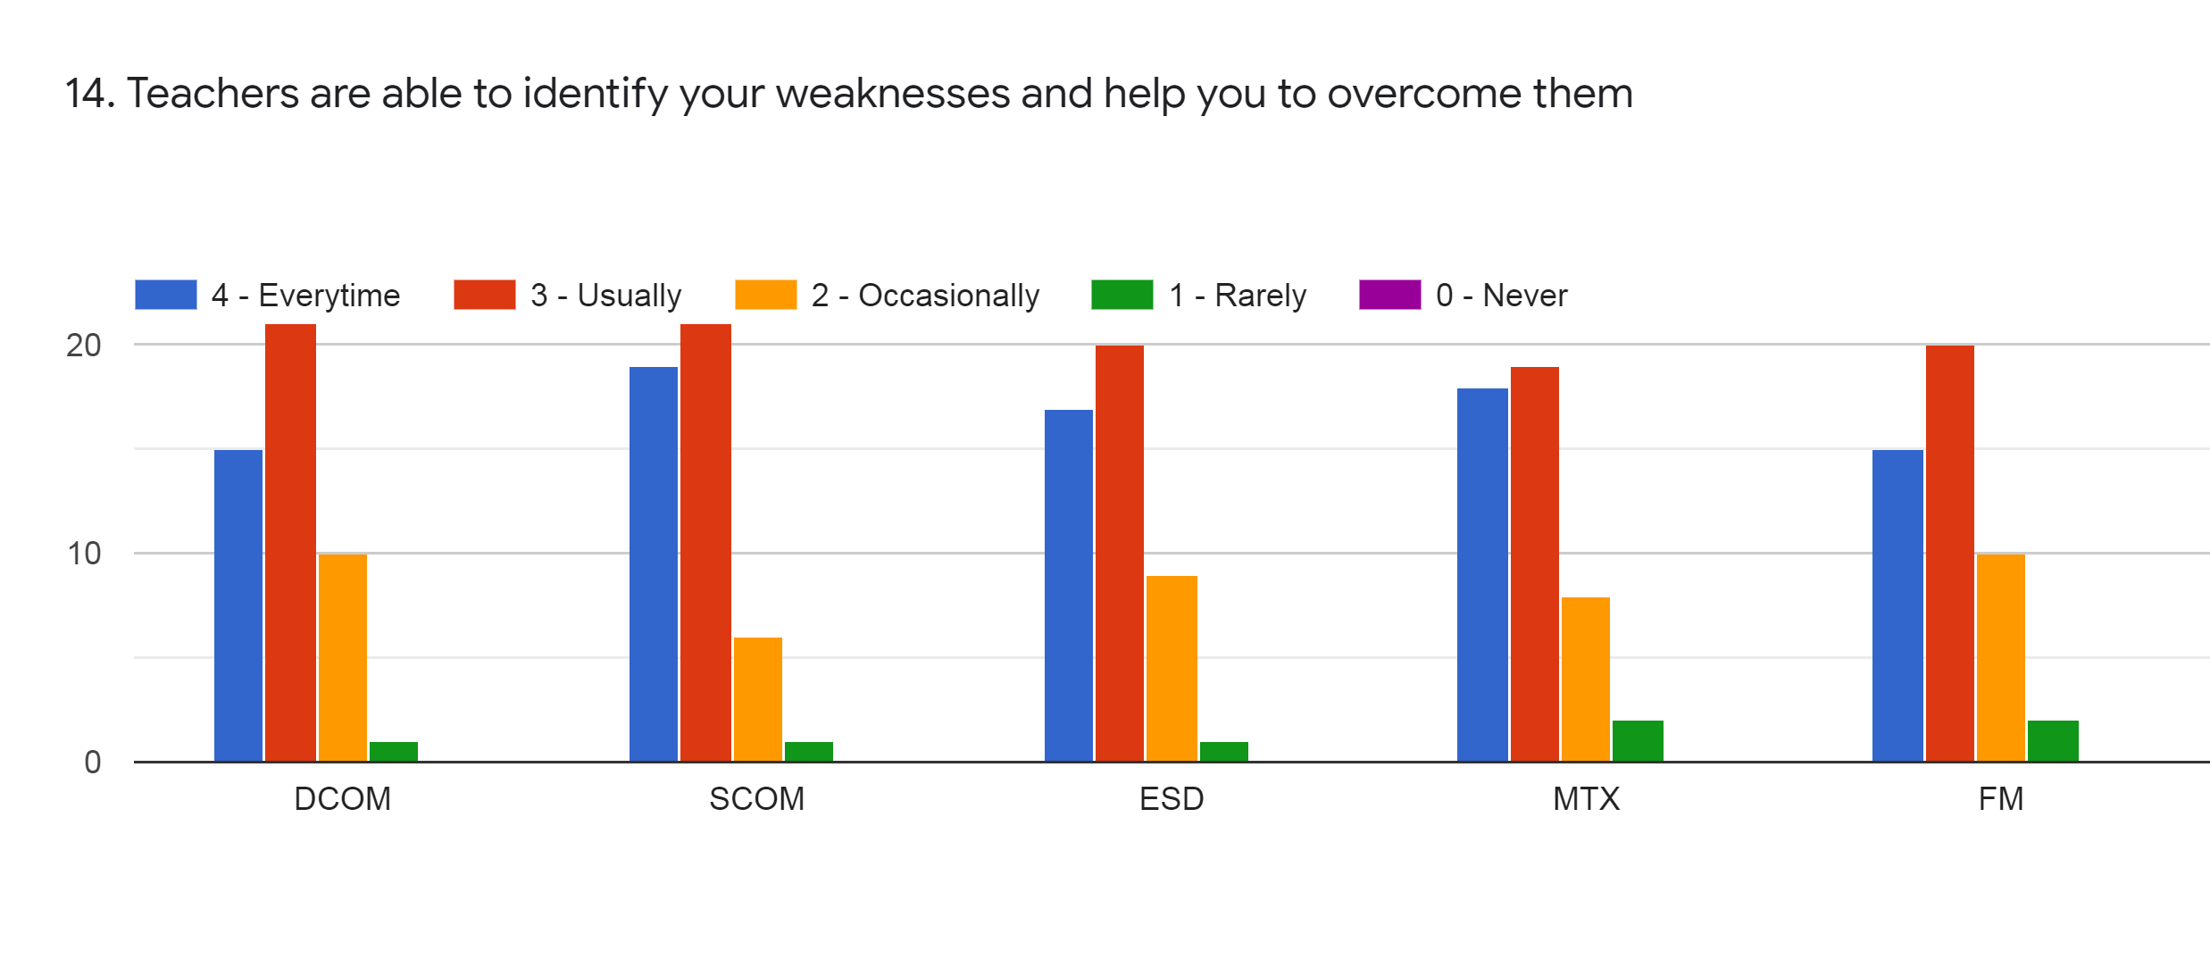
Faculty | JDB | BVT | HVS | KA | KA | %
Subject | DCOM | SCOM | ESD | MTX | FM
Every time | 15 | 19 | 17 | 18 | 15 | 34%
Usually | 21 | 21 | 20 | 19 | 20 | 41%
Occasionally | 10 | 6 | 9 | 8 | 10 | 18%
Rarely | 1 | 1 | 1 | 2 | 2 | 3%
Never | 0 | 0 | 0 | 0 | 0 | 0%

Slide 17
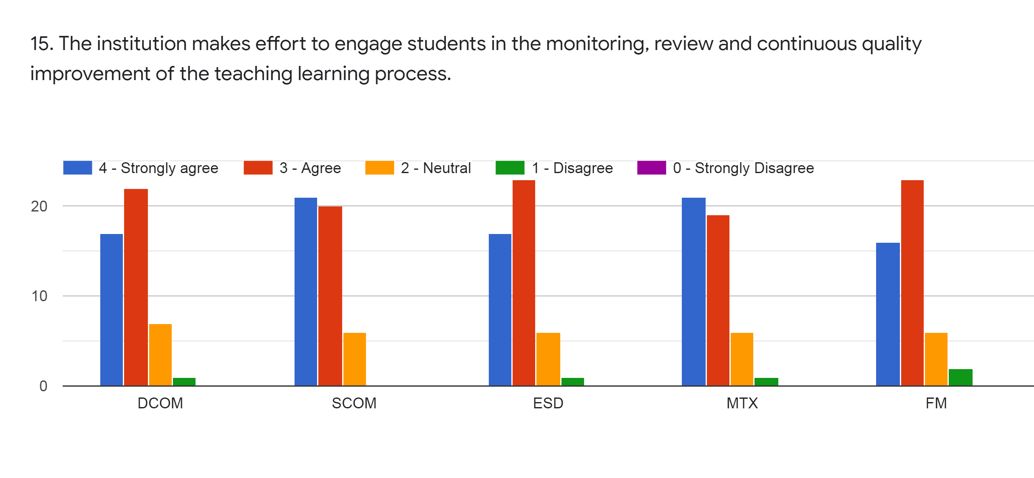
Faculty | JDB | BVT | HVS | KA | KA | %
Subject | DCOM | SCOM | ESD | MTX | FM
Strongly Agree | 17 | 21 | 17 | 21 | 16 | 38%
Agree | 22 | 20 | 23 | 19 | 23 | 44%
Neutral | 7 | 6 | 6 | 6 | 6 | 13%
Disagree | 1 | 0 | 1 | 1 | 2 | 2%
Strongly Disagree | 0 | 0 | 0 | 0 | 0 | 0%

Slide 18
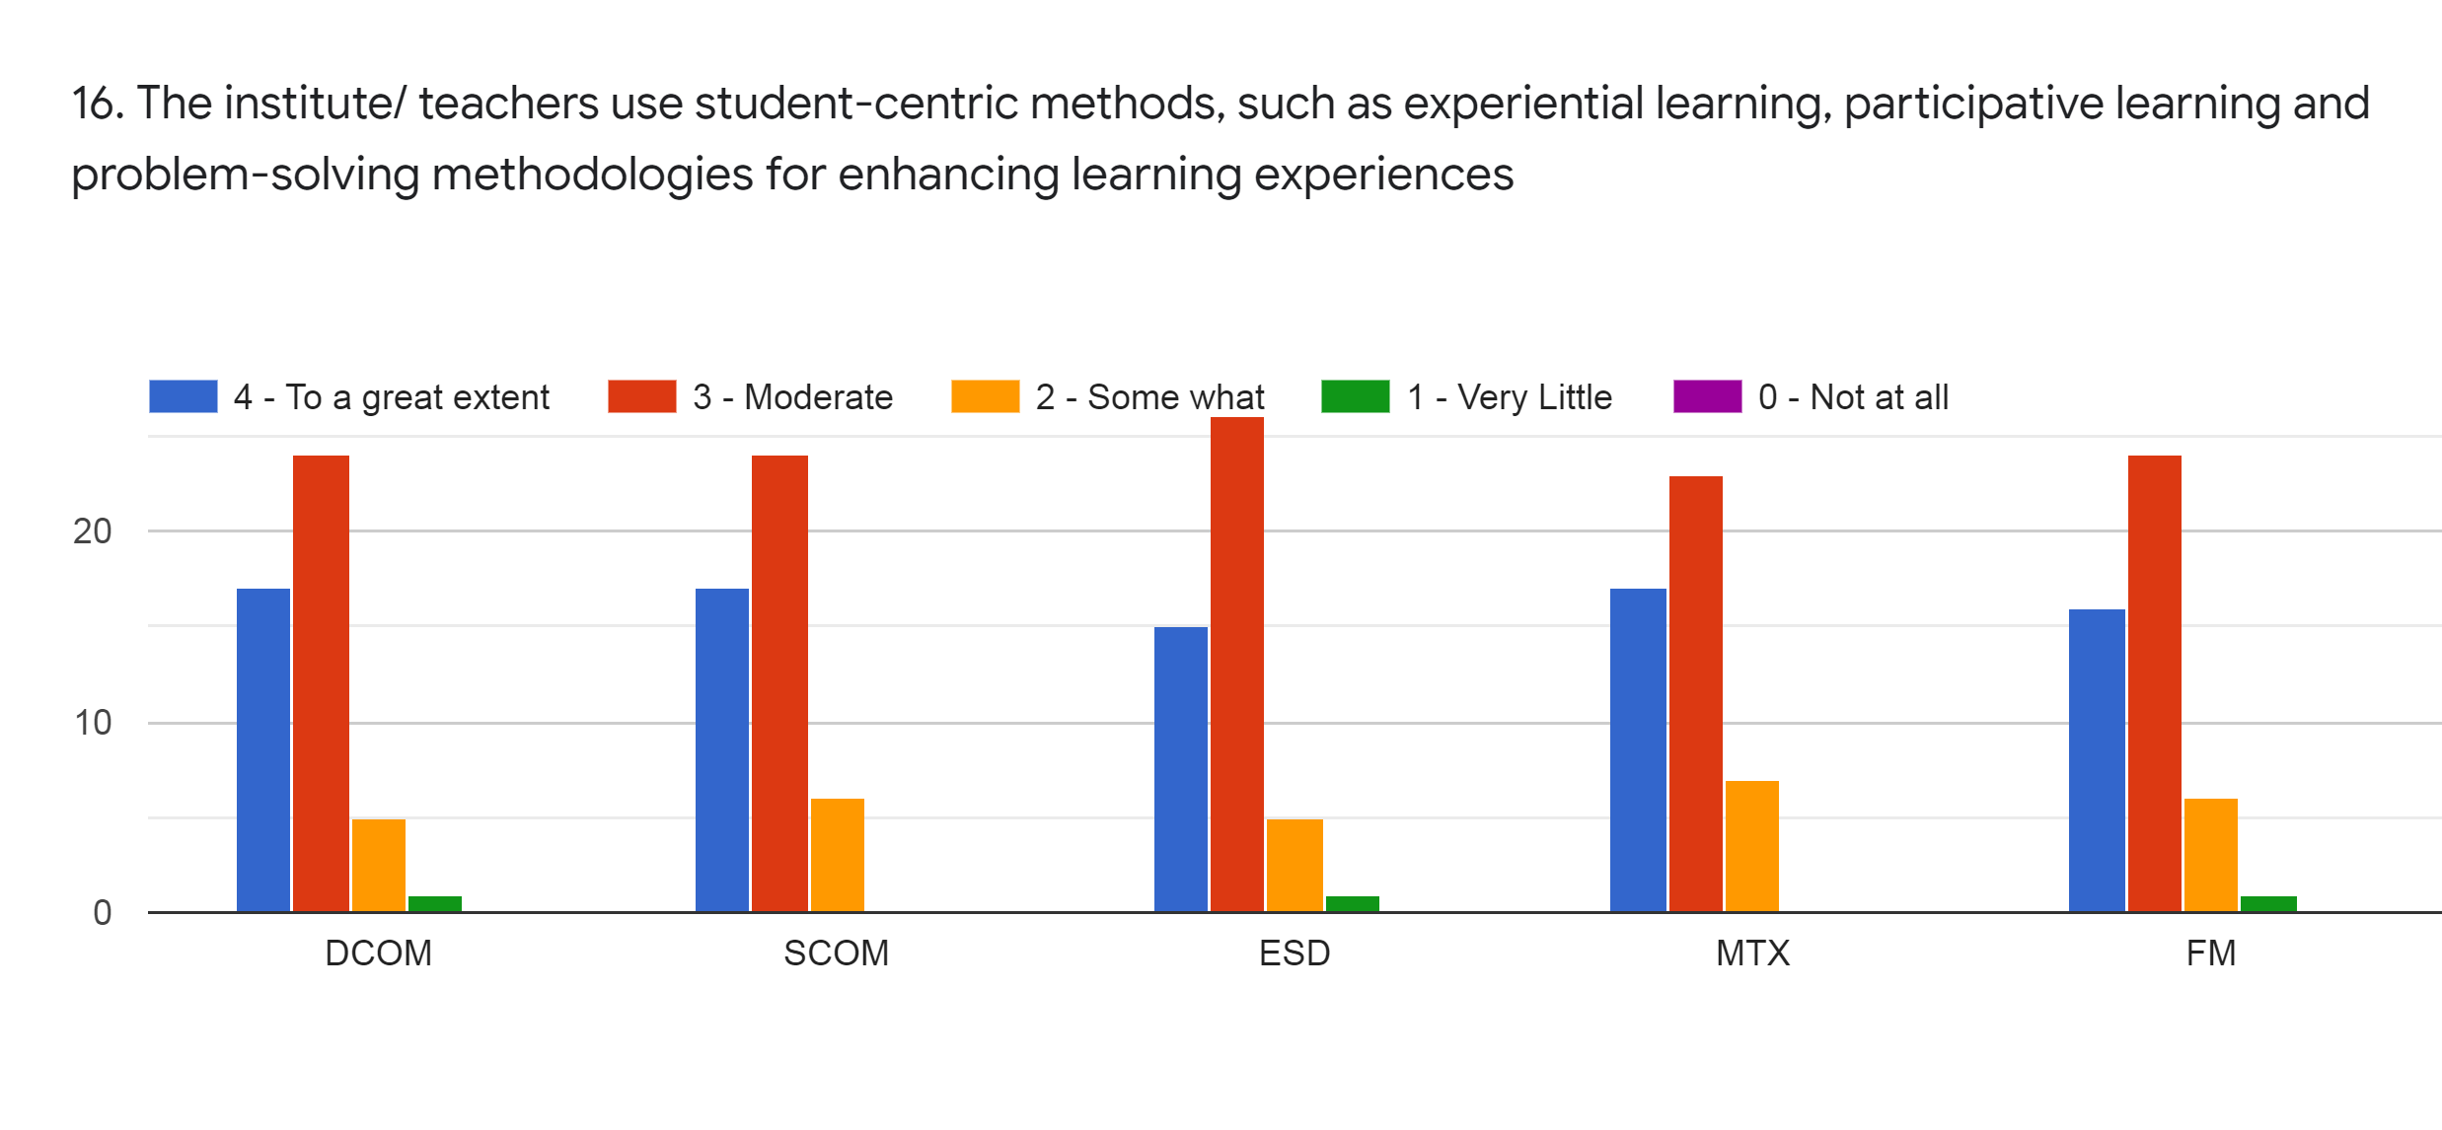
Faculty | JDB | BVT | HVS | KA | KA | %
Subject | DCOM | SCOM | ESD | MTX | FM
To a great extent | 17 | 17 | 15 | 17 | 16 | 33%
Moderate | 24 | 24 | 26 | 23 | 24 | 49%
Some What | 5 | 6 | 5 | 7 | 6 | 12%
Very Little | 1 | 0 | 1 | 0 | 1 | 1%
Not at all | 0 | 0 | 0 | 0 | 0 | 0%

Slide 19
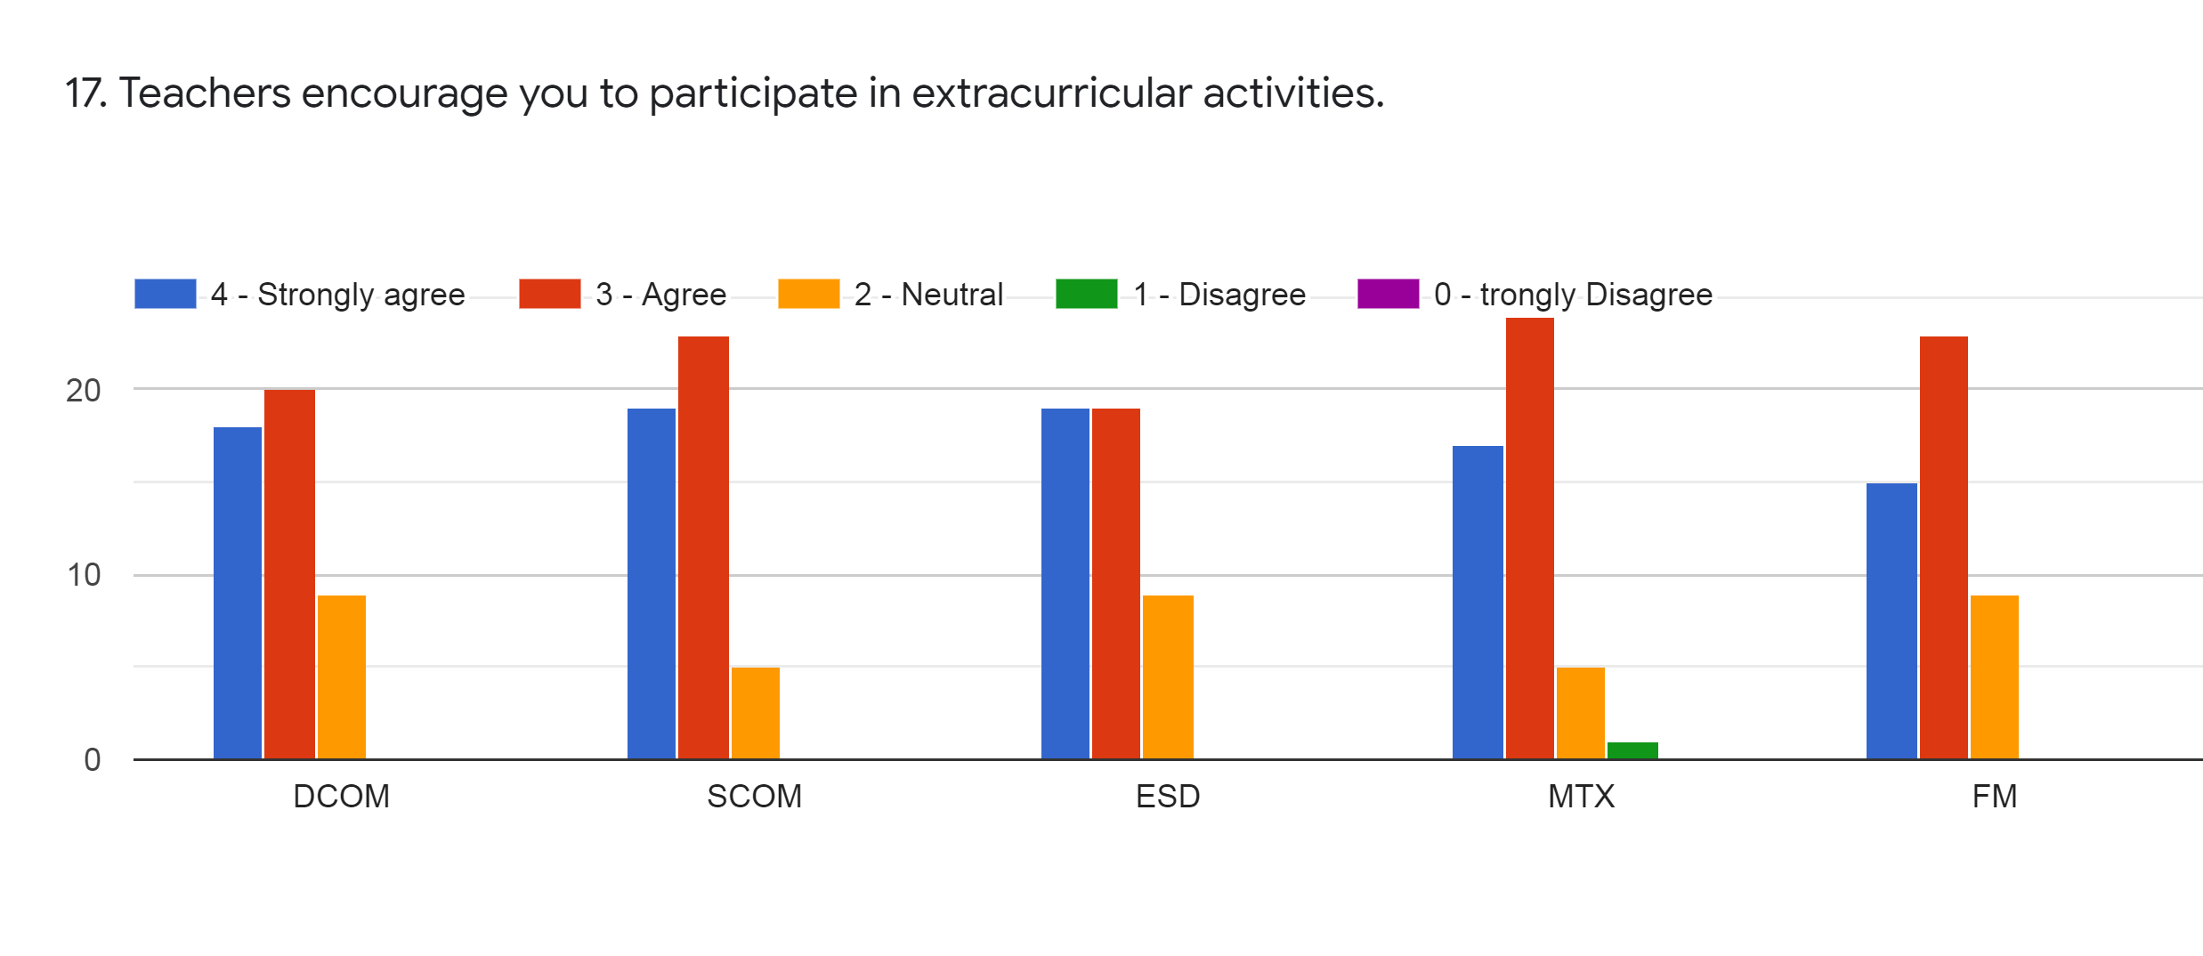
Faculty | JDB | BVT | HVS | KA | KA | %
Subject | DCOM | SCOM | ESD | MTX | FM
Strongly Agree | 18 | 19 | 19 | 17 | 15 | 36%
Agree | 20 | 23 | 19 | 24 | 23 | 44%
Neutral | 9 | 5 | 9 | 5 | 9 | 15%
Disagree | 0 | 0 | 0 | 1 | 0 | 0%
Strongly Disagree | 0 | 0 | 0 | 0 | 0 | 0%

Slide 20
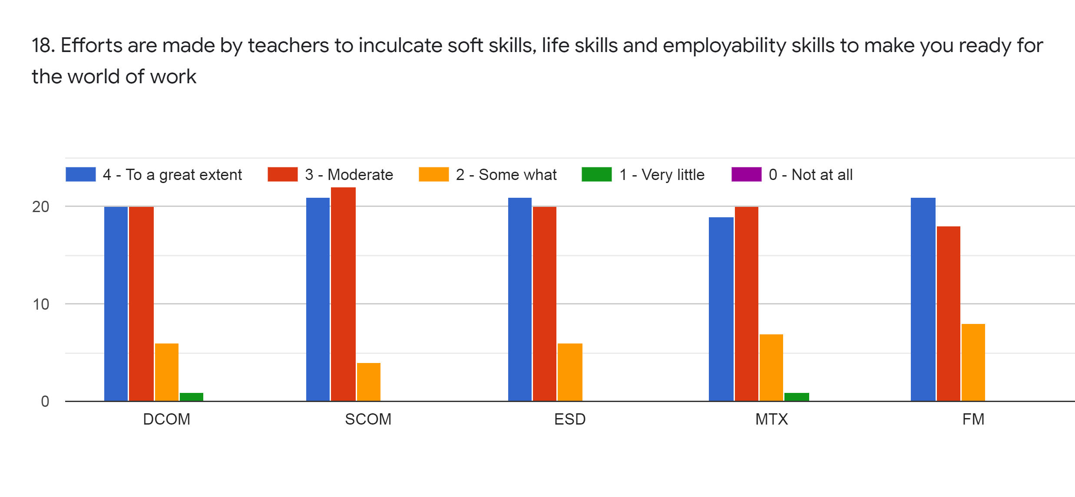
Faculty | JDB | BVT | HVS | KA | KA | %
Subject | DCOM | SCOM | ESD | MTX | FM
To a great extent | 20 | 21 | 21 | 19 | 21 | 42%
Moderate | 20 | 22 | 20 | 20 | 18 | 41%
Some What | 6 | 4 | 6 | 7 | 8 | 13%
Very Little | 1 | 0 | 0 | 1 | 0 | 1%
Not at all | 0 | 0 | 0 | 0 | 0 | 0%

Slide 21
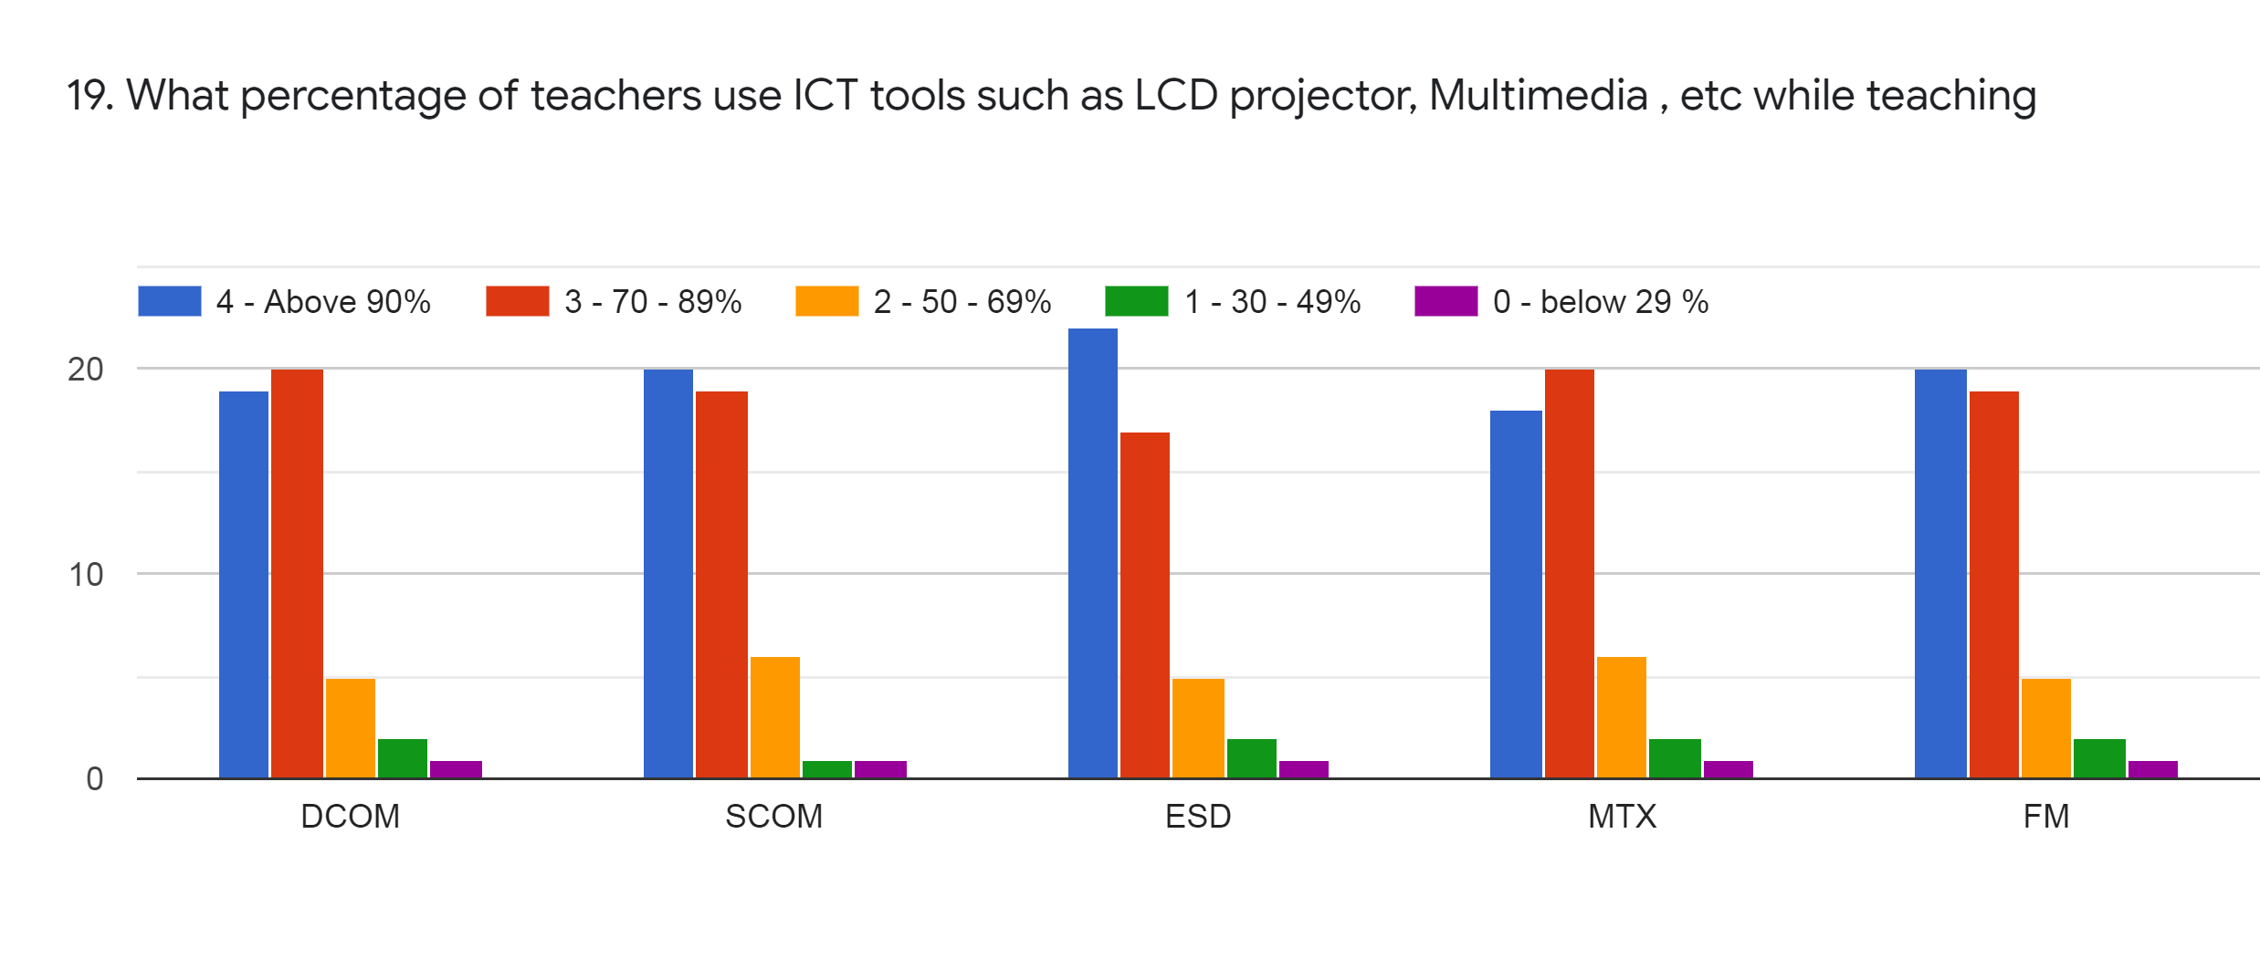
Faculty | JDB | BVT | HVS | KA | KA | %
Subject | DCOM | SCOM | ESD | MTX | FM
Above 90% | 19 | 20 | 22 | 18 | 20 | 40%
70-89% | 20 | 19 | 17 | 20 | 19 | 39%
50-69 % | 5 | 6 | 5 | 6 | 5 | 11%
30-49 % | 2 | 1 | 2 | 2 | 2 | 4%
0-below 29% | 1 | 1 | 1 | 1 | 1 | 2%

Slide 22
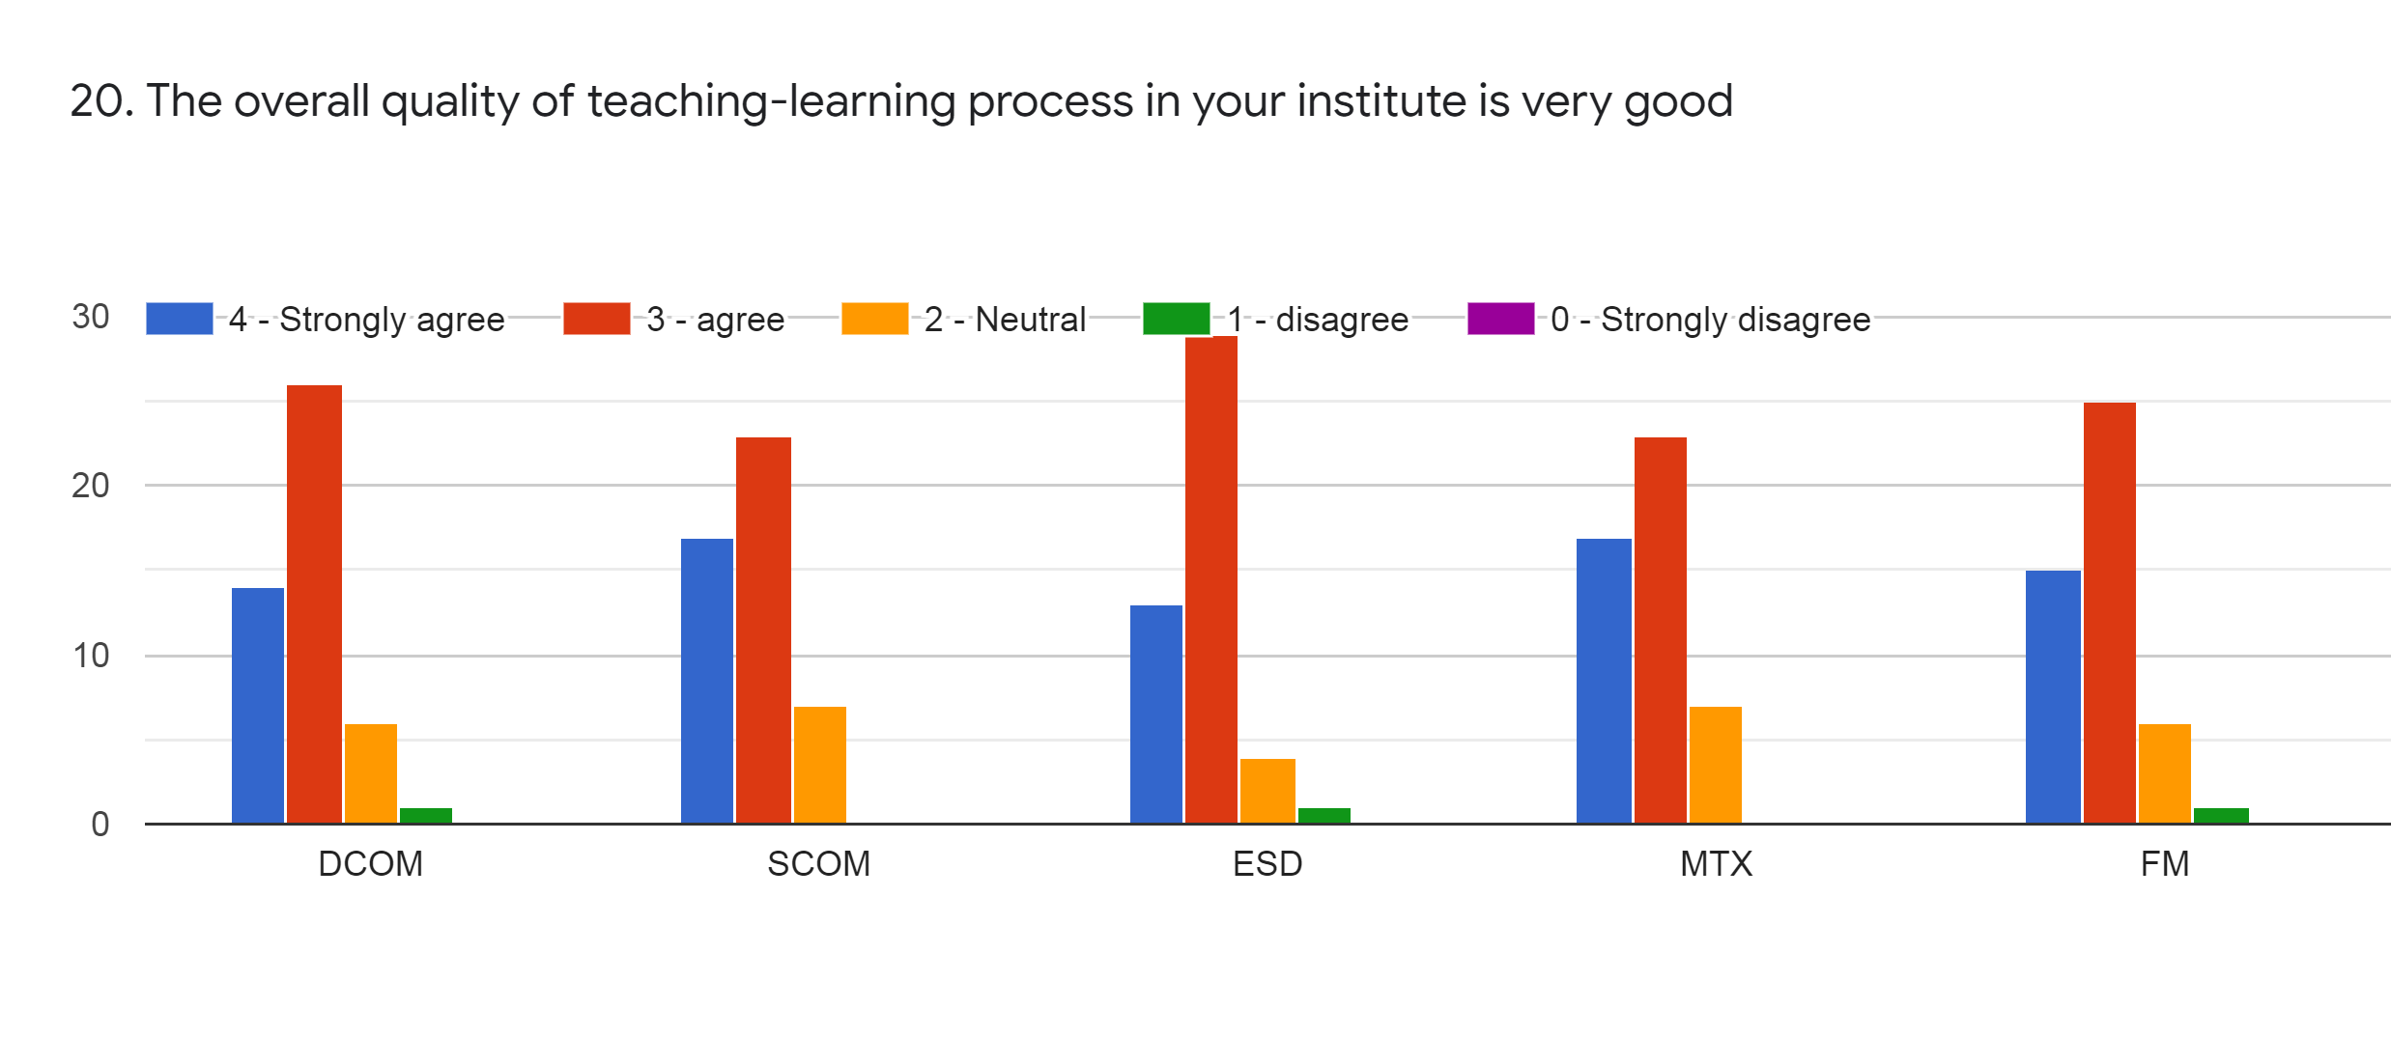
Faculty | JDB | BVT | HVS | KA | KA | %
Subject | DCOM | SCOM | ESD | MTX | FM
Strongly Agree | 14 | 17 | 13 | 17 | 15 | 31%
Agree | 26 | 23 | 29 | 23 | 25 | 51%
Neutral | 6 | 7 | 4 | 7 | 6 | 12%
Disagree | 1 | 0 | 1 | 0 | 1 | 1%
Strongly Disagree | 0 | 0 | 0 | 0 | 0 | 0%

Slide 23
21. Give 3 observations/ suggestions to improve the overall teaching-learning experience of respective teachers
All are good but sometimes it cant satisfactory determine.
Teaching process is satisfactory
Do not use YouTube video for teaching . Sometimes they are not understandable.

Slide 24
OVERALL ANALYSIS
Sub | Faculty | Appreciation | Suggestions for improvement
DCOM | JDB | Inform about CO/PO, Identify strength, ICT use, Encourage for extra curricular activity | Internal evaluation process , Identify weakness, mentoring process
SCOM | BVT | Teacher’s communication, Teaching & mentoring process, taking follow up of assigned task, ICT use | Teaching approach, Identify weakness, Illustrate through example
ESD | HVS | Teacher’s Preparation, communication, Identify strength & weakness | Discussion on assignments, Illustrate through example
MTX | KAM | Teachers preparation, communication, Inform about CO/PO, taking follow up of assigned task | Mentoring process, Identify strength & weakness, effort for monitoring
FM | KAM | Teacher uses students centric method, best teaching approach | Syllabus coverage, promoting for internship

