Slide 1
Arvind Gavali College of Engineering, Satara
Department of civil Engineering
Final Year Feedback
Month-Sept.-Oct. 2020
Total Responses-:54
Total Class Strength-:65
Feedback Percentage-:83.07%

Slide 2
Faculty-Subject Distribution
Sr.No | Subject | Abb. | Name of the Faculty | Abb.
1 | Design of Concrete Structure-II | DCS-II | Mr. Gujar A.V. | AVG
2 | Infrastructure Engineering | Infra Engg. | Ms. Khatal J.M. | JMK
3 | Water Resources Engineering | WRE | Ms. Machhav Pallavi | PM
4 | Professional Practices | PP | Mr. Sapkal R.N. | RNS
5 | Construction Techniques | CT | Mr. Salunkhe S.P. | SPS
6 | Town & Urban Planning | TUP | Dr. Thombare V.R. | VRT

Slide 3
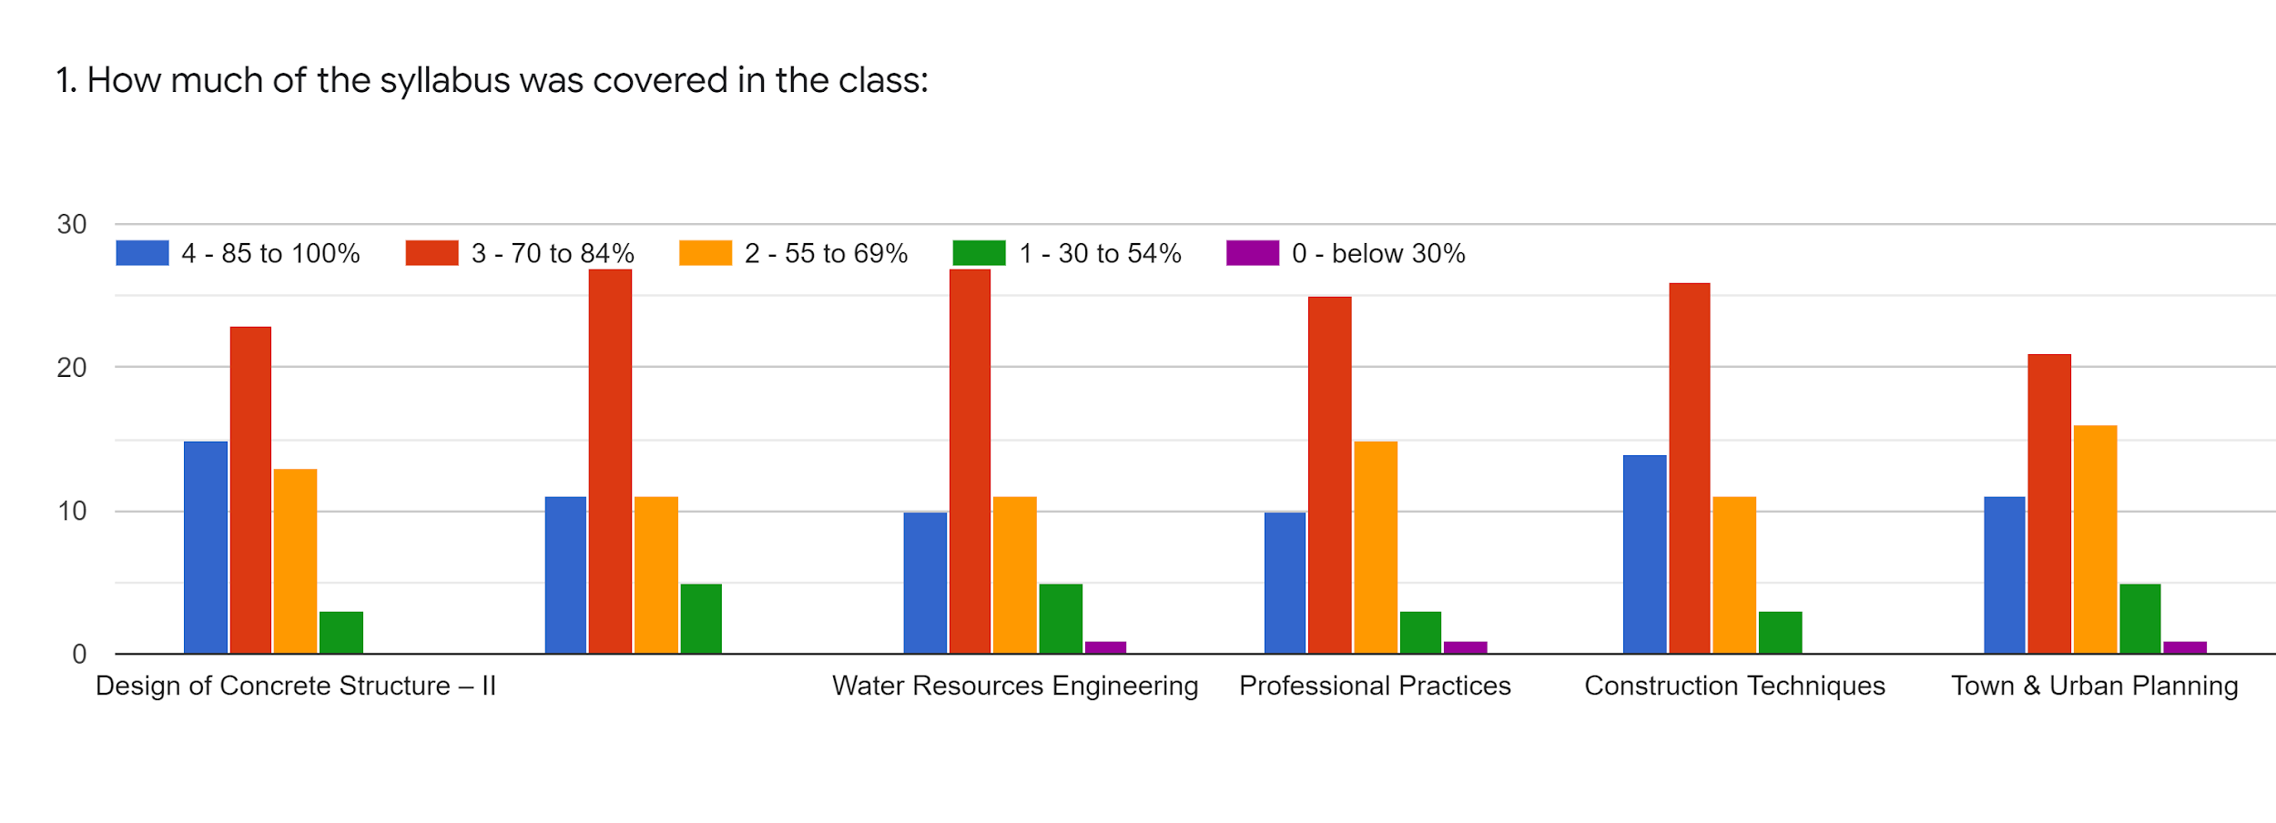
Faculty | AVG | JMK | JMK | RNS | SPS | VRT | %
Subject | DCS-II | Infra Engg. | WRE | PP | CT | TUP
85-100% | 15 | 11 | 10 | 10 | 14 | 11 | 25.17
70-84% | 23 | 27 | 27 | 25 | 26 | 21 | 52.83
55-69% | 13 | 11 | 11 | 15 | 11 | 16 | 27.30
30-54% | 3 | 5 | 5 | 3 | 3 | 5 | 8.51
0-Below 30 | 0 | 0 | 1 | 1 | 0 | 1 | 1.06

Slide 4
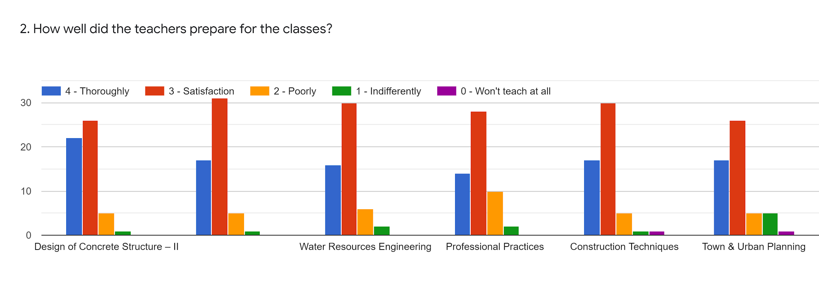
Faculty | AVG | JMK | JMK | RNS | SPS | VRT | %
Subject | DCS-II | Infra Engg. | WRE | PP | CT | TUP
85-100% | 22 | 17 | 16 | 14 | 17 | 17 | 36.52
70-84% | 26 | 31 | 30 | 28 | 30 | 26 | 60.63
55-69% | 5 | 5 | 6 | 10 | 5 | 5 | 12.76
30-54% | 1 | 1 | 2 | 2 | 1 | 5 | 4.25
0-Below 30 | 0 | 0 | 0 | 0 | 1 | 1 | 0.70

Slide 5
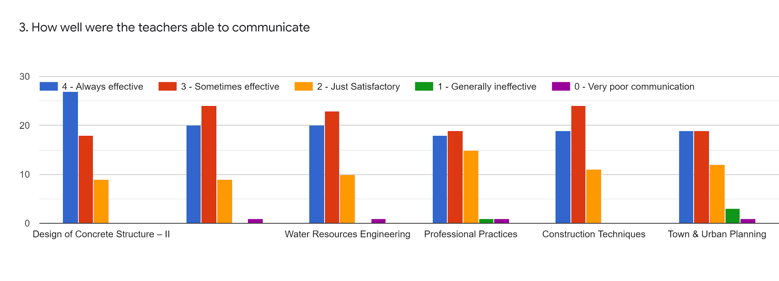
Faculty | AVG | JMK | JMK | RNS | SPS | VRT | %
Subject | DCS-II | Infra Engg. | WRE | PP | CT | TUP
85-100% | 27 | 20 | 20 | 18 | 19 | 19 | 43.61
70-84% | 18 | 24 | 23 | 19 | 24 | 19 | 45.03
55-69% | 9 | 9 | 10 | 15 | 11 | 12 | 23.40
30-54% | 0 | 0 | 0 | 1 | 0 | 3 | 1.41
0-Below 30 | 0 | 1 | 1 | 1 | 0 | 1 | 1.41

Slide 6
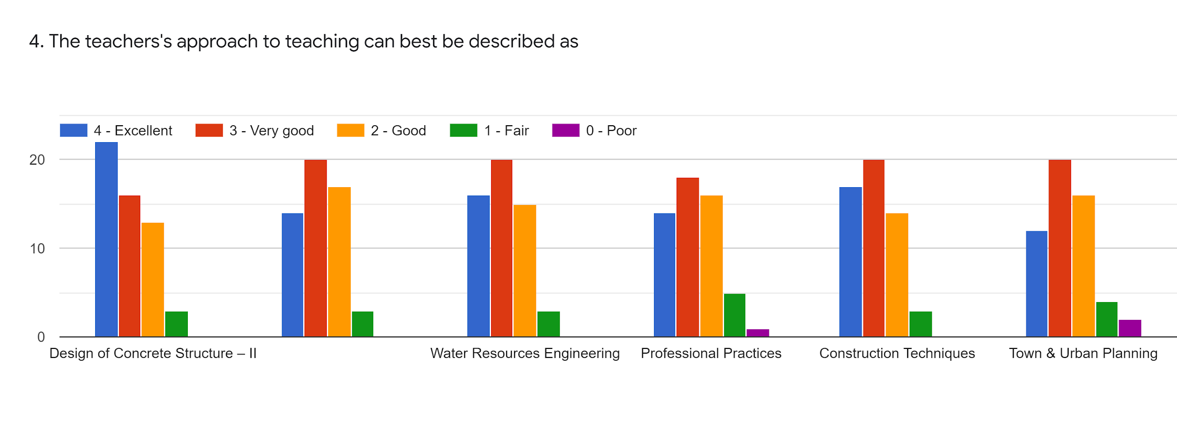
Faculty | AVG | JMK | JMK | RNS | SPS | VRT | %
Subject | DCS-II | Infra Engg. | WRE | PP | CT | TUP
85-100% | 22 | 14 | 16 | 14 | 17 | 12 | 33.68
70-84% | 16 | 20 | 20 | 18 | 20 | 20 | 40.42
55-69% | 13 | 17 | 15 | 16 | 14 | 16 | 32.26
30-54% | 3 | 3 | 3 | 5 | 3 | 4 | 7.44
0-Below 30 | 0 | 0 | 0 | 1 | 0 | 2 | 1.06

Slide 7
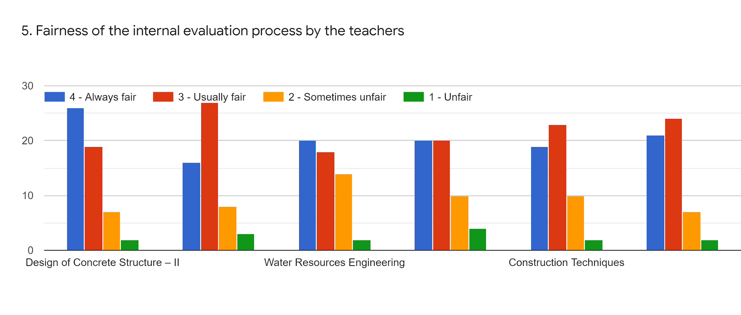
Faculty | AVG | JMK | JMK | RNS | SPS | VRT | %
Subject | DCS-II | Infra Engg. | WRE | PP | CT | TUP
85-100% | 26 | 16 | 20 | 20 | 19 | 21 | 43.26
70-84% | 19 | 27 | 18 | 20 | 23 | 14 | 42.90
55-69% | 7 | 8 | 14 | 10 | 10 | 7 | 19.85
30-54% | 2 | 3 | 2 | 4 | 2 | 2 | 5.31
0-Below 30 | 0 | 0 | 0 | 0 | 0 | 0 | 0

Slide 8
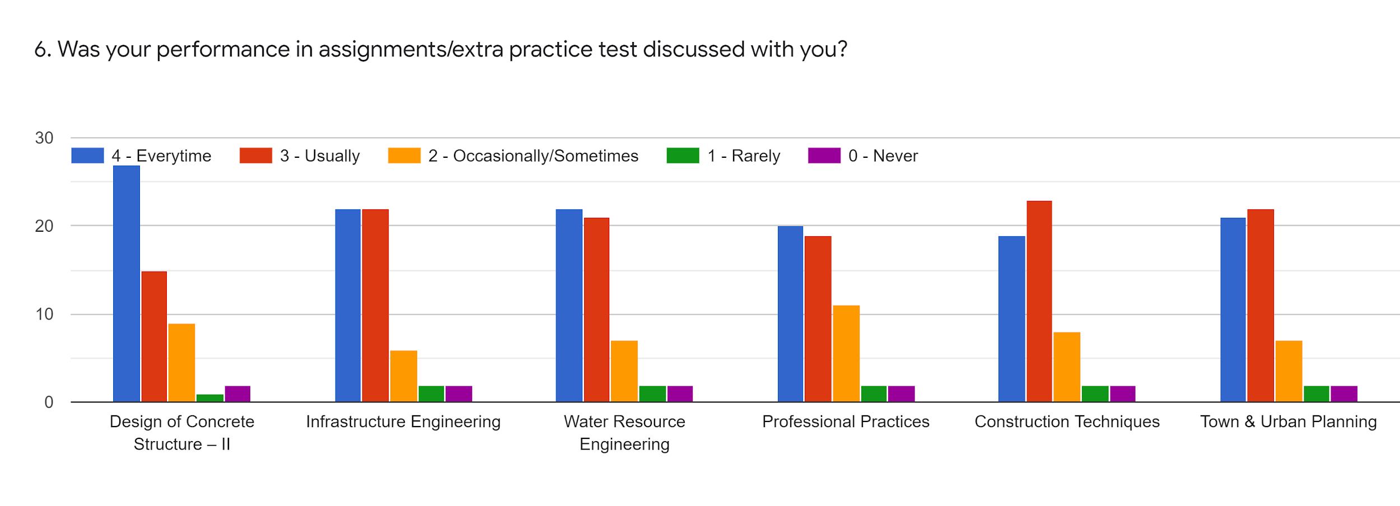
Faculty | AVG | JMK | JMK | RNS | SPS | VRT | %
Subject | DCS-II | Infra Engg. | WRE | PP | CT | TUP
85-100% | 27 | 22 | 22 | 20 | 19 | 21 | 46.45
70-84% | 15 | 22 | 21 | 19 | 23 | 22 | 43.26
55-69% | 9 | 6 | 7 | 11 | 8 | 7 | 17.02
30-54% | 1 | 2 | 2 | 2 | 2 | 2 | 3.90
0-Below 30 | 2 | 2 | 2 | 2 | 2 | 2 | 4.25

Slide 9
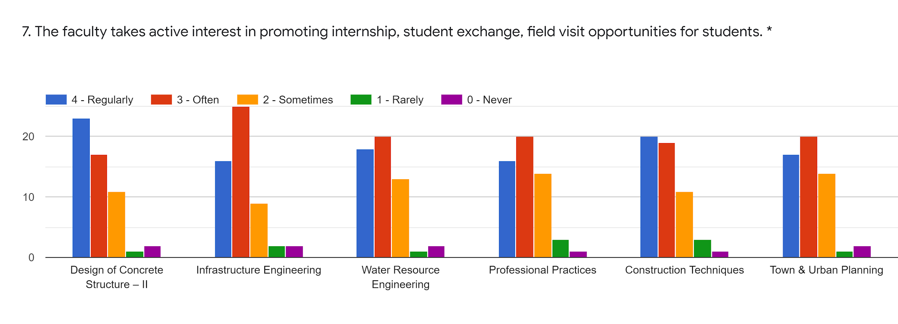
Faculty | AVG | JMK | JMK | RNS | SPS | VRT | %
Subject | DCS-II | Infra Engg. | WRE | PP | CT | TUP
85-100% | 23 | 16 | 18 | 16 | 20 | 17 | 39
70-84% | 17 | 25 | 20 | 20 | 19 | 20 | 42.90
55-69% | 11 | 14 | 13 | 14 | 11 | 14 | 27.30
30-54% | 1 | 2 | 1 | 3 | 3 | 1 | 3.90
0-Below 30 | 2 | 2 | 2 | 1 | 1 | 2 | 3.54

Slide 10
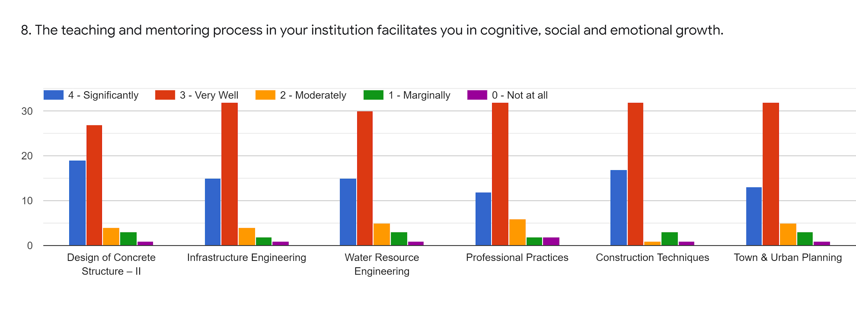
Faculty | AVG | JMK | JMK | RNS | SPS | VRT | %
Subject | DCS-II | Infra Engg. | WRE | PP | CT | TUP
85-100% | 19 | 15 | 15 | 12 | 17 | 13 | 32.26
70-84% | 17 | 32 | 20 | 32 | 32 | 32 | 58.51
55-69% | 4 | 4 | 5 | 6 | 1 | 5 | 8.86
30-54% | 3 | 2 | 4 | 2 | 3 | 3 | 6.02
0-Below 30 | 1 | 1 | 1 | 2 | 1 | 1 | 2.48

Slide 11
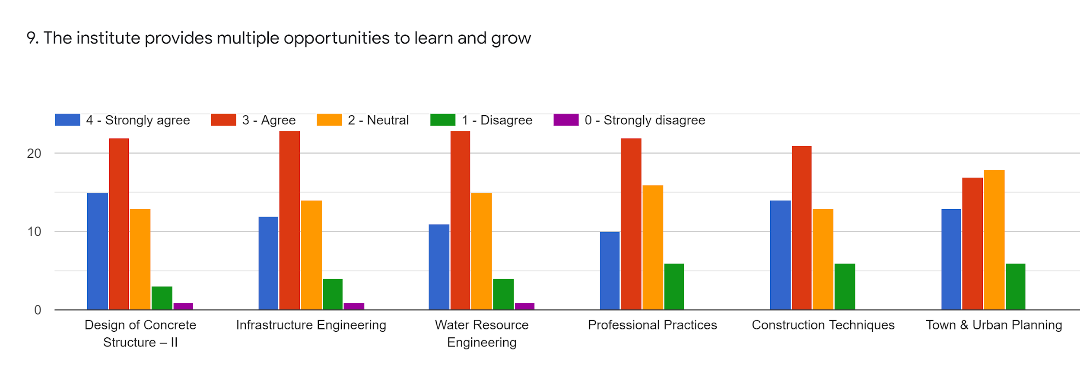
Faculty | AVG | JMK | JMK | RNS | SPS | VRT | %
Subject | DCS-II | Infra Engg. | WRE | PP | CT | TUP
85-100% | 15 | 12 | 11 | 10 | 14 | 13 | 26.59
70-84% | 22 | 23 | 23 | 22 | 21 | 17 | 45.39
55-69% | 13 | 14 | 15 | 16 | 13 | 18 | 31.56
30-54% | 3 | 4 | 4 | 6 | 6 | 6 | 10.28
0-Below 30 | 1 | 1 | 1 | 0 | 0 | 0 | 1.06

Slide 12
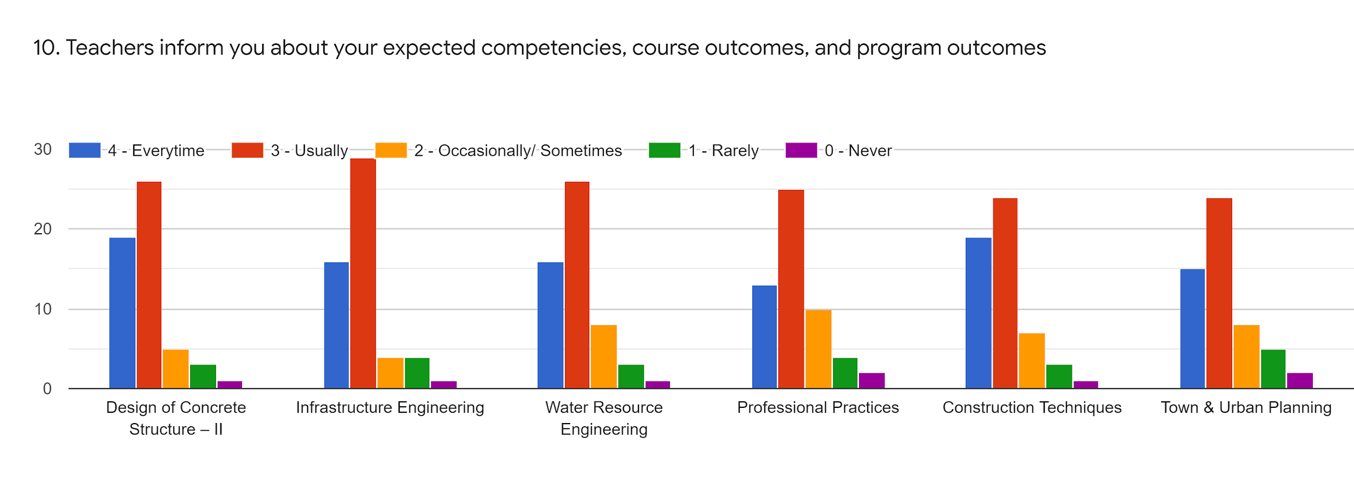
Faculty | AVG | JMK | JMK | RNS | SPS | VRT | %
Subject | DCS-II | Infra Engg. | WRE | PP | CT | TUP
85-100% | 19 | 11 | 16 | 13 | 19 | 15 | 32.97
70-84% | 26 | 29 | 26 | 25 | 24 | 24 | 54.60
55-69% | 5 | 4 | 8 | 10 | 7 | 8 | 14.89
30-54% | 3 | 4 | 3 | 4 | 3 | 5 | 7.80
0-Below 30 | 1 | 1 | 1 | 2 | 1 | 2 | 2.83

Slide 13
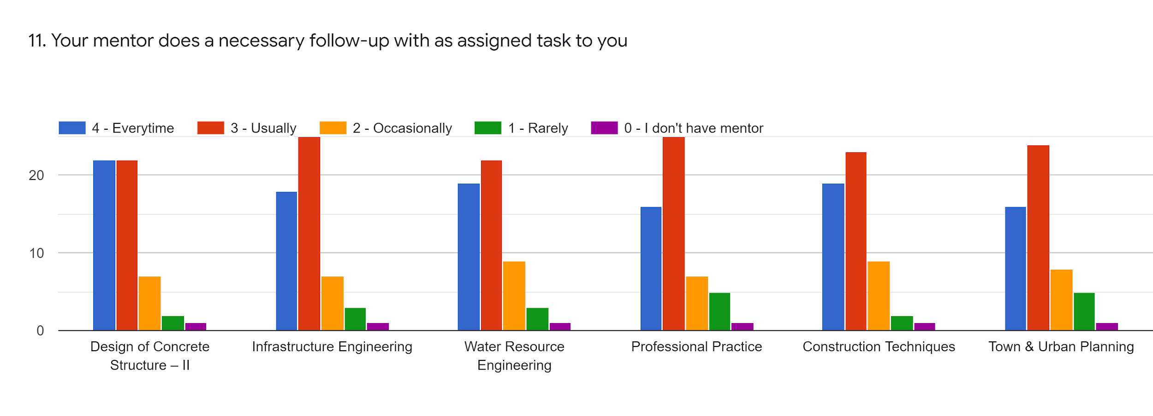
Faculty | AVG | JMK | JMK | RNS | SPS | VRT | %
Subject | DCS-II | Infra Engg. | WRE | PP | CT | TUP
85-100% | 22 | 18 | 19 | 16 | 19 | 16 | 33.95
70-84% | 22 | 25 | 22 | 25 | 23 | 24 | 43.51
55-69% | 7 | 7 | 9 | 7 | 9 | 8 | 14.50
30-54% | 2 | 3 | 3 | 5 | 2 | 5 | 6.17
0-Below 30 | 1 | 1 | 1 | 1 | 1 | 1 | 1.85

Slide 14
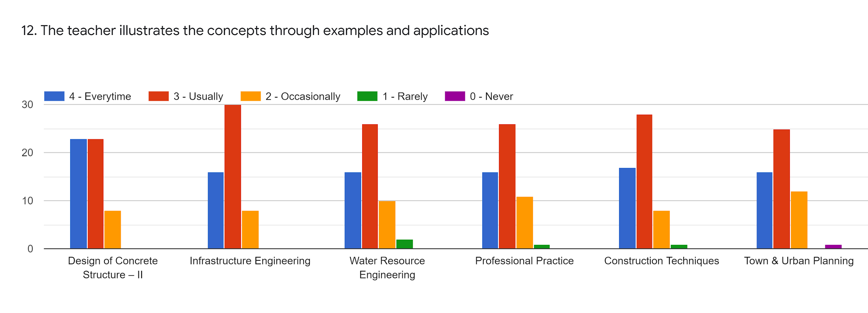
Faculty | AVG | JMK | JMK | RNS | SPS | VRT | %
Subject | DCS-II | Infra Engg. | WRE | PP | CT | TUP
85-100% | 23 | 16 | 16 | 16 | 17 | 16 | 27.16
70-84% | 23 | 30 | 26 | 26 | 28 | 25 | 48.76
55-69% | 8 | 8 | 10 | 11 | 7 | 12 | 17.28
30-54% | 0 | 0 | 2 | 1 | 1 | 0 | 1.23
0-Below 30 | 0 | 0 | 0 | 0 | 0 | 1 | 0.30

Slide 15
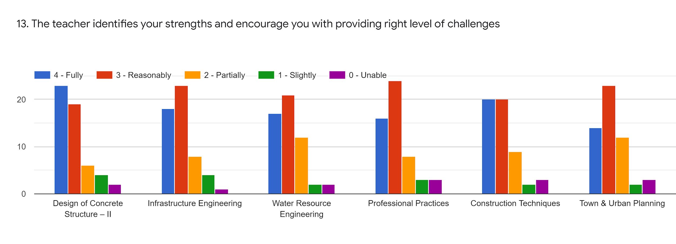
Faculty | AVG | JMK | JMK | RNS | SPS | VRT | %
Subject | DCS-II | Infra Engg. | WRE | PP | CT | TUP
85-100% | 23 | 18 | 17 | 16 | 20 | 14 | 33.33
70-84% | 19 | 23 | 21 | 24 | 20 | 23 | 40.12
55-69% | 6 | 8 | 12 | 8 | 9 | 12 | 16.97
30-54% | 4 | 4 | 2 | 3 | 3 | 3 | 5.24
0-Below 30 | 3 | 1 | 2 | 3 | 3 | 3 | 4.62

Slide 16
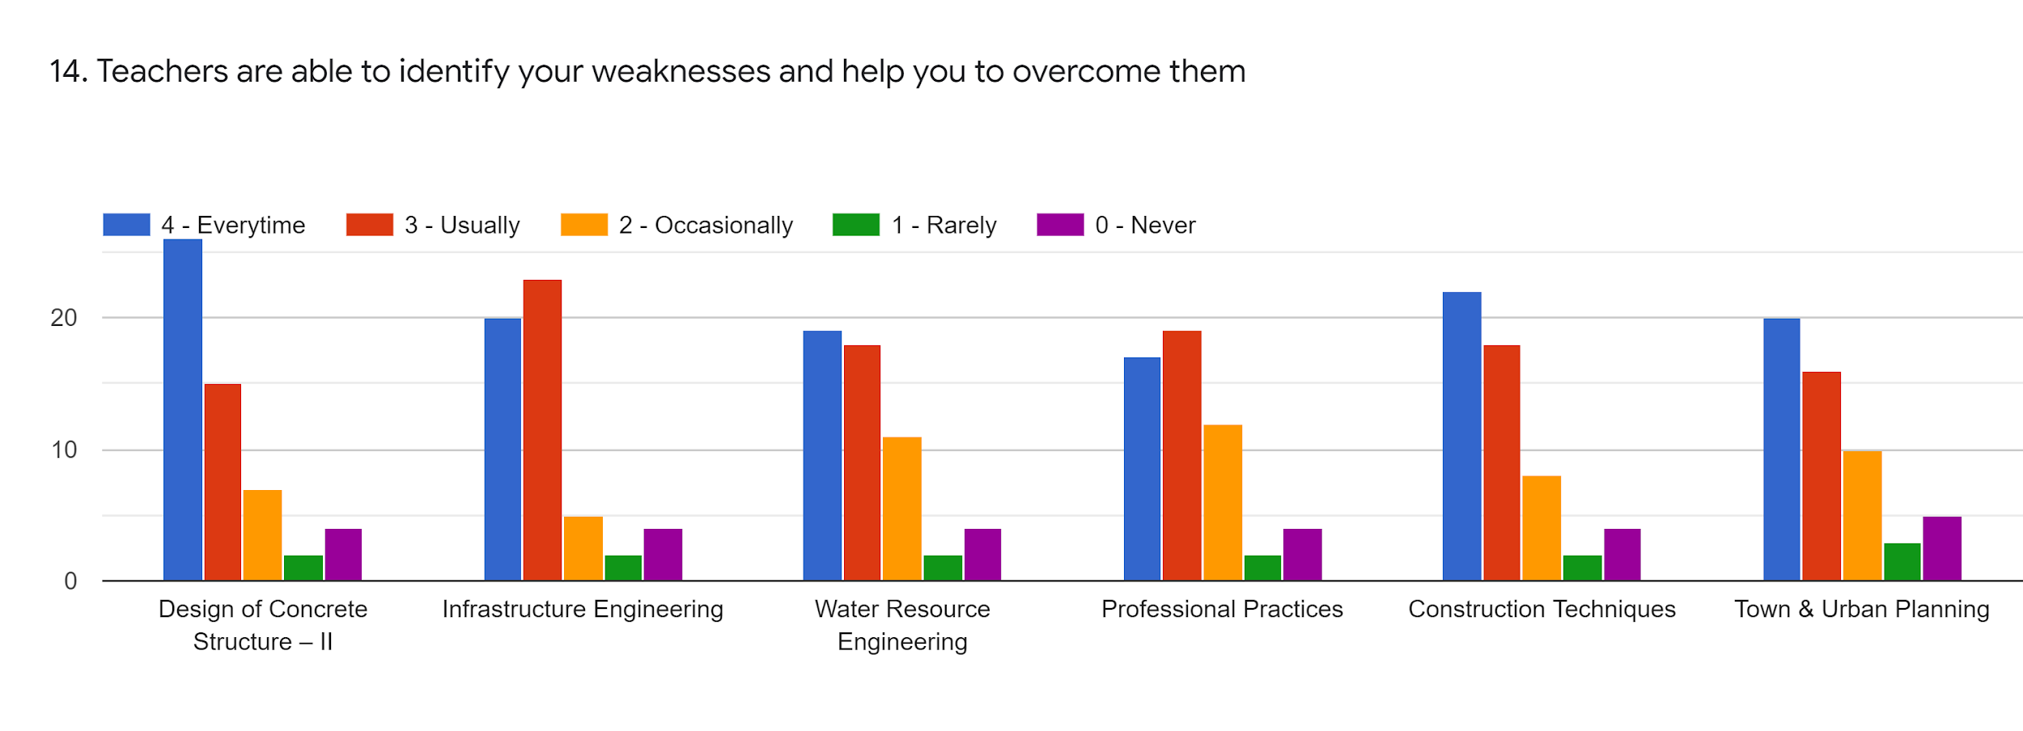
Faculty | AVG | JMK | JMK | RNS | SPS | VRT | %
Subject | DCS-II | Infra Engg. | WRE | PP | CT | TUP
85-100% | 26 | 20 | 19 | 17 | 22 | 20 | 38.27
70-84% | 15 | 23 | 18 | 19 | 18 | 16 | 33.64
55-69% | 7 | 5 | 11 | 12 | 8 | 10 | 16.35
30-54% | 2 | 2 | 2 | 2 | 2 | 3 | 4.62
0-Below 30 | 4 | 4 | 4 | 4 | 4 | 5 | 7.71

Slide 17
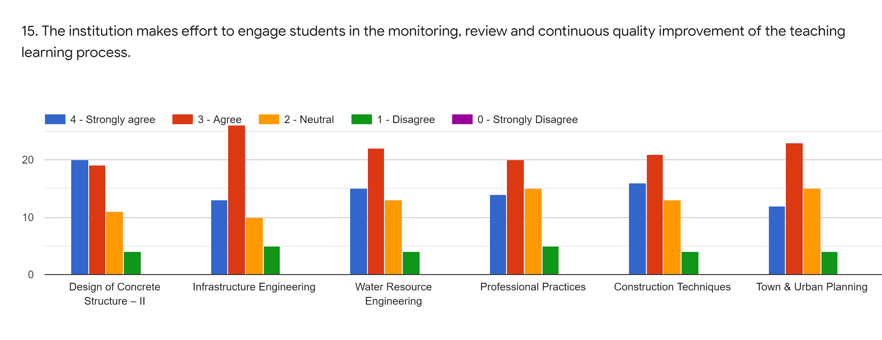
Faculty | AVG | JMK | JMK | RNS | SPS | VRT | %
Subject | DCS-II | Infra Engg. | WRE | PP | CT | TUP
85-100% | 20 | 13 | 16 | 14 | 16 | 12 | 28.08
70-84% | 19 | 16 | 22 | 20 | 21 | 23 | 37.34
55-69% | 11 | 10 | 13 | 15 | 13 | 15 | 23.76
30-54% | 4 | 5 | 4 | 5 | 4 | 4 | 8.02
0-Below 30 | 0 | 0 | 0 | 0 | 0 | 0 | 0

Slide 18
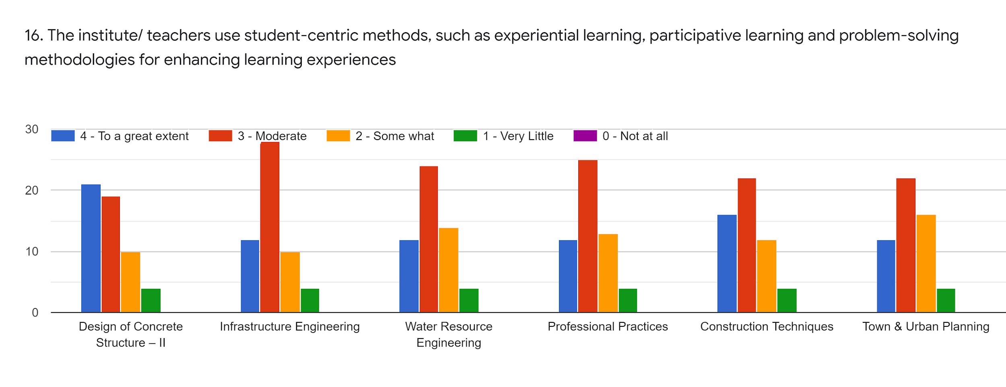
Faculty | AVG | JMK | JMK | RNS | SPS | VRT | %
Subject | DCS-II | Infra Engg. | WRE | PP | CT | TUP
85-100% | 21 | 12 | 12 | 12 | 16 | 12 | 26.23
70-84% | 19 | 28 | 24 | 25 | 22 | 22 | 43.20
55-69% | 10 | 10 | 14 | 13 | 12 | 16 | 23.14
30-54% | 4 | 4 | 4 | 4 | 4 | 4 | 7.40
0-Below 30 | 0 | 0 | 0 | 0 | 0 | 0 | 0

Slide 19
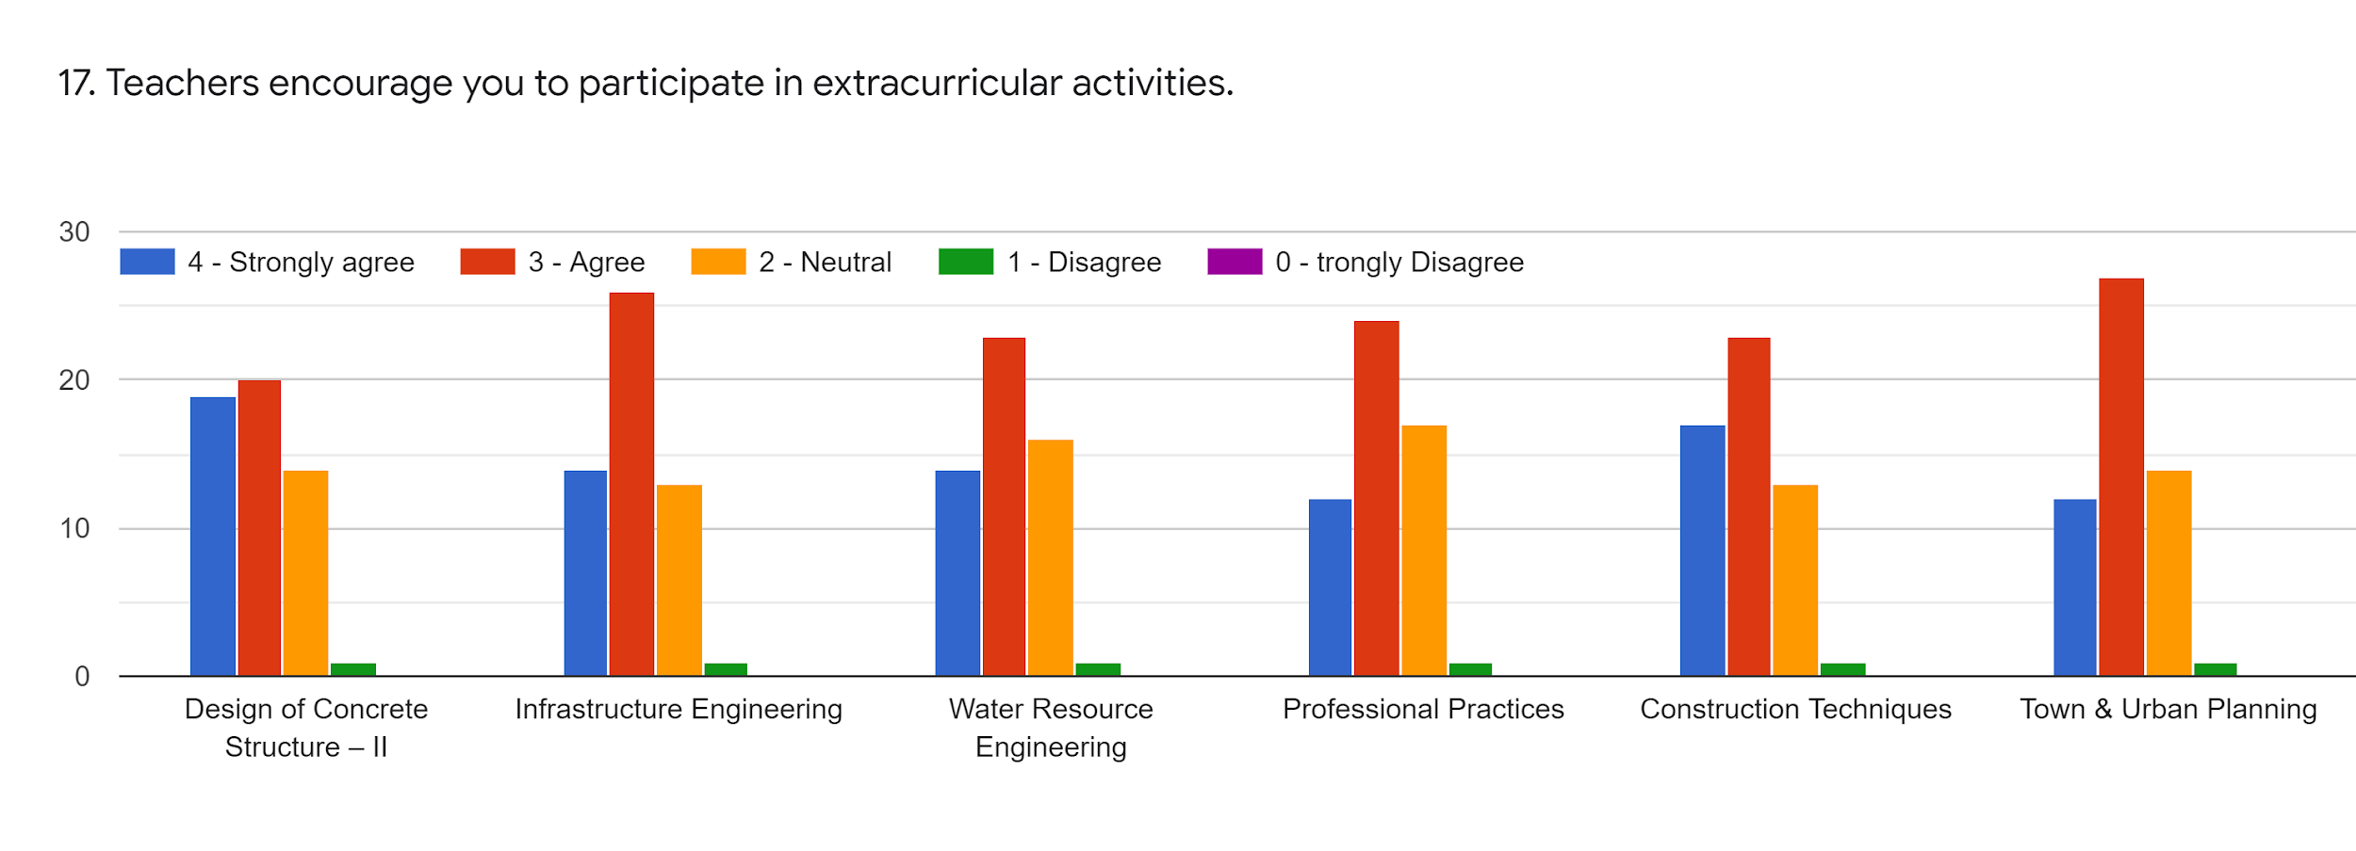
Faculty | AVG | JMK | JMK | RNS | SPS | VRT | %
Subject | DCS-II | Infra Engg. | WRE | PP | CT | TUP
85-100% | 19 | 14 | 14 | 12 | 17 | 12 | 27.16
70-84% | 20 | 26 | 23 | 24 | 23 | 27 | 44.13
55-69% | 14 | 13 | 16 | 17 | 13 | 14 | 26.85
30-54% | 1 | 1 | 1 | 1 | 1 | 1 | 2.16
0-Below 30 | 0 | 0 | 0 | 0 | 0 | 0 | 0

Slide 20
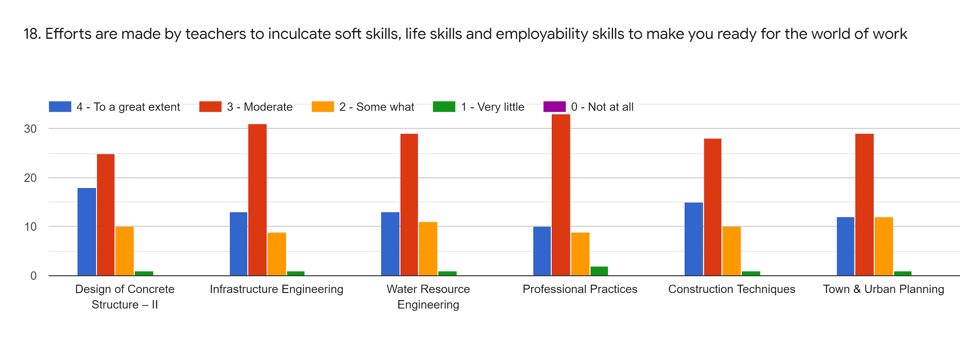
Faculty | AVG | JMK | JMK | RNS | SPS | VRT | %
Subject | DCS-II | Infra Engg. | WRE | PP | CT | TUP
85-100% | 18 | 13 | 13 | 10 | 15 | 12 | 25
70-84% | 25 | 31 | 29 | 33 | 28 | 29 | 54.01
55-69% | 10 | 9 | 11 | 9 | 10 | 12 | 18.82
30-54% | 1 | 1 | 1 | 2 | 1 | 1 | 2.16
0-Below 30 | 0 | 0 | 0 | 0 | 0 | 0 | 0

Slide 21
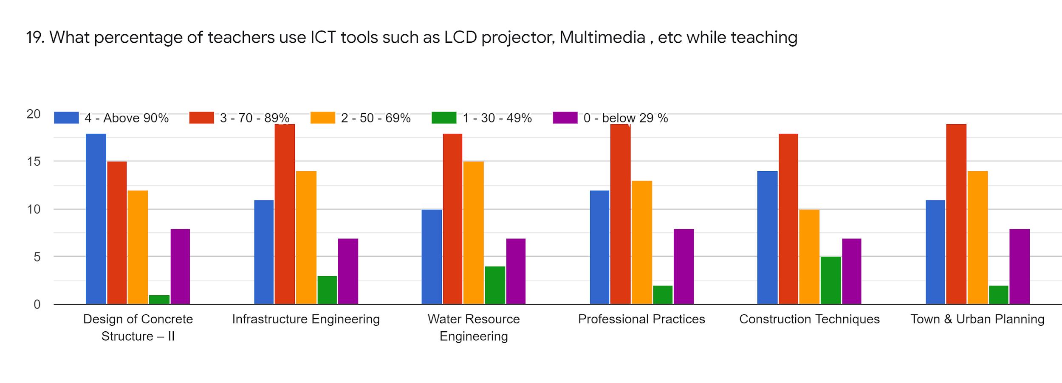
Faculty | AVG | JMK | JMK | RNS | SPS | VRT | %
Subject | DCS-II | Infra Engg. | WRE | PP | CT | TUP
85-100% | 18 | 11 | 10 | 12 | 14 | 11 | 23.45
70-84% | 15 | 19 | 18 | 19 | 18 | 19 | 33.34
55-69% | 12 | 14 | 15 | 13 | 10 | 14 | 24.07
30-54% | 1 | 3 | 4 | 2 | 5 | 2 | 5.24
0-Below 30 | 8 | 7 | 7 | 8 | 7 | 8 | 13.88

Slide 22
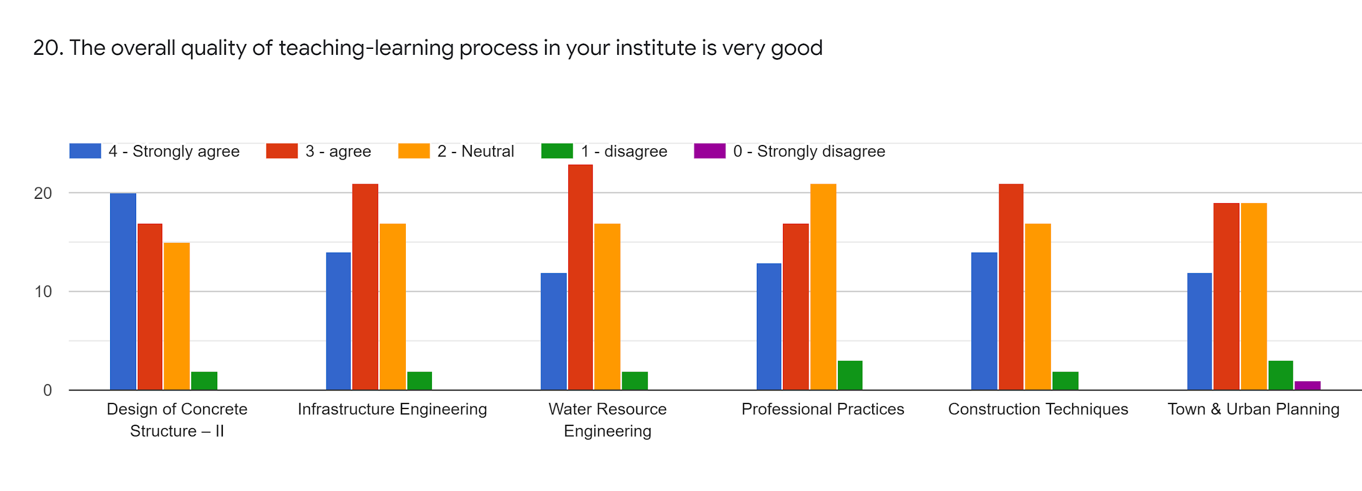
Faculty | AVG | JMK | JMK | RNS | SPS | VRT | %
Subject | DCS-II | Infra Engg. | WRE | PP | CT | TUP
85-100% | 20 | 14 | 12 | 13 | 14 | 12 | 26.23
70-84% | 17 | 21 | 23 | 17 | 21 | 19 | 36.41
55-69% | 15 | 17 | 17 | 21 | 17 | 19 | 32.71
30-54% | 2 | 2 | 2 | 3 | 2 | 3 | 4.32
0-Below 30 | 0 | 0 | 0 | 0 | 0 | 1 | 0.30

Slide 23
Give 3 observation/ suggestions to improve the overall teaching experience of respective teachers
All teachers are taking more effort to conducting lectures
Communicate to the all students.
Record the online lectures & send to students.
Good Teaching Staff
Town n professional practice staff plz explain more n more
Focus on teaching skilll & The presentation can be improve.

Slide 24
Overall Analysis
Subject | Faculty | Appreciation | Suggestion for Improvement
DCS-II | AVG | Good Communication, Better Understanding | Syllabus Coverage, Take more Examples for design
Infra. Engg. | JMK | Give notes before lecture, | Improve Presentation skill, give notes before lecture
WRE | JMK | Syllabus Coverage, Give assignment | Lecture have start as per given time Improve Presentation skill,
PP | RNS | Syllabus Coverage, Share screen in online lecture | Explain More Examples, give notes before lecture
CT | SPS | Syllabus Coverage, Talk to all Students | Give notes before lecture, Take more examples
TUP | VRT | Give notes before lecture, Better Communication | Talk to all students, Explain More Examples

