Slide 1
Arvind Gavali College of Engineering, Satara
Department of Computer Science & Engineering
Final Year Feedback
Month-Sept.-Oct. 2020
Total Responses-:75
Total Class Strength-75
Feedback Percentage-:100%

Slide 2
Faculty-Subject Distribution
Sr.No | Subject | Abb. | Name of the Faculty | Abb.
1 | Software Engineering | SE | Mr. Jadhav D.V. | JDV
2 | Data Analytics | DA | Dr. Bhosale V.K. | BVK
3 | Business Intelligence | BI | Ms.Kulkarni A. | KA
4 | Computer Graphics | CG | Mrs.Mandhare R.M. | MRM
6 | Full Stack Development | FSD | Ms. Shingade R. | SR
7 | Software Administration | SA | Mr. Jadhav D.V. | JDV

Slide 3
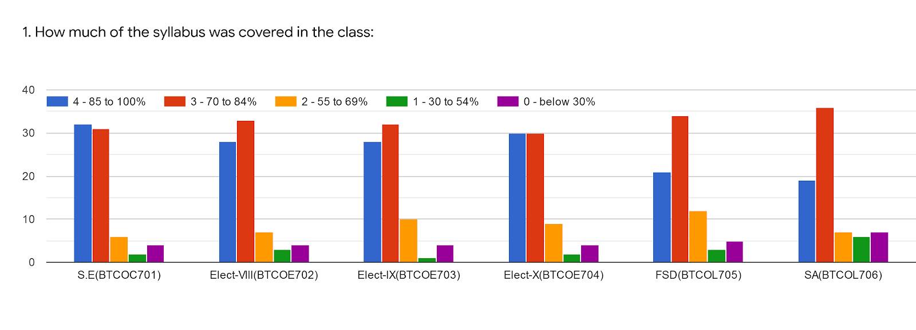
 | S.E(BTCOC701) | Elect-VIII(BTCOE702) | Elect-IX(BTCOE703) | Elect-X(BTCOE704) | FSD(BTCOL705) | SA(BTCOL706) | %
 | Mr.Jadhav D.V. | Dr.Varsha Bhosale | Mrs. Anuja Kulkarni | Mrs Mandhare R.M | Rohini Shingade | Mr.Jadhav D.V.
Excellent | 33 | 28 | 28 | 30 | 21 | 19 | 37%
Very Good | 31 | 33 | 32 | 30 | 34 | 36 | 46%
Good | 6 | 8 | 10 | 9 | 12 | 7 | 12%
Average | 1 | 2 | 1 | 1 | 3 | 6 | 03%
Poor | 4 | 4 | 4 | 5 | 5 | 7 | 06%
Total | 75 | 75 | 75 | 75 | 75 | 75

Slide 4
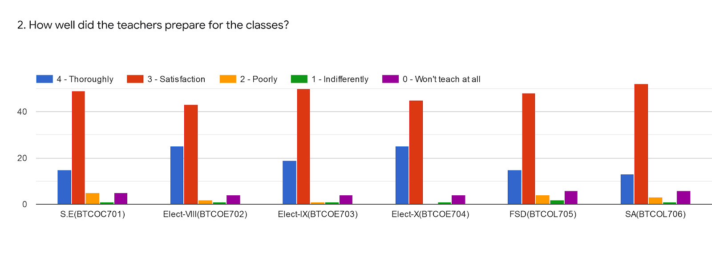
 | S.E(BTCOC701) | Elect-VIII(BTCOE702) | Elect-IX(BTCOE703) | Elect-X(BTCOE704) | FSD(BTCOL705) | SA(BTCOL706) | %
 | Mr.Jadhav D.V. | Dr.Varsha Bhosale | Mrs. Anuja Kulkarni | Mrs Mandhare R.M | Rohini Shingade | Mr.Jadhav D.V.
Excellent | 18 | 23 | 20 | 24 | 22 | 13 | 29%
Very Good | 48 | 43 | 50 | 44 | 31 | 52 | 62%
Good | 4 | 4 | 1 | 1 | 5 | 3 | 4%
Average | 1 | 2 | 1 | 1 | 1 | 1 | 01%
Poor | 4 | 3 | 3 | 3 | 6 | 6 | 05%
Total | 75 | 75 | 75 | 72 | 75 | 75

Slide 5
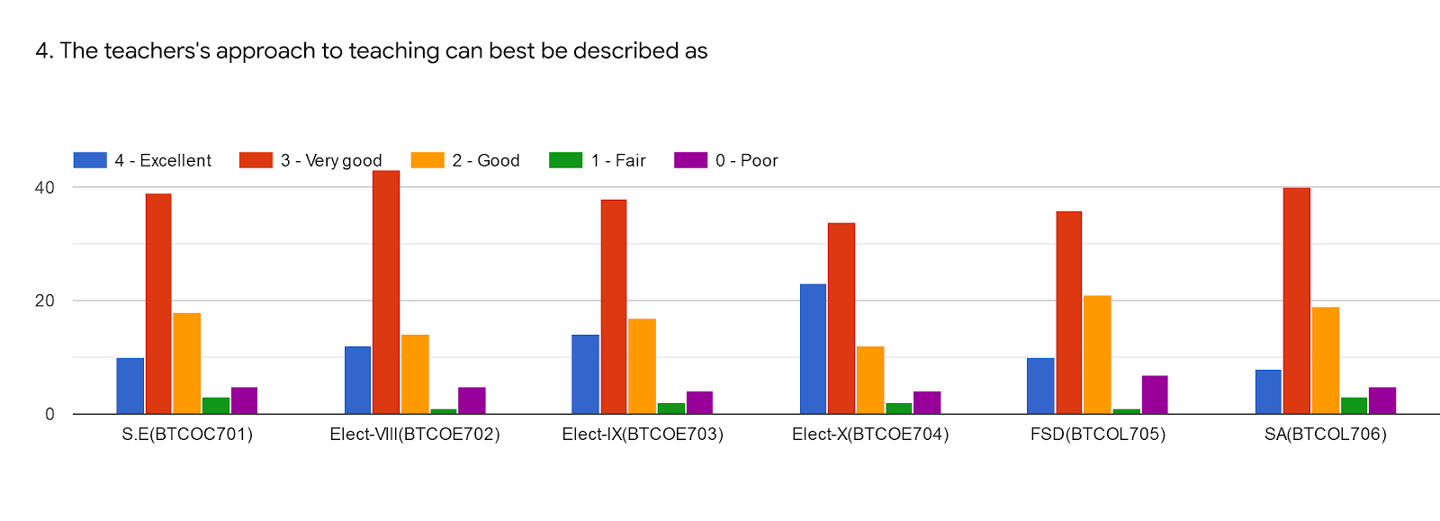
 | S.E(BTCOC701) | Elect-VIII(BTCOE702) | Elect-IX(BTCOE703) | Elect-X(BTCOE704) | FSD(BTCOL705) | SA(BTCOL706) | %
 | Mr.Jadhav D.V. | Dr.Varsha Bhosale | Mrs. Anuja Kulkarni | Mrs Mandhare R.M | Rohini Shingade | Mr.Jadhav D.V.
Excellent | 10 | 12 | 13 | 23 | 10 | 9 | 17%
Very Good | 39 | 42 | 38 | 33 | 35 | 40 | 53%
Good | 19 | 15 | 18 | 13 | 21 | 19 | 24%
Average | 3 | 2 | 2 | 2 | 1 | 2 | 02%
Poor | 4 | 4 | 4 | 4 | 8 | 5 | 06%
Total | 75 | 75 | 75 | 75 | 75 | 75

Slide 6
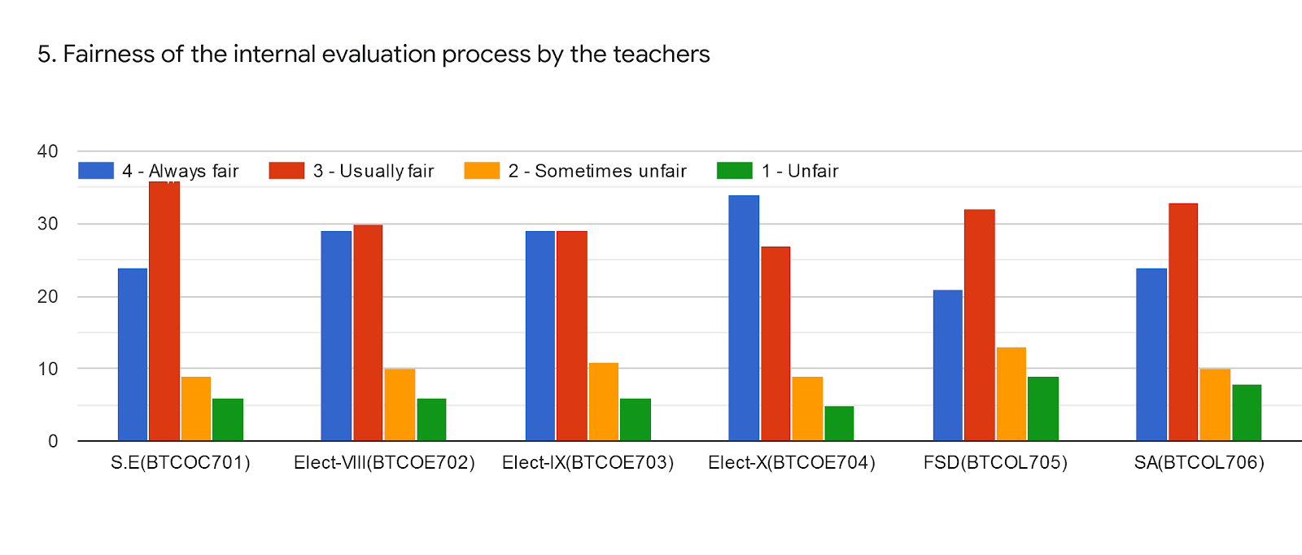
 | S.E(BTCOC701) | Elect-VIII(BTCOE702) | Elect-IX(BTCOE703) | Elect-X(BTCOE704) | FSD(BTCOL705) | SA(BTCOL706) | %
 | Mr.Jadhav D.V. | Dr.Varsha Bhosale | Mrs. Anuja Kulkarni | Mrs Mandhare R.M | Rohini Shingade | Mr.Jadhav D.V.
Excellent | 24 | 29 | 29 | 34 | 20 | 24 | 37%
Very Good | 36 | 30 | 29 | 27 | 32 | 33 | 43%
Good | 9 | 10 | 11 | 9 | 15 | 10 | 15%
Average | 6 | 6 | 6 | 5 | 8 | 8 | 39%
Total | 75 | 75 | 75 | 75 | 75 | 75

Slide 7
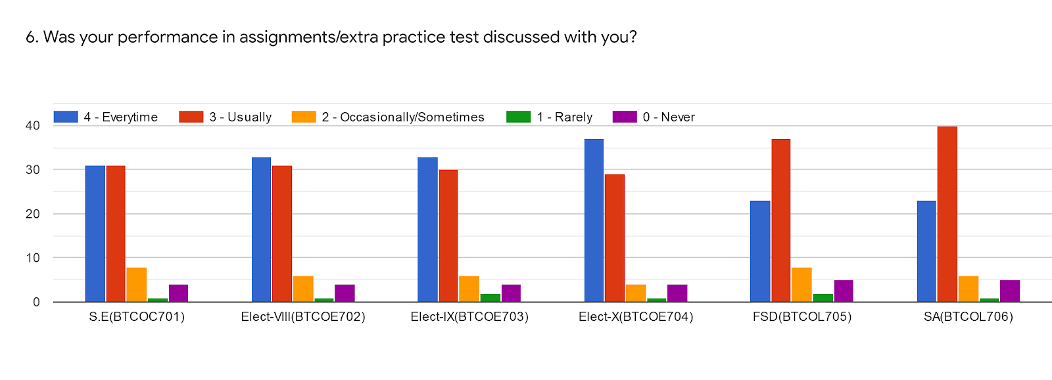
 | S.E(BTCOC701) | Elect-VIII(BTCOE702) | Elect-IX(BTCOE703) | Elect-X(BTCOE704) | FSD(BTCOL705) | SA(BTCOL706) | %
 | Mr.Jadhav D.V. | Dr.Varsha Bhosale | Mrs. Anuja Kulkarni | Mrs Mandhare R.M | Rohini Shingade | Mr.Jadhav D.V.
Excellent | 31 | 33 | 33 | 37 | 22 | 24 | 42%
Very Good | 31 | 31 | 30 | 29 | 39 | 40 | 47%
Good | 8 | 6 | 6 | 4 | 5 | 5 | 07%
Average | 1 | 1 | 2 | 1 | 4 | 1 | 02%
Poor | 4 | 4 | 4 | 4 | 5 | 5 | 06%
Total | 75 | 75 | 75 | 75 | 75 | 75

Slide 8
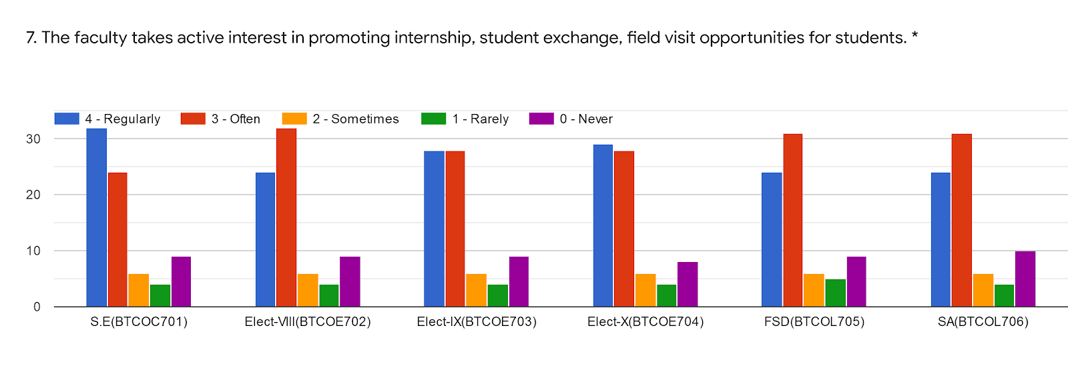
 | S.E(BTCOC701) | Elect-VIII(BTCOE702) | Elect-IX(BTCOE703) | Elect-X(BTCOE704) | FSD(BTCOL705) | SA(BTCOL706) | %
 | Mr.Jadhav D.V. | Dr.Varsha Bhosale | Mrs. Anuja Kulkarni | Mrs Mandhare R.M | Rohini Shingade | Mr.Jadhav D.V.
Excellent | 33 | 25 | 27 | 29 | 27 | 24 | 38%
Very Good | 24 | 32 | 27 | 28 | 31 | 31 | 40%
Good | 5 | 6 | 67 | 7 | 5 | 6 | 7%
Average | 4 | 4 | 5 | 4 | 4 | 4 | 5%
Poor | 9 | 8 | 9 | 8 | 8 | 10 | 12%
Total | 75 | 75 | 75 | 75 | 75 | 75

Slide 9
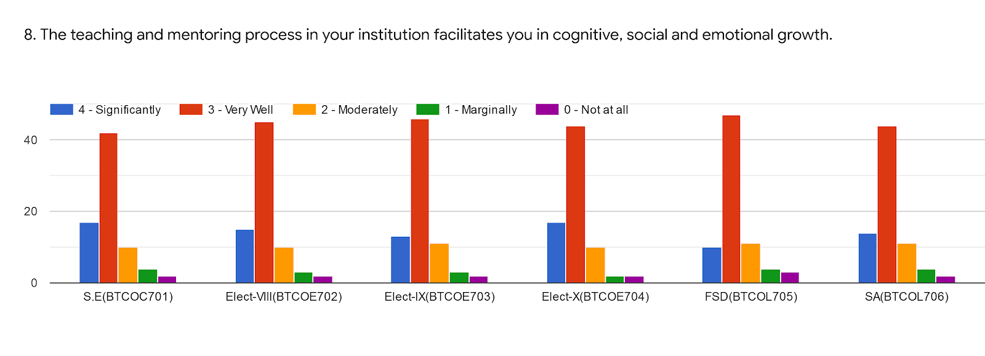
 | S.E(BTCOC701) | Elect-VIII(BTCOE702) | Elect-IX(BTCOE703) | Elect-X(BTCOE704) | FSD(BTCOL705) | SA(BTCOL706) | %
 | Mr.Jadhav D.V. | Dr.Varsha Bhosale | Mrs. Anuja Kulkarni | Mrs Mandhare R.M | Rohini Shingade | Mr.Jadhav D.V.
Excellent | 18 | 15 | 12 | 18 | 10 | 15 | 20%
Very Good | 42 | 46 | 46 | 45 | 47 | 44 | 63%
Good | 10 | 10 | 11 | 10 | 10 | 11 | 14%
Average | 5 | 3 | 4 | 1 | 4 | 4 | 05%
Poor | 1 | 1 | 2 | 1 | 4 | 1 | 02%
Total | 75 | 75 | 75 | 75 | 75 | 75

Slide 10
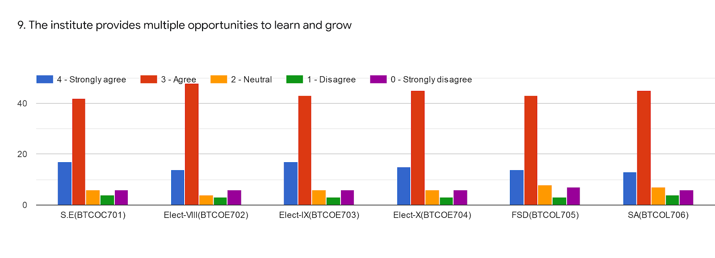
 | S.E(BTCOC701) | Elect-VIII(BTCOE702) | Elect-IX(BTCOE703) | Elect-X(BTCOE704) | FSD(BTCOL705) | SA(BTCOL706) | %
 | Mr.Jadhav D.V. | Dr.Varsha Bhosale | Mrs. Anuja Kulkarni | Mrs Mandhare R.M | Rohini Shingade | Mr.Jadhav D.V.
Excellent | 18 | 16 | 18 | 16 | 15 | 12 | 22%
Very Good | 42 | 48 | 42 | 44 | 43 | 44 | 61%
Good | 5 | 4 | 5 | 5 | 8 | 8 | 08%
Average | 4 | 3 | 3 | 3 | 5 | 4 | 05%
Poor | 5 | 4 | 4 | 4 | 7 | 7 | 07%
Total | 74 | 75 | 72 | 72 | 78 | 75

Slide 11
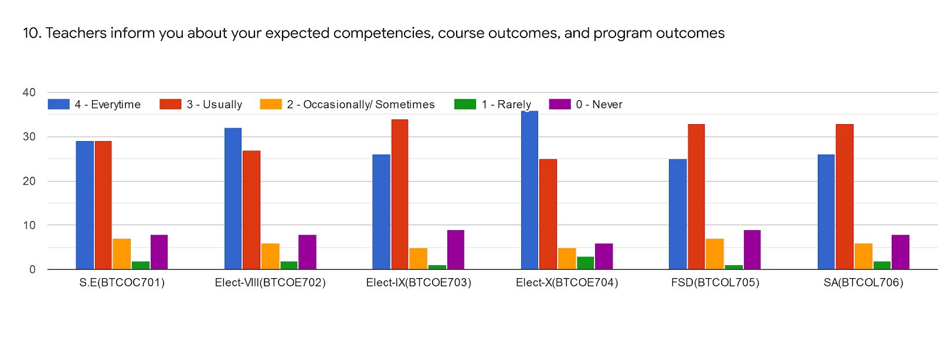
 | S.E(BTCOC701) | Elect-VIII(BTCOE702) | Elect-IX(BTCOE703) | Elect-X(BTCOE704) | FSD(BTCOL705) | SA(BTCOL706) | %
 | Mr.Jadhav D.V. | Dr.Varsha Bhosale | Mrs. Anuja Kulkarni | Mrs Mandhare R.M | Rohini Shingade | Mr.Jadhav D.V.
Excellent | 29 | 34 | 26 | 36 | 25 | 26 | 41%
Very Good | 29 | 28 | 34 | 25 | 33 | 34 | 42%
Good | 7 | 5 | 5 | 6 | 6 | 6 | 07%
Average | 2 | 1 | 1 | 3 | 2 | 1 | 02%
Poor | 8 | 7 | 9 | 5 | 9 | 8 | 10%
Total | 75 | 75 | 75 | 75 | 75 | 75

Slide 12
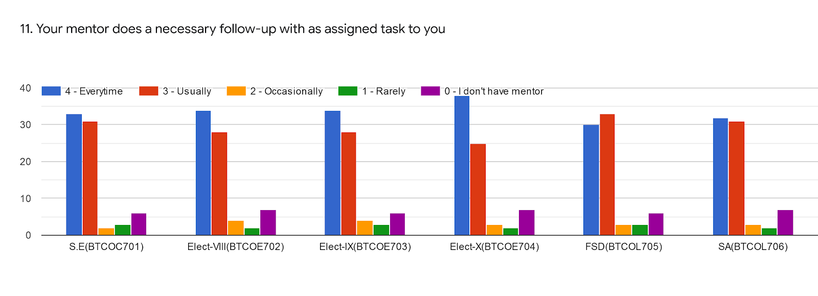
 | S.E(BTCOC701) | Elect-VIII(BTCOE702) | Elect-IX(BTCOE703) | Elect-X(BTCOE704) | FSD(BTCOL705) | SA(BTCOL706) | %
 | Mr.Jadhav D.V. | Dr.Varsha Bhosale | Mrs. Anuja Kulkarni | Mrs Mandhare R.M | Rohini Shingade | Mr.Jadhav D.V.
Excellent | 33 | 35 | 34 | 38 | 30 | 32 | 47%
Very Good | 32 | 28 | 28 | 25 | 34 | 31 | 42%
Good | 1 | 4 | 4 | 3 | 3 | 3 | 03%
Average | 3 | 2 | 3 | 2 | 2 | 2 | 02%
Poor | 6 | 6 | 6 | 7 | 7 | 7 | 08%
Total | 75 | 75 | 75 | 75 | 75 | 75

Slide 13
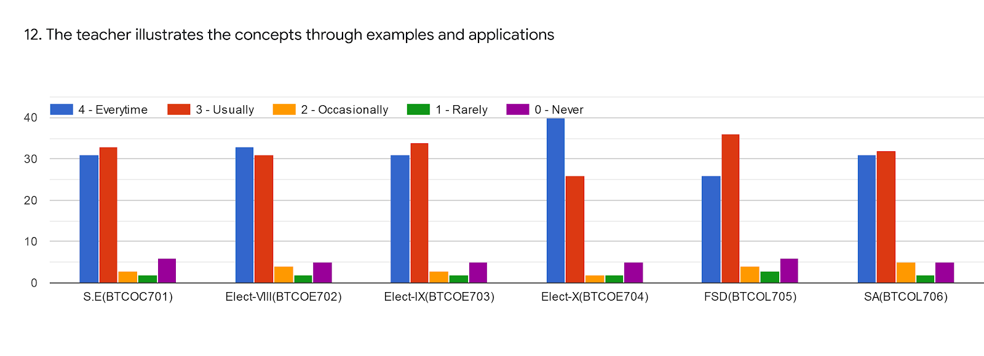
 | S.E(BTCOC701) | Elect-VIII(BTCOE702) | Elect-IX(BTCOE703) | Elect-X(BTCOE704) | FSD(BTCOL705) | SA(BTCOL706) | %
 | Mr.Jadhav D.V. | Dr.Varsha Bhosale | Mrs. Anuja Kulkarni | Mrs Mandhare R.M | Rohini Shingade | Mr.Jadhav D.V.
Excellent | 31 | 34 | 31 | 40 | 25 | 31 | 45%
Very Good | 34 | 31 | 34 | 25 | 36 | 32 | 45%
Good | 2 | 4 | 3 | 2 | 5 | 5 | 04%
Average | 2 | 2 | 2 | 2 | 4 | 2 | 03%
Poor | 6 | 4 | 5 | 6 | 6 | 5 | 07%
Total | 75 | 75 | 75 | 75 | 75 | 75

Slide 14
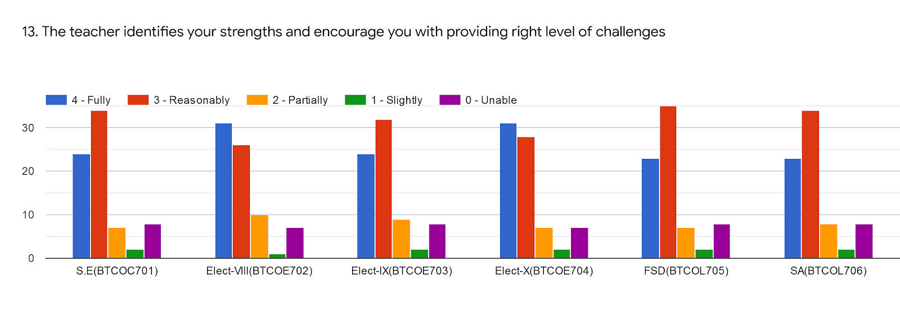
 | S.E(BTCOC701) | Elect-VIII(BTCOE702) | Elect-IX(BTCOE703) | Elect-X(BTCOE704) | FSD(BTCOL705) | SA(BTCOL706) | %
 | Mr.Jadhav D.V. | Dr.Varsha Bhosale | Mrs. Anuja Kulkarni | Mrs Mandhare R.M | Rohini Shingade | Mr.Jadhav D.V.
Excellent | 24 | 32 | 24 | 26 | 18 | 23 | 36%
Very Good | 34 | 26 | 32 | 26 | 37 | 34 | 45%
Good | 7 | 10 | 9 | 8 | 6 | 8 | 11%
Average | 2 | 1 | 3 | 3 | 3 | 2 | 03%
Poor | 8 | 6 | 8 | 8 | 7 | 8 | 10%
Total | 75 | 75 | 75 | 75 | 75 | 75

Slide 15
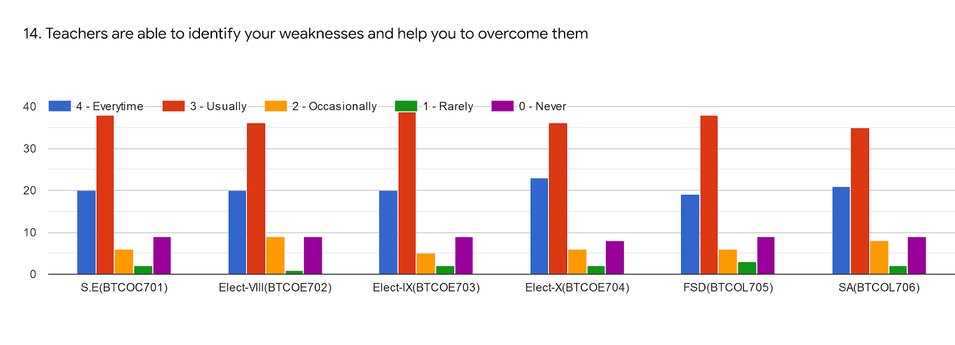
 | S.E(BTCOC701) | Elect-VIII(BTCOE702) | Elect-IX(BTCOE703) | Elect-X(BTCOE704) | FSD(BTCOL705) | SA(BTCOL706) | %
 | Mr.Jadhav D.V. | Dr.Varsha Bhosale | Mrs. Anuja Kulkarni | Mrs Mandhare R.M | Rohini Shingade | Mr.Jadhav D.V.
Excellent | 20 | 20 | 20 | 22 | 18 | 21 | 28%
Very Good | 39 | 37 | 39 | 36 | 48 | 35 | 54%
Good | 5 | 9 | 5 | 5 | 6 | 8 | 08%
Average | 1 | 1 | 2 | 2 | 2 | 2 | 02%
Poor | 9 | 8 | 9 | 9 | 8 | 9 | 12%
Total | 75 | 75 | 75 | 75 | 75 | 75

Slide 16
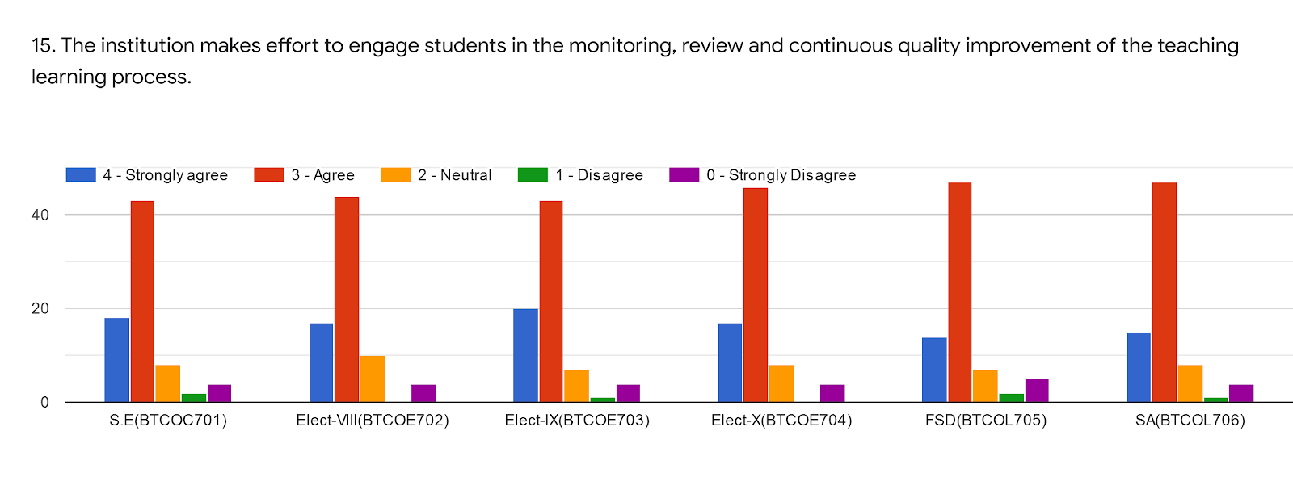
 | S.E(BTCOC701) | Elect-VIII(BTCOE702) | Elect-IX(BTCOE703) | Elect-X(BTCOE704) | FSD(BTCOL705) | SA(BTCOL706) | %
 | Mr.Jadhav D.V. | Dr.Varsha Bhosale | Mrs. Anuja Kulkarni | Mrs Mandhare R.M | Rohini Shingade | Mr.Jadhav D.V.
Excellent | 19 | 18 | 20 | 18 | 15 | 17 | 25%
Very Good | 44 | 44 | 44 | 45 | 45 | 47 | 63%
Good | 8 | 10 | 7 | 8 | 8 | 7 | 11%
Average | 1 | 0 | 1 | 0 | 2 | 1 | 01%
Poor | 3 | 3 | 3 | 4 | 5 | 3 | 04%
Total | 75 | 75 | 75 | 75 | 75 | 75

Slide 17
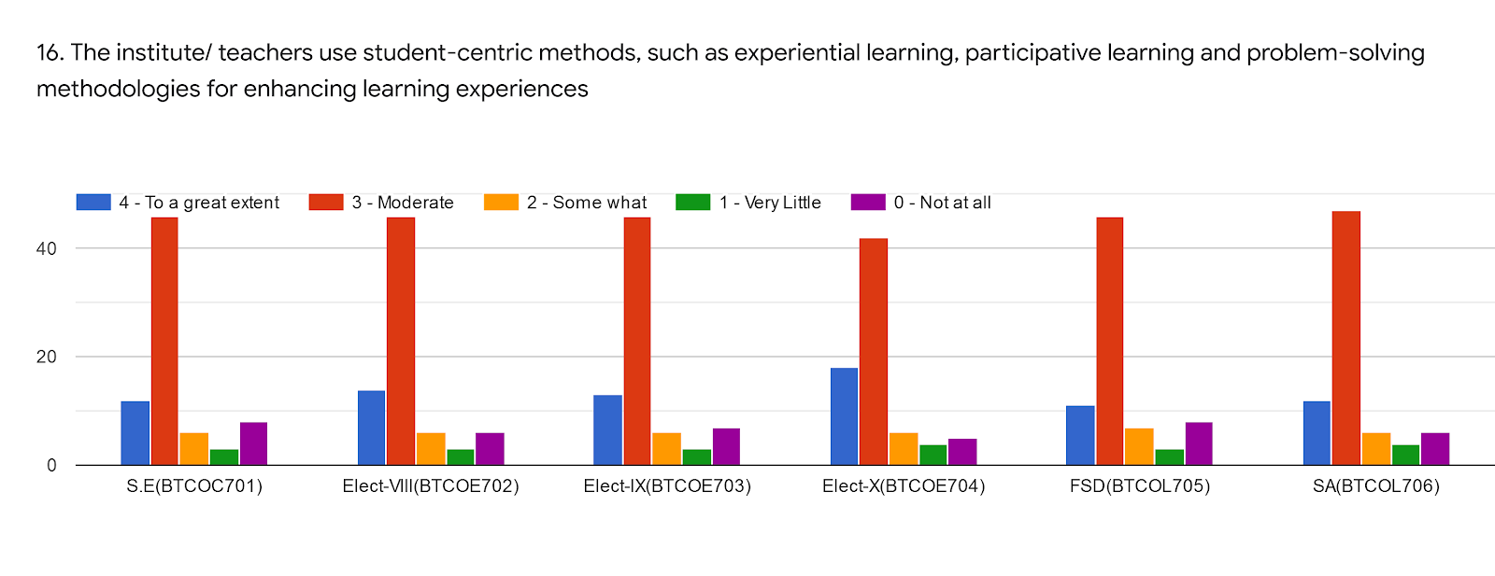
 | S.E(BTCOC701) | Elect-VIII(BTCOE702) | Elect-IX(BTCOE703) | Elect-X(BTCOE704) | FSD(BTCOL705) | SA(BTCOL706) | %
 | Mr.Jadhav D.V. | Dr.Varsha Bhosale | Mrs. Anuja Kulkarni | Mrs Mandhare R.M | Rohini Shingade | Mr.Jadhav D.V.
Excellent | 11 | 14 | 13 | 18 | 10 | 12 | 18%
Very Good | 45 | 46 | 46 | 42 | 45 | 48 | 63%
Good | 7 | 6 | 6 | 8 | 7 | 6 | 09%
Average | 3 | 3 | 3 | 3 | 3 | 3 | 03%
Poor | 9 | 6 | 7 | 4 | 10 | 6 | 09%
Total | 75 | 75 | 75 | 75 | 75 | 75

Slide 18
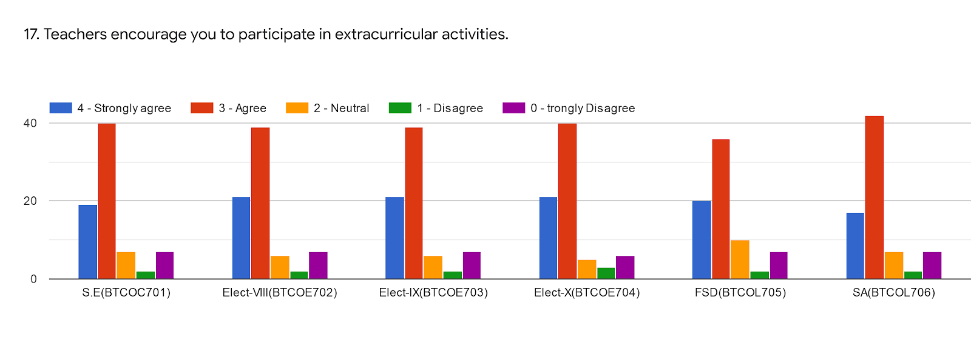
 | S.E(BTCOC701) | Elect-VIII(BTCOE702) | Elect-IX(BTCOE703) | Elect-X(BTCOE704) | FSD(BTCOL705) | SA(BTCOL706) | %
 | Mr.Jadhav D.V. | Dr.Varsha Bhosale | Mrs. Anuja Kulkarni | Mrs Mandhare R.M | Rohini Shingade | Mr.Jadhav D.V.
Excellent | 19 | 21 | 21 | 21 | 20 | 18 | 28%
Very Good | 40 | 39 | 39 | 40 | 35 | 42 | 55%
Good | 7 | 5 | 6 | 5 | 10 | 7 | 09%
Average | 2 | 2 | 2 | 4 | 2 | 1 | 02%
Poor | 7 | 8 | 7 | 5 | 8 | 7 | 09%
Total | 75 | 75 | 75 | 75 | 75 | 75

Slide 19
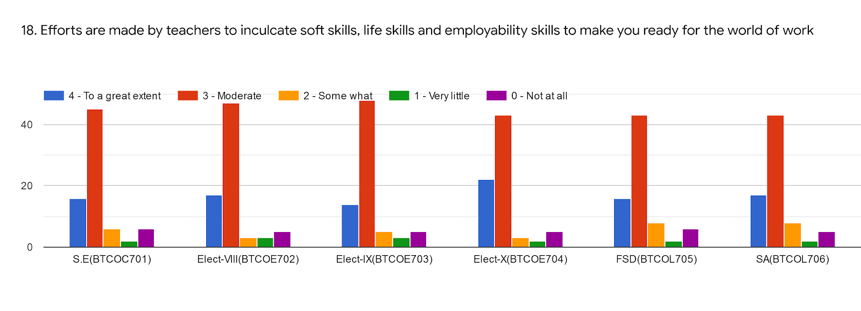
 | S.E(BTCOC701) | Elect-VIII(BTCOE702) | Elect-IX(BTCOE703) | Elect-X(BTCOE704) | FSD(BTCOL705) | SA(BTCOL706) | %
 | Mr.Jadhav D.V. | Dr.Varsha Bhosale | Mrs. Anuja Kulkarni | Mrs Mandhare R.M | Rohini Shingade | Mr.Jadhav D.V.
Excellent | 17 | 17 | 13 | 21 | 15 | 18 | 23%
Very Good | 45 | 48 | 48 | 42 | 42 | 42 | 62%
Good | 5 | 3 | 5 | 5 | 8 | 8 | 07%
Average | 3 | 3 | 4 | 3 | 2 | 2 | 03%
Poor | 5 | 4 | 5 | 5 | 8 | 5 | 07%
Total | 75 | 75 | 75 | 75 | 75 | 75

Slide 20
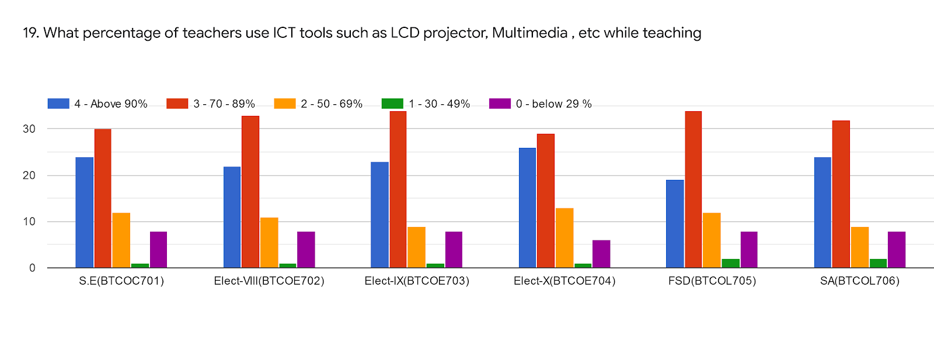
 | S.E(BTCOC701) | Elect-VIII(BTCOE702) | Elect-IX(BTCOE703) | Elect-X(BTCOE704) | FSD(BTCOL705) | SA(BTCOL706) | %
 | Mr.Jadhav D.V. | Dr.Varsha Bhosale | Mrs. Anuja Kulkarni | Mrs Mandhare R.M | Rohini Shingade | Mr.Jadhav D.V.
Excellent | 24 | 23 | 23 | 26 | 19 | 24 | 32%
Very Good | 30 | 34 | 35 | 29 | 35 | 32 | 45%
Good | 12 | 11 | 9 | 13 | 12 | 9 | 15%
Average | 1 | 1 | 1 | 1 | 2 | 2 | 01%
Poor | 8 | 6 | 7 | 6 | 7 | 8 | 09%
Total | 75 | 75 | 75 | 75 | 75 | 75

Slide 21
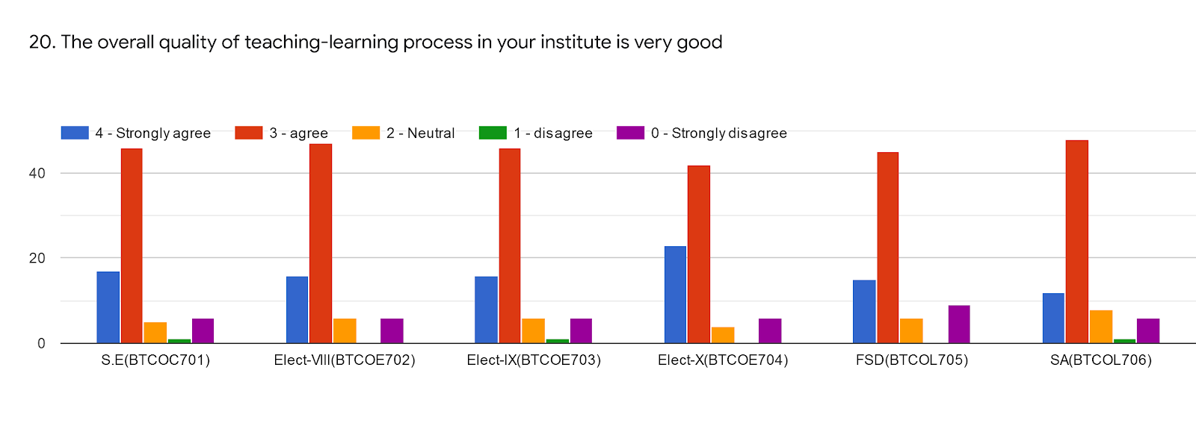
 | S.E(BTCOC701) | Elect-VIII(BTCOE702) | Elect-IX(BTCOE703) | Elect-X(BTCOE704) | FSD(BTCOL705) | SA(BTCOL706) | %
 | Mr.Jadhav D.V. | Dr.Varsha Bhosale | Mrs. Anuja Kulkarni | Mrs Mandhare R.M | Rohini Shingade | Mr.Jadhav D.V.
Excellent | 18 | 16 | 16 | 23 | 15 | 12 | 23%
Very Good | 45 | 48 | 48 | 42 | 45 | 48 | 64%
Good | 6 | 6 | 5 | 5 | 7 | 8 | 08%
Average | 1 | 0 | 1 | 0 | 0 | 1 | 00%
Poor | 6 | 5 | 5 | 5 | 8 | 6 | 08%
Total | 75 | 75 | 75 | 75 | 75 | 75

Slide 22
Give 3 Observation/Suggestion to improve the overall teaching learning experience of respective teachers
Overall teaching is good but practical are not taken yet.
Industrial expert talk needed.
All staff teaching very good so it is easy to understand.
Exam guidance of GATE and GRE, Placements campus selection preparation
5. 1.Teacher can give real-time examples.2.Sometimes more explanation required as per students

Slide 23
Overall Analysis
Subject | Faculty | Appreciation | Suggestion for improvement
SE | JDV | Syllabus Coverage, Teacher illustrate concept through example & application, Teacher takes effort for internship, softskill,employeability | Weak encouragement of student to participate in extra curricular activities, Less use of ICT
DA | BVK | Teacher takes effort for internship, softskill,employeability Teacher illustrate concept through example & application, Teacher identifies weakness of student and helps to overcome it. | Weak encouragement of student to participate in extra curricular activities, Teacher is weak in identification of strength and weakness of student.
BI | KA | Teacher identifies weakness of student and helps to overcome it., Proper mentorship | Weak in communication of outcome of course, Weak in promoting internship, student exchange, field visit
CG | MRM | Proper preparation of lecture, Teacher illustrate concept through example & application, Proper mentorship | Weak follow-up of assigned task , Teacher is weak in identification of strength and weakness of student
FSD | SR | Teacher identifies strengths of student and Provide right level of challenge, Syllabus Coverage | Teacher prepares weakly for lecture, Teacher is weak in effort for internship, softskill,employeability ,Weak Student center teaching.
SA | JDV | Teacher illustrate concept through example & application, Teachers approach to teaching is good | Syllabus Coverage,less use of ICT,Weak fairness in internal evaluation

